Slide 1
CrewFund
Group accommodation funding
with individual refund rights
WHU Hackathon 2026
Fictional hotel. Test SOL. Verified Localnet demo.
Notes:
Opening: Three students want one room. CrewFund keeps the pooled payment under program rules rather than one friend’s private control. Current verified network: Localnet, not Devnet.

Slide 2
The group-payment problem
Three students want to book one room.
One friend collects the money.
The others depend on that friend to pay the hotel
and return contributions if the plan fails.
CrewFund fixes who can receive the pooled payment.
CrewFund / Test SOL prototype
Notes:
This is a qualitative product scenario, not a market-size claim. No surveys, revenue or partnerships are asserted.

Slide 3
Payment rules
01
02
03
Each student funds
The hotel confirms
Each student refunds
0.01 Test SOL each
Three fixed signers
One deposit per person
All three shares present
Fixed hotel signature
Before the deadline
If the hotel misses the deadline
Only the depositor’s share
One refund per person
CrewFund / Test SOL prototype
Notes:
Contract source: outputs/crewfund/program/src/lib.rs. Each fixed participant deposits 10,000,000 lamports once. The hotel receives exactly 30,000,000 lamports. Fees are separate. Deadline uses the Solana Clock sysvar.

Slide 4
Solana enforces the escrow
A program-owned account holds the funds.
No participant can privately withdraw the pool.
The fixed hotel signs and receives the full payment.
The deadline separates confirmation from refunds.
Booking terms stay fixed.
The demonstrated program has no upgrade authority.
CrewFund / Test SOL prototype
Notes:
Official technical references checked: https://solana.com/docs/core/pda ; https://solana.com/docs/core/accounts ; https://solana.com/docs/programs/rust . Localnet program CsP2XV9HKm95uETQ2zY7TnETF4oxQ8GLnGYBme7isKgq. solana program show verified Authority: none.

Slide 5
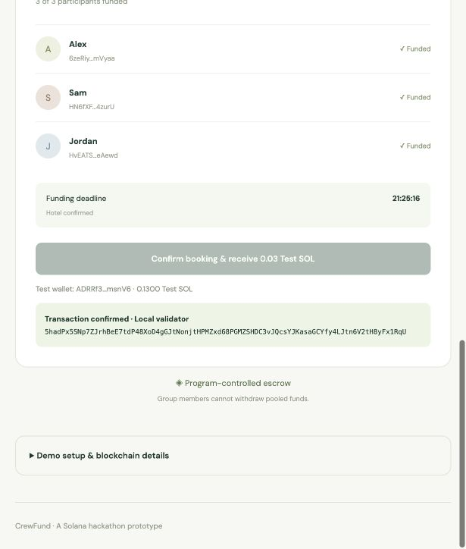
Working prototype and test evidence
5 passing integration tests
Exact hotel payout
Failed funding and own-share refunds
Unauthorized actions rejected
Duplicate deposits and refunds rejected
Fully funded booking without confirmation
English React / TypeScript interface
Full deposit-to-confirmation browser flow
CrewFund / Test SOL prototype
Notes:
Evidence: outputs/crewfund/evidence-localnet.txt and README.md. Five integration tests ran against Agave 4.3.0 local validator with the compiled SBPFv3 program, not mocked logic. Browser payout signature: 5hadPx5SNp7ZJrhBeE7tdP48XoD4gGJtNonjtHPMZxd68PGMZSHDC3vJQcsYJKasaGCYfy4LJtn6V2tH8yFx1RqU. Screenshot is the real Localnet browser demo. This signature is not Devnet Explorer proof.

Slide 6
First users and a small pilot
Student clubs organising shared trips
Reach two small groups through campus clubs.
Test whether they understand deposit and refund rights.
Use a provider-controlled test wallet in each demo.
Pilot question
Will groups prefer fixed payment rules to one friend holding the pool?
CrewFund / Test SOL prototype
Notes:
Pilot proposal only. No recruitment, interviews, hotel partnerships or demand validation have occurred. The Superteam WHU listing asks for intended users, utility and how to reach initial users: https://superteam.fun/earn/listing/build-at-whu .

Slide 7
Demo scope and next step
Current demo: Localnet
Fictional test hotel and four separate test wallets
0.03 Test SOL total
Devnet deployment awaits faucet funding
Next: independent wallet ownership and hotel integration
External security review before any real-money use
CrewFund / Test SOL prototype
Notes:
No production readiness or real booking is claimed. Devnet RPC was reachable. Two CLI requests for Devnet test SOL were rejected by rate limit and the funding wallet balance remained zero. Deadline supplied by user: 4 October 2026, 23:59 Europe/Berlin.

