Slide 1


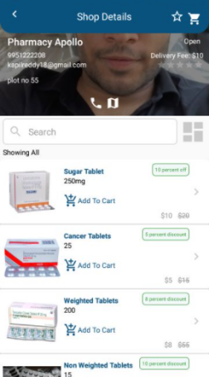
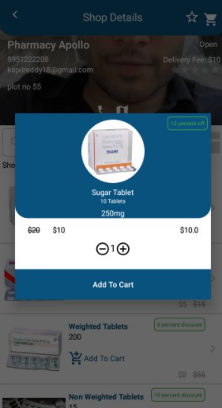





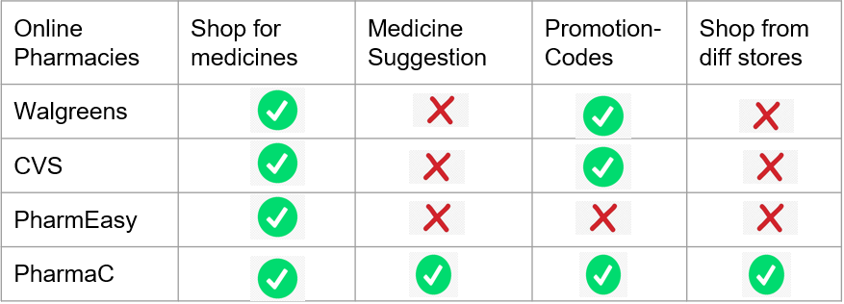
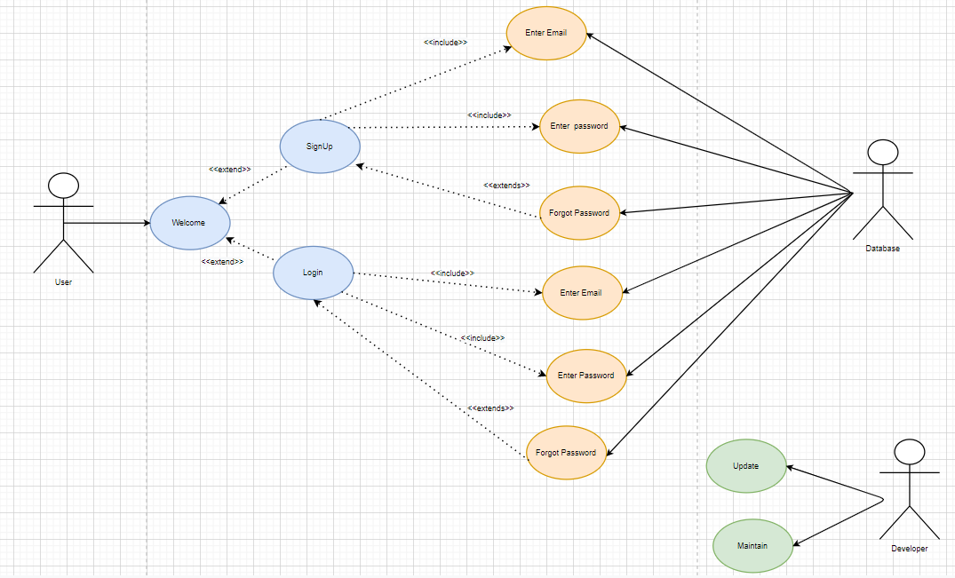
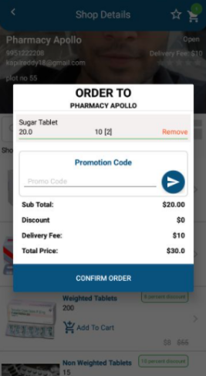
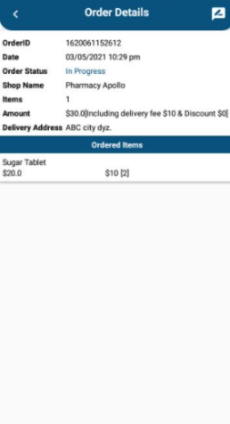
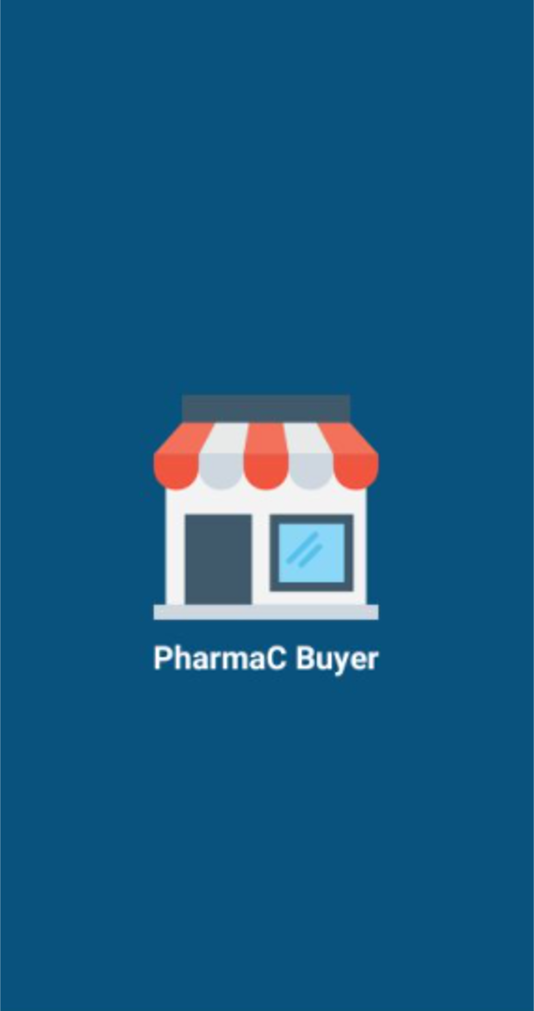
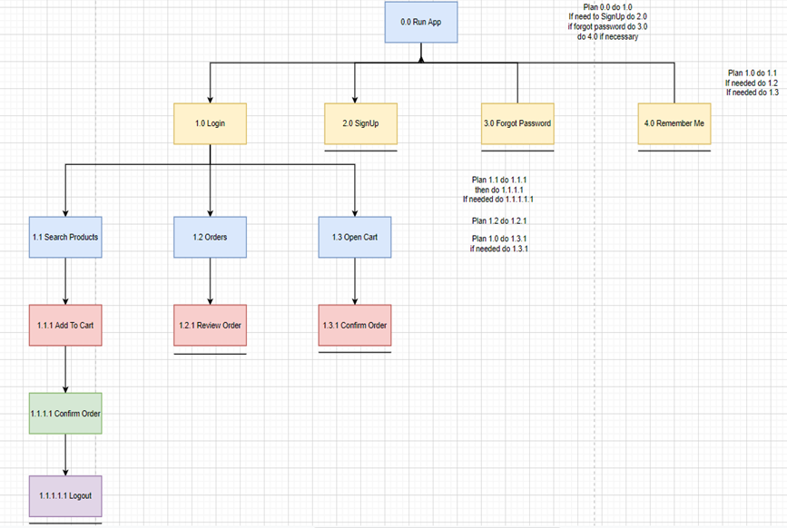
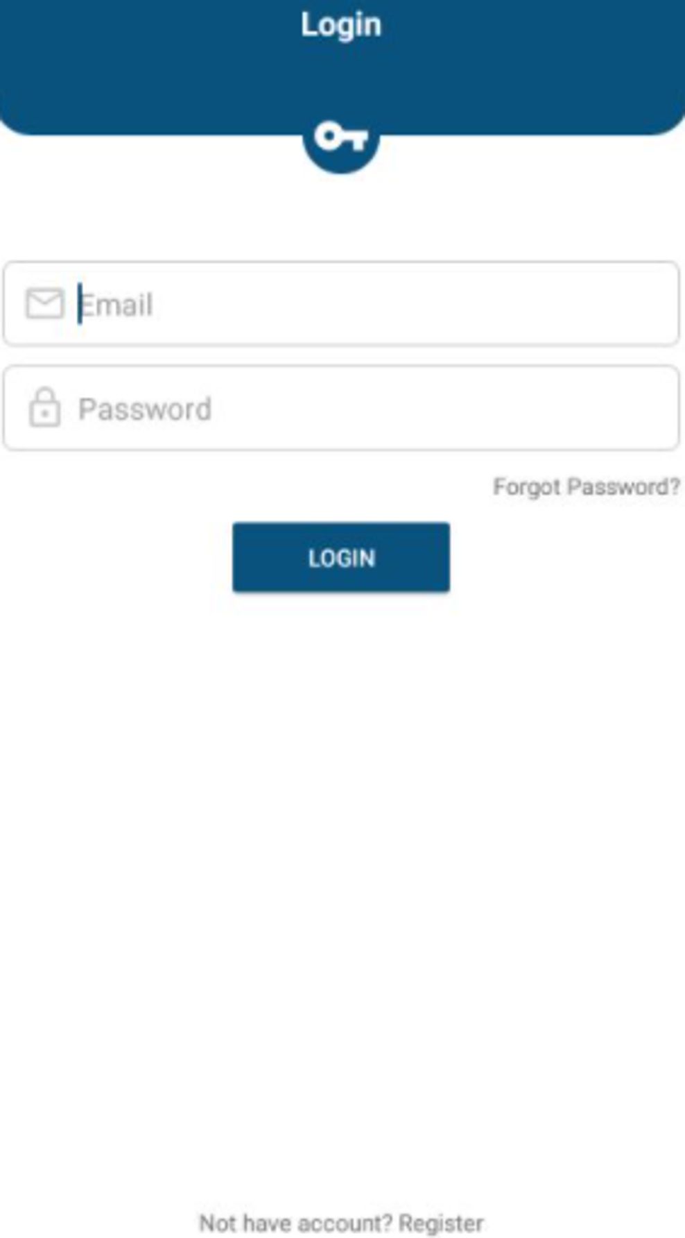
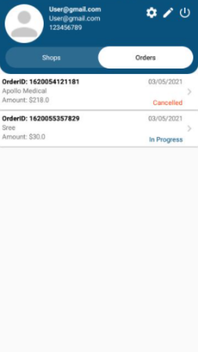
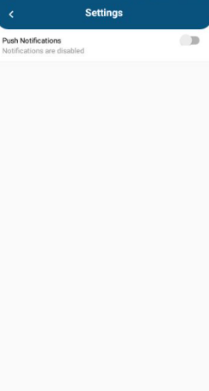
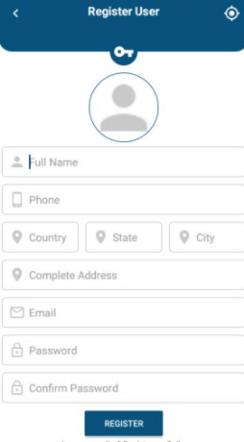
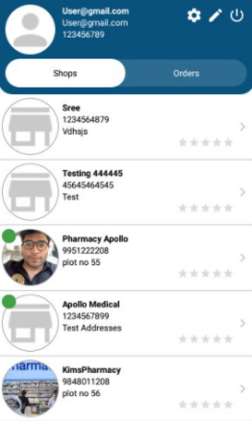
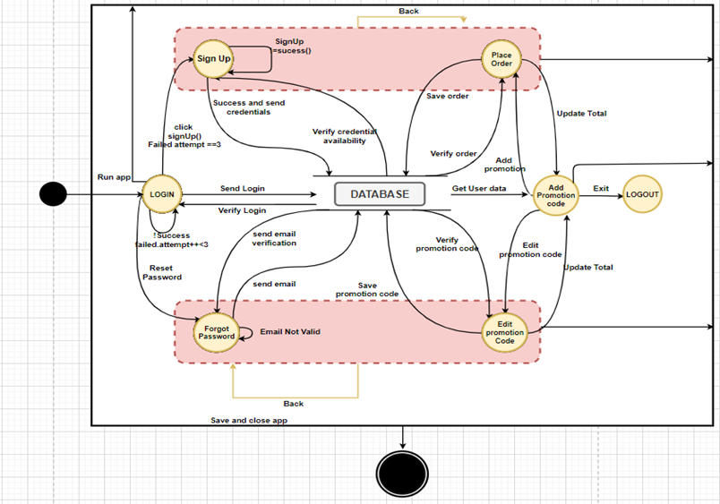
Pic
PharmaC App
Kuchekulla Kapil Reddy
Faculty Advisor: Dr. Victor Govindaswamy
Concordia University Chicago
Pic
Abstract
Comparison Table
Level 0 Use Case Diagram
Technology stack
PharmaC App is designed and implemented to allow users to purchase medicines online. This will enable users to buy medicines directly from the app where they place their order, pay for it right in the app and get them delivered excluding the need for going physically to the pharmacy.
The purpose of the app is to provide reliable and easy access to medicines for the medical community including physicians and a normal buyer with doorstep delivery. Many customers consider this to be more convenient than traveling to medical shops on a day-to-day basis. Prescription medications are very expensive, and customers may turn to online pharmacies to save money as we offer promotion/coupon codes as well as help the seller to thrive their business. Many pharmacy owners and managers, as well as entrepreneurs will benefit from this. In comparison to other apps, PharmaC app gives the user the ability to compare and select a product for the best lowest price across multiple stores and suggest over the counter medicines to users based on their selection of the illness.
The app is developed using the Android Studio Integrated Development Environment (IDE), which contains Java and Extensible Markup (XML) programming languages. It is designed using software design tools such as Adobe XD and diagrams.net (formerly draw.io). To keep the data securely stored and easily accessible, Google’s Firebase, a Backend-as-a-Service (BaaS) platform, is used. Testing, consisting of Black-box, White-box, Grey-Box, Unit Testing techniques, are used.
Future work includes extending the app to suggest over the counter medicines to users based on their selection of the illness and scale it.
Key features where PharmaC app stands out from the existing marketplace apps: 1. PharmaC provides the a capability of suggesting OTC medicines based on the illness type
2. We accept a wide range of promo codes offered by various pharmacy businesses including our own for customer retention
3. Users have the capability to shop from different stores available on the marketplace via B2C
Below is the comparison table
Design Diagrams
This page will show the available products from the store
This page shows the selected [product and add to cart option
Use Case Diagram
GUI
Hierarchical Task Analysis
This is the order summary page with and promo code entry option before placing the order
This is the order confirmation screen after placing the order
App logo
Login screen: User can login by entering username and password
Data Flow Diagram
Order History screen
User settings screen
Contacts
Bioinformatics And Technology Laboratory (BAT Lab)
- Mobile Application Implementation and Design (MAID) Group
Computer Science Program (CSC@CUC)
Member: Kuchekulla Kapil Reddy
Advisors: Dr Visvasuresh (Victor) Govindaswamy Victor.Govindaswamy@cuchicago.edu
Address: Concordia Chicago University 7400 Augusta Street River Forest, IL, 60306-1499
User registration screen: New user will register from this page.
Display marketplace stores: User can select from the available marketplace stores

