Slide 1
PharmaC
By: Kapil Reddy
Advisor: Dr. Victor Govindaswamy

Slide 2
Abstract
PharmaC providing an easy opportunity to purchase large variety of medicines. These offer various advantages like lower costs, easy accessibility, doorstep delivery etc.

Slide 3
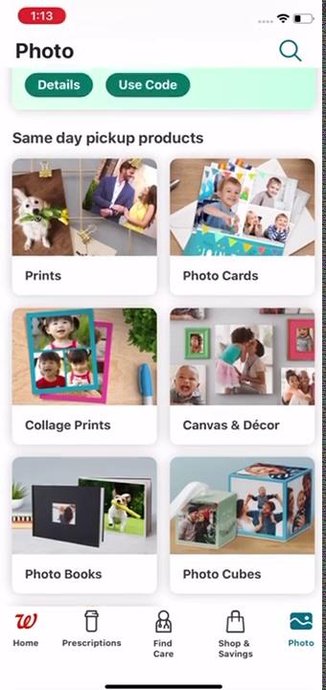
Demo 1
Walgreens

Slide 4
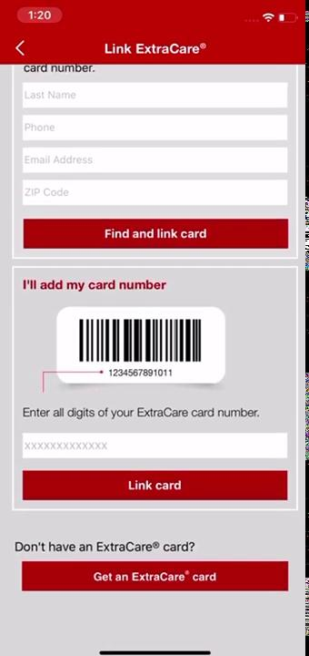
Demo 2
Cvs

Slide 5

Demo 3
Rite Aid

Slide 6
Demo 4
PharmEasy

Slide 7
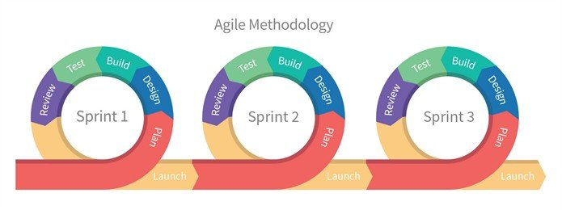

Slide 8


Comparison Table
Online Pharmacies | Shop for medicines | Medicine Suggestion | Promotion-Codes | Shop from diff stores
Walgreens
CVS
PharmEasy
PharmaC

Slide 9

Design

Slide 10
Agile Sprint Timetable
Sprint 1 (Jan 25- Feb 8)
- Analyze similar apps
- Design the initial GUI of the app by using adobe XD
-Develop Login Page
Sprint 2(Feb8- Feb 22)
-Develop Create Account & Forget Password Pages of application
-Link Android studio to firebase for user information
Sprint 3(Feb22- March8)
-Create Diagrams and Models for the project.
-Create Subpages
Sprint 4(March8- March22)
-Develop layout for homepage for seller and buyer app and add search functionality

Slide 11
Agile Sprint Timetable
Sprint5(March22- April 5)
-Built functionality for inserting products, promocodes for seller side
-Built lookout functionality for buyer side
Sprint6(April5- April19)
-Link search bar to information stored in firebase.
-Lookout if everything is working fine on seller and buyer side
Sprint7(April19- May3)
-Prep for launch(May3)

Slide 12
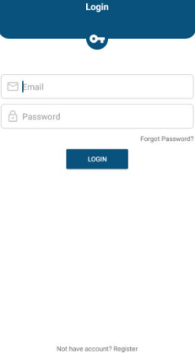
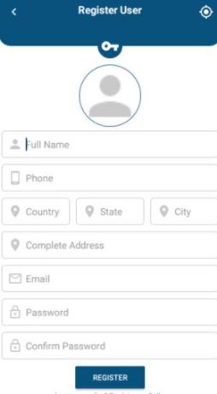

Slide 13
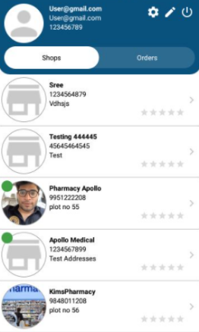
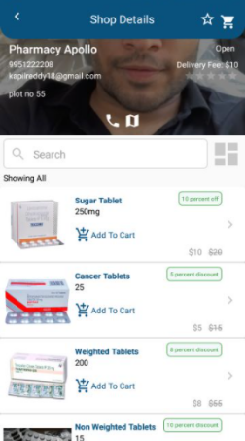

Slide 14
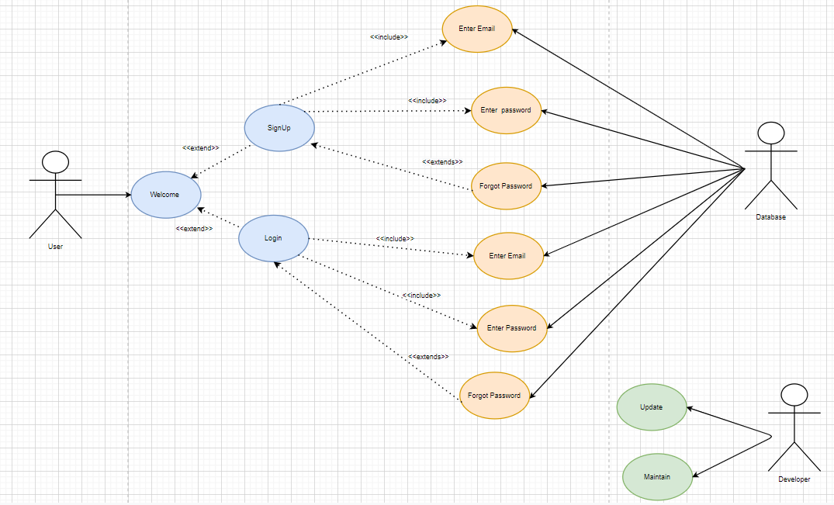
Use Case

Slide 15
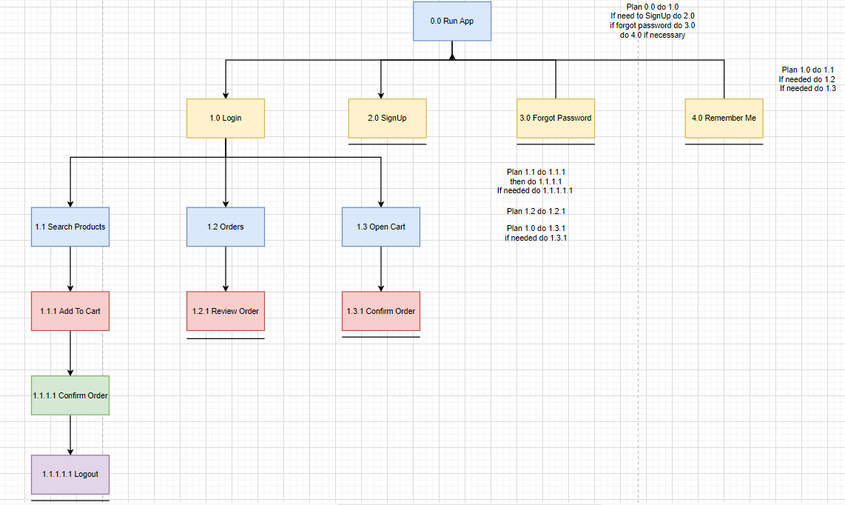
Hierarchical Task Analysis

Slide 16
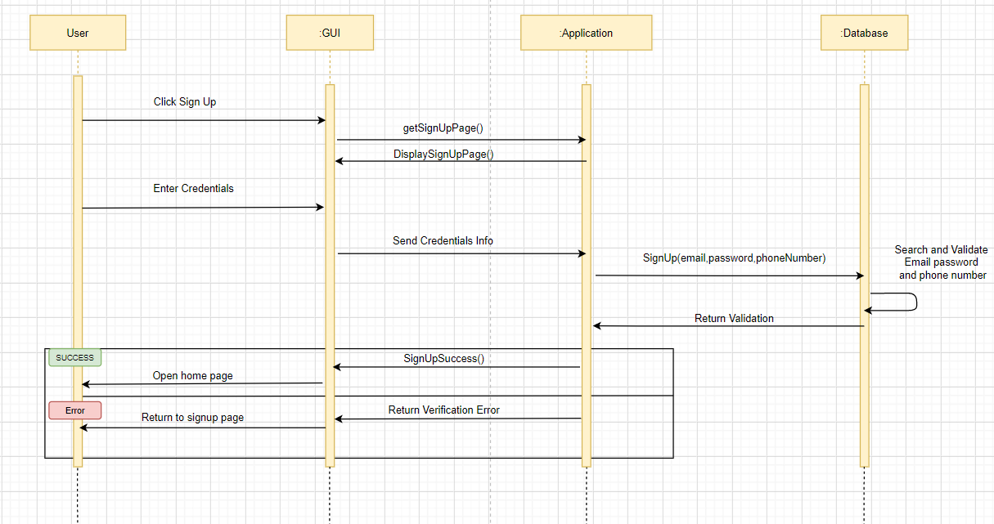
Sequence Diagram - SignUp

Slide 17
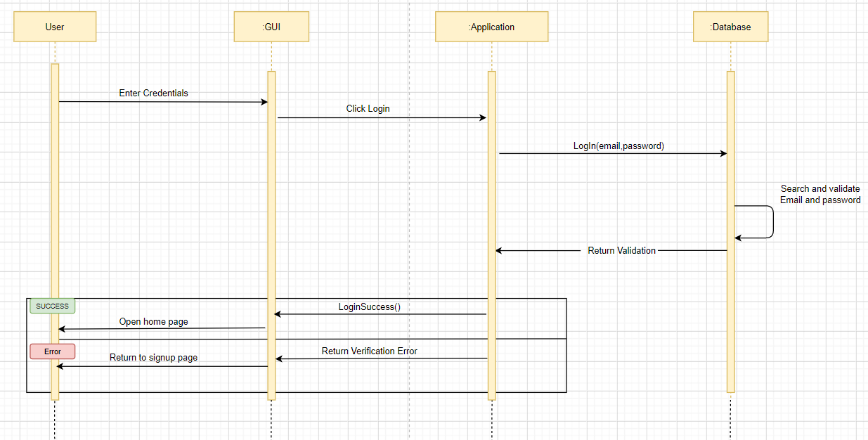
Sequence Diagram- Login

Slide 18
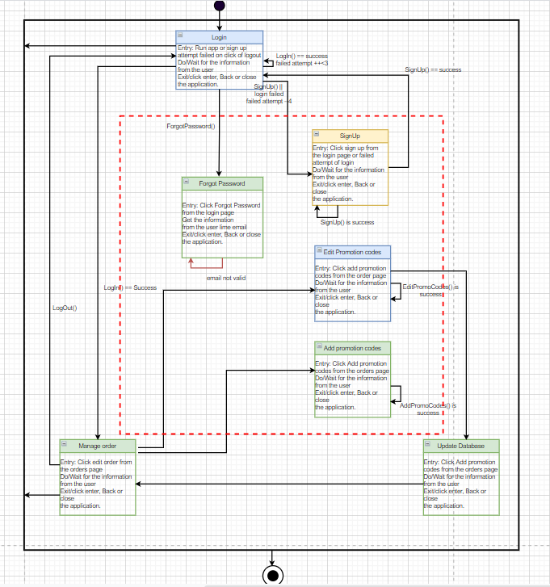
Finite State Machine- Level 1

Slide 19
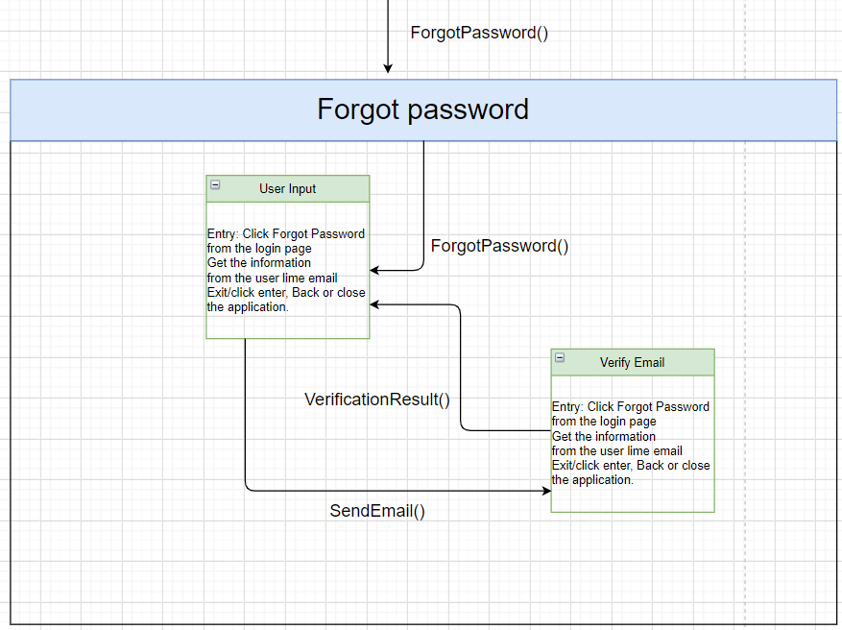
Finite State Machine- Level 2

Slide 20
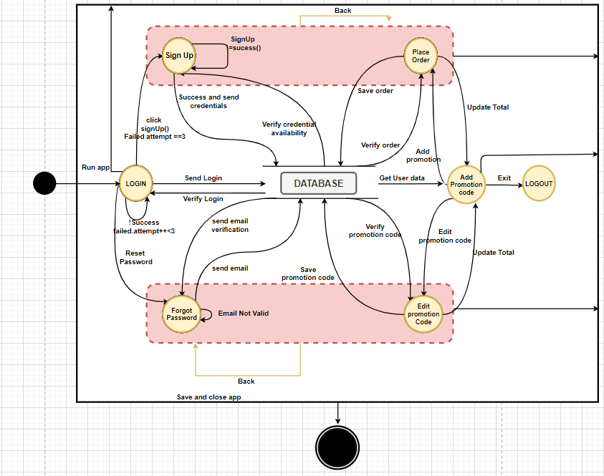
Data Flow Diagram

Slide 21
Future Enhancements
I would like to implement in the ios and extend the app to suggest over the counter medicines to users based on their selection of the illness and scale it.

Slide 22
Testing
Testing includes black box, White box and grey box testing.

Slide 23
References
https://apps.apple.com/us/app/cvs-pharmacy/id395545555
https://apps.apple.com/us/app/walgreens/id335364882

Slide 24
Thank You

