Slide 1
PharmaC
By: Kapil Reddy
Advisor: Dr. Victor Govindaswamy

Slide 2
Abstract
PharmaC providing an easy opportunity to purchase large variety of medicines. These offer various advantages like lower costs, easy accessibility, doorstep delivery etc.

Slide 3
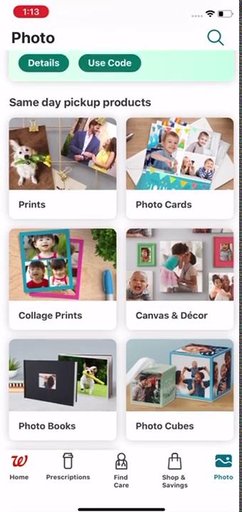
Demo 1
Walgreens

Slide 4
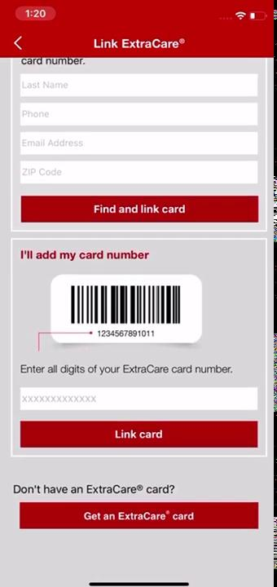
Demo 2
Cvs

Slide 5

Demo 3
Rite Aid

Slide 6
Demo 4
PharmEasy

Slide 7
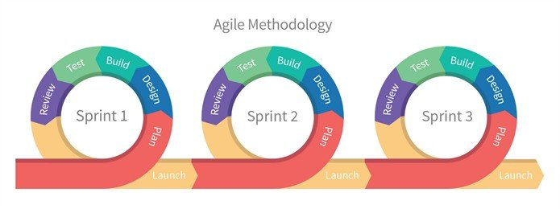

Slide 8


Comparison Table
Online Pharmacies | Shop for medicines | Medicine Suggestion | Promotion-Codes | Shop from diff stores
Walgreens
CVS
PharmEasy
PharmaC

Slide 9
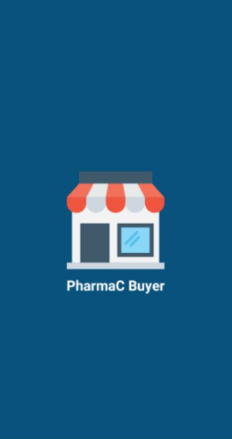
Design

Slide 10
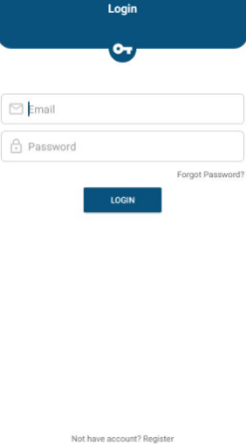
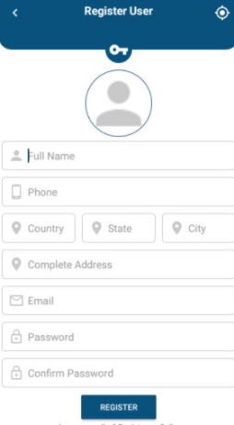

Slide 11
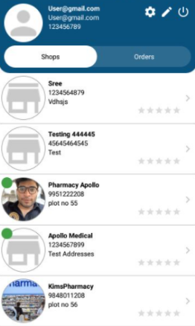
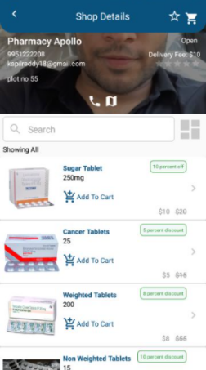

Slide 12
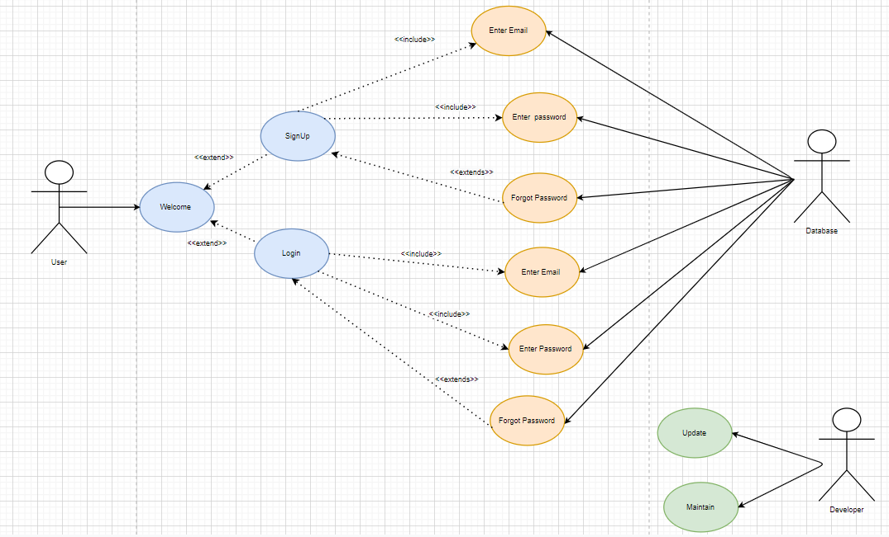
Use Case

Slide 13
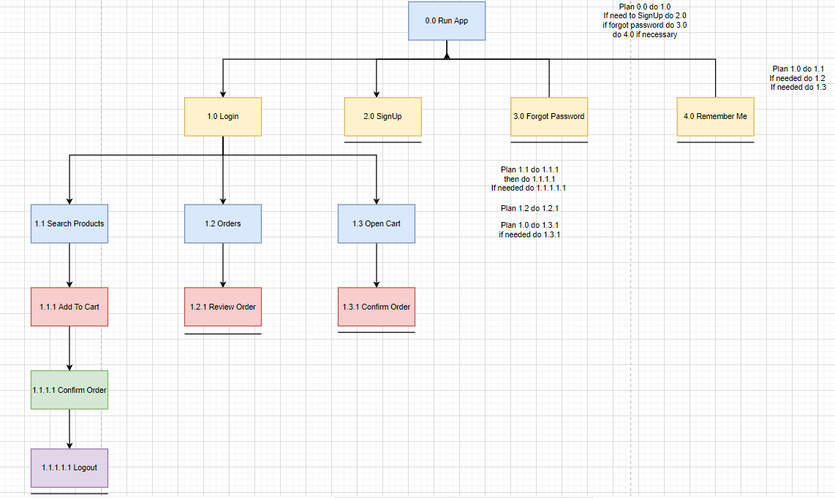
Hierarchical Task Analysis

Slide 14
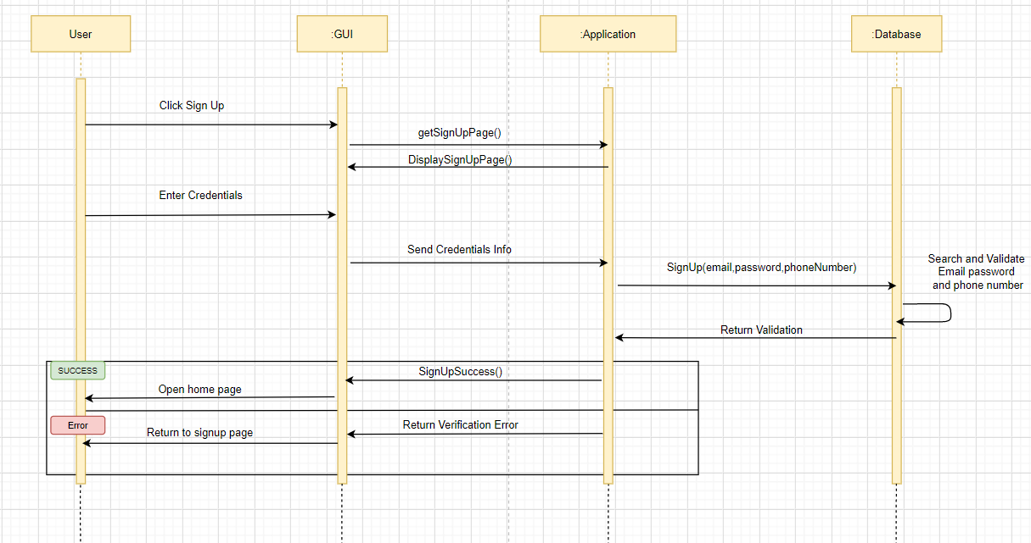
Sequence Diagram - SignUp

Slide 15
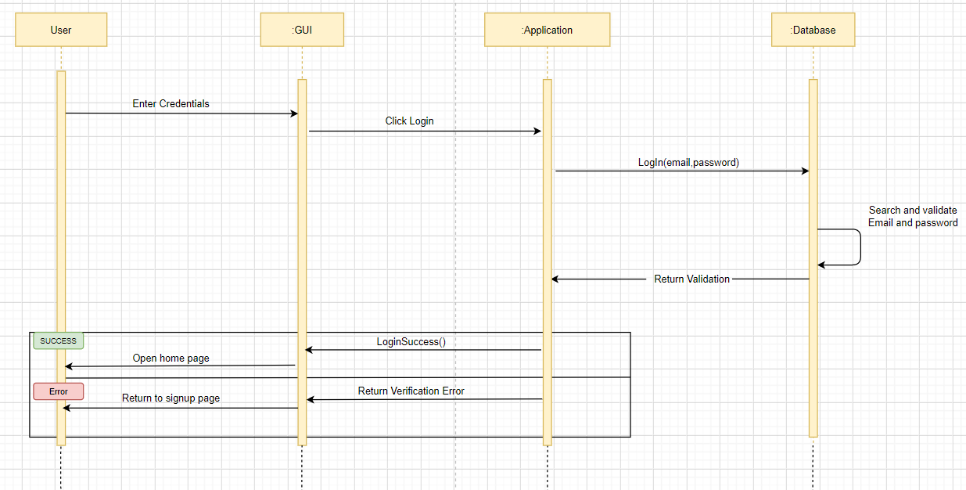
Sequence Diagram- Login

Slide 16
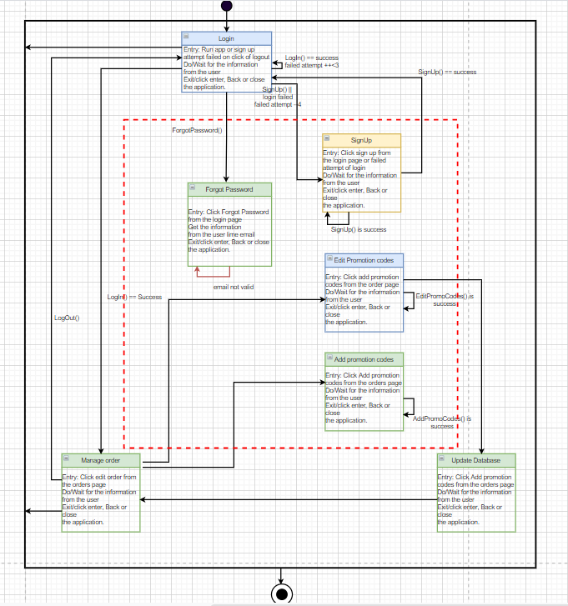
Finite State Machine- Level 1

Slide 17
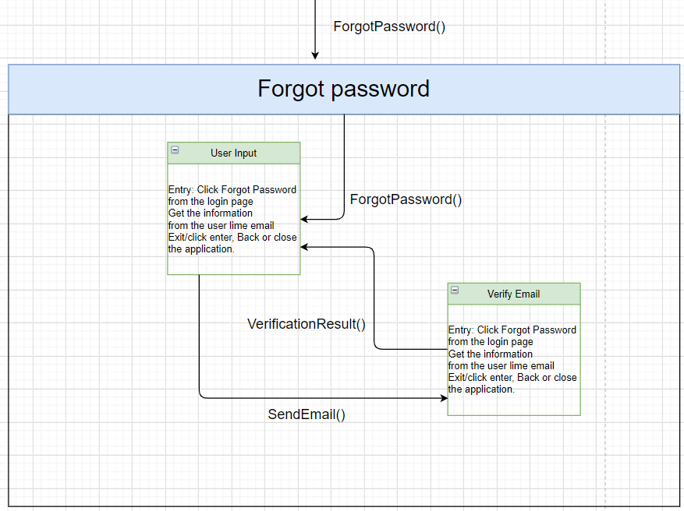
Finite State Machine- Level 2

Slide 18
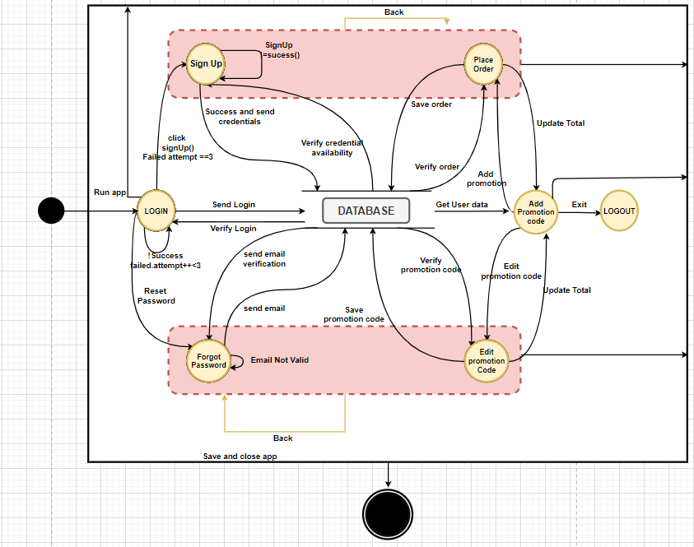
Data Flow Diagram

Slide 19
Future Enhancements
I would like to implement in the ios and extend the app to suggest over the counter medicines to users based on their selection of the illness and scale it.

Slide 20
Testing
Testing includes black box, White box and grey box testing.

Slide 21
References
https://apps.apple.com/us/app/cvs-pharmacy/id395545555
https://apps.apple.com/us/app/walgreens/id335364882

Slide 22
Thank You

