Slide 1
Background Apps
By: Kapil Reddy
Advisor: Dr. Victor Govindaswamy

Slide 2
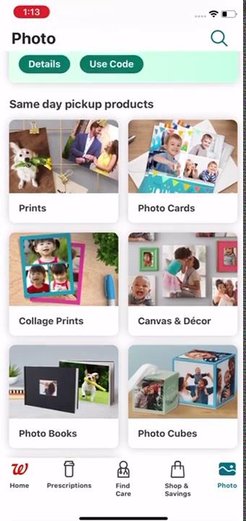
Demo 1
Walgreens

Slide 3
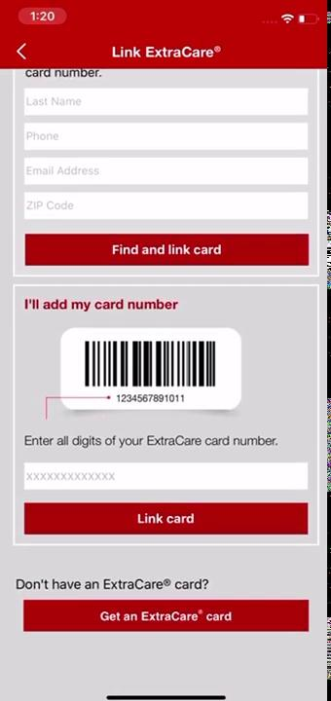
Demo 2
Cvs

Slide 4

Demo 3
Rite Aid

Slide 5
Demo 4
PharmEasy

