Slide 1
Tutorial # 3

Slide 2
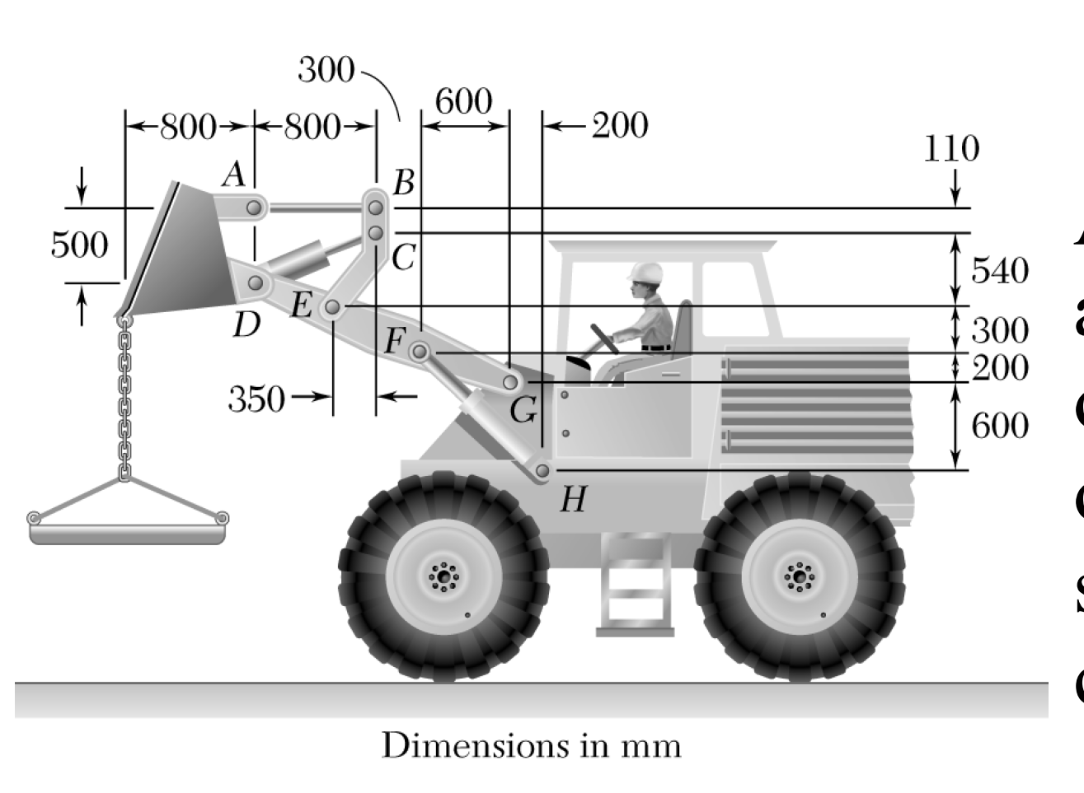
Question # 1
A 500-kg concrete slab is supported by a chain and sling attached to the bucket of the front-end loader shown in Fig. 1. The action of the bucket is controlled by two identical mechanisms, only one of which is shown. Knowing that the mechanism supports half of the 500-kg slab, determine the force
(a) in the cylinder CD,
(b) in cylinder FH.
Fig. 1

Slide 3
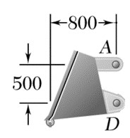

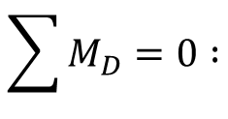

Solution # 1
(a).
We know that if a system is in equilibrium, then any part of it will also be in equilibrium.
Also, the line of action of F_{AB} is known, since it is a two force member.
F_{AB}
D_{y}
D_{x}
$$\sum{M_{D}=0 :}$$
$$250g\left(0.8\right)−F_{AB}\left(0.5\right)=0$$
250g
FBD of bucket of the front-end loader
$$F_{AB}=400g N$$

Slide 4
Solution # 1
Now, if we isolate BCE from here, and draw its fbd, there will be three external forces on it ; F_{AB} , F_{CD} , and reactions at E.
We have calculated F_{AB} , and CD is a two force member, so we also know the line of action of F_{CD} .

Slide 5

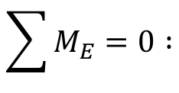



Solution # 1
The line of action of F_{CD} is known.
800
$$tanα=\frac{(500−110)}{800}=\frac{390}{800}$$
B
F_{AB}
110
$$α≈26°$$
500
F_{CD}
C
$$\sum{M_{E}=0 :}$$
E_{y}
540
D
E_{x}
E
$${(F}_{CD}cosα)\left(0.54\right)−\left(F_{CD}sinα\right)\left(0.35\right)+F_{AB}\left(0.65\right)=0$$
350
$$0.485F_{CD}−0.153F_{CD}+3924×0.65=0$$
FBD of BCE
$$F_{CD}≈−7.68 kN$$

Slide 6
Solution # 1
(b).
Force in FH
We take this whole load carrying mechanism ABCDEFG and draw its free-body diagram, noting that FH is a two force member.

Slide 7
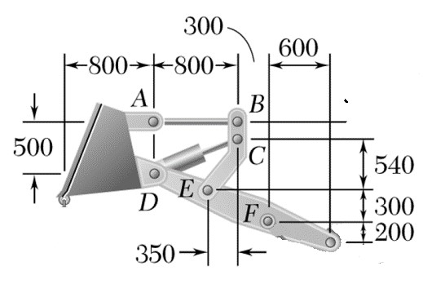

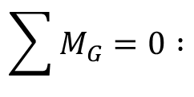

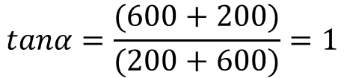

Solution # 1
The line of action of F_{FH} is known.
$$tanα=\frac{(600+200)}{(200+600)}=1$$
$$α=45°$$
G_{y}
$$\sum{M_{G}=0 :}$$
F_{FH}
G
G_{x}
600
250g
𝛼
H
$${(F}_{FH}cosα)\left(0.2\right)−\left(F_{FH}sinα\right)\left(0.6\right)+(250g)\left(2.5\right)=0$$
200
$$−0.2828F_{FH}=−6131.25$$
$$F_{FH}≈21.68 kN$$

Slide 8
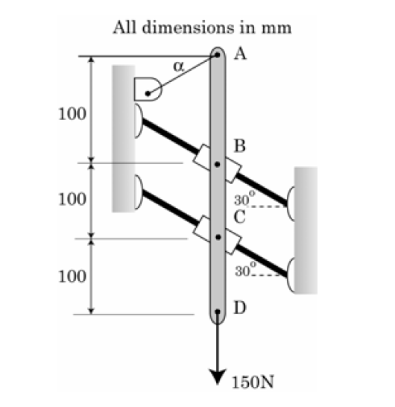
Question # 2
A light rod (see Fig. 2) AD supports a 150N vertical load and is attached to collars B and C, which may slide freely on the rods shown. Knowing that the wire attached at A forms an angle α = 30° with the horizontal, determine
(a) the tension in the wire,
(b) the reactions at B and C.
Fig. 2

Slide 9
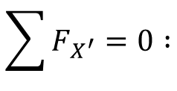


Solution # 2
(a).
30°
A
X
𝛼
30°
100
T_{A}
30°
R_{B}
X′
30°
Balancing the forces along X′ axis, which is normal to R_{B} and R_{C} , so that their components are zero ;
B
30°
100
R_{C}
C
30°
$$\sum{F_{X^{′}}=0 :}$$
100
D
$$150cos\left(60°\right)−T_{A}cos\left(60°\right)=0$$
60°
𝛼 = 30°
150 N
$$T_{A}=150 N$$
FBD of rod AD

Slide 10
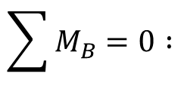
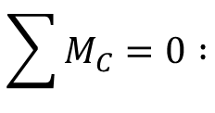

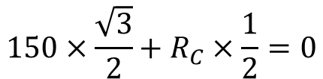

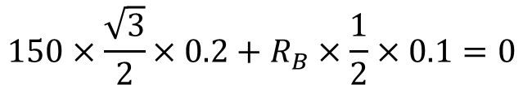
Solution # 2
(b).
$$\sum{M_{B}=0 :}$$
A
$$\left(T_{A}cosα\right)\left(0.1\right)+\left(R_{C}\cos\left(60°\right)\right)\left(0.1\right)=0$$
𝛼
$$150×\frac{\sqrt{3}}{2}+R_{C}×\frac{1}{2}=0$$
100
T_{A}
R_{B}
B
30°
$$R_{C}≈−259.8 N$$
100
R_{C}
$$\sum{M_{C}=0 :}$$
C
30°
$$\left(T_{A}cosα\right)\left(0.2\right)−\left(R_{B}\cos\left(60°\right)\right)\left(0.1\right)=0$$
100
$$150×\frac{\sqrt{3}}{2}×0.2+R_{B}×\frac{1}{2}×0.1=0$$
D
$$R_{B}≈519.6 N$$
150 N

Slide 11
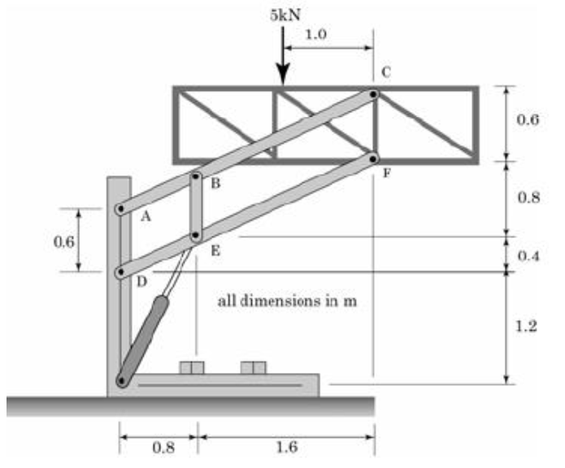
Question # 3
The elevation of a platform is controlled by two identical mechanisms only one of which is shown in Fig. 3. A load of 5 kN is applied to the mechanism shown. Knowing that the pin at C can transmit
only a horizontal force, determine
(a) the force in link BE,
(b) the components of the force exerted by the hydraulic cylinder on pin H.
Fig. 3

Slide 12

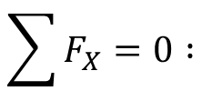




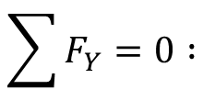
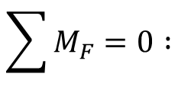

Solution # 3
(a).
$$\sum{M_{F}=0 :}$$
$$−0.6C_{X}+5×1.0=0$$
$$C_{X}=\frac{25}{3} kN$$
$$\sum{F_{X}=0 :}$$
$$C_{X}+F_{X}=0$$
5 kN
1.0
C
C_{x}
$$F_{X}=−\frac{25}{3} kN$$
F_{y}
0.6
$$\sum{F_{Y}=0 :}$$
$$F_{Y}−5=0$$
F
F_{x}
$$F_{Y}=5 kN$$
FBD of the platform

Slide 13
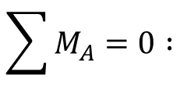



Solution # 3
Because of equilibrium at joint C, direction of C_{X} in fbd of member ABC must be taken opposite to that assumed in the fbd of the platform. Also, line of action of F_{BE} is known.
C
C_{x}
A_{y}
B
1.2
A
A_{x}
$$\sum{M_{A}=0 :}$$
F_{BE}
$$−F_{BE}(0.8)+C_{X}(1.2)=0$$
0.8
1.6
$$\{ C_{X}=\frac{25}{3} kN \}$$
F_{BE}
FBD of ABC
B
$$F_{BE}=12.5 kN$$
Since F_{BE} came out as positive, the initial assumed direction is correct. The force in link BE is tensile.
E
F_{BE}

Slide 14
Solution # 3
(b).
the components of the force exerted by the hydraulic cylinder on pin H.
Now that we have calculated the force in link BE, and the forces at F, we can take the fbd of member DEF to calculate the force exerted by the hydraulic cylinder, the line of action of which is already known to us.

Slide 15




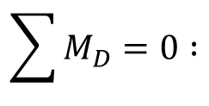

Solution # 3
The line of action of F_{H} is known.
0.8
1.6
$$tanα=\frac{1.6}{0.8}=2$$
F_{BE}
F_{x}
F
0.8
D_{y}
$$α≈63.43°$$
F_{y}
0.4
E
0.4
D
D_{x}
$$\sum{M_{D}=0 :}$$
F_{H}
1.2
FBD of DEF
$$0.8F_{BE}+0.8\left(F_{H}sinα\right)−0.4\left(F_{H}cosα\right)+1.2F_{X}−2.4F_{Y}=0$$
$$\{ {F_{BE}=12.5 kN, F}_{X}=−\frac{25}{3} kN, F_{Y}=5 kN \}$$
$$F_{H}≈22.36 kN$$

Slide 16
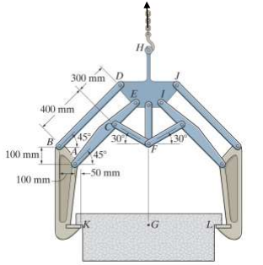
Question #4
The symmetric coil tong shown in Fig. 4 supports the coil which has mass 800 kg and centre of mass at G. Determine the horizontal and vertical components of force the linkage exerts on plate DEIJH at points D and E. The coil exerts only vertical reaction at K and L. Use g = 10 m/s²
Fig. 4

Slide 17
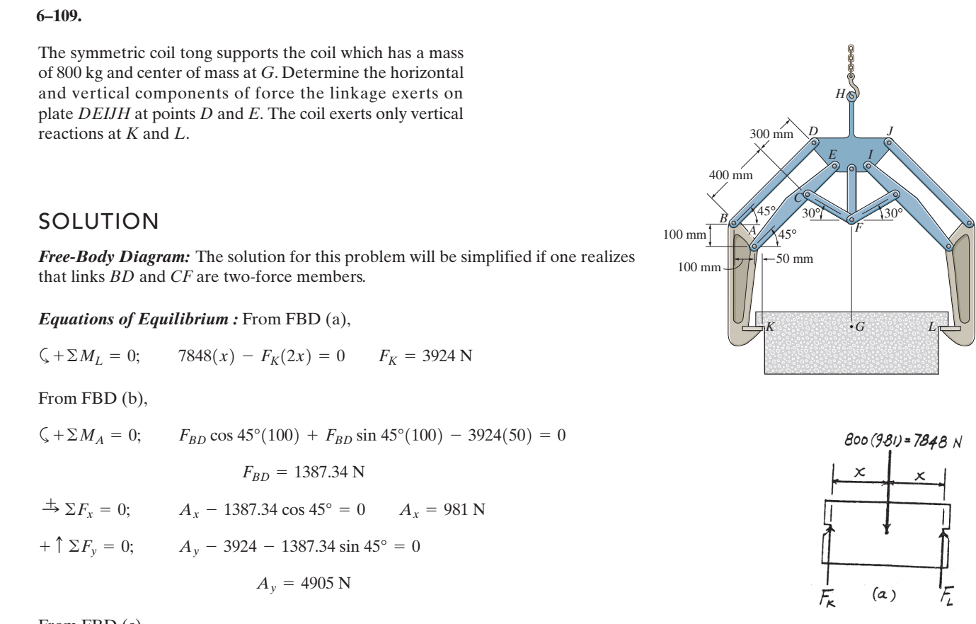
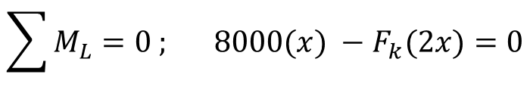

Solution # 4
From FBD (a)
800(10) = 8000 N
$$\sum{M_{L}=0 ; } 8000(x) −F_{k}(2x)=0$$
$$∴F_{k}=4000 N$$

Slide 18
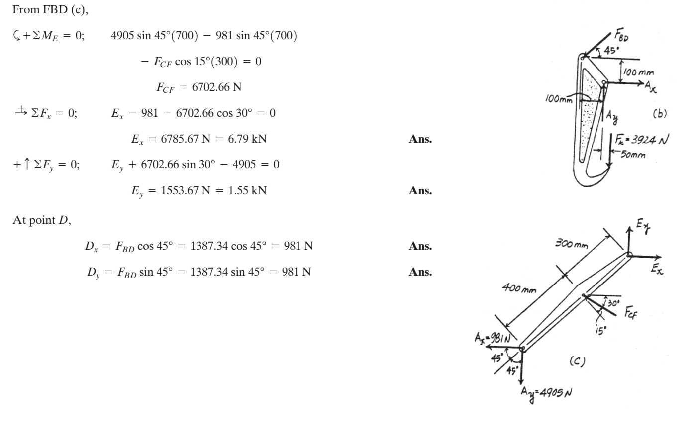



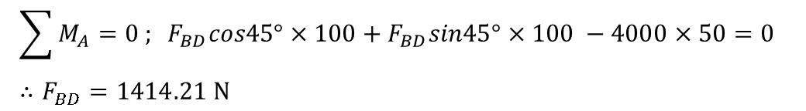

Solution # 4
From FBD (b)
$$\sum{M_{A}=0 ; }F_{BD}cos45°×100+F_{BD}sin45°×100 −4000×50=0 ∴F_{BD}=1414.21 N$$
B
$$\sum{F_{x}=0; A_{x} −1414.21cos{45}^{o}=0 }$$
A
$$∴A_{x}=1000 N$$
F_{k} = 4000
$$\sum{F_{y}=0; A_{y} −4000 −1414.21sin{45}^{o}=0 }$$
K
$$∴A_{y}=5000 N$$

Slide 19
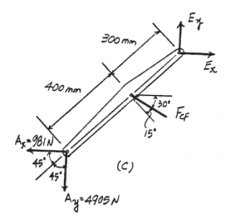





Solution # 4
From FBD (c)
$$\sum{M_{E}=0; 5000sin{45}^{o}\left(700\right) −1000sin{45}^{o}\left(700\right)−F_{CF}cos{15}^{o}\left(300\right)=0 }$$
$$∴F_{CF}=6832.5 N$$
E
$$\sum{F_{x}=0; E_{x}−1000 −6832.5cos{30}^{o}}$$
$$∴E_{x}=6785.66 N$$
C
A_{x} = 1000 N
$$\sum{F_{y}=0; E_{y}+6832.5sin{30}^{o} −5000=0}$$
A
$$∴E_{y}=1583.75 N$$
A_{y} = 5000 N

Slide 20
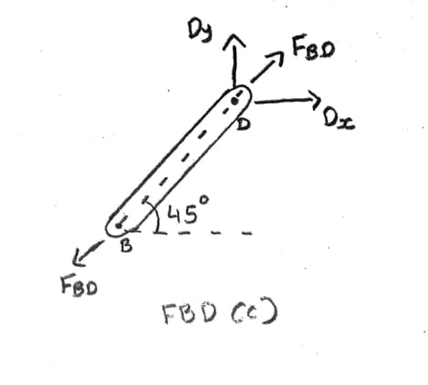
Solution # 4
From FBD (c)
BD is a two force member
At point D:
$$D_{x}=F_{BD}cos{45}^{o}=1414.21cos{45}^{o}=1000 N$$
$$D_{y}=F_{BD}sin{45}^{o}=1414.21sin{45}^{o}=1000 N$$

Slide 21
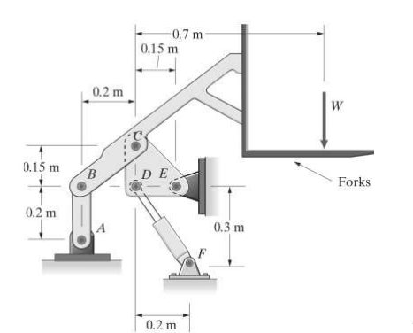
Problem # 5
The four bar linkage operates the forks of a fork lift truck. The force supported by the forks is W = 8 kN. Determine reaction on member CDE.

Slide 22
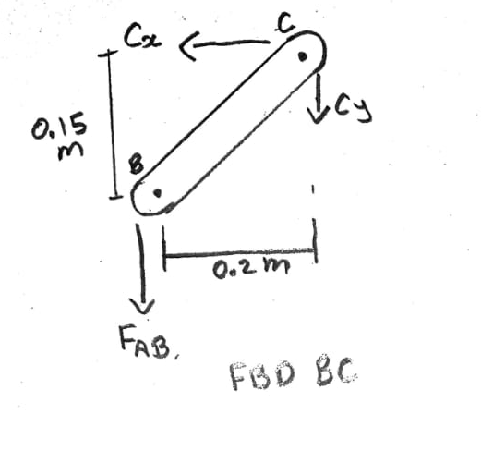
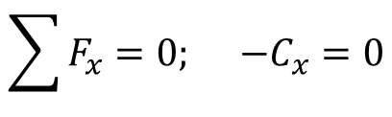

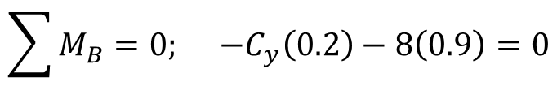
Solution # 5
Consider Body BC.
$$\sum{F_{x}=0; −C_{x}=0}$$
$$\sum{M_{B}=0; −C_{y}\left(0.2\right)−8\left(0.9\right)=0}$$
$${∴C}_{y}=−36 kN$$

Slide 23
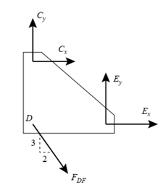
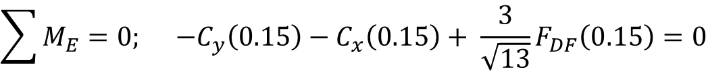
Solution # 5
Now examine CDE.
$$\sum{M_{E}=0; −C_{y}\left(0.15\right)−C_{x}\left(0.15\right)+ \frac{3}{\sqrt{13}}F_{DF}\left(0.15\right)=0}$$
0
FDF = - 43.3 kN

Slide 24
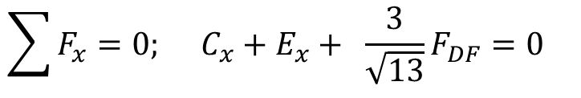


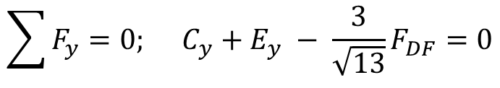
Solution # 5
2
$${∴E}_{x}=24 kN$$
$$\sum{F_{y}=0; C_{y}+E_{y} − \frac{3}{\sqrt{13}}F_{DF}=0}$$
$${∴E}_{y}=0 kN$$

Slide 25
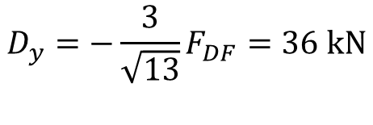
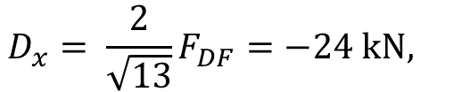
Solution # 5
DF is a two force member.
$$D_{x}= \frac{2}{\sqrt{13}}F_{DF}=−24 kN,$$
$$D_{y}=−\frac{3}{\sqrt{13}}F_{DF}=36 kN$$

Slide 26
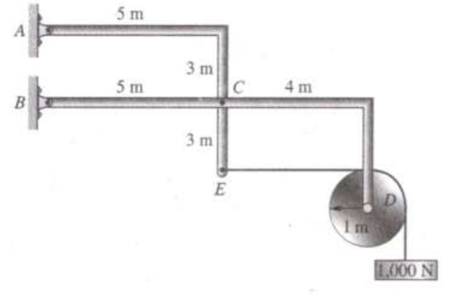
Question # 6
Members ACE and BCD are connected at C by a pin, as shown in Fig 6. Find the supporting forces at A and B. Note that circular cylinder attached at D weighs 1000 N.
Fig. 6

Slide 27
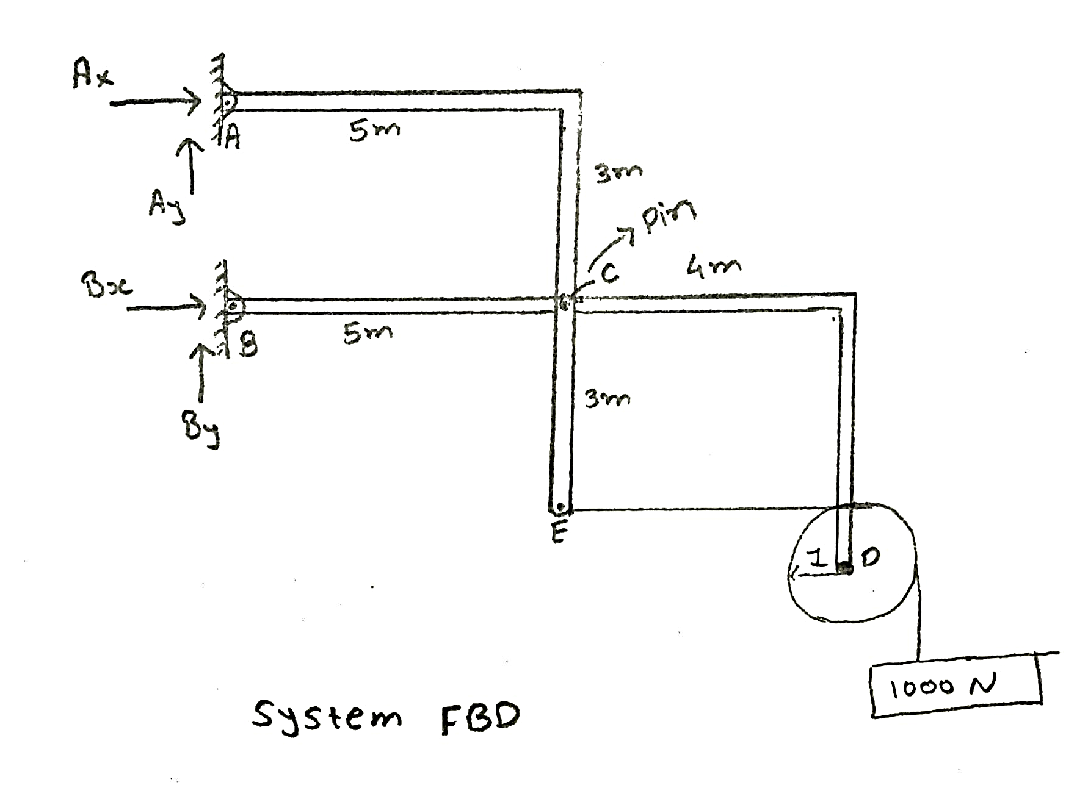
Solution # 6
FBD of system
ƩMA = 0;
Bx Χ 3 – 1000 Χ 10 - 1000 Χ 9 = 0
Bx = 6333.33 N
1000N

Slide 28
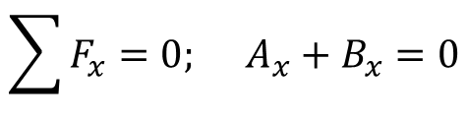
Solution # 6
$$\sum{F_{x}=0; A_{x}+B_{x}=0}$$
Ax = -6333.33 N
Ʃ Fy = 0; Ay + By – 1000 – 1000 = 0
1000N

Slide 29
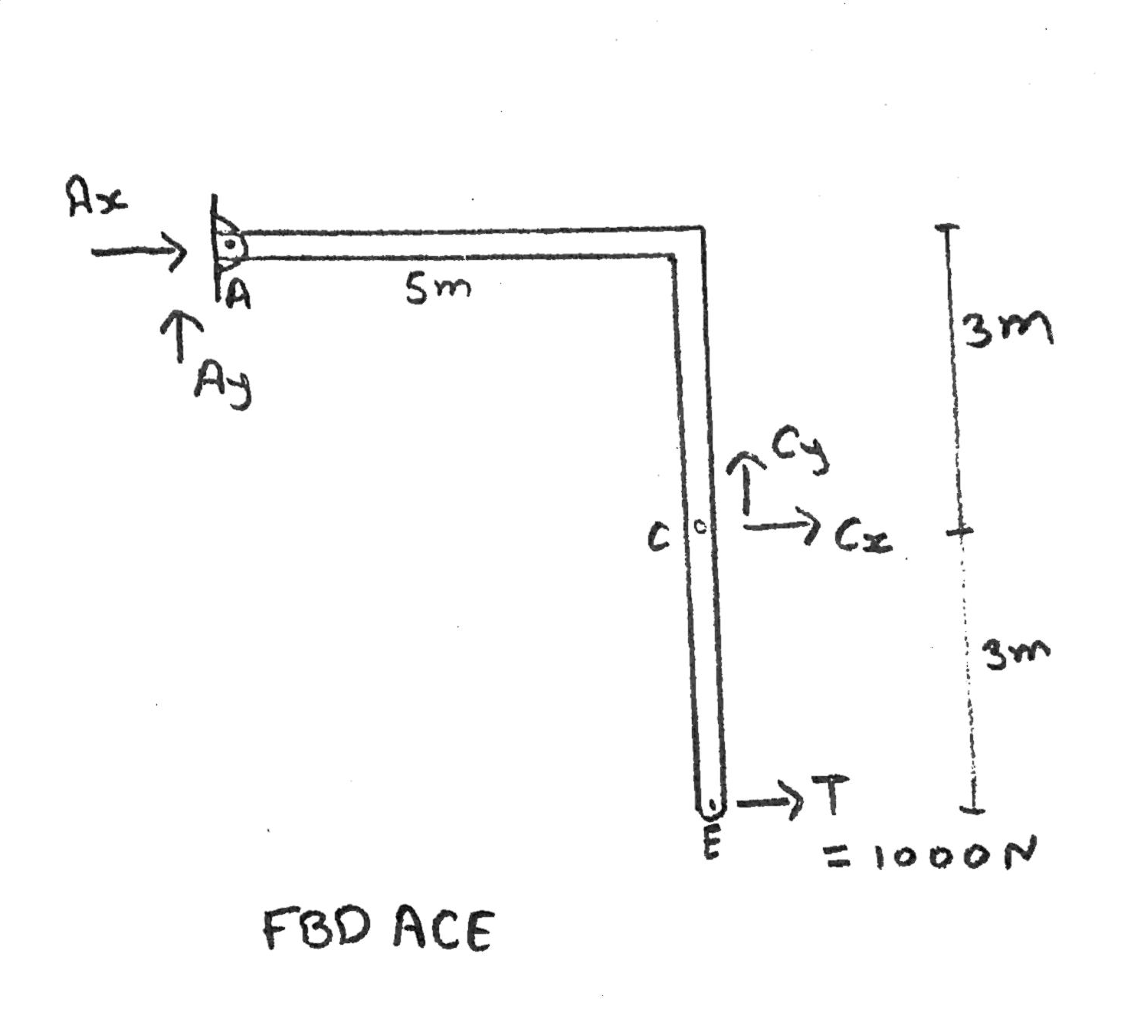

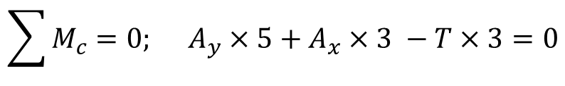
Solution # 6
$$FBD ACE$$
Pinned connection at C
$$\sum{M_{c}=0; A_{y}×5+A_{x}×3 −T×3=0}$$
Ay = 4400 N

Slide 30
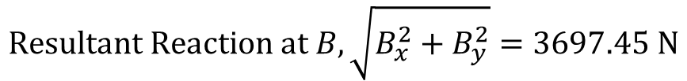
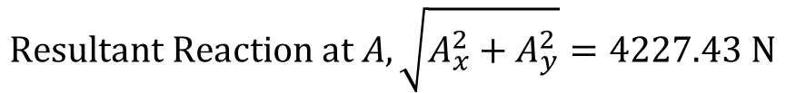
Solution # 6
From, Ay + By = 2000 N
By = -2400 N
$$Resultant Reaction at A, \sqrt{A_{x}^{2}+A_{y}^{2}}=4227.43 N$$
7711.75 N
$$Resultant Reaction at B, \sqrt{B_{x}^{2}+B_{y}^{2}}=3697.45 N$$
6772.82 N

