Slide 1
Social Networks
EXPLORING FACEBOOK USING GRAPH API

Slide 2
Structure of the Facebook Network
The network of Facebook is structured in the form of a Graph, which consists of:
Nodes: Entities such as a user, a photo, a page or a comment
Edges: Connections between those objects, such as a friendship between two users, a page's photos
Fields: Information about those objects, such as a person’s birthday

Slide 3
The Graph API is the primary way to obtain data from the Facebook's social graph.
It's a low-level HTTP-based API that is used to query data, post new stories, upload photos and a variety of other tasks that an app might need to do.
In this project, we have used Python to extract the data from the Graph.

Slide 4
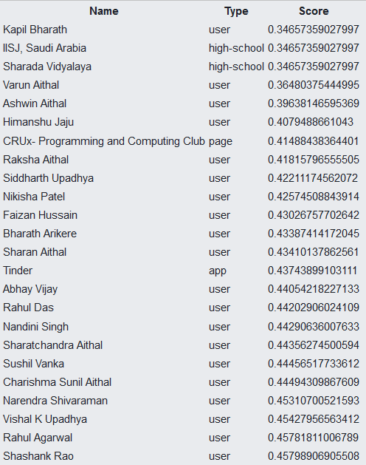
Facebook Search Box
GET Requests a File called first_degree.php
The Nodes are the Users and their respective data.
Edges Lengths are with the respect to the Score displayed.
Lower the Score, Closer the Node, Higher in the Search Box.

Slide 5
Centrality Measures
1. Degree Centrality:
It is defined as the number of links incident upon the node.
2. Closeness Centrality:
In a connected graph, the normalized closeness centrality (or closeness) of a node is the average length of the shortest path between the node and all other nodes in the graph. Thus the more central a node is, the closer it is to all other nodes.

Slide 6
3. Betweenness: Betweenness is a centrality measure within a vertex of a graph. It quantifies number of times a node acts a bridge along the shortest path between two nodes.
4. Cluster Coefficient: In graph theory, a clustering coefficient is a measure of the degree to which nodes in a graph tend to cluster together. Evidence suggests that in most real-world networks, and in particular social networks, nodes tend to create tightly knit groups characterised by a relatively high density of ties; this likelihood tends to be greater than the average probability of a tie randomly established between two nodes.

Slide 7
Closeness Formula
The closeness formula generates a number that is used as a measure to approximate the edge length and hence closeness of two friends on Facebook.

Slide 8
Features
The features considered to derive the closeness formula are:
1. Count of tags in photos and posts
2. Current location distance
3. Percentage of mutual friends
4. Common education details
5. Common pages liked
6. Number of posts on Wall
7. Common work place
8. Count of comments
9. Number of shares
10. Age difference
11. Reactions(Love,Haha, Wow, Angry)
12. Number of wall likes

Slide 9
Calculation of Closeness:
The closeness to each friend is calculated as:
∑ x_{i} * w_{i}
x_{i} = number of recurrence of i_{th} attribute or boolean occurrence of the attribute between me and friend.
w_{i} = weight of the i_{th} attribute.

Slide 10
Weights for Attributes
Count of Tags in photos (By others for me) => 70
Count of tags in posts (By others for me) => 70
Perct of common friends(Mutual friends/total friends) >50 => 160
Perct of common friends(Mutual friends/total friends) >1, <20 => 20
Perct of common friends(Mutual friends/total friends) <50 => 60
Common school => 400
Common college => 400

Slide 11
Weights for Attributes
Wall likes(By others on my wall) => 3.5
Common work place => 400
Number of Wall posts (By others on my wall) => 60
Count of comments by others on my posts => 10
Count of Tags in photos (By me for others) => 80
Count of Tags in posts (By me for others) => 80
Number of times a friend has shared my post => 10
Age Difference => 40/(d+1)

Slide 12
Weights for Attributes
Common pages liked(<5) => 10
Common pages liked(5-20) => 20
Common pages liked(20+) => 50
Wall Love Reactions(By others on my wall) => 5
Wall haha reaction(By others on my wall) => 5
Wall Wow reaction(By others on my wall) => 5
Wall Sad(By others on my wall) => 5
Wall Angry(By others on my wall) => 5

Slide 13
Deploying Facebook App
Facebook gives each App an ID.
The App must be hosted on a website, and all the Processing is done on the Host Server.
When an user runs that app, the user gives permissions to the app to use their data.
Facebook then permits the developer to access the data of said user, on the basis of App ID.

Slide 14
Final Objectives
Publish a Facebook App that allows any Facebook User to access the above Features.
Track other Facebook Users by their last location.
Travel Recommendation System based on your Closest Friends.
Emotion Detection using NLP, based on your Interactions with your Closest Friends, i.e., To Determine who you are the Happiest with.

