Slide 1
ACADEMIC PROJECT PRESENTATION (2023-2027)
STUDENT DETAILS
Student Name:
Kapilesh Saami Nagesh
Register Number:
RA2311003050255
Department:
CSE CORE
College Name:
SRM Institute of Science and Technology
Academic Year:
2023-2027
CampusLoop
Employee Leave Management System
Web-Based Employee Leave Management & Approval Platform
React.js | Spring Boot | MySQL | REST API | Playwright
Slide 1 / 10

Slide 2
CAMPUSLOOP PRESENTATION
Problem Statement
TRADITIONAL LEAVE MANAGEMENT
- Manual paper-based leave applications
- Informal & unorganized approval workflows
- Difficulty tracking real-time leave balances
- Lack of centralized employee record-keeping
- Delayed manager responses & approval bottlenecks
- Limited visibility of application status for employees
- Increased risk of data-entry & accounting errors
CORE PROBLEM DEFINITION
Employees and managers require a centralized digital web platform where leave requests can be submitted, tracked, reviewed, and approved efficiently without administrative friction.
Traditional Flow (Flawed): Employee -> Manual Paper Form -> Manager Desk -> Delayed Approval -> Manual Records
Slide 2 / 10

Slide 3
CAMPUSLOOP PRESENTATION
Proposed Solution
CampusLoop is a web-based employee leave management system designed to digitize, automate, and simplify the complete organizational leave workflow.
KEY SOLUTION ADVANTAGES
[+] Secure Employee & Manager Authentication
[+] Interactive Employee Dashboard with Leave History
[+] Online Application Submission with Instant Validation
[+] Real-Time Leave Balance Calculation & Tracking
[+] Streamlined Manager Approval / Rejection Portal
[+] Transparent Live Status Tracking for Employees
[+] Centralized MySQL Relational Database Persistence
[+] Robust RESTful Backend APIs built with Spring Boot
DIGITAL WORKFLOW
1. Employee Login
2. Apply Leave Online
3. Manager Review
4. Approve / Reject
5. Updated Status Sync
Slide 3 / 10

Slide 4
CAMPUSLOOP PRESENTATION
Key Features Grid
EMPLOYEE FEATURES
- Secure User Authentication
- Personalized Dashboard
- Real-Time Leave Balances
- Online Leave Application
- Comprehensive Leave History
- Track Live Approval Status
MANAGER FEATURES
- View Pending Requests
- Review Applications
- One-Click Approve/Reject
- Add Manager Comments
- Department Balance Audit
- Action History Trail
SYSTEM FEATURES
- REST API Integration
- MySQL Relational DB
- Robust Error Handling
- Strict Payload Validation
- Automated Playwright Tests
- CORS Security Setup
Slide 4 / 10

Slide 5
CAMPUSLOOP PRESENTATION
System Architecture
CAMPUSLOOP HIGH-LEVEL ARCHITECTURE
REACT FRONTEND (Client Layer)
- React.js (JSX)
- Vite Build Tool
- React Router
- Auth Context
- Dashboard & Forms
SPRING BOOT BACKEND (Business Logic)
- REST Controllers
- Service Layer
- Repository Layer
- Spring Security
- DTOs & Validation
MYSQL DB (Persistence)
- User Table
- Employee Table
- LeaveRequest Table
- Relational Keys
<-> REST APIs
<-> JPA / JDBC
Architecture Summary: The React frontend communicates with Spring Boot REST APIs, which process business logic and persist employee & leave information in MySQL. API quality is verified using Postman and Playwright.
Slide 5 / 10

Slide 6
CAMPUSLOOP PRESENTATION
Employee -> Manager Leave Workflow
STEP 1
Employee Login
Employee authenticates using secure email and password.
STEP 2
Apply Leave
Selects Leave Type, Start/End Dates, Number of Days & Reason.
STEP 3
Request Stored
Leave request is persisted in MySQL database with PENDING status.
STEP 4
Manager Reviews
Manager views pending leave requests in their portal.
STEP 5
Manager Decision
Manager evaluates the request and selects APPROVE or REJECT.
STEP 6
Status Updated
Employee views updated status and updated balance on dashboard.
Slide 6 / 10

Slide 7
CAMPUSLOOP PRESENTATION
AI-Assisted Development
AI ACCELERATION & DEVELOPER VALIDATION
- Assisted in generating and refining boilerplate code
- Accelerated Spring Boot API controller & service layer debugging
- Assisted with React UI component layout & state management
- Helped identify and resolve CORS & API integration issues
- Assisted in creating comprehensive test scenarios
- Helped optimize backend error handling and validation logic
- Supported Playwright end-to-end test automation setup
- Developer reviewed, modified, and validated all generated code
DEVELOPMENT WORKFLOW
[1] Developer Intent
[2] AI Assistance Prompt
[3] Code Generation
[4] Manual Debug & Refine
[5] Validation & Testing
Note: AI tools were used purely as development assistance. All application logic, schema, and API integrations were thoroughly verified and tested by the developer.
Slide 7 / 10

Slide 8
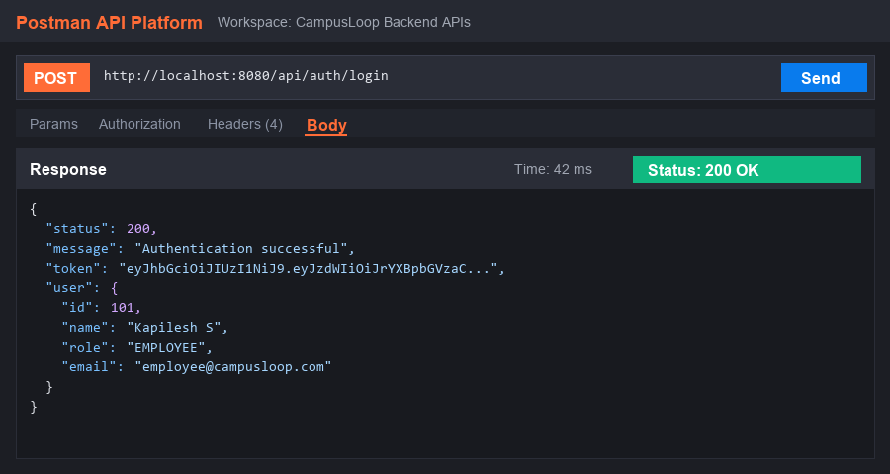
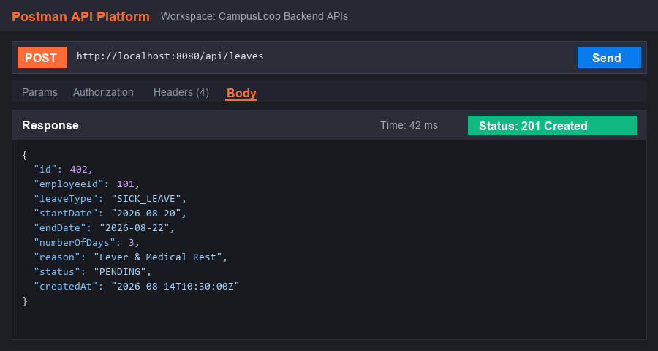
CAMPUSLOOP PRESENTATION
API Testing & Test Automation
VALIDATED REST API ENDPOINTS
POST /api/auth/login
Purpose: Employee authentication & JWT session
POST /api/leaves
Purpose: Create a new leave request
GET /api/leaves
Purpose: Retrieve all leave applications
GET /api/leaves/employee/{id}
Purpose: Retrieve employee specific history
PUT /api/leaves/{id}/status
Purpose: Update leave status (Approve/Reject)
Slide 8 / 10

Slide 9
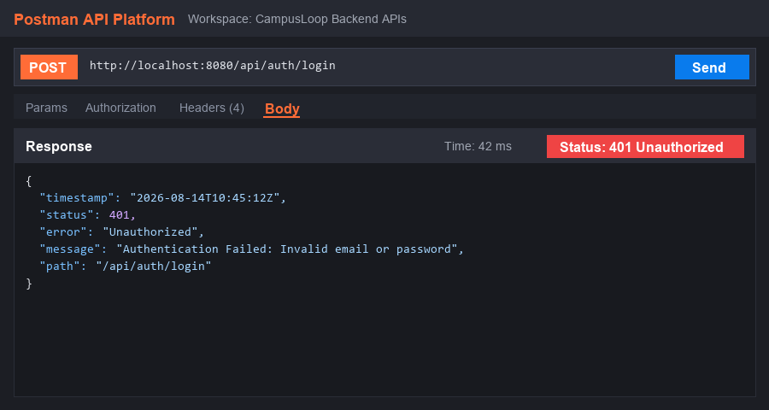
CAMPUSLOOP PRESENTATION
Test Validation: Failure -> Fix -> Pass
1. DELIBERATE FAILURE
Login tested with wrong password.
Result: 401 Unauthorized 'Invalid email or password'
2. FIX
Correct employee credentials provided.
Action: Request payload updated & re-sent to /api/auth/login
3. PASS
Valid authentication request.
Result: 200 OK 'Authentication successful'
Slide 9 / 10

Slide 10
CAMPUSLOOP PRESENTATION
Conclusion & Live Demo
PROJECT OUTCOMES
[+] Simplifies and digitizes employee leave application
[+] Reduces manual administrative paperwork and delays
[+] Provides transparent real-time status & leave balances
[+] Improves manager approval and decision workflow
[+] Robust Spring Boot REST architecture & MySQL persistence
[+] Validated with Playwright automated tests & Postman
LIVE DEMO FLOW
1. Employee Login & Dashboard
2. View Leave Balances
3. Submit New Leave Request
4. View Pending Application
5. Manager Reviews Request
6. Manager Approve / Reject Action
7. Employee View Updated Status
8. Demonstrate Postman API Validation
CampusLoop - Simplifying Employee Leave Management Through Technology
THANK YOU! | Q & A SESSION
Slide 10 / 10

