Slide 1
AVL Trees
CENG 213 Data Structures

Slide 2
AVL Trees
An AVL tree is a binary search tree with a balance condition.
AVL is named for its inventors: Adel’son-Vel’skii and Landis
AVL tree approximates the ideal tree (completely balanced tree).
AVL Tree maintains a height close to the minimum.
Definition:
  An AVL tree is a binary search tree such that
  for any node in the tree, the height of the left and
  right subtrees can differ by at most 1.
CENG 213 Data Structures

Slide 3
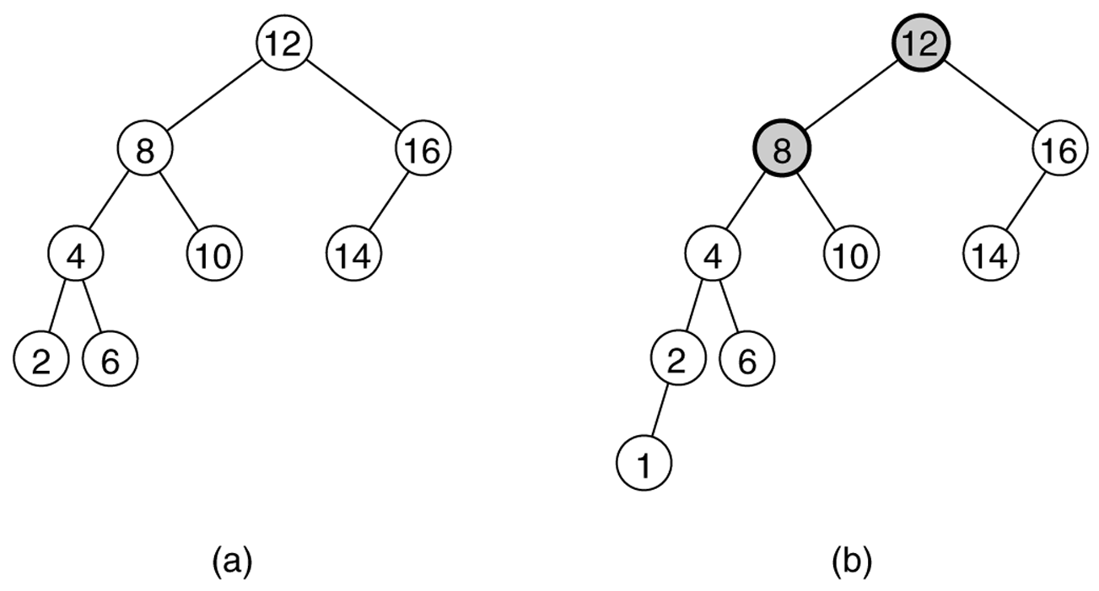
Figure 19.21
Two binary search trees: (a) an AVL tree; (b) not an AVL tree (unbalanced nodes are darkened)
CENG 213 Data Structures

Slide 4
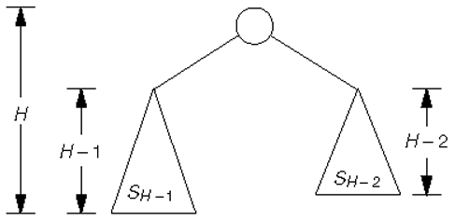
Figure 19.22
Minimum tree of height H
CENG 213 Data Structures

Slide 5
Properties
The depth of a typical node in an AVL tree is very close to the optimal log N.
Consequently, all searching operations in an AVL tree have logarithmic worst-case bounds.
An update (insert or remove) in an AVL tree could destroy the balance. It must then be rebalanced before the operation can be considered complete.
After an insertion, only nodes that are on the path from the insertion point to the root can have their balances altered.
CENG 213 Data Structures

Slide 6
Rebalancing
Suppose the node to be rebalanced is X. There are 4 cases that we might have to fix (two are the mirror images of the other two):
  An insertion in the left subtree of the left child of X,
  An insertion in the right subtree of the left child of X,
  An insertion in the left subtree of the right child of X, or
  An insertion in the right subtree of the right child of X.
Balance is restored by tree rotations.
CENG 213 Data Structures

Slide 7
Balancing Operations: Rotations
Case 1 and case 4 are symmetric and requires the same operation for balance.
  Cases 1,4 are handled by single rotation.
Case 2 and case 3 are symmetric and requires the same operation for balance.
  Cases 2,3 are handled by double rotation.
CENG 213 Data Structures

Slide 8
Single Rotation
A single rotation switches the roles of the parent and child while maintaining the search order.
Single rotation handles the outside cases (i.e. 1 and 4).
We rotate between a node and its child.
  Child becomes parent. Parent becomes right child in case 1, left child in case 4.
The result is a binary search tree that satisfies the AVL property.
CENG 213 Data Structures

Slide 9
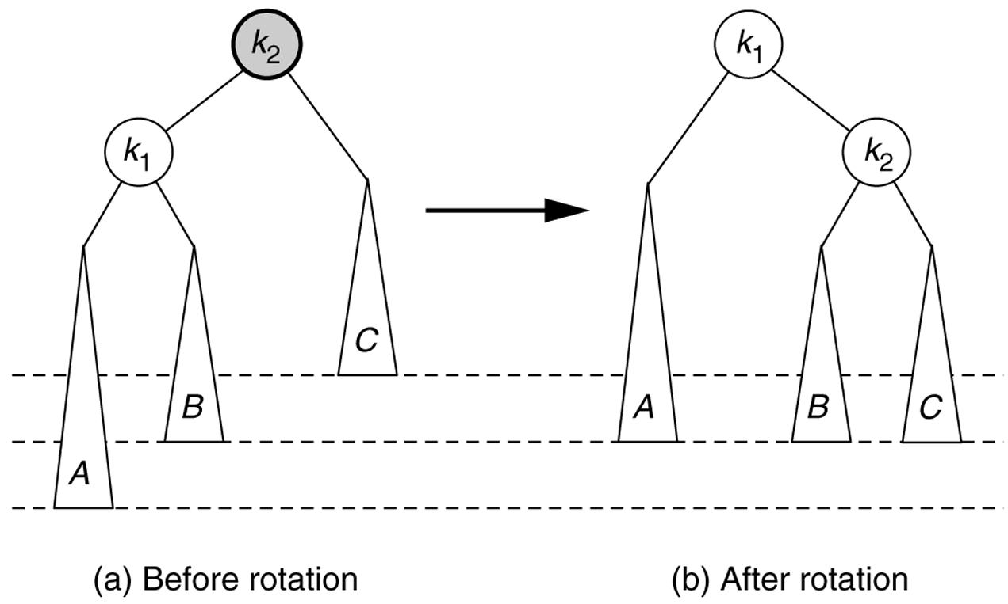
Figure 19.23
Single rotation to fix case 1: Rotate right
CENG 213 Data Structures

Slide 10
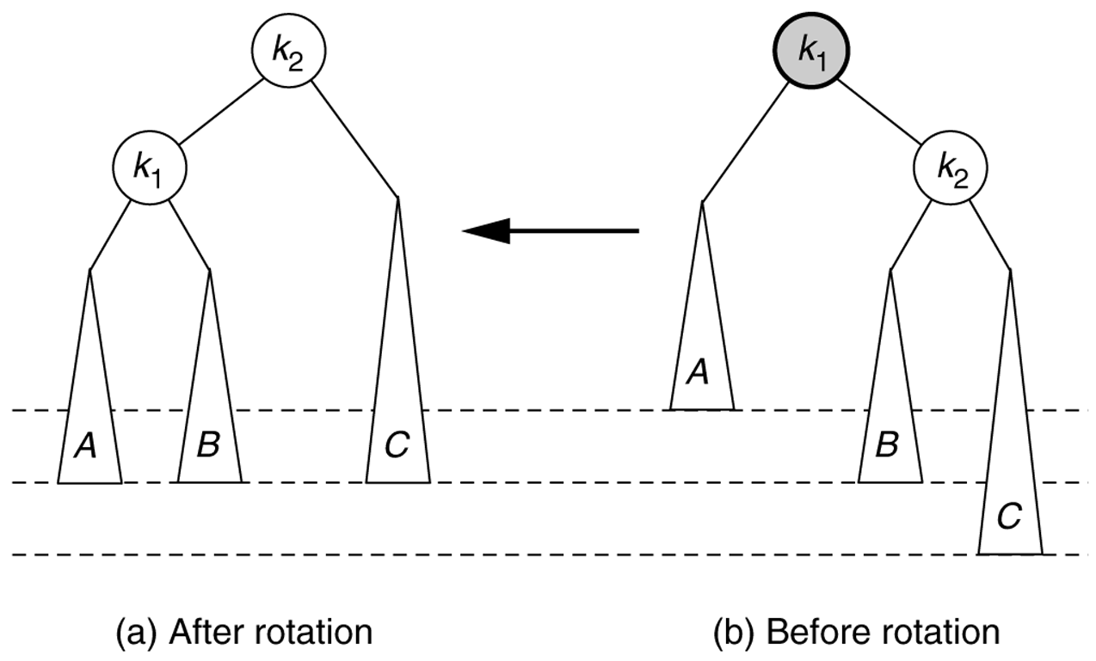
Figure 19.26
Symmetric single rotation to fix case 4 : Rotate left
CENG 213 Data Structures

Slide 11
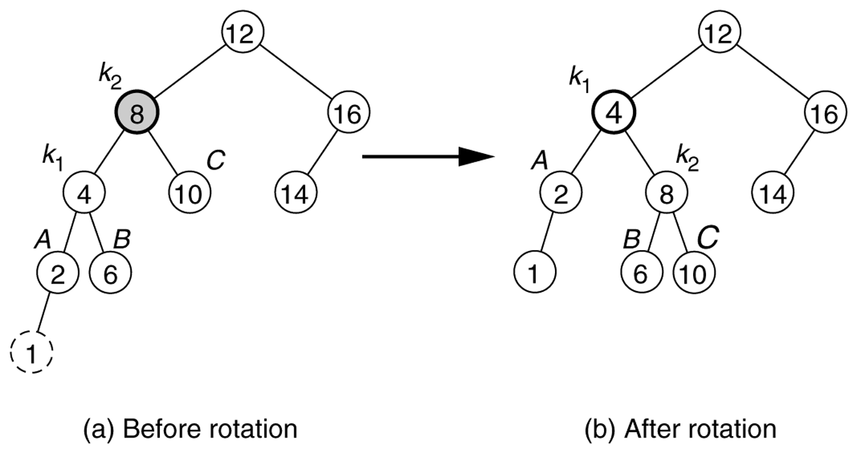
Figure 19.25
Single rotation fixes an AVL tree after insertion of 1.
CENG 213 Data Structures

Slide 12
Example
Start with an empty AVL tree and insert the items 3,2,1, and then 4 through 7 in sequential order.
Answer:
1
CENG 213 Data Structures

Slide 13
Example
Start with an empty AVL tree and insert the items 3,2,1, and then 4 through 7 in sequential order.
Answer:
1
2
CENG 213 Data Structures

Slide 14


Example
Start with an empty AVL tree and insert the items 3,2,1, and then 4 through 7 in sequential order.
Answer:
1
2
CENG 213 Data Structures

Slide 15
Example
Start with an empty AVL tree and insert the items 3,2,1, and then 4 through 7 in sequential order.
2
1
3
CENG 213 Data Structures

Slide 16

Example
Start with an empty AVL tree and insert the items 3,2,1, and then 4 through 7 in sequential order.
Answer:
2
1
3
CENG 213 Data Structures

Slide 17

Example
Start with an empty AVL tree and insert the items 3,2,1, and then 4 through 7 in sequential order.
2
1
3
CENG 213 Data Structures

Slide 18

Example
Start with an empty AVL tree and insert the items 3,2,1, and then 4 through 7 in sequential order.
2
1
3
CENG 213 Data Structures

Slide 19
Example
Start with an empty AVL tree and insert the items 3,2,1, and then 4 through 7 in sequential order.
2
1
3
6
CENG 213 Data Structures

Slide 20
Example
Start with an empty AVL tree and insert the items 3,2,1, and then 4 through 7 in sequential order.
2
1
3
6
CENG 213 Data Structures

Slide 21
Example
Start with an empty AVL tree and insert the items 3,2,1, and then 4 through 7 in sequential order.
2
1
3
6
7
CENG 213 Data Structures

Slide 22
Example
Start with an empty AVL tree and insert the items 3,2,1, and then 4 through 7 in sequential order.
Answer:
4
2
6
1
3
5
7
CENG 213 Data Structures

Slide 23
Example
Start with an empty AVL tree and insert the items 3,2,1, and then 4 through 7 in sequential order.
4
2
6
1
3
5
7
4.5
CENG 213 Data Structures

Slide 24
Example
Start with an empty AVL tree and insert the items 3,2,1, and then 4 through 7 in sequential order.
4
2
6
1
3
5
7
4.5
4.8
CENG 213 Data Structures

Slide 25
Example
Start with an empty AVL tree and insert the items 3,2,1, and then 4 through 7 in sequential order.
4
2
6
1
3
4.8
7
4.5
5
CENG 213 Data Structures

Slide 26
Example
Start with an empty AVL tree and insert the items 3,2,1, and then 4 through 7 in sequential order.
4
2
6
1
3
4.8
7
4.5
5
5.5
CENG 213 Data Structures

Slide 27
Example
Start with an empty AVL tree and insert the items 3,2,1, and then 4 through 7 in sequential order.
4
2
5
1
3
4.8
6
4.5
5.5
7
CENG 213 Data Structures

Slide 28
Example
Start with an empty AVL tree and insert the items 3,2,1, and then 4 through 7 in sequential order.
4
2
5
1
3
4.8
6
4.5
5.5
7
5.7
CENG 213 Data Structures

Slide 29
Example
Start with an empty AVL tree and insert the items 3,2,1, and then 4 through 7 in sequential order.
5
6
4
4.8
5.5
7
2
4.5
5.7
1
3
CENG 213 Data Structures

Slide 30
Example
Start with an empty AVL tree and insert the items 3,2,1, and then 4 through 7 in sequential order.
4
2
5
1
3
4.8
6
4.5
5.5
7
4.7
CENG 213 Data Structures

Slide 31
Analysis
One rotation suffices to fix cases 1 and 4.
Single rotation preserves the original height:
  The new height of the entire subtree is exactly the same as the height of the original subtree before the insertion.
Therefore it is enough to do rotation only at the first node, where imbalance exists, on the path from inserted node to root.
Thus the rotation takes O(1) time.
Hence insertion is O(logN)
CENG 213 Data Structures

Slide 32
Double Rotation
Single rotation does not fix the inside cases (2 and 3).
These cases require a double rotation, involving three nodes and four subtrees.
CENG 213 Data Structures

Slide 33
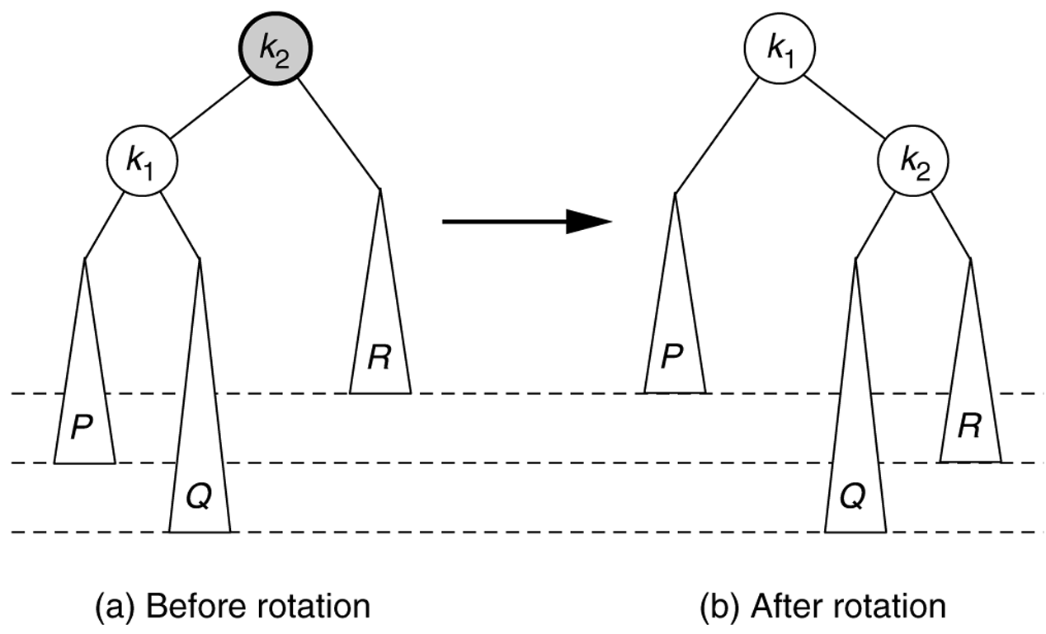
Figure 19.28
Single rotation does not fix case 2.
CENG 213 Data Structures

Slide 34
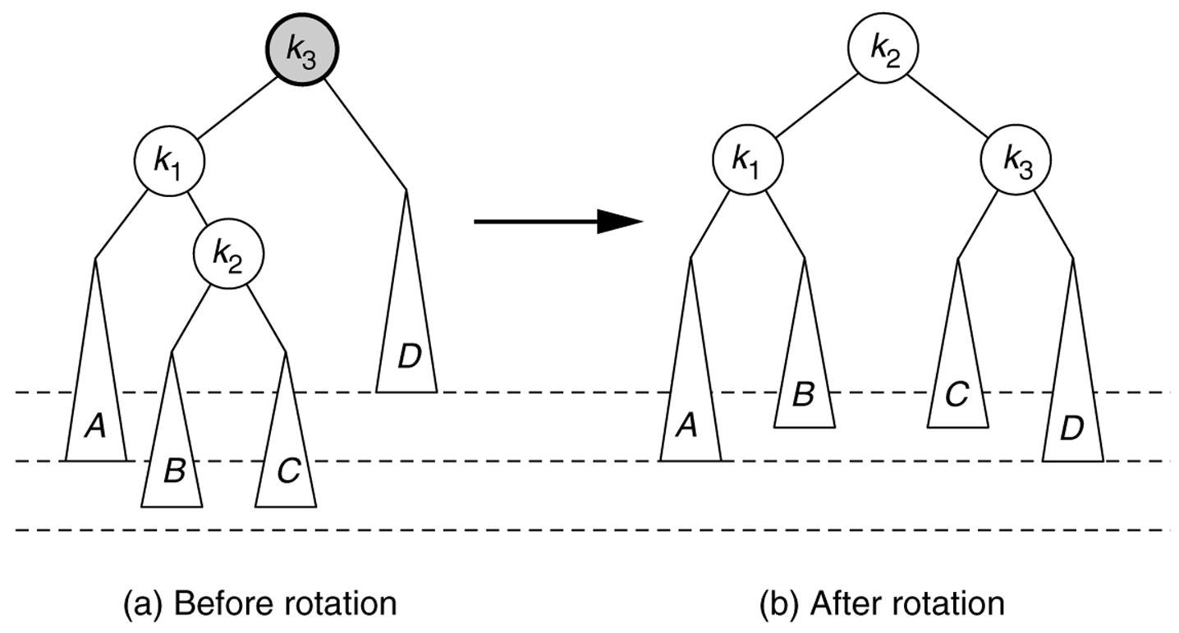
Left–right double rotation to fix case 2
Lift this up:
first rotate left between (k_{1,}k₂),
then rotate right betwen (k₃,k₂)
CENG 213 Data Structures

Slide 35
Left-Right Double Rotation
A left-right double rotation is equivalent to a sequence of two single rotations:
  1st rotation on the original tree:
  a left rotation between X’s left-child and grandchild
  2nd rotation on the new tree:
  a right rotation between X and its new left child.
CENG 213 Data Structures

Slide 36
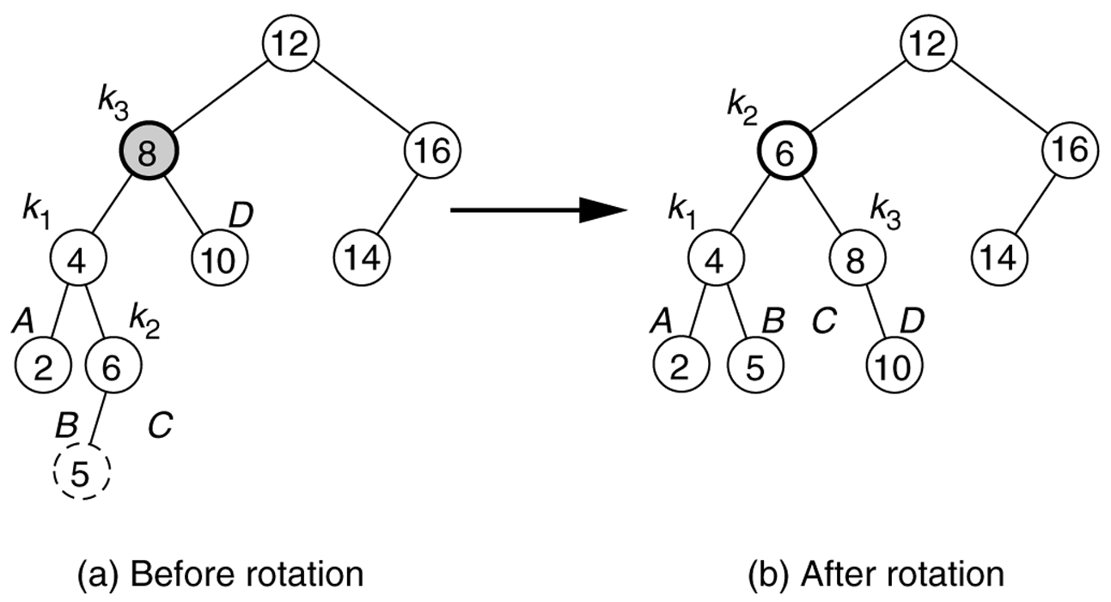
Figure 19.30
Double rotation fixes AVL tree after the insertion of 5.
CENG 213 Data Structures

Slide 37
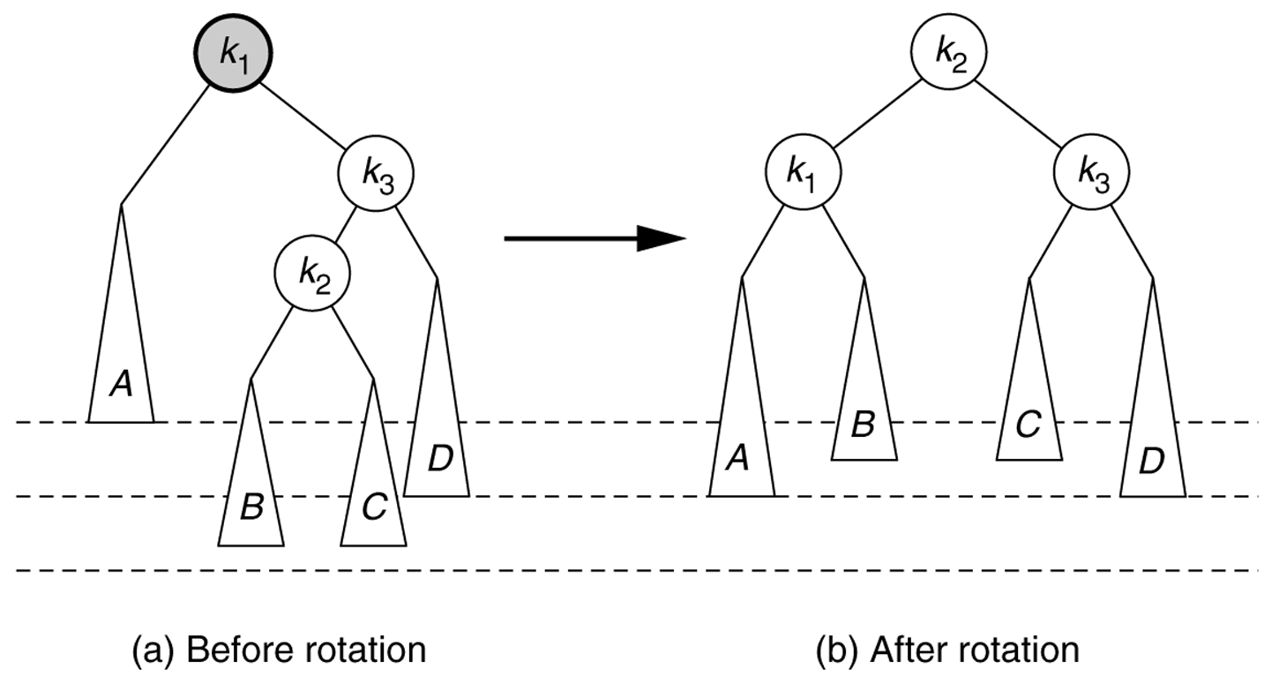
Right–Left double rotation to fix case 3.
CENG 213 Data Structures

Slide 38
Example
Insert 16, 15, 14, 13, 12, 11, 10, and 8, and 9 to the previous tree obtained in the previous single rotation example.
Answer:
7
4
13
2
6
11
15
1
3
5
9
12
14
16
8
10
CENG 213 Data Structures

Slide 39
Node declaration for AVL trees
template <class Comparable>
class AvlTree;
template <class Comparable>
class AvlNode
{
Comparable element;
AvlNode *left;
AvlNode *right;
int height;
AvlNode( const Comparable & theElement, AvlNode *lt,
AvlNode *rt, int h = 0 )
: element( theElement ), left( lt ), right( rt ),
height( h ) { }
friend class AvlTree<Comparable>;
};
CENG 213 Data Structures

Slide 40
Height
template class <Comparable>
int AvlTree<Comparable>::height( AvlNode<Comparable> *t) const
{
return t == NULL ? -1 : t->height;
}
CENG 213 Data Structures

Slide 41
Single right rotation
/**
* Rotate binary tree node with left child.
* For AVL trees, this is a single rotation for case 1.
* Update heights, then set new root.
*/
template <class Comparable>
void AvlTree<Comparable>::rotateWithLeftChild( AvlNode<Comparable> * & k2 ) const
{
AvlNode<Comparable> *k1 = k2->left;
k2->left = k1->right;
k1->right = k2;
k2->height = max( height( k2->left ), height( k2->right ))+1;
k1->height = max( height( k1->left ), k2->height ) + 1;
k2 = k1;
}
CENG 213 Data Structures

Slide 42
Double Rotation
/**
* Double rotate binary tree node: first left child.
* with its right child; then node k3 with new left child.
* For AVL trees, this is a double rotation for case 2.
* Update heights, then set new root.
*/
template <class Comparable>
void AvlTree<Comparable>::doubleWithLeftChild( AvlNode<Comparable> * & k3 ) const
{
rotateWithRightChild( k3->left );
rotateWithLeftChild( k3 );
}
CENG 213 Data Structures

Slide 43
/* Internal method to insert into a subtree.
* x is the item to insert.
* t is the node that roots the tree.
*/
template <class Comparable>
void AvlTree<Comparable>::insert( const Comparable & x, AvlNode<Comparable> * & t ) const
{
if( t == NULL )
t = new AvlNode<Comparable>( x, NULL, NULL );
else if( x < t->element )
{
insert( x, t->left );
if( height( t->left ) - height( t->right ) == 2 )
if( x < t->left->element )
rotateWithLeftChild( t );
else
doubleWithLeftChild( t );
}
else if( t->element < x )
{
insert( x, t->right );
if( height( t->right ) - height( t->left ) == 2 )
if( t->right->element < x )
rotateWithRightChild( t );
else
doubleWithRightChild( t );
}
else
; // Duplicate; do nothing
t->height = max( height( t->left ), height( t->right ) ) + 1;
}
CENG 213 Data Structures

Slide 44
AVL Tree -- Deletion
Deletion is more complicated.
We may need more than one rebalance on the path from deleted node to root.
Deletion is O(logN)
CENG 213 Data Structures

Slide 45
Deletion of a Node
Deletion of a node x from an AVL tree requires the same basic ideas, including single and double rotations, that are used for insertion.
With each node of the AVL tree is associated a balance factor that is left high, equal or right high according, respectively, as the left subtree has height greater than, equal to, or less than that of the right subtree.
CENG 213 Data Structures

Slide 46
Method
Reduce the problem to the case when the node x to be deleted has at most one child.
  If x has two children replace it with its immediate predecessor y under inorder traversal (the immediate successor would be just as good)
  Delete y from its original position, by proceeding as follows, using y in place of x in each of the following steps.
CENG 213 Data Structures

Slide 47
Method (cont.)
Delete the node x from the tree.
  We’ll trace the effects of this change on height through all the nodes on the path from x back to the root.
  We use a Boolean variable shorter to show if the height of a subtree has been shortened.
  The action to be taken at each node depends on
    the value of shorter
    balance factor of the node
    sometimes the balance factor of a child of the node.
shorter is initially true. The following steps are to be done for each node p on the path from the parent of x to the root, provided shorter remains true. When shorter becomes false, the algorithm terminates.
CENG 213 Data Structures

Slide 48
Case 1
Case 1: The current node p has balance factor equal.
  Change the balance factor of p.
  shorter becomes false
p
p
No rotations
Height unchanged
−
\
T₁
T₂
T₁
T₂
deleted
CENG 213 Data Structures

Slide 49
Case 2
Case 2: The balance factor of p is not equal and the taller subtree was shortened.
  Change the balance factor of p to equal
  Leave shorter true.
p
p
No rotations
Height reduced
/
−
T₁
T₂
T₁
T₂
deleted
CENG 213 Data Structures

Slide 50
Case 3
Case 3: The balance factor of p is not equal, and the shorter subtree was shortened.
  Rotation is needed.
  Let q be the root of the taller subtree of p. We have three cases according to the balance factor of q.
CENG 213 Data Structures

Slide 51
Case 3a
Case 3a: The balance factor of q is equal.
  Apply a single rotation
  shorter becomes false.
height unchanged
p
q
/
\
q
−
p
\
h-1
T₁
h
T₃
h
T₂
h
T₃
deleted
h-1
T₁
T₂
h
CENG 213 Data Structures

Slide 52
Case 3b
Case 3b: The balance factor of q is the same as that of p.
  Apply a single rotation
  Set the balance factors of p and q to equal
  leave shorter as true.
height reduced
p
q
-
\
q
p
-
\
h-1
T₁
T₃
h
h-1
h-1
h-1
T₁
T₂
T₂
h
T₃
deleted
CENG 213 Data Structures

Slide 53
Case 3c
Case 3c: The balance factors of p and q are opposite.
  Apply a double rotation
  set the balance factors of the new root to equal
  leave shorter as true.
height reduced
p
r
\
-
/
q
p
q
h-1
r
T₁
h-1
T₄
h-1 or
h-2
T₄
h-1
T₂
T₃
T₁
h-1
h-1 or
h-2
T₂
T₃
CENG 213 Data Structures

Slide 54
AVL Tree Example:
Insert 14, 17, 11, 7, 53, 4, 13 into an empty AVL tree
14
11
17
7
53
4

Slide 55
AVL Tree Example:
Insert 14, 17, 11, 7, 53, 4, 13 into an empty AVL tree
14
7
17
4
11
53
13

Slide 56
AVL Tree Example:
Now insert 12
14
7
17
4
11
53
13
12

Slide 57
AVL Tree Example:
Now insert 12
14
7
17
4
11
53
12
13

Slide 58
AVL Tree Example:
Now the AVL tree is balanced.
14
7
17
4
12
53
11
13

Slide 60
Node { int val;
Node lchild;
Node rchild;
Node Parent;
int ht;
}
insertAVL( root, Node n ) {
n = insertBST(root, n); flag = false;
par1 = n.parent;
while(par1 !=null || flag == false ) {
par.ht = max(par1.left.ht+1, par1.right.ht+1)
leftht = getleftht(par1);
rtht = getrightht(par1);
if ( abs(leftht – rht) == 2) {
avlBalance(par1,leftht, rtht);
flag = true;
}
par1 = par1.parent;
}

Slide 61
avlBalance(Node n1, ltht, rtht) {
if (ltht > rtht ) {
n2 = n1.left
}
else {
n2 = n1.right;
}
lltht3 = getleftht( n2 );
rtht3 = getrightht(n2);
if ( ltht3 > rtht3 ) {
n3 = n2.left;
}
else {
n3 = n2.right;
}

Slide 62
If ( n3 == n2.left && n2 == n1.left ) {
balanceleftStline(n1,n2,n3);
}
If ( n3 == n2.right && n2 == n1.right ) {
balancerightStline(n1, n2, n3 );
}
If ( n3 == n2.left && n2 == n1.right ) {
balancezigzagright( n1, n2, n3 );
}
If ( n3 == n2.right && n2 == n1.left) {
balancezigagleft(n1, n2, n3);
}
updateHt(n1, n2, n3);

Slide 63
Balanceleftstline(n1, n2, n3) {
tmp1 = n1.lchild;
tmp2 = n1.parent;
n1.left = n2.right;
n1.parent = n2;
n2.parent = tmp2;
n2.right = n1;
tmp2.left = n2;
n2.right.parent = n1;

Slide 64
AVL Tree Example:
Now insert 8
14
7
17
4
12
53
11
13
8

Slide 65
AVL Tree Example:
Now insert 8
14
7
17
4
11
53
8
12
13

Slide 66
AVL Tree Example:
Now the AVL tree is balanced.
14
11
17
7
12
53
4
8
13

Slide 67
AVL Tree Example:
Now remove 53
14
11
17
7
12
53
4
8
13

Slide 68
AVL Tree Example:
Now remove 53, unbalanced
14
11
17
7
12
4
8
13

Slide 69
AVL Tree Example:
Balanced! Remove 11
11
7
14
4
8
12
17
13

Slide 70
AVL Tree Example:
Remove 11, replace it with the largest in its left branch
8
7
14
4
12
17
13

Slide 71
AVL Tree Example:
Remove 8, unbalanced
7
4
14
12
17
13

Slide 72
AVL Tree Example:
Remove 8, unbalanced
7
4
12
14
13
17

Slide 73
AVL Tree Example:
Balanced!!
12
7
14
4
13
17

Slide 74
In Class Exercises
Build an AVL tree with the following values:
  15, 20, 24, 10, 13, 7, 30, 36, 25

Slide 75
  15, 20, 24, 10, 13, 7, 30, 36, 25
20
15
15
24
20
10
24
13
20
20
13
24
15
24
10
15
13
10

Slide 76
  15, 20, 24, 10, 13, 7, 30, 36, 25
20
13
13
24
10
20
10
15
7
15
24
7
30
13
36
10
20
7
15
30
24
36

Slide 77
  15, 20, 24, 10, 13, 7, 30, 36, 25
13
13
10
20
10
20
7
15
30
7
15
24
24
36
30
25
13
25
36
10
24
7
20
30
15
25
36

Slide 78
  Remove 24 and 20 from the AVL tree.
13
13
10
24
10
20
7
20
30
7
15
30
15
25
36
25
36
13
13
10
30
10
15
7
15
36
7
30
25
25
36

Slide 79
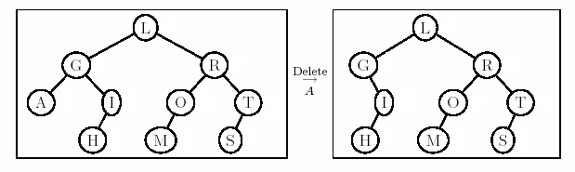
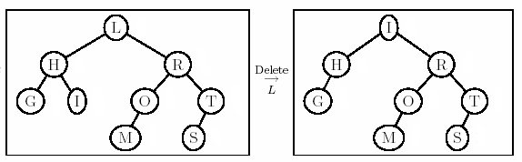
Deletion Example 2
Right most child of left subtree = I
Double rotation
Ok here!

Slide 80
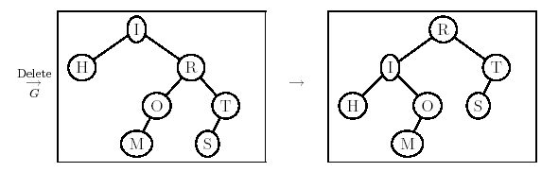
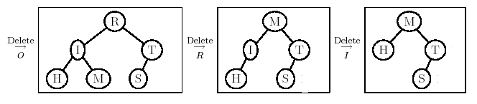
Example 2 Cont’d
New case

Slide 81
AVL Trees
(Adelson – Velskii – Landis)
AVL tree:
20
16
25
7
18
30
5
17
19

Slide 82
AVL Trees
Not AVL tree:
20
16
25
7
18
30
5
17
19
27

Slide 83
AVL Tree Rotations
Single rotations: insert 14, 15, 16, 13, 12, 11, 10
First insert 14 and 15:
14
15
Now insert 16.

Slide 84
AVL Tree Rotations
Single rotations:
Inserting 16 causes AVL violation:
14
15
16
Need to rotate.

Slide 85
AVL Tree Rotations
Single rotations:
Inserting 16 causes AVL violation:
14
15
16
Need to rotate.

Slide 86
AVL Tree Rotations
Single rotations:
Rotation type:
14
15
16

Slide 87
AVL Tree Rotations
Single rotations:
Rotation restores AVL balance:
15
14
16

Slide 88
AVL Tree Rotations
Single rotations:
Now insert 13 and 12:
15
14
16
13
12
AVL violation - need to rotate.

Slide 89
AVL Tree Rotations
Single rotations:
Rotation type:
15
14
16
13
12

Slide 90
AVL Tree Rotations
Single rotations:
15
13
16
12
14
Now insert 11.

Slide 91
AVL Tree Rotations
Single rotations:
15
13
16
12
14
11
AVL violation – need to rotate

Slide 92
AVL Tree Rotations
Single rotations:
Rotation type:
15
13
16
12
14
11

Slide 93
AVL Tree Rotations
Single rotations:
13
12
15
14
16
11
Now insert 10.

Slide 94
AVL Tree Rotations
Single rotations:
13
12
15
14
16
11
10
AVL violation – need to rotate

Slide 95
AVL Tree Rotations
Single rotations:
Rotation type:
13
12
15
14
16
11
10

Slide 96
AVL Tree Rotations
Single rotations:
13
11
15
10
12
14
16
AVL balance restored.

Slide 97
AVL Tree Rotations
Double rotations: insert 1, 2, 3, 4, 5, 7, 6, 9, 8
First insert 1 and 2:
13
11
15
10
12
14
16

Slide 98
AVL Tree Rotations
Double rotations:
AVL violation - rotate
13
11
15
14
16
10
12
1
2

Slide 99
AVL Tree Rotations
Double rotations:
Rotation type:
13
11
15
14
16
10
12
1
2

Slide 100
AVL Tree Rotations
Double rotations:
AVL balance restored:
13
11
15
2
12
14
16
1
10
Now insert 3.

Slide 101
AVL Tree Rotations
Double rotations:
AVL violation – rotate:
13
11
15
2
12
14
16
1
10
3

Slide 102
AVL Tree Rotations
Double rotations:
Rotation type:
13
11
15
2
12
14
16
1
10
3

Slide 103
AVL Tree Rotations
Double rotations:
AVL balance restored:
13
10
15
2
11
14
16
1
3
12
Now insert 4.

Slide 104
AVL Tree Rotations
Double rotations:
AVL violation - rotate
13
10
15
2
11
14
16
1
3
12
4

Slide 105
AVL Tree Rotations
Double rotations:
Rotation type:
13
10
15
2
11
14
16
1
3
12
4

Slide 106
AVL Tree Rotations
Double rotations:
10
2
13
1
3
11
15
4
12
14
16
Now insert 5.

Slide 107
AVL Tree Rotations
Double rotations:
10
2
13
1
3
11
15
4
12
14
16
5
AVL violation – rotate.

Slide 108
AVL Tree Rotations
Single rotations:
Rotation type:
10
2
13
1
3
11
15
4
12
14
16
5

Slide 109
AVL Tree Rotations
Single rotations:
AVL balance restored:
10
2
13
1
4
11
15
3
5
12
14
16
Now insert 7.

Slide 110
AVL Tree Rotations
Single rotations:
AVL violation – rotate.
10
2
13
1
4
11
15
3
5
12
14
16
7

Slide 111
AVL Tree Rotations
Single rotations:
Rotation type:
10
2
13
1
4
11
15
3
5
12
14
16
7

Slide 112
AVL Tree Rotations
Double rotations:
AVL balance restored.
10
4
13
2
5
11
15
7
12
14
16
1
3
Now insert 6.

Slide 113
AVL Tree Rotations
Double rotations:
AVL violation - rotate.
10
4
13
2
5
11
15
7
12
14
16
1
3
6

Slide 114
AVL Tree Rotations
Double rotations:
Rotation type:
10
4
13
2
5
11
15
7
12
14
16
1
3
6

Slide 115
AVL Tree Rotations
Double rotations:
AVL balance restored.
10
4
13
2
6
11
15
12
14
16
1
3
5
7
Now insert 9 and 8.

Slide 116
AVL Tree Rotations
Double rotations:
AVL violation - rotate.
10
4
13
2
6
11
15
12
14
16
1
3
5
7
9
8

Slide 117
AVL Tree Rotations
Double rotations:
Rotation type:
10
4
13
2
6
11
15
12
14
16
1
3
5
7
9
8

Slide 118
AVL Tree Rotations
Final tree:
Tree is almost perfectly balanced
10
4
13
2
6
11
15
12
14
16
1
3
5
8
7
9

Slide 119
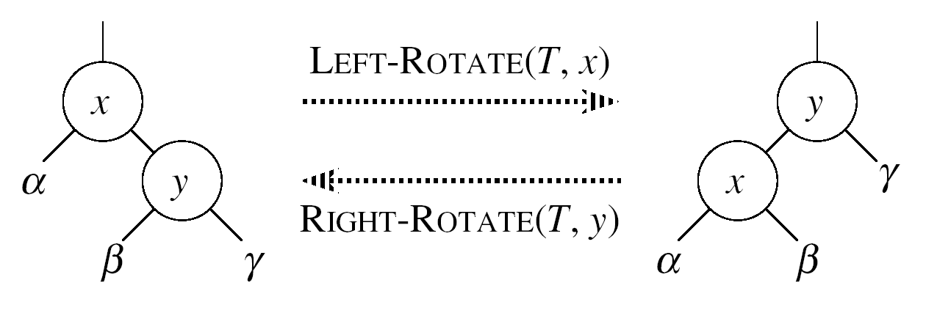
LEFT-ROTATE(T, x)
y ← right[x] ►Set y
right[x] ← left[y] ► y’s left subtree becomes x’s right subtree
if left[y] ≠ NIL
then p[left[y]] ← x ► Set the parent relation from left[y] to x
p[y] ← p[x] ► The parent of x becomes the parent of y
if p[x] = NIL
then root[T] ← y
else if x = left[p[x]]
then left[p[x]] ← y
else right[p[x]] ← y
left[y] ← x ► Put x on y’s left
p[x] ← y ► y becomes x’s parent

Slide 120
Example
Delete p.
m
p
e
c
j
n
s
d
h
k
r
u
b
o
a
g
i
l
t
f
CENG 213 Data Structures

