Slide 1
Description:
The rise of the 5G communication has led to the widespread use of the containerization technology Docker with K8s as the orchestration tools for efficient service deployment and execution with improved performance.
Major challenges
Orchestrator risk - Administrator access, unauthorized access, poorly Separated Inter-Container Network Traffic
Container risks - Insecure container runtime configurations, app vulnerabilities, and insider attacks.
Anomaly detection is the identification of rare events, items, or observations which are suspicious because they differ significantly from standard behaviors or patterns.
Network anomalies can be broadly classified into two categories:
Security problems: DoS attacks, network intrusions etc.
Network Performance problems: Network bandwidth congestion, web server failure etc.
Proposal:
We propose a solution, which aims to improve the overall container security with Kubernetes.
This solution is based on anomaly classification model using AI/ML technology to detect anomaly behavior of a container.
This model uses supervised learning. We use a dataset that contains normal and abnormal samples to build the model.

Slide 2
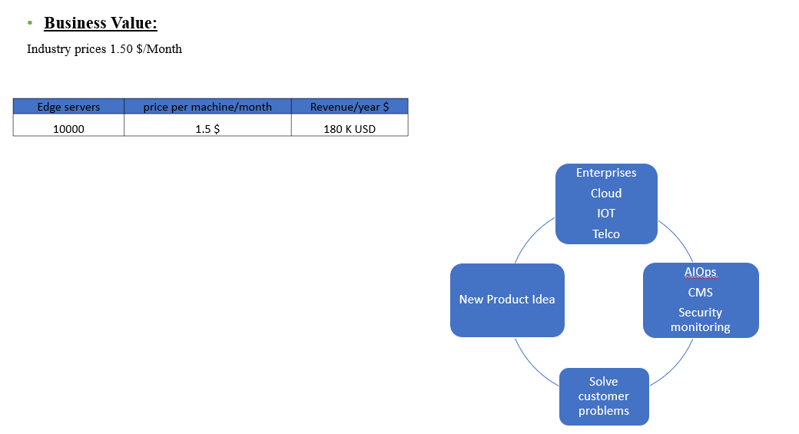

Slide 3
Overall Solution Architecture
GUI
Restful
API
Service
Analyzer
System has three major components
Web Portal: The web portal is used to inform users about the container status, and it refreshes the detection results every10 seconds.
Center: Collect the monitor logs from every agent service. It uses pretrained
anomaly classification model to detect whether a container shows anomaly
behavior.
Analyzer: It have two subcomponents.
Feature Extractor:
Parses the raw data sent by scheduler
Extract each container event and normalizing the logs.
Sends these features to a behavior detection component.
Behavior Detector:
Loads the anomaly classification model on features data received
Apply different AL/ML algorithm models and detect container behavior
Send result to scheduler “Normal” or “Abnormal”
Anomaly classification model: The anomaly classification model is used to detect abnormal container behavior using multiple classification models.
Scheduler: The scheduler is used to communicate with every other module in the system. The scheduler also saves these results in a database
Agent Service: The agent service is used to collect monitor logs from containers.(Sysdig and Falco)
Behavior Detector
Classification
Model
User
Management
User DB
Feature
Extractor
Scheduler
System Data DB
Agent Service
Container
Information Collector
Container
Behavior
Collector
Agent Service Handler
Log Collector
K8s

Slide 4
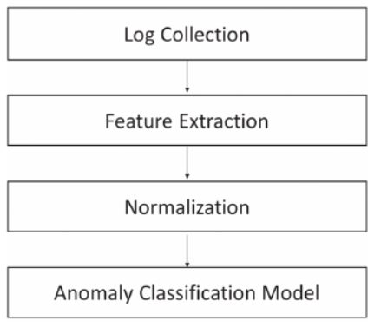
Implementation Concept
Build the different AI/ML model for Kubernetes Anomaly detection and evaluate their accuracy with real-world experimental data sets.
Feature extraction:
Receive raw data
Parse and transform them to get in desired format
Unsupervised PCA for feature selection
Normalization:
Data normalization has advantages for machine learning, such as fast convergence and improved accuracy
StandardScaler, MinMaxScaler, Normalizer provided by Sklearn.
Anomaly classification model construction:
Build the models using Keran with Tensor flow
Supervise machine learning models
System can have multiple classification models like linear SVM, RBF SVM, MLP, CNN

Slide 5
Implementation : Target event list for monitoring
Event name | Description | Type
Read | Container exhibits read behavior | System call
File_IO | Container contains file operation | System call
Write | Container exhibits write behavior | System call
Accept | Container accepts connection on a socket | System call
Network_Http | Container has http flow | System call
Clone | Container creates a new program | System call
Select | Container monitors socket, waiting for data | System call
Poll | Container waits for stream event | System call
Rename | Container exhibits rename behavior | System call
Chdir | Container changes the current process working directory | System call
Kill | Container sends a kill signal | System call
Postgresql | Container exhibits postgresql flow | System call
Mkdir | Container exhibits mkdir behavior | System call
Brk | Allocate a small amount of memory | System call
Mmap | Allocate memory | System call
Munmap | Free memory | System call
Bin | Container accesses file under bin directory | Root directory access
Home | Container accesses file under home directory | Root directory access
Etc | Container accesses file under etc directory | Root directory access
Boot | Container accesses file under boot directory | Root directory access
Dev | Container accesses file under dev directory | Root directory access
Host | Container accesses file under host directory | Root directory access
Media | Container accesses file under media directory | Root directory access
Mnt | Container accesses file under mnt directory | Root directory access
Opt | Container accesses file under opt directory | Root directory access
Proc | Container accesses file under proc directory | Root directory access
Root | Container accesses file under root directory | Root directory access
Run | Container accesses file under run directory | Root directory access
Srv | Container accesses file under srv directory | Root directory access
Usr | Container accesses file under usr directory | Root directory access
Var | Container accesses file under var directory | Root directory access

Slide 6
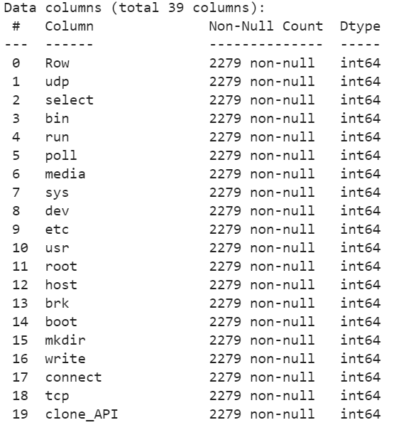
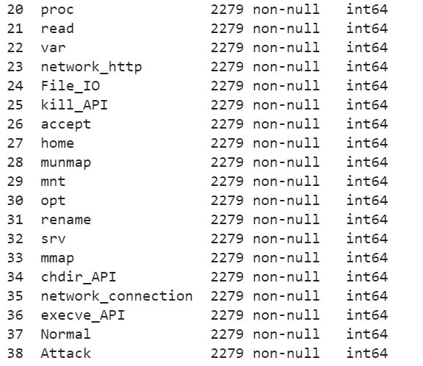
Implementation: Raw data

Slide 7
Demo Use Case
Sample Data set
Train test split (20, 80)
Feature engineering
Normalization
Model evaluation
Attack type | Sample type | # of samples
None | Normal | 2279
Web attack | SQL injection | 2520
Web attack and CVE attack | Command injection | 2880
 | Abnormal (total) | 5400
Machine learning algo | Precision % | Recall % | F1 % | ACC %
SVM linear | 99.54 | 99.54 | 99.54 | 99.67
MLP | 99.41 | 99.41 | 99.41 | 99.51
CNN | 99.47 | 99.47 | 99.47 | 99.62

Slide 8
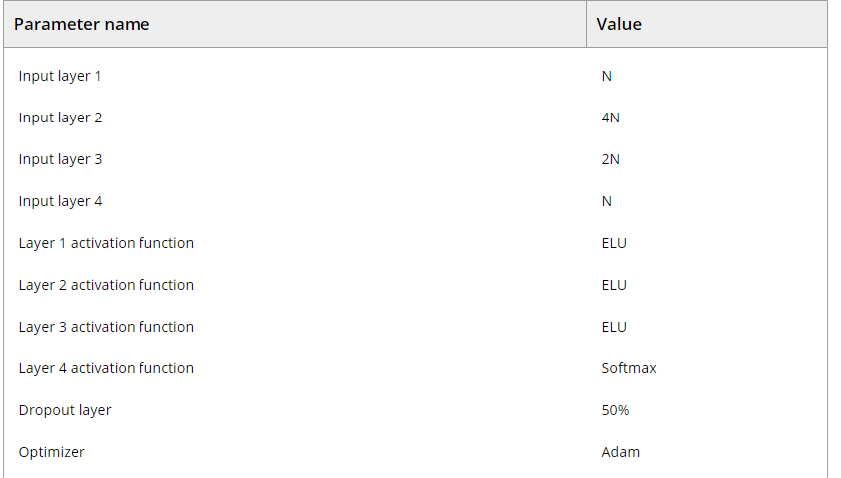
Implementation: Parameters of the anomaly classification model

Slide 9
Future Plan
Including live data set
Prepare setup with agent services, center and web portal
Create live web attack on web server
Future Product roadmap | Codethon | Activities | Estimation (person days) | Total
 | Real time data set | Setup of K8s cluster | 2 | 37
 |  | Angent service (sysdig and falco ) setup | 7
 |  | Webserver setup with hacking attack | 5
 |  | Raw data clearing | 5
 |  | Feature extraction | 5
 |  | Normalization | 3
 |  | Apply different models | 7
 |  | Model evaluations | 3
Futher Enchancement for product devlopment
Phase 2: | Future Enhancements | Analysis | 7 | 54
Only with product development
 |  | Mlops pipiline | 15
 |  | Scheduler | 15
 |  | Rest api suport | 7
 |  | Web portal | 10

Slide 10
Thanks

