Slide 1

Deep Learning Foundation Project
Advertisement success Dataset
Kapil Gupta
22-May

Slide 2

Objective
The objective of this project to use the neural networking MLP algorithm and improve the model performance by hyperparameter tuning using different mechanism.
We used below technology stacks
Google Colab
EDA
Tensorflow & Keras
Imbalancing handling using Class_weight and SMOTE
Regularization: Dropout and callbacks=EarlyStopping, Checkpoint
Keras tuner with HyperModel, RandomSearch, Hyperband, BayesianOptimization.

Slide 3
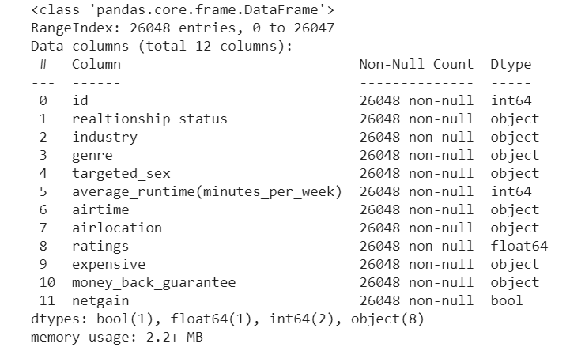
Dataset description
Here Target Variable is netgain (Binary classification)

Slide 4
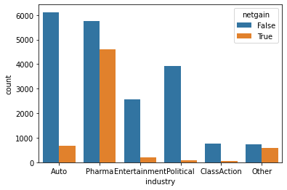
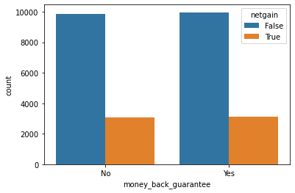
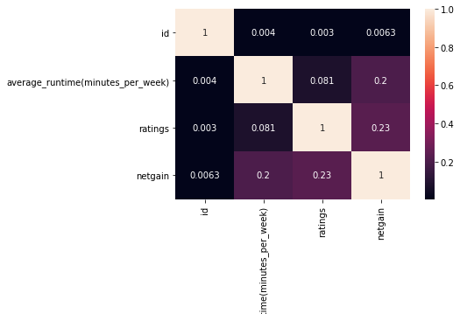
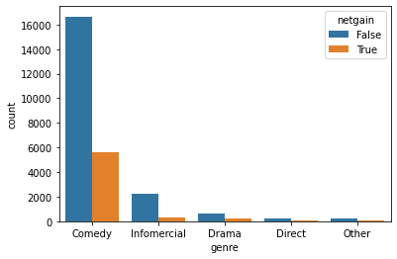
EDA
Pharma industry have higher netgain
ClassAction, Political, Entertainment low netgain
Most of the ads have genre as Comedy, so its obvious that the netgain will be higher for this genre
Money_back_guarantee does not make much difference
Netgain is more corelated with rating.

Slide 5
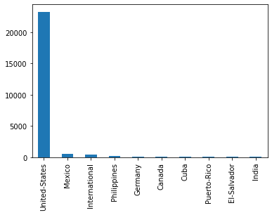
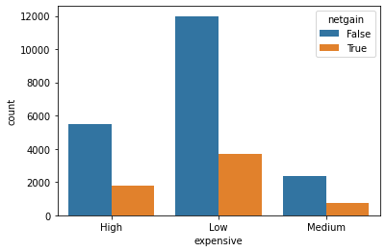
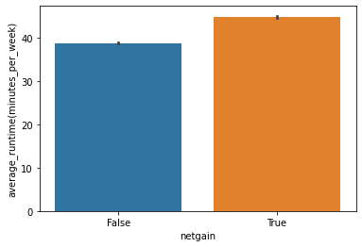
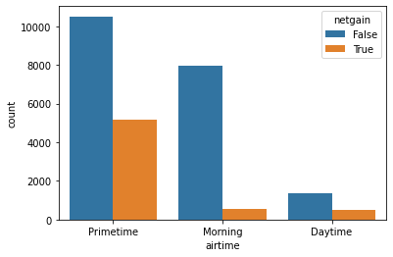
EDA cont..
average_runtime increases the little more netgain
As you can see the ads which are shown on primetime have more netgain
United States have higher no. ads shown (90%)
the ads which are showing are showing low expense are the one where ppl are more attracted and profitable. (60 %)

Slide 6
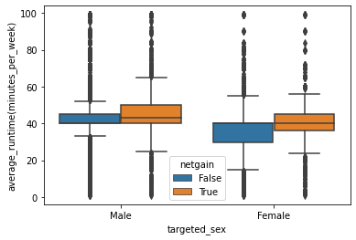
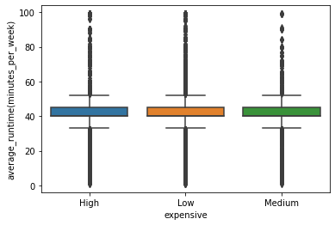
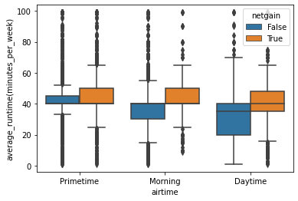
EDA cont..
males like more adds where the average time 40 minutes(average run time per week)
females like adds them in same range 38-42 minutes (average run time per week)
primetime shows have higher average runtime
the ads which got netgain have higher running time
all expense type of ads have same distribution of average runtime

Slide 7
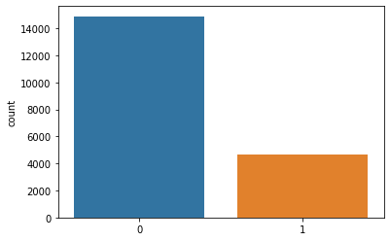
Identify class Imbalancing in Target Variable “Netgain”

Slide 8
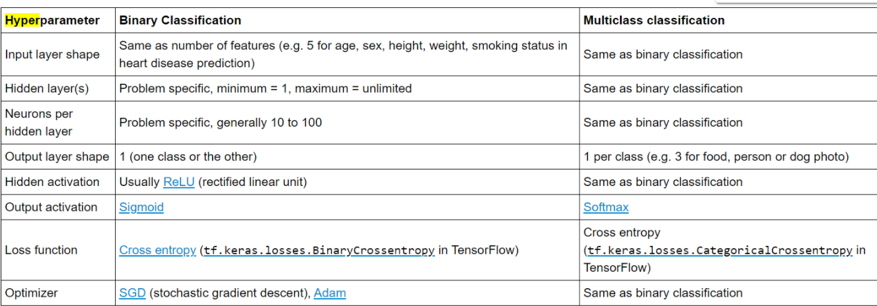
Neural networking Hyperparameter for Binary classification
Base model
model1 = keras.models.Sequential()
model1.add(keras.layers.Flatten(input_shape=(X_train_full.shape[1],)))
model1.add(keras.layers.Dense(30, activation="relu"))
model1.add(keras.layers.Dropout(rate=0.5))
model1.add(keras.layers.Dense(20, activation="relu")) # hidden layer with Relu as activation
model1.add(keras.layers.Dropout(rate=0.3))
model1.add(keras.layers.Dense(1, activation="sigmoid")) #output shape is 1, sigmoid is activation function in output layer

Slide 9
Handle imbalance data.
Method 1: Class_weight
Method : SMOTE oversampling

Slide 10
Model performance tuning
RandomizedSearchCV
Keras tuner with HyperModel, RandomSearch, Hyperband, BayesianOptimization

Slide 11
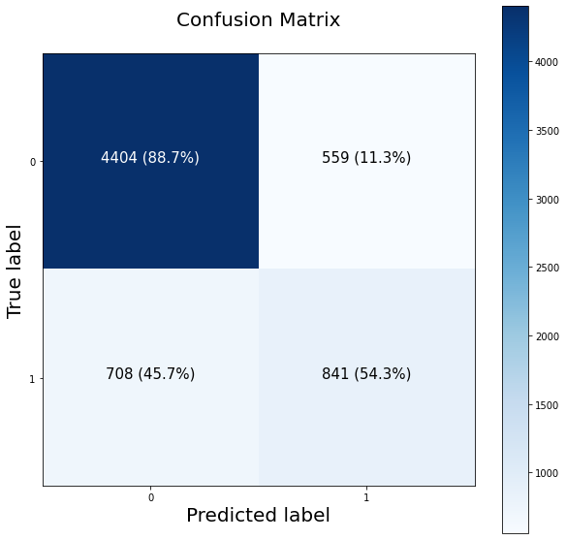
Confusion Matrix

Slide 12
Conclusion
False +Ve and False –Ve are not minimizing further
Need to use ML algorithm like Decision tree, Random forest or XGBoost
We can also try with CNN algorithm

