Slide 1
AWSome Mavericks Team Members: Jitesh, Sagar, Mukesh, Kapil, Abhijeet, Rajashree and Madhura
Presents
KILL-BILL
Mobile & Web Application Tech9 Hackathon

Slide 2

AWS Billing
Why so much... Where can I see the details easily?
How can I KILL the BILL

Slide 3

Problem Statement
No FREE app or service (Amazon Quicksight is paid service) available to view the bill dashboard with nitty-gritty details of each service and its individual component.
You can see the bill region wise, but can you see the bill component wise? Which bucket of S3 is getting highest request?
You can see the usage but can you control it there itself without navigating to each service, individually?
You can take action on the services, but can you do that without navigating away from the billing section?
Kill bill mobile/web app helps you to
address this all at one place.

Slide 4

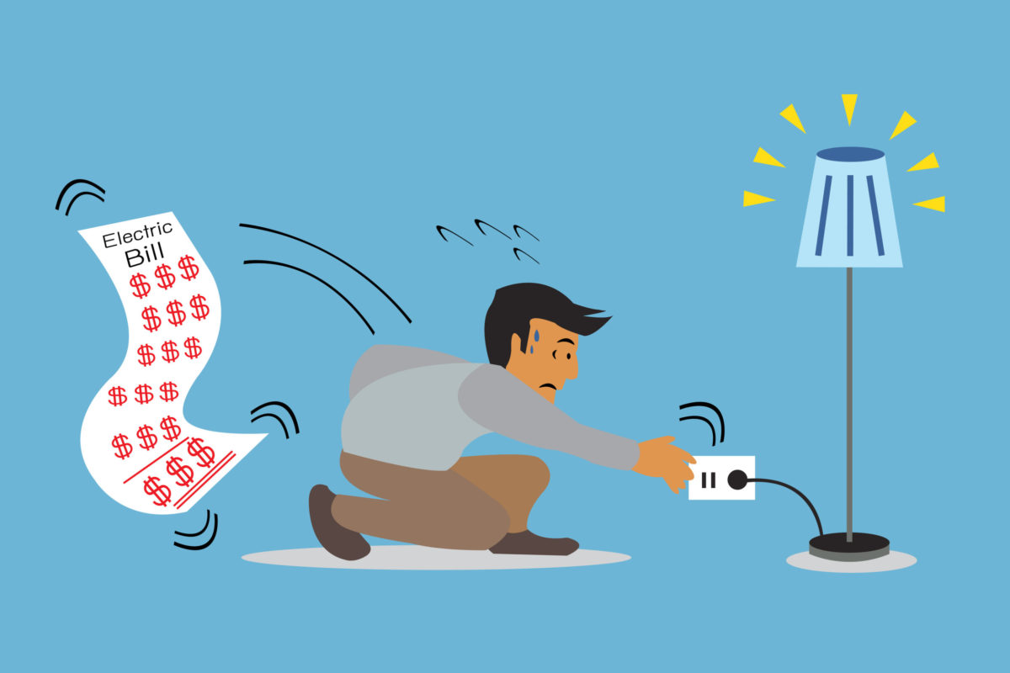
Solutions - Till Yesterday...
Call the AWS customer care and understand the bill details
Go to each services and its components to take appropriate action.

Slide 5


Solutions - Available Today...
Come to AWSome Mavericks
And Kill your AWS Bills… Here we will hold your hand and walk you through the services which are burning a hole in your pocket.

Slide 6
Technical Solution
“Kill enemy with their own weapon”
A single-point source to see nitty-gritty details about your bill at a single place.
A single place to take action on Services based on usage bills.
We are leveraging AWS APIs and Serverless architecture to fetch all those details and present it at a single place.
We are leveraging AWS API to take appropriate action on services with high bills.
A single dashboard
To VIEW your account’s complete bill, monthly bill, daily bill etc.
To VIEW Top services who are adding more to your bill as compared to others.
To VIEW components of a particular service which is consuming more.
To VIEW Graphical representation of the bills based on a particular time frame.
To ACT there itself in case you see bill is more than expected.
Notify the user there itself in case you need to.

Slide 7
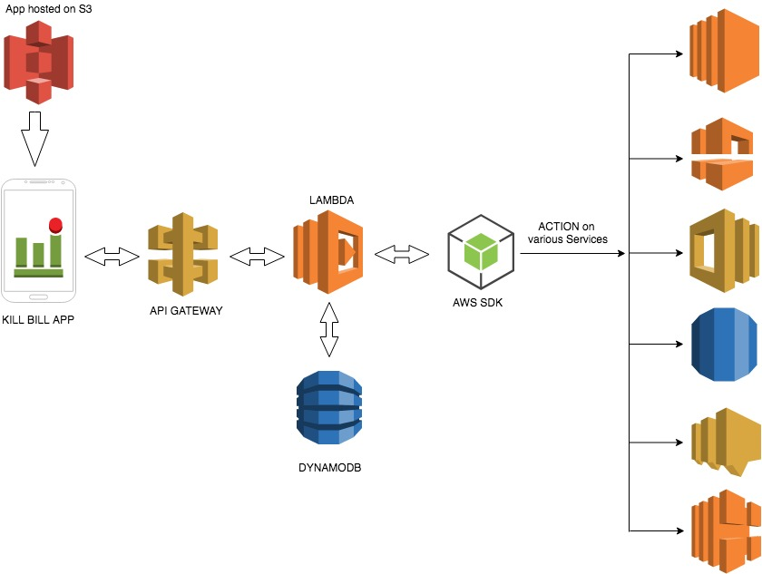
Architecture Diagram
Elastic Cloud Compute
VPC
SWF
RDS
SNS
ELB

Slide 8
Demo

Slide 9
Future features
Set once and forget settings
Configure your application to set the monthly billing limit. Once the limit reached you will be notified through email / push notification.
You may configure some services to shutdown automatically once the limit is reached.
Track your bill using cost allocation tags.
A tag is a label that you or AWS assigns to an AWS resource. It helps you to track your AWS costs on a detailed level.
Activate AWS generated tags ‘createdBy’ before creating these resources. This ‘createdBy’ tag tracks who created a resource. It will help you to have user / department wise bill tracking.
Control your other services like Elastic beanstalk & Elastic load balancing.
Elastic Beanstalk is designed to ensure that all the resources that you need are running, which means that it automatically relaunches any services that you stop.
ELB load balancers are designed to keep a minimum number of Amazon Elastic Compute Cloud (Amazon EC2) instances running.
Send email and push notification once you take any action on any service through KillBill app.

Slide 10

Questions

Slide 11

Do contact us if you want to Kill you AWS bill… :-)

