Slide 1
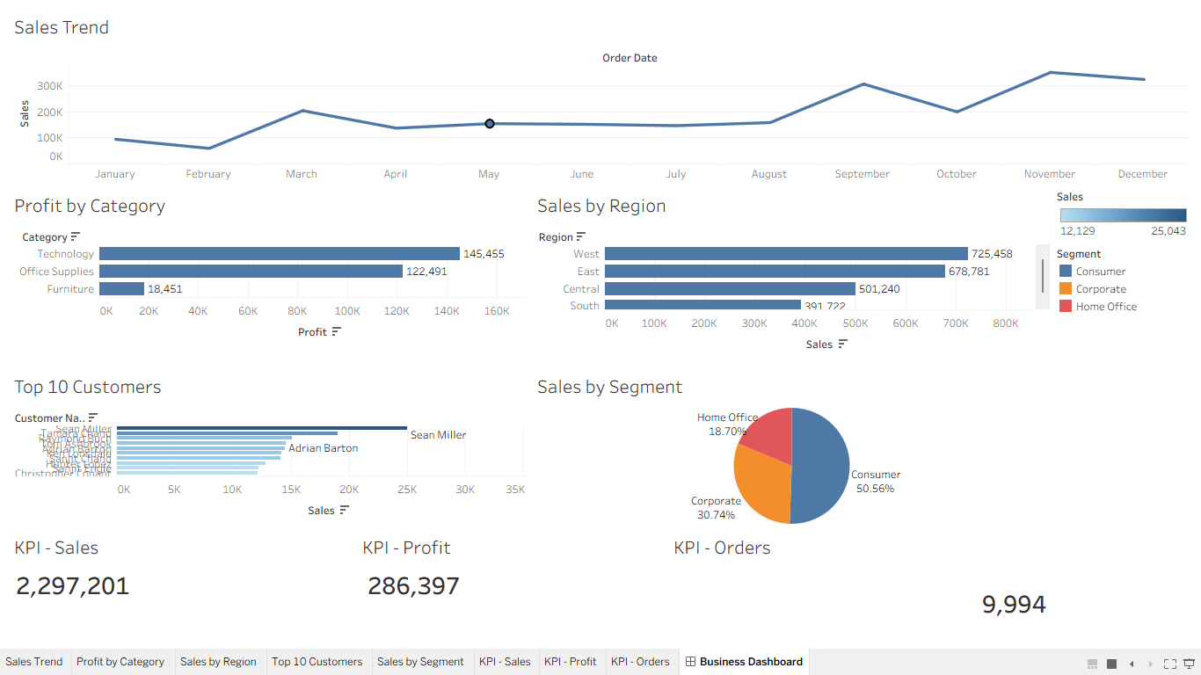
Task 4: Business Performance Dashboard
Prepared by: Kapil Kalirana
Internship: Elevate Labs
Tool: Tableau Public

Slide 2
Objective
Design an interactive dashboard for business stakeholders using Tableau.
The dashboard enables analysis of sales, profit, customers and regional performance through interactive charts, KPI cards and filters.

Slide 3
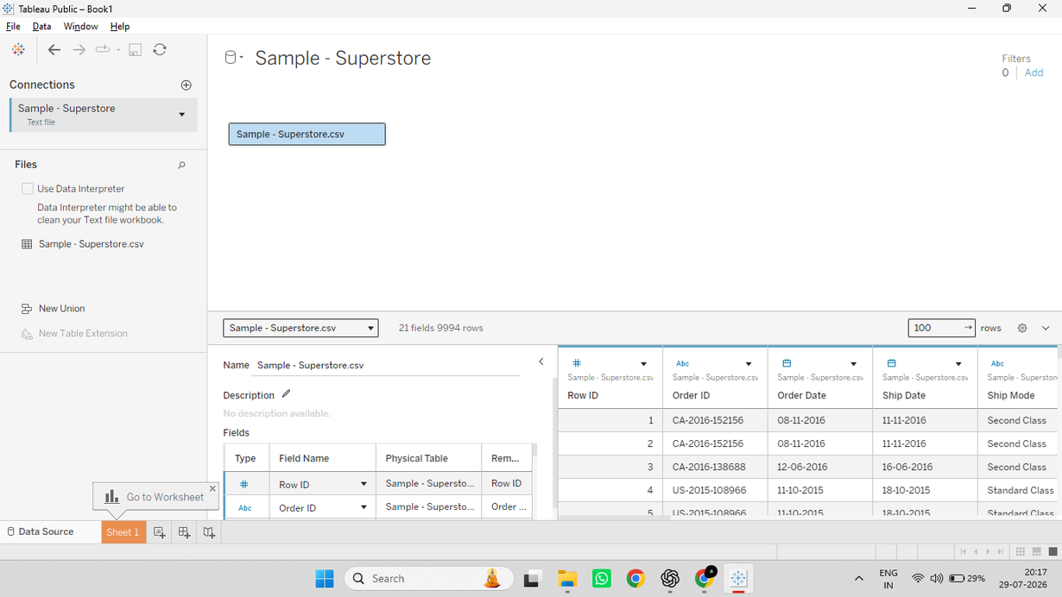
Dataset
Dataset: Sample Superstore.csv
Rows: 9,994
Columns: 21
Key fields:
• Order Date
• Sales
• Profit
• Category
• Region
• Segment
• Customer Name

Slide 4
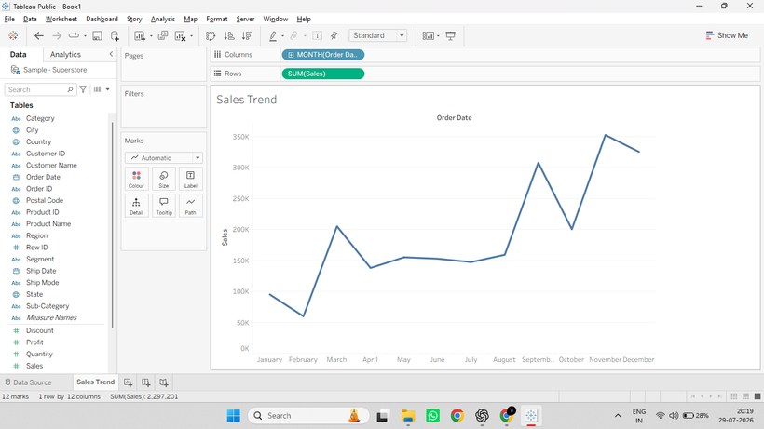
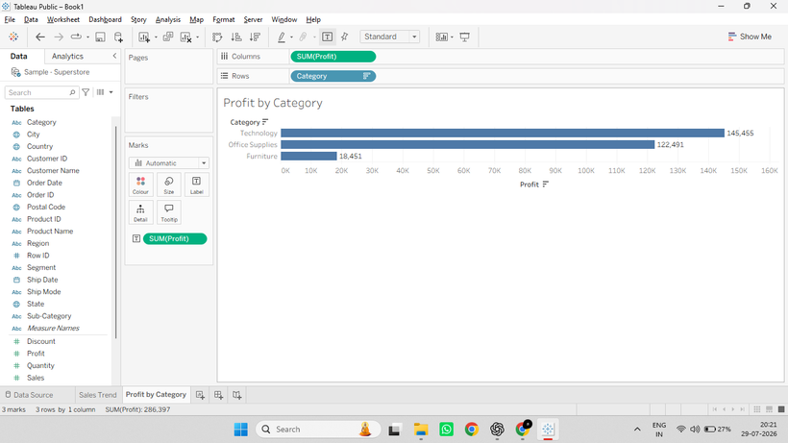
Dashboard Components
The dashboard contains:
• Sales Trend
• Profit by Category
• Sales by Region
• Top 10 Customers
• Sales by Segment
• KPI Cards
• Interactive Filters

Slide 5
Final Interactive Dashboard
The completed dashboard provides a consolidated business view with interactive filters for Region, Category and Segment.

Slide 6
Key Insights
• Sales are higher towards the end of the year.
• West region recorded the highest sales.
• Technology is the most profitable category.
• Consumer segment contributes the largest share of sales.
• KPI cards summarise Total Sales, Profit and Orders.

Slide 7
Conclusion
An interactive Tableau dashboard was successfully developed using the Sample Superstore dataset.
The dashboard combines charts, KPI cards and filters to support business analysis and decision-making.

