Slide 1

Basic Calculator using Python Tkinter
Developed By: Kapil Patil
Python GUI Project

Slide 2
Project Introduction
GUI-based Calculator Application
Developed using the Python programming language
Built using the Tkinter library
Modern dark theme interface

Slide 3
Project Objectives
Understand GUI development in Python
Implement arithmetic operations
Apply event-driven programming
Enhance problem-solving skills

Slide 4
Features of basic Calculator
Addition, Subtraction, Multiplication, Division
Square Root (√)
Square (x²)
Backspace and Clear Function
Calculation History Panel
Keyboard Support
Error Handling using try-except

Slide 5
Technologies Used
Python
Tkinter Library
Visual Studio Code
GitHub

Slide 6
Code Structure
Global variables for expression handling
Functions for mathematical operations
Event binding for keyboard input
Button grid layout system
Exception handling mechanism

Slide 7
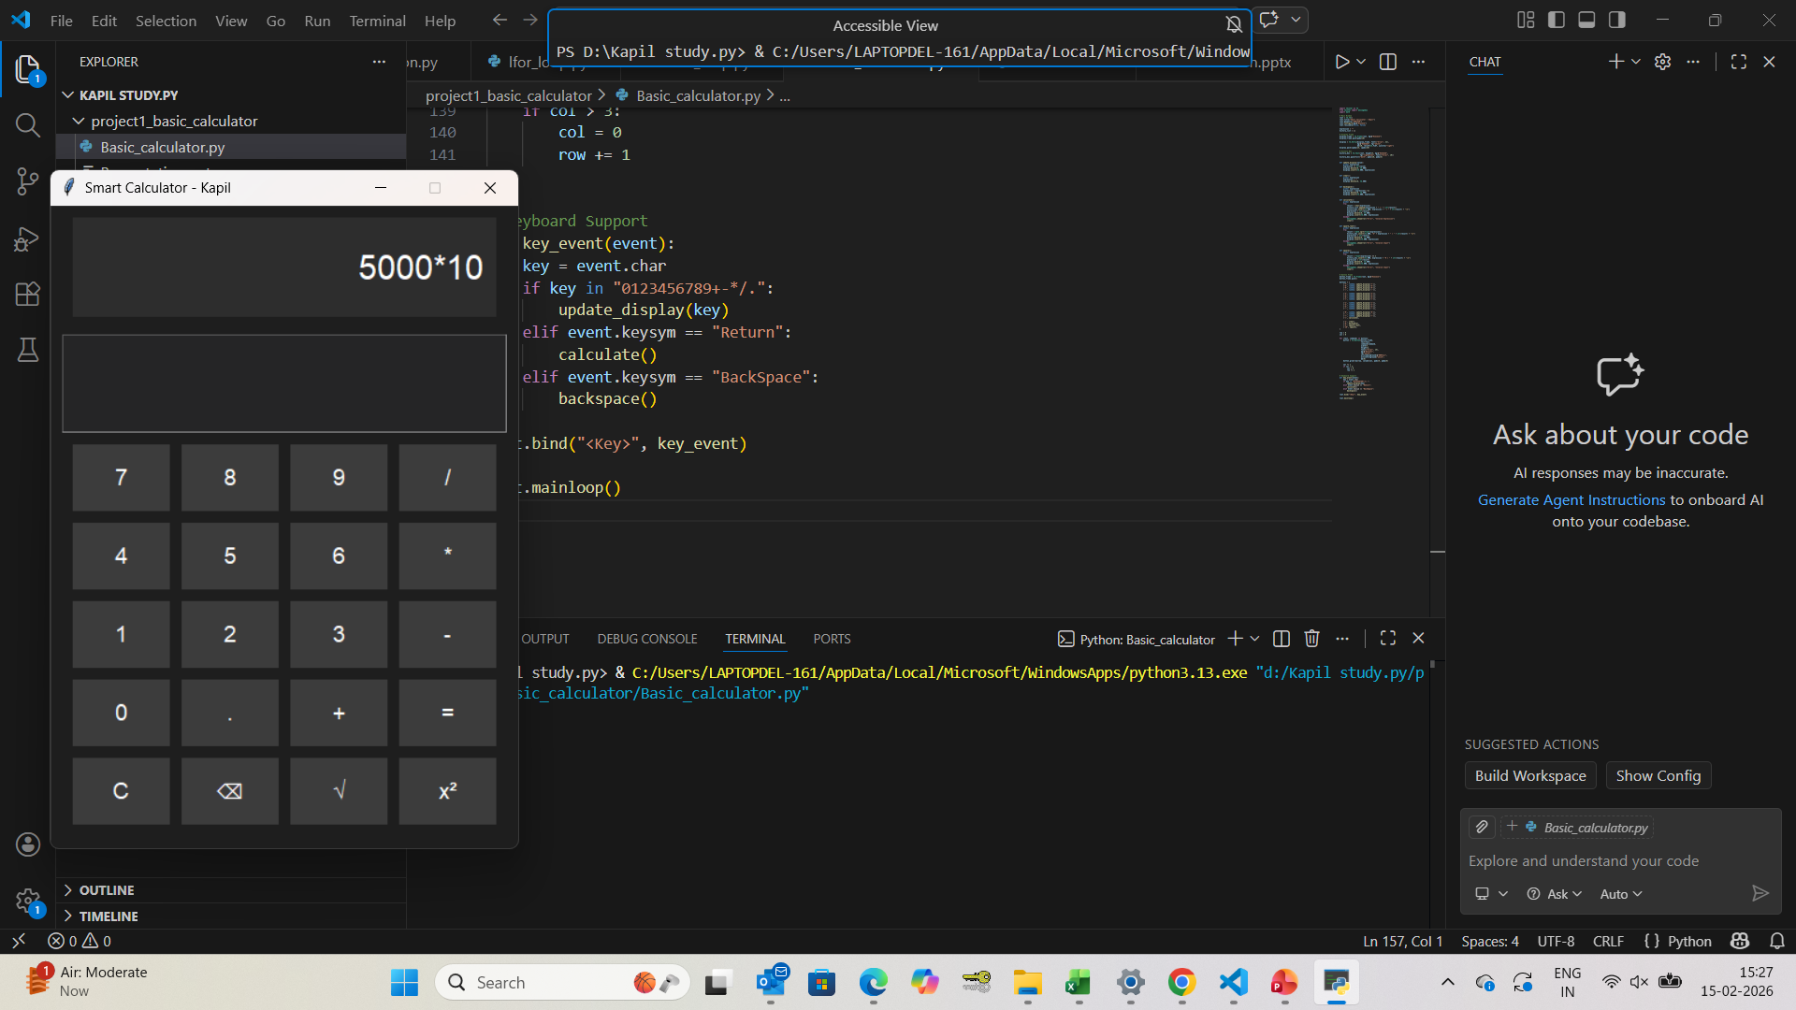
Basic calculator

Slide 8
Learning Outcomes
Strong understanding of Python basics
GUI application development skills
Event-driven programming concept
Error handling implementation
Improved logical thinking

Slide 9
Conclusion
Successfully developed a Basic Calculator
Improved Python GUI skills
Practical application development experience
Foundation for advanced projects

Slide 10
Conclusion
Successfully developed a Smart Calculator
Improved Python GUI skills
Practical application development experience
Foundation for advanced projects

