Slide 1

UNIT # 01:
PRINCIPLES OF PROGRAMMING LANGUAGES
SIRT Bhopal

Slide 2
The Study of Programming Languages
The purpose of language is simply that it must convey meaning. (Confucius)
That which can be said, can be said clearly. (Wittgenstein,1963)
A program is a specification of a computation. A programming language is a notation for writing programs.(Sethi,89)
SIRT Bhopal

Slide 3
What is a programming language?
A language that is intended for the expression of computer programs and that is capable of expressing any computer program.
SIRT Bhopal

Slide 4
How are programming languages different?
According to our definition they are all theoretically equally powerful.
But not equally easy to use!
Theoretical power <> Practical power
SIRT Bhopal

Slide 5
Why study programming languages?
Programming languages are important for students in all disciplines of computer science because they are the primary tools of the central activity of computer science : programming.
There is an idea: the structure of language defines the boundaries of thought.
SIRT Bhopal

Slide 6
Why study programming languages? (cont.)
To improve your ability to develop effective algorithms and to improve your use of your existing programming language.
  O-O features, recursion
  Call by value, call by reference
To increase your vocabulary of useful programming constructs.
To allow a better choice of programming languages.
To make it easier to learn a new language.
To make it easier to design a new language.
SIRT Bhopal

Slide 7
A short history of programming Languages
1950 : LISP (LISt of Processing), FORTRAN
1970 : Ada (Automatic Data Acquisition), C, Pascal, Prolog, Smalltalk
1980 : C++, ML (Meta Language)
During 1970 : a lot of PLs were designed.
Early languages:
  Numerically based languages. (FORTRAN:55,ALGOL:58)
  Business languages. (COBOL(Common Bussiness Oriented Language):60)
  Artificial intelligence languages. (LISP,Prolog)
  Systems languages. ( C:70)
SIRT Bhopal

Slide 8
A short history of programming languages (cont.)
50s and 60s :
  Early high level languages : FORTRAN, COBOL, ALGOL60
  Early mathematical based languages : LISP, APL, SNOBOL
  General-purpose language : PL/1
  Next leap forward: Algol68, SIMULA67, BASIC
70s:
  High level and structured programming: Pascal
  Systems programming: C, modula-2
  Logical programming: Prolog
  Improvement of functional programming: Scheme
SIRT Bhopal

Slide 9
A short history of programming languages (cont.)
80s:
  Development of functional programming: ML, Miranda
  Need for reliability and maintainability: Ada
  Object-oriented programming: Smalltalk, C++
90s:
  Fourth-generation languages
  Productivity tools (such as spreadsheets)
  Visual languages : Delphi
  Scripting languages : Perl
  Expert systems shells
  Network computing : Java
SIRT Bhopal

Slide 10
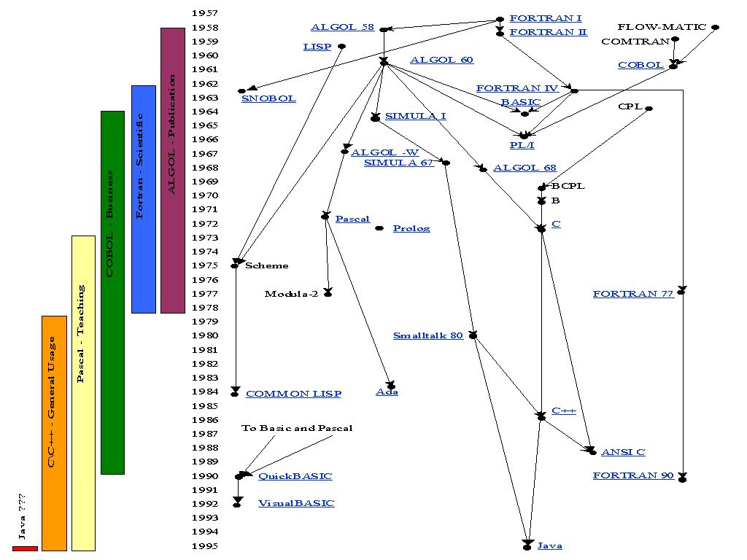
A short history of programming languages (cont.)
SIRT Bhopal

Slide 11
Influences on programming languages
Computer capabilities
  Hardware and OS
Applications
  Wide area of applications
Programming methods
  Multiprogramming, interactive systems, data abstraction, formal semantics,O-O programming,…
Implementation methods
Theoretical studies
Standardization
SIRT Bhopal

Slide 12
Attributes of a good language
Clarity, simplicity, and unity
  Have a minimum number of different concepts, with the rules for their combination, simple and regular (conceptual integrity).
  readability
Orthogonality
  Being able to combine various features of a language in all possible combinations.
Naturalness for the application
Support for abstraction
SIRT Bhopal

Slide 13
Attributes of a good language
Ease of program verification
  Proof of correctness, desk checking, test
  Simplicity of semantic and syntax
Programming environment
Portability of programs
Cost of use
  Program execution
  Program translation
  Program creation, testing, and use
  Program maintenance
SIRT Bhopal

Slide 14
Attributes of a good language (another view: to make a software reliable, maintainable, efficient)
Reliability
  Writability
  Readability
  Simplicity
  Safety (no goto, no pointers)
  Robustness (undesired events can be trapped, like arithmetic overflow, invalid inputs)
Maintainability
  Factoring (modularity)
  Locality
Efficiency
SIRT Bhopal

Slide 15
Language Evaluation Criteria
Readability – easily understood?
Writability – easy to write?
Simplicity, orthogonality
High expressive power, flexibility
Reliability
Safety
Cost (influenced by above)
  Creation
  Execution
  Maintenance
SIRT Bhopal

Slide 16
Cost of Software
Total cost - due to many language factors:
  Training programmers (time)
  Developing software and environment (ease of use, time)
  Compiling programs (time, space)
  Executing programs (time, space)
  Language implementation system (interpreter, compiler)
  Reliability (failures per time unit)
  Maintenance (time to fix bugs, keep current with new hardware/software)
  Extensibility/need for modification (ease, time)
SIRT Bhopal

Slide 17
Costs over the Software Lifecycle
(Generic model)
Requirements
Specifications
Design
Module coding
Module testing
Module Integration
Maintenance
Retirement
SIRT Bhopal

Slide 18
Relative Cost of Each Phase of Software Development
Maintenance constitutes 67% of total cost From: Software Engineering
Module
Testing
7%
Integration
8%
Module
coding
5%
Desine
6%
Specification
(analysis)
5%
Requirements
2%
Maintenance
67%
SIRT Bhopal

Slide 19
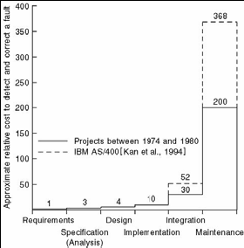
Cost to Fix a Fault vs. Development Phase
SIRT Bhopal

Slide 20
Readability
Code easy/fast - to read and understand
Language factors that affect readability
  Overall language simplicity
  Orthogonality
  Control statements built-in
  Data types & structures built-in
  Syntax considerations – closeness to natural language and/or mathematics
SIRT Bhopal

Slide 21
Writability – Ease of Writing Programs
Ease/speed - to create programs solving problems in a specific problem domain
Language factors that affect writability
  Simplicity and orthogonality
  Support for abstraction
  Expressive power
  Development/Computer Aided Software Engineering (CASE) environments
Cryptic vs. wordy syntax
SIRT Bhopal

Slide 22
Simplicity Improves Read/Writability
A large language takes more time to learn
  Programmers might learn only a subset
Feature multiplicity (having more than one way to perform a particular operation) is often confusing
  For example, in C++ or Java you can decrement a variable in four different ways: x = x – 1; x -= 1; x--; --x
Operator overloading (a single operator symbol has more than one meaning) can lead to confusion
Some languages (e.g. assembly languages), can be "too simple" – too low level. 2, 3, 4, 5 or more statements needed to have the effect of 1 statement in a high-level language
SIRT Bhopal

Slide 23
Orthogonality
In geometry, orthogonal means "involving right angles"
In general use, it means being independent, non-redundant, non-overlapping, or not related
In computer languages, it means a construct can be used without consideration as to how its use will affect something else
A programming language is considered orthogonal if its features can be used without thinking about how their use will affect other features, e.g. objects and arrays
SIRT Bhopal

Slide 24
Orthogonality Improves Read/Writability
Having fewer constructs and having few exceptions increases readability and writability
Orthogonal languages are easier to learn
Examples:
  Pointers should be able to point to any type of variable or data structure
    Exceptions (e.g. in C) are due to a lack of orthogonality
  ADD op1 op2 􀃆 op1 vs.:
  ADDR Reg1 Reg2 􀃆 Reg1 and
  ADDRM Reg1 MemA 􀃆 Reg1
  A different ADD operation depending on operand location in memory!
However, if a language is too orthogonal, an inexperienced programmer might assume they can do something that makes no sense,
  e.g. add two pointers together
SIRT Bhopal

Slide 25
Structured Control Improves Read/Writability
goto statements were replaced by structured programming in the 1970s
Can be read from top to bottom
  Most languages now contain sufficient control statements making goto’s unnecessary
The following are equivalent
  if (x < y) x++; if (x < y) goto L1;
  else y++; y++;
  goto L2;
  L1: x++;
  L2:
SIRT Bhopal

Slide 26
Concise Data Structures/Types
Improve Read/Writability
Adequate data types and data structures also aid readability
A language with Boolean types is easier to read than one without
  indicatorFlag = 0
  is more difficult to read than
  indicatorFlag = false
SIRT Bhopal

Slide 27
Syntax and Read/Write-ability
Syntax - the way linguistic elements (e.g. words) are put together to form phrases or clauses/sentences
Identifier forms
  If too short, reduces readability
Special word use
  Ada has end if and end loop, while Java uses } for both
  In Fortran 95, Do and End can also be variable names
Form and meaning
  In C, static changes meaning depending on position
SIRT Bhopal

Slide 28
Abstraction
The ability to define and then use complex structures or operations
  Allows details to be ignored
  Allows code to be re-used instead of repeated
  Example: A binary tree in Fortran 77 required arrays, while in OO languages, nodes with pointers may be used
Abstract data types
  implementation details are separated from the interface, allowing them to be changed without re-writing all code
Objects
Subprograms
SIRT Bhopal

Slide 29
Abstraction Increases Expressivity
Expressive language - has powerful built-in primitives for high-level abstractions
For example, in Lisp
  Pointer manipulation is implicit – avoid mistakes
  Mapcar – apply a function to every element of a list (and return the corresponding results in a list)
    No need to write the iteration yourself – you would need to write a different function for each different type of data
Infinite precision integers and rational numbers
  No need to develop functions yourself
  Completely avoid round-off errors at will
    E.g. 2/3 + 1/3 = 1, not .999999
SIRT Bhopal

Slide 30
Reliability
A reliable program performs to its specifications under all conditions
Factors that affect reliability
  Type checking
  Exception handling
  Aliasing
  Readability and writability
  Environmental factors – real-time or safety-critical application?
SIRT Bhopal

Slide 31
Type Checking and Exception Handling
Improve Reliability
Type checking
  Testing for type errors in a given program
    For example, if a function is expecting an integer receives a float instead
Exception handling
  Used in Ada, C++, Lisp and Java, but not in C and Fortran
    E.g. the try and catch blocks of C++ can catch runtime errors, fix the problem, and then continue the program without an “abnormal end”
SIRT Bhopal

Slide 32
Aliasing Reduces Readability and Reliability
Aliasing
  Referencing the same memory cell with more than one name
    E.g., in C, both x and y can be used to refer to the same memory cell
    int x = 5;
    int *y = &x;
  Leads to errors
Reliability increases with better read/writability
  If a program is difficult to read or write, its easier to make mistakes and more difficult to find them
SIRT Bhopal

Slide 33
Language Design Trade-offs
Reliability and cost – costs more to ensure greater reliability
  Example – type checking
    In C, the index ranges of arrays are not checked
    So executes fast, but it not so reliable
    On the other hand, Java checks all references to array elements
    Java executes slower, but is more reliable
SIRT Bhopal

Slide 34
Programming Domains
Scientific applications
  Large number of floating point computations
  Fortran
Business applications
  Produce reports, use decimal numbers and characters
  COBOL
Artificial intelligence
  Symbols rather than numbers manipulated
  LISP
Systems programming
  Need efficiency because of continuous use
  C
Web Software
  Eclectic collection of languages: markup (e.g., XHTML), scripting (e.g., PHP), general-purpose (e.g., Java)
SIRT Bhopal

Slide 35
Influences on Language Design
Computer Architecture
  Languages are developed around the prevalent computer architecture, known as the von Neumann architecture
Programming Methodologies
  New software development methodologies (e.g., object-oriented software development) led to new programming paradigms and by extension, new programming languages
SIRT Bhopal

Slide 36
Language Categories
Imperative
  Central features are variables, assignment statements, and iteration
  Examples: C, Pascal
Functional
  Main means of making computations is by applying functions to given parameters
  Examples: LISP, Scheme
Logic
  Rule-based (rules are specified in no particular order)
  Example: Prolog
Object-oriented
  Data abstraction, inheritance, late binding
  Examples: Java, C++
Markup
  New; not a programming per se, but used to specify the layout of information in Web documents
  Examples: XHTML, XML
SIRT Bhopal

Slide 37
Computer Architecture Influence
Well-known computer architecture: Von Neumann
Imperative languages, most dominant, because of von Neumann computers
  Data and programs stored in memory
  Memory is separate from CPU
  Instructions and data are piped from memory to CPU
  Basis for imperative languages
    Variables model memory cells
    Assignment statements model piping
    Iteration is efficient
SIRT Bhopal

Slide 38

The Von-Neumann Architecture
SIRT Bhopal

Slide 39
Programming Methodologies Influences
1950s and early 1960s: Simple applications; worry about machine efficiency
Late 1960s: People efficiency became important; readability, better control structures
  structured programming
  top-down design and step-wise refinement
Late 1970s: Process-oriented to data-oriented
  data abstraction
Middle 1980s: Object-oriented programming
  Data abstraction + inheritance + polymorphism
SIRT Bhopal

Slide 40
Implementation Methods
Compilation
  Programs are translated into machine language
Pure Interpretation
  Programs are interpreted by another program known as an interpreter
Hybrid Implementation Systems
  A compromise between compilers and pure interpreters
SIRT Bhopal

Slide 41

Layered View of Computer
The operating system and language implementation are layered over
Machine interface of a computer
SIRT Bhopal

Slide 42
Compilation
Translate high-level program (source language) into machine code (machine language)
Slow translation, fast execution
Compilation process has several phases:
  lexical analysis: converts characters in the source program into lexical units
  syntax analysis: transforms lexical units into parse trees which represent the syntactic structure of program
  Semantics analysis: generate intermediate code
  code generation: machine code is generated
SIRT Bhopal

Slide 43

The Compilation Process
SIRT Bhopal

Slide 44
Additional Compilation Terminologies
Load module (executable image): the user and system code together
Linking and loading: the process of collecting system program and linking them to user program
SIRT Bhopal

Slide 45
Execution of Machine Code
Fetch-execute-cycle (on a von Neumann architecture)
  initialize the program counter
  repeat forever
  fetch the instruction pointed by the counter
  increment the counter
  decode the instruction
  execute the instruction
  end repeat
SIRT Bhopal

Slide 46
Von-Neumann Bottleneck
A bottleneck is a phenomenon where the performance or capacity of an entire system is limited by a single or limited number of components or resources
Connection speed between a computer’s memory and its processor determines the speed of a computer
Program instructions often can be executed a lot faster than the above connection speed; the connection speed thus results in a bottleneck
Known as von Neumann bottleneck; it is the primary limiting factor in the speed of computers
SIRT Bhopal

Slide 47
Pure Interpretation
No translation
Easier implementation of programs (run-time errors can easily and immediately displayed)
Slower execution (10 to 100 times slower than compiled programs)
Often requires more space
Becoming rare on high-level languages
Significant comeback with some Web scripting languages (e.g., JavaScript)
SIRT Bhopal

Slide 48

Pure Interpretation Process
SIRT Bhopal

Slide 49
Hybrid Implementation Systems
A compromise between compilers and pure interpreters
A high-level language program is translated to an intermediate language that allows easy interpretation
Faster than pure interpretation
Examples
  Perl programs are partially compiled to detect errors before interpretation
  Initial implementations of Java were hybrid; the intermediate form, byte code, provides portability to any machine that has a byte code interpreter and a run-time system (together, these are called Java Virtual Machine)
SIRT Bhopal

Slide 50

Hybrid Implementation Process
SIRT Bhopal

Slide 51
Just-in-Time Implementation Systems
Initially translate programs to an intermediate language
Then compile intermediate language into machine code
Machine code version is kept for subsequent calls
JIT systems are widely used for Java programs
.NET languages are implemented with a JIT system
SIRT Bhopal

Slide 52
Preprocessors
Preprocessor macros (instructions) are commonly used to specify that code from another file is to be included
A preprocessor processes a program immediately before the program is compiled to expand embedded preprocessor macros
A well-known example: C preprocessor
  expands #include, #define, and similar macros
SIRT Bhopal

Slide 53
Programming Environments
The collection of tools used in software development
UNIX
  An older operating system and tool collection
  Nowadays often used through a GUI (e.g., CDE, KDE, or GNOME) that run on top of UNIX
Borland JBuilder
  An integrated development environment for Java
Microsoft Visual Studio.NET
  A large, complex visual environment
  Used to program in C#, Visual BASIC.NET, Jscript, J#, or C++
SIRT Bhopal

