Slide 1
What is the Spiral Development Model?
Prepared By:
Prof.Rashmi Singh Lodhi
Associate Professor,CSE,SIRT BHOPAL

Slide 2
What is it?
The Spiral Development ( or Lifecycle) Model is a systems development method used in information technology.
It combines the features of the prototyping model and the waterfall model.
It is favored for large, expensive, and complicated models.

Slide 3
Steps of the Spiral Model
Define the problem with as much detail as possible by interviewing the client and potential users of the system, as well as, studying any existing system.
A preliminary design is created for the new system.
A first prototype of the new system is constructed from the preliminary design and is a scaled down version of the final product.

Slide 4
Steps of the Spiral Model
4. A second prototype is derived by the following procedure
  Evaluate the first prototype for strengths, weaknesses and risks
  Define the requirements of the 2nd prototype
  Plan and design the 2nd prototype
  Construct and test the 2nd prototype

Slide 5
Steps of the Spiral Model
At this point the customer may decide to scrap the whole project if the risk is too high.
  Development cost overruns
  Operating-cost miscalculation
  Other factors that might result in a substandard product

Slide 6
Steps of the Spiral Model
Evaluate the current prototype in the same way as the previous prototype and create another one if needed
Iterate the proceeding steps until the customer is satisfied that the current prototype represents the final product.
Construct the final system

Slide 7
Steps of the Spiral Model
9. The final system is thoroughly evaluated and tested and routine maintenance is carried out for the life of the product.

Slide 8
Advantages
Estimates of the budget and schedule become more realistic as work progresses because of the questions that have been raised
Easier to cope with the changes inherent to software development
Software engineers can start working on the project earlier rather than wading through a lengthy early design process.

Slide 9
Disadvantages
Estimates of budget and time are harder to judge at the beginning of the project since the requirements evolve through the process

Slide 10
So What?
This semester you will use the Spiral Model (mostly) with 2-3 iterations.
Initially devise your problem statement and requirements analysis as thoroughly as possible
Create your design specification to reflect your first prototype pass
First and second drafts of each will be turned in to ensure you are doing it right.

Slide 11
Documentation
When you complete your second drafts you will amend the original documents.
Subsequent submissions will have new information appended to documents in new sections.
Your final documents will not only reflect your final product but the path you took to get there.

Slide 12
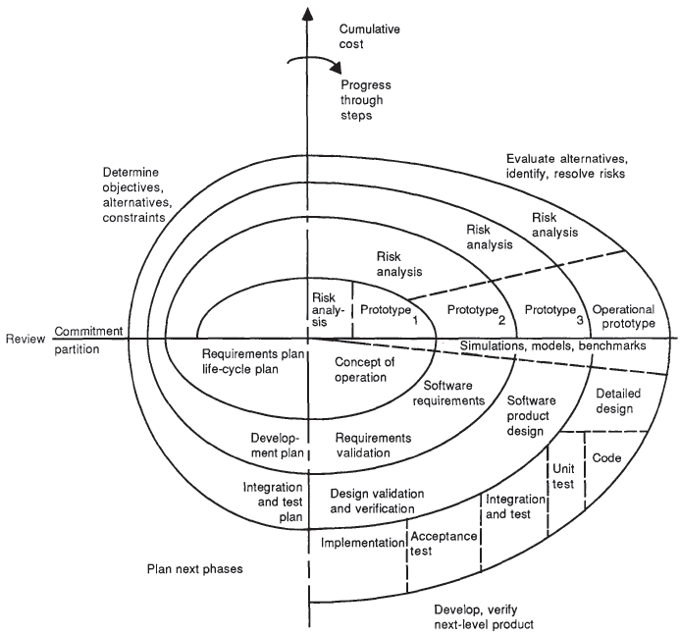
The spiral model

Slide 13
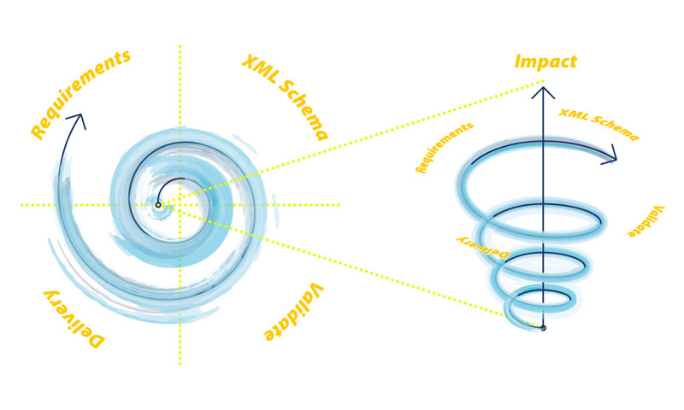
The spiral model

Slide 14
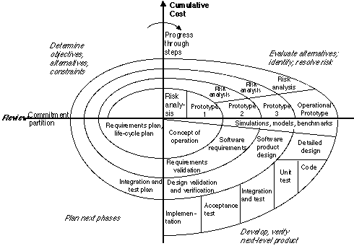
The spiral model
Cycle Requirements
Each cycle is completed by a review by the people concerned with the project.
Plans for the next cycle should be introduced.
With each succeeding level in the spiral the level of detail increases.

Slide 15
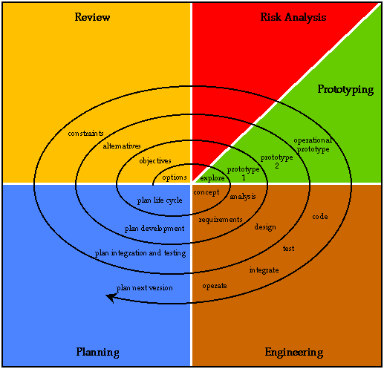

Slide 16
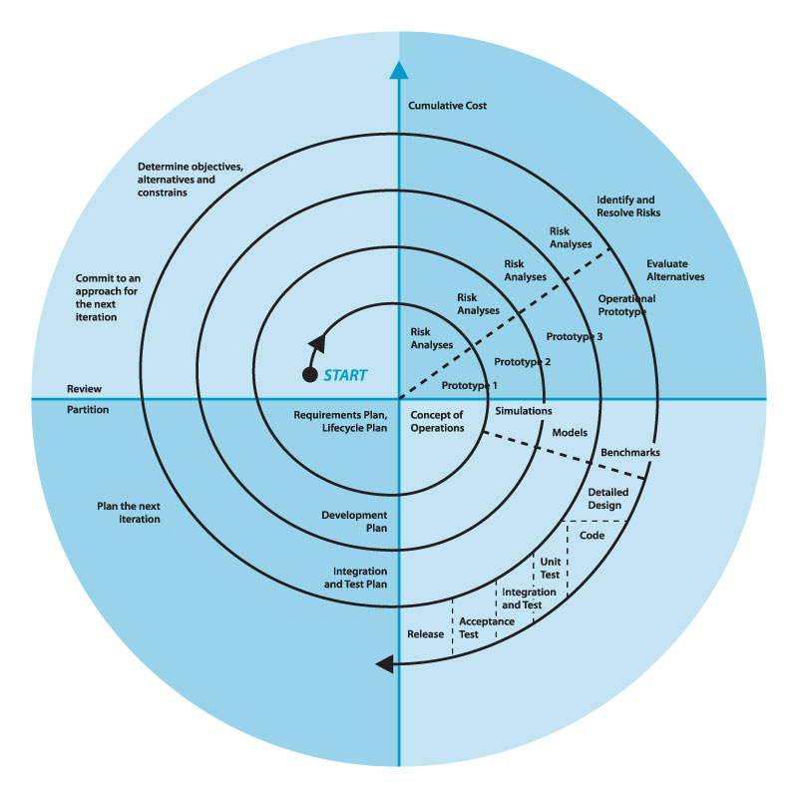

Slide 17
The spiral model
Prototype
Throwaway prototyping
Throwaway or Rapid Prototyping refers to the creation of a model that will eventually be discarded rather than becoming part of the final delivered software.
Evolutionary prototyping
The main goal when using Evolutionary Prototyping is to build a very robust prototype in a structured manner and constantly refine it.
Incremental prototyping
The final product is built as separate prototypes. At the end the separate prototypes are merged in an overall design.
Extreme prototyping
It is a development process is used especially for developing web applications.

Slide 18
The spiral model
Advantages of prototyping
Reduced time and costs
Improved and increased user involvement
Disadvantages of prototyping
Insufficient analysis
User confusion of prototype and finished system
Developer misunderstanding of user objectives
Developer attachment to prototype
Excessive development time of the prototype
Expense of implementing prototyping

