Slide 1











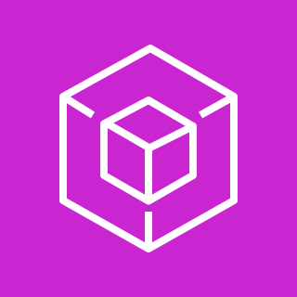
Bedrock
Data Source
Chunking Strategy
Action Group
Data Source
Data Source
Embeddings Model (Titan)
Vector DB (OpenSearch)
sync from
embed chunks
store embeddings
LLM Model
(e.g., Anthropic)
Knowledge Base
Knowledge Base
Knowledge Base
as reasoning engine
as a knowledge tool
as fn tools
Agent
Bedrock Test Playground
as retriever
As LLM Model
As Chat Model
As Reasoning Engine
as AI Service
Semantic Search
Agentic Framework
Custom RAG
BR Agent SDK
GenAI App
GenAI App

Slide 2
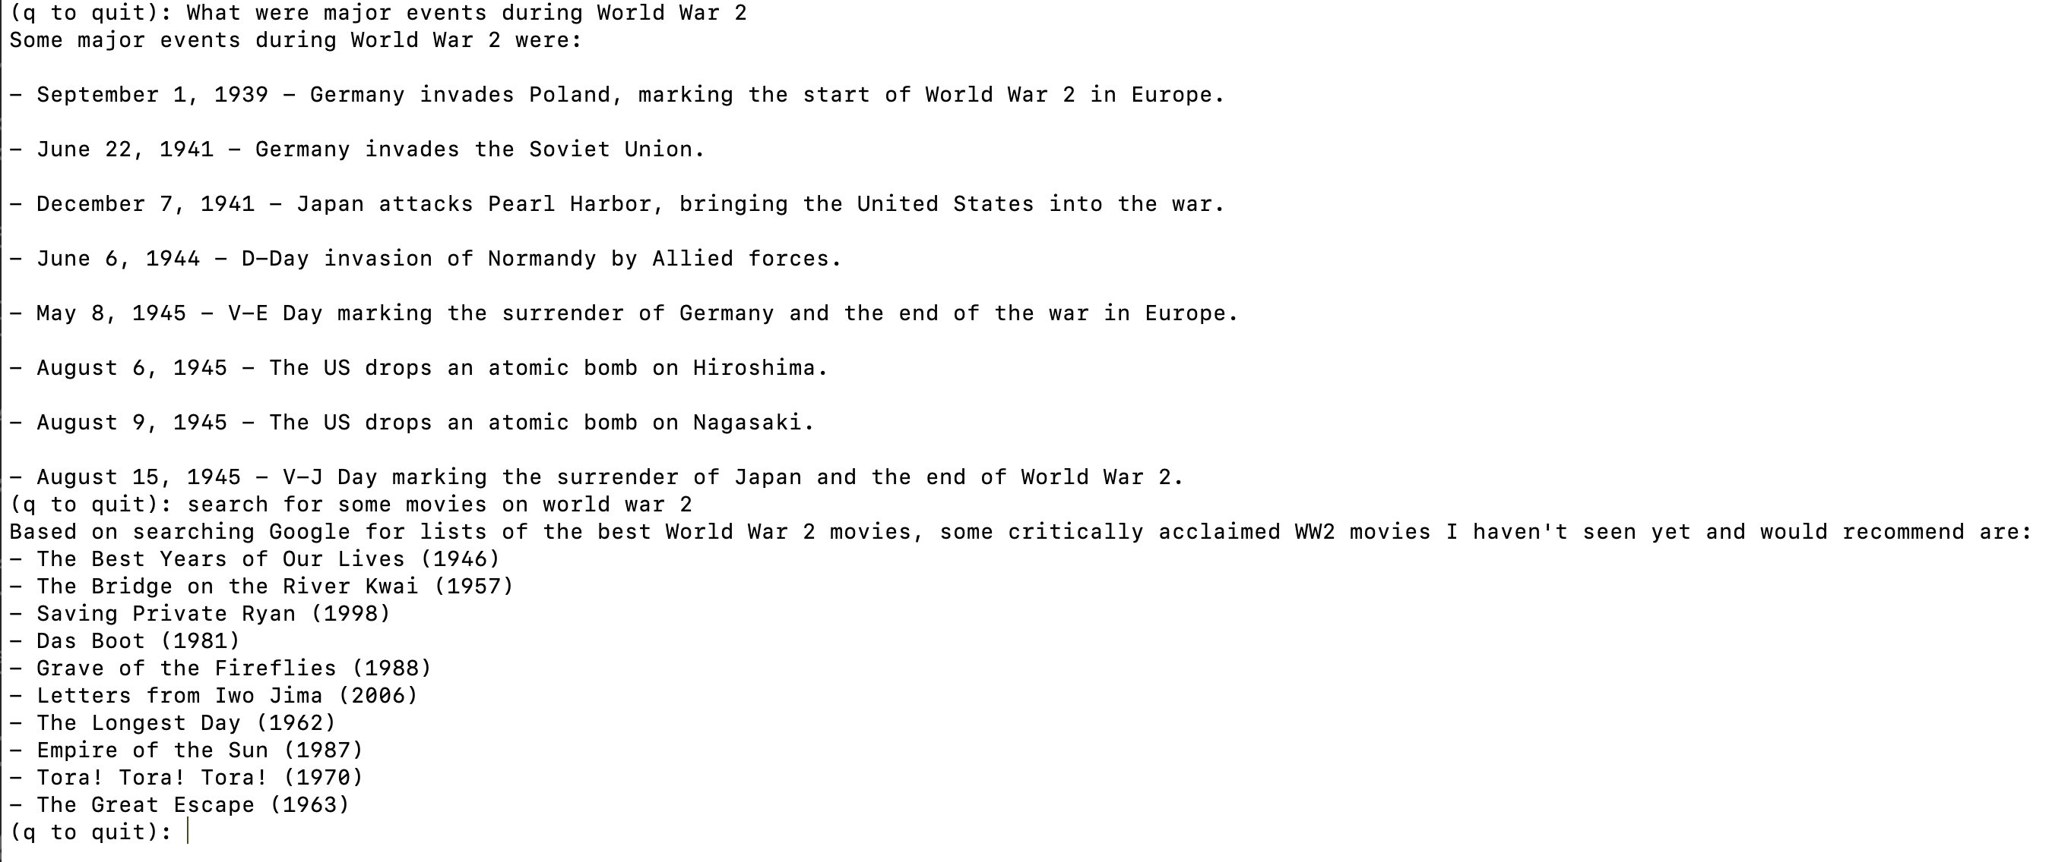
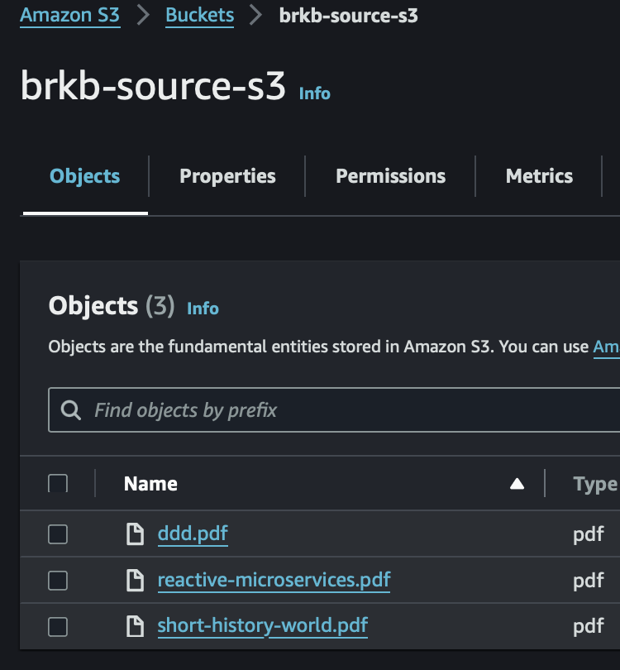
Via KnowledgeBase Tool
Via Search Tool

Slide 3
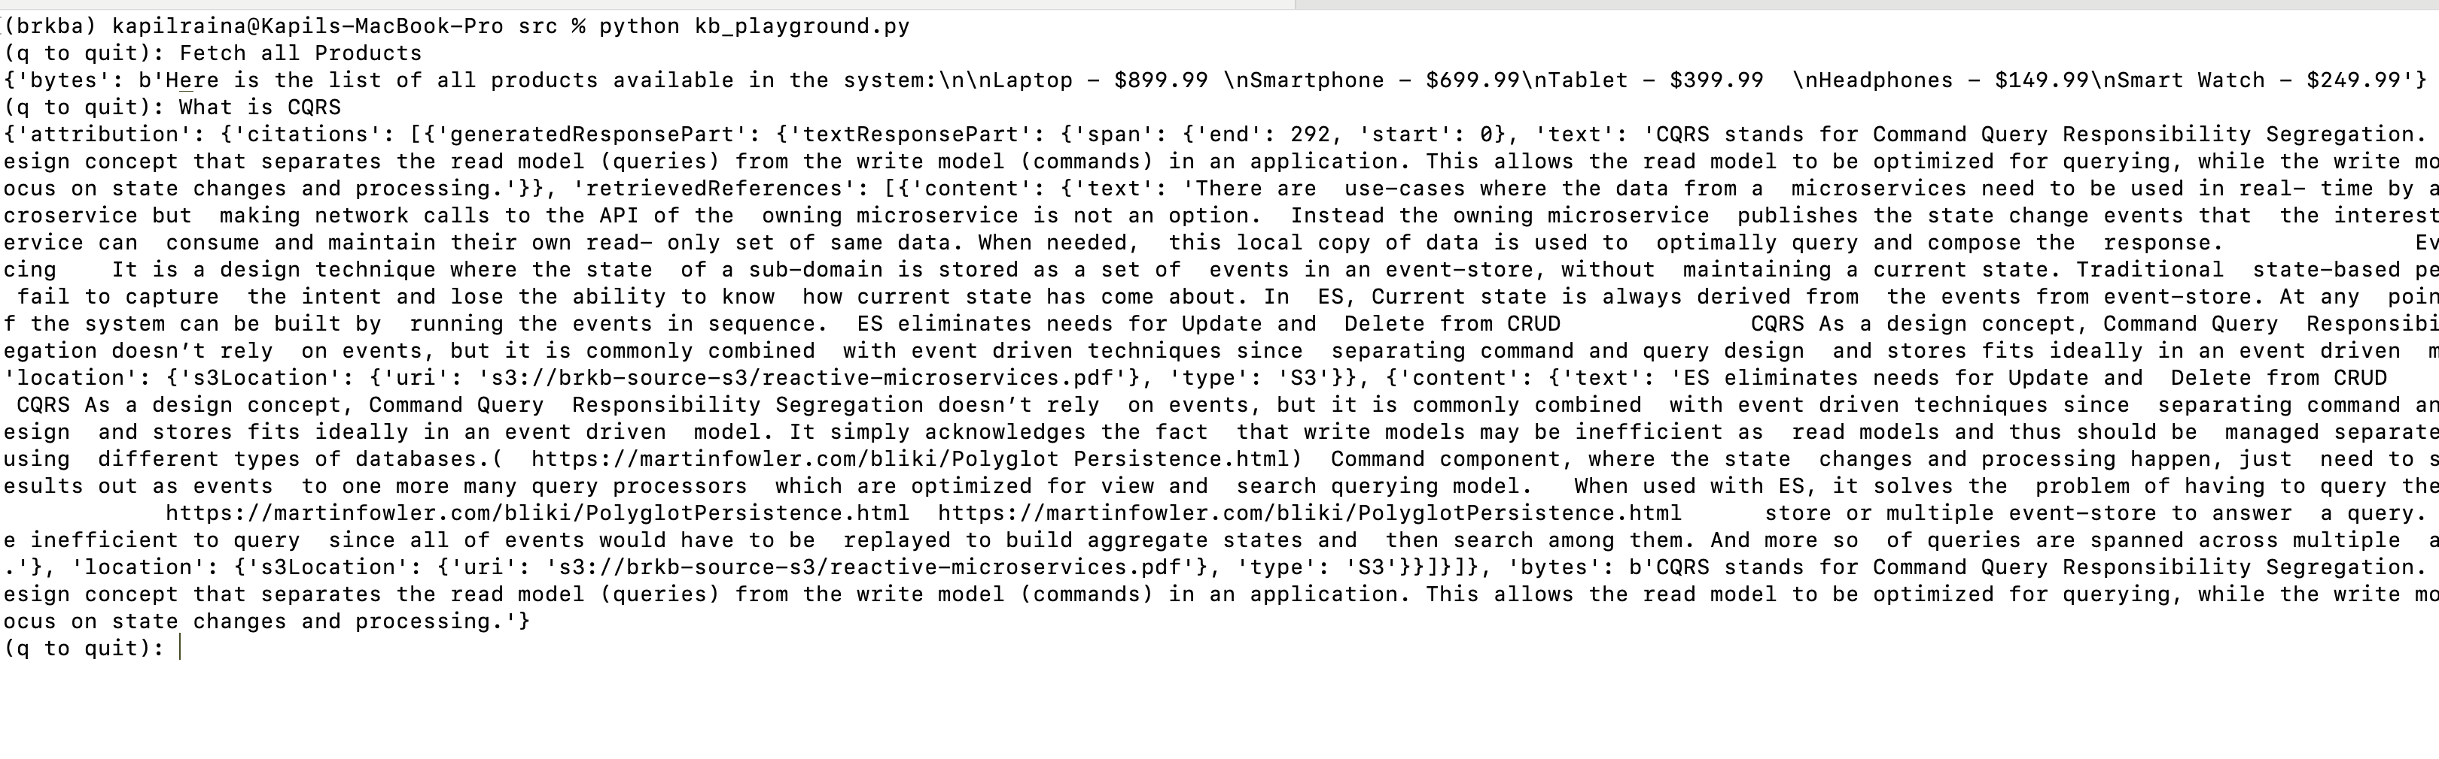
Via Bedrock Agent API Action Group Tool
Via Bedrock Agent Knowledge Base Tool

