Slide 1
productDB
auditDB
Ribbon/Feign
apigateway
productms
discountms
audit
Hystrix
bus
bus
bus
Rabbit MQ / AMQP
bus
Config Server
Eureka Server
Zipkin /Jaeger

Slide 2
SERVER SIDE DISCOVERY
S1
client
LB
S2
S3
S-new

Slide 3
CLIENT SIDE DISCOVERY
S1 host:port
S2 host:port
S3 host:port
S
S1
Eureka Client
Service Registry
S
client
S1 host:port
S2 host:port
S3 host:port
Eureka Server
S2
Eureka Client
Client side load Balancing
S3
Eureka Client
S1 host:port
S2 host:port
S3 host:port
Service Registry
Service Registry
S-new
Eureka Client
S1 host:port
S2 host:port
S3 host:port
S1 host:port
S2 host:port
S3 host:port
S1 host:port
S3 host:port

Slide 4
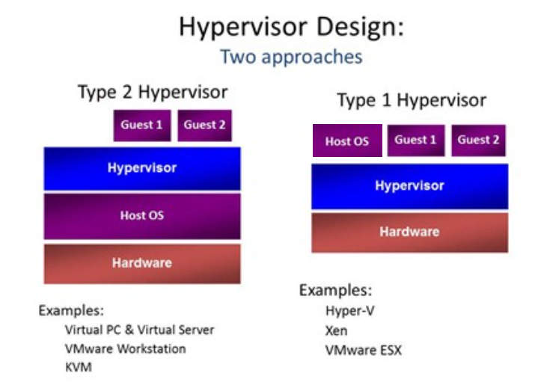
VM

Slide 5
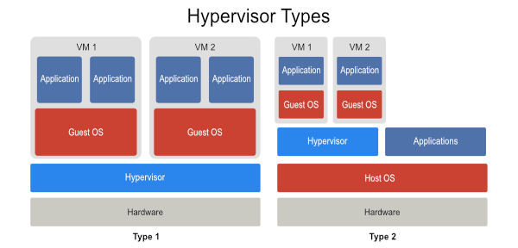
VM

Slide 6
docker
WINDOWS VM
VM Box
Docker-vm1 (docker-host)
dockerd
Image cache
nginx:80
80:80
docker-machine.exe
docker.exe
Browser / client
SET DOCKER_TLS_VERIFY=1
SET DOCKER_HOST=tcp://192.168.99.105:2376
SET DOCKER_CERT_PATH=C:\Users\w2cluster01\.docker\machine\machines\docker-vm1
SET DOCKER_MACHINE_NAME=docker-vm1

Slide 7
Docker networking
Docker-vm1 (docker-host)
N2
N1
s1
s7
s2
s3

Slide 8
K8S
WINDOWS VM
Virtual VM
node01
node02
ClusterIP:ContainerPort
K8S Master Node
nodePort:ContainerPort
nodePort:ContainerPort
kubectl
Browser / client

Slide 9
Kubectl config
cluster
auth
context
Set as current

Slide 10
Spring logging
logback
SL4J
log4j
log4j2

Slide 11
