Slide 1
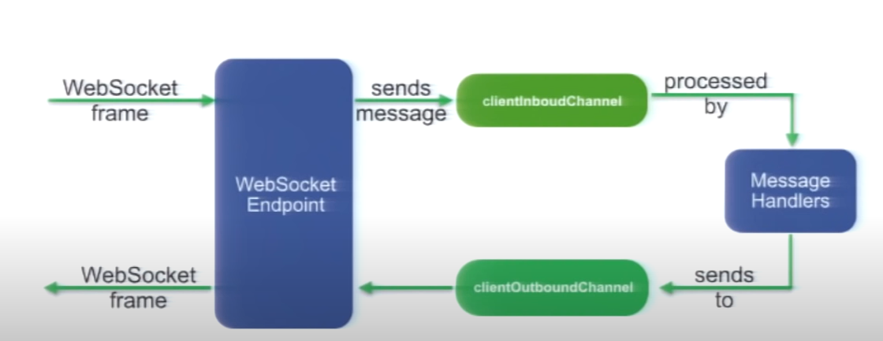
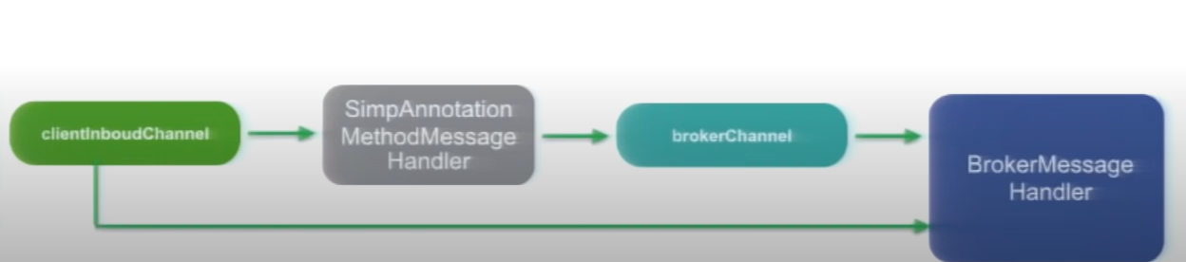

Slide 2
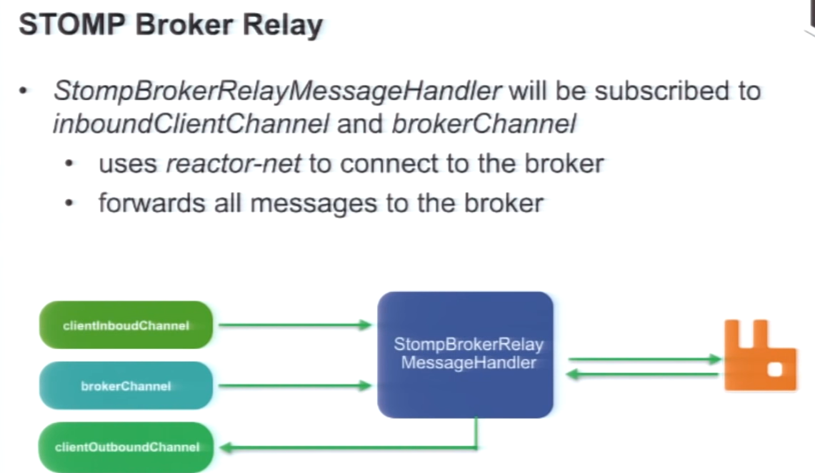

Slide 3
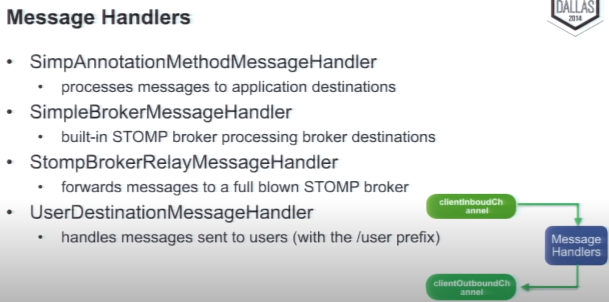

Slide 4
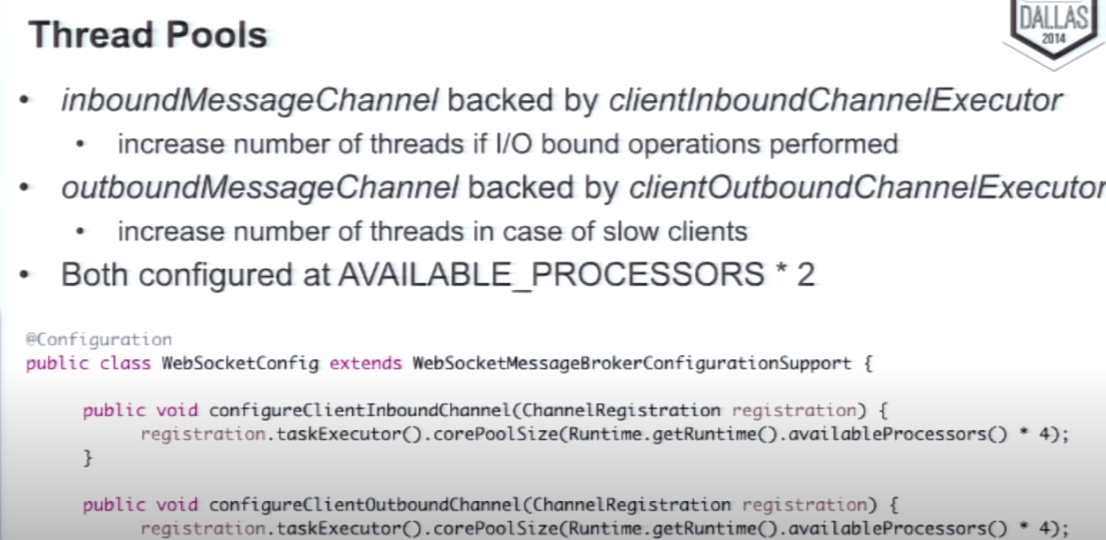

Slide 5
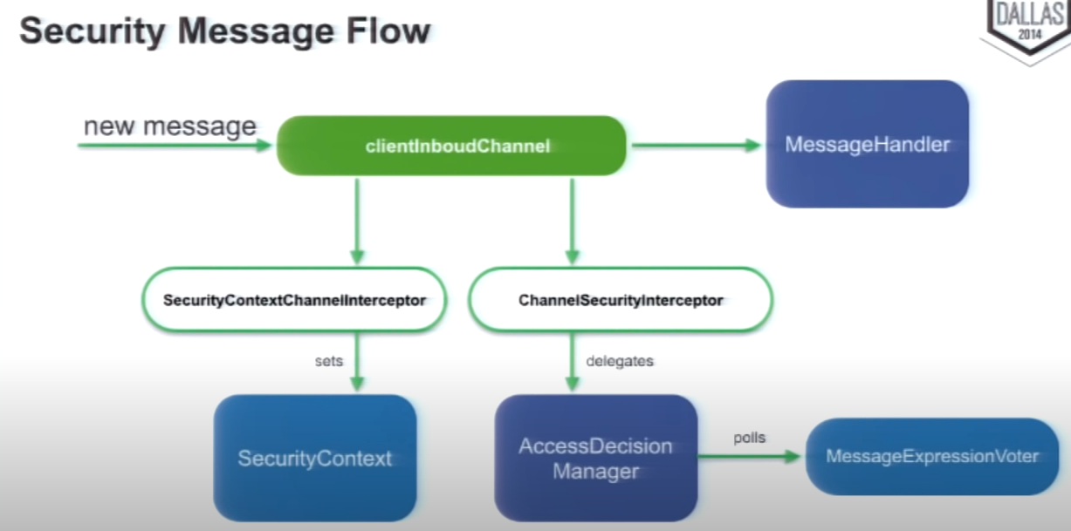

Slide 6
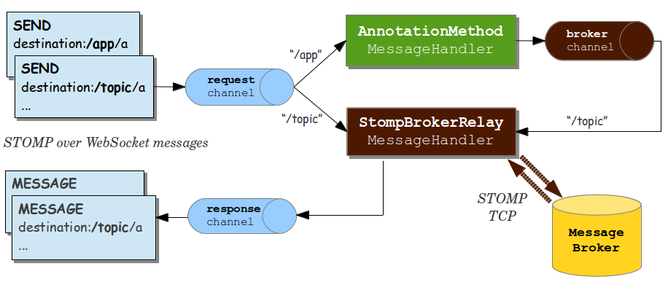

Slide 7
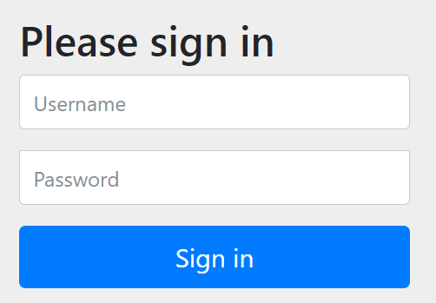
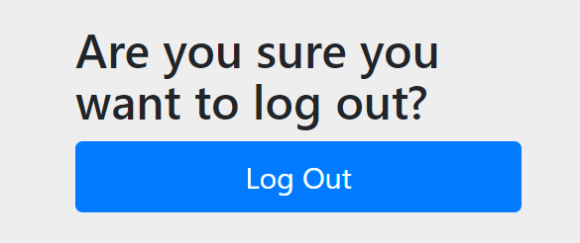

Slide 8
Socket Client
Socket Client
JVM
HTTP SESSION
HTTP SESSION
SOCKET SESSION
Multiplexer
SOCKET SESSION
Socket Session Handler
Socket Session Handler
Outbound Flux
Inbound Flux
Inbound Flux
Outbound Flux
Socket Session DB

Slide 9
Socket Client
Socket Client
JVM
HTTP SESSION
HTTP SESSION
SOCKET SESSION
Sinks.Many
SOCKET SESSION
Socket Session Handler
Socket Session Handler
Outbound Flux
Inbound Flux
Inbound Flux
Outbound Flux
Socket Session DB

Slide 10
Socket Client
Socket Client
JVM
HTTP SESSION
HTTP SESSION
SOCKET SESSION
PubSubChannel (e.g FluxMessageChannel)
SOCKET SESSION
Socket Session Handler
Socket Session Handler
Outbound Flux
Inbound Flux
Inbound Flux
Outbound Flux
Socket Session DB

Slide 11
Socket Client
Socket Client
JVM
HTTP SESSION
HTTP SESSION
SOCKET SESSION
SOCKET SESSION
Socket Session Handler
Socket Session Handler
Outbound Flux
Inbound Flux
Inbound Flux
Outbound Flux
Socket Session DB
Publish Channel
Subscribe Channel

Slide 12
Socket Client
Socket Client
HTTP SESSION
HTTP SESSION
Socket Session
Socket Session
SOCKET SESSION
SOCKET SESSION
Outbound Flux
Inbound Flux
Inbound Flux
Outbound Flux
Socket Session DB
Subscribe Channel
Publish Channel
Publish Channel
Subscribe Channel
Exchange
Queue
AMQP

Slide 13
Socket Client
Socket Client
HTTP SESSION
HTTP SESSION
Socket Session
Socket Session
SOCKET SESSION
SOCKET SESSION
Outbound Flux
Inbound Flux
Inbound Flux
Outbound Flux
Socket Session DB
Subscribe Channel
Publish Channel
Publish Channel
Subscribe Channel
Topic
Partition(s)
Partition(s)
Kafka

Slide 14
