Slide 1
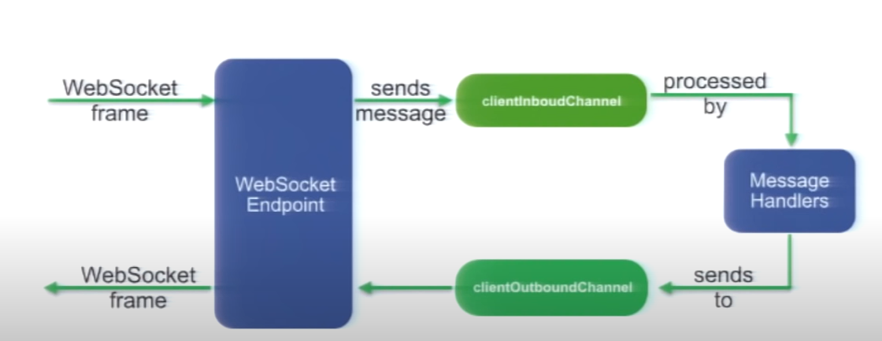
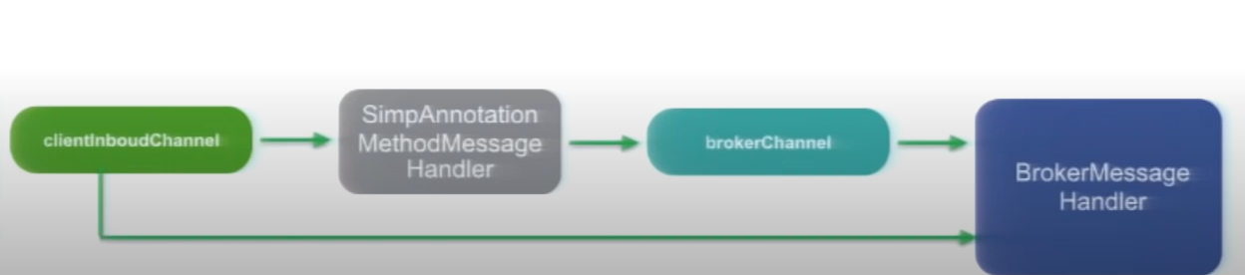

Slide 2
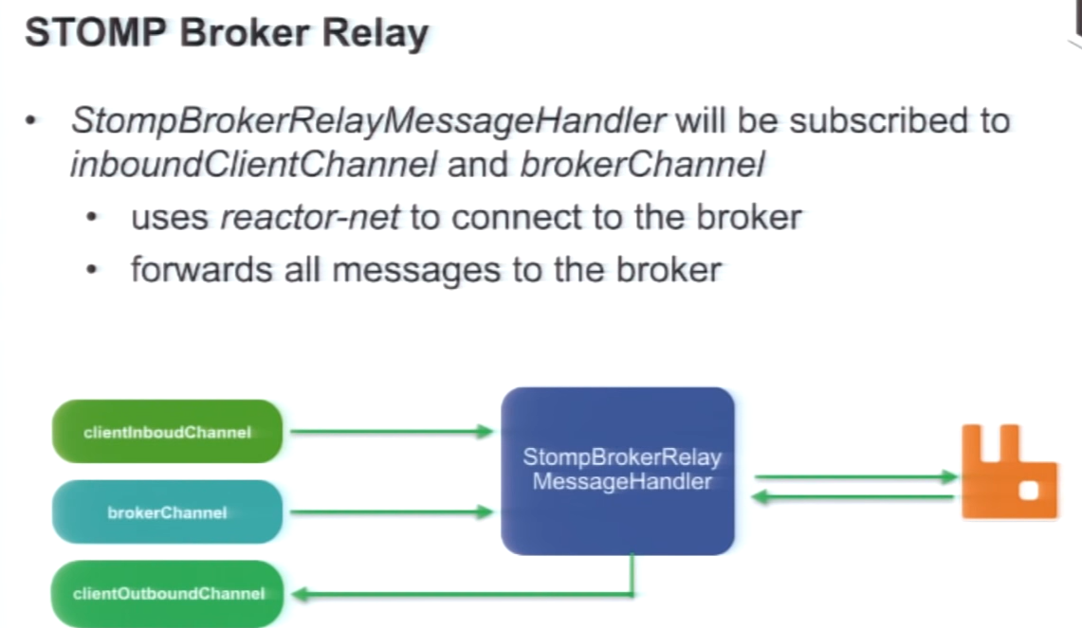

Slide 3
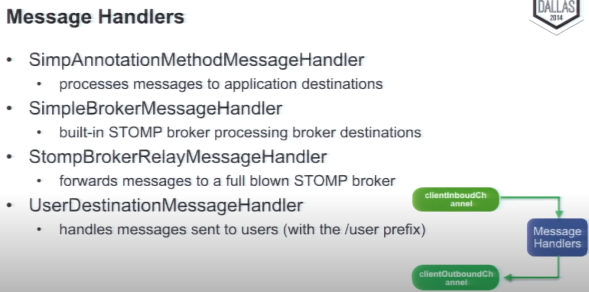

Slide 4
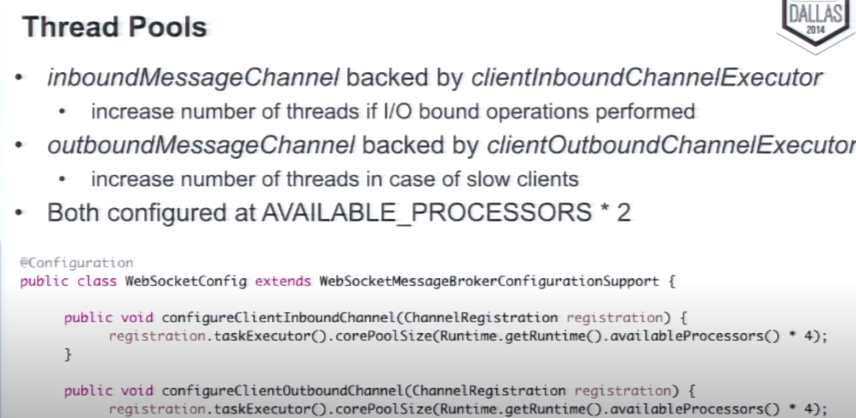

Slide 5
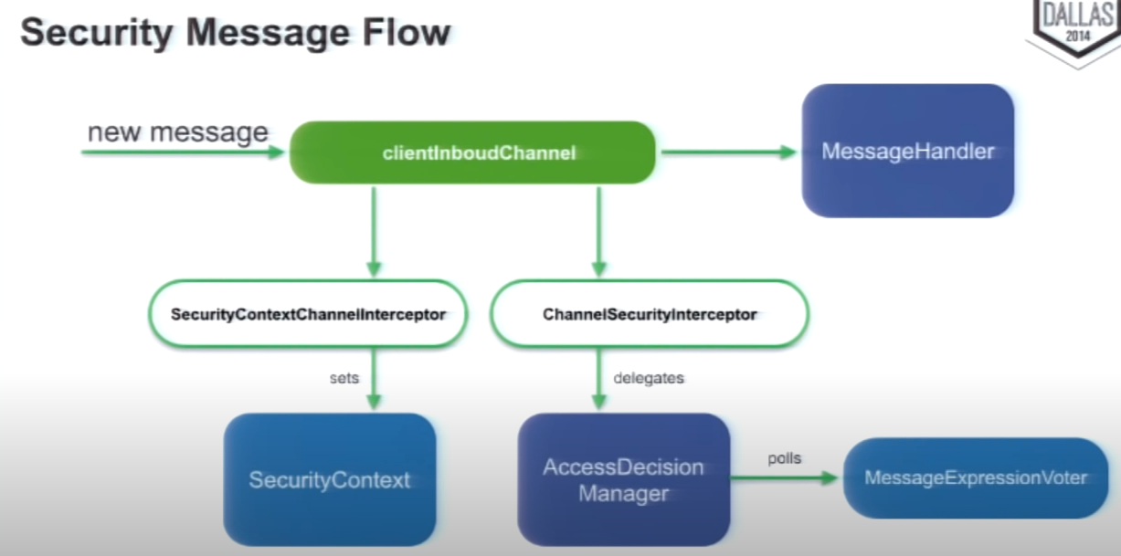

Slide 6
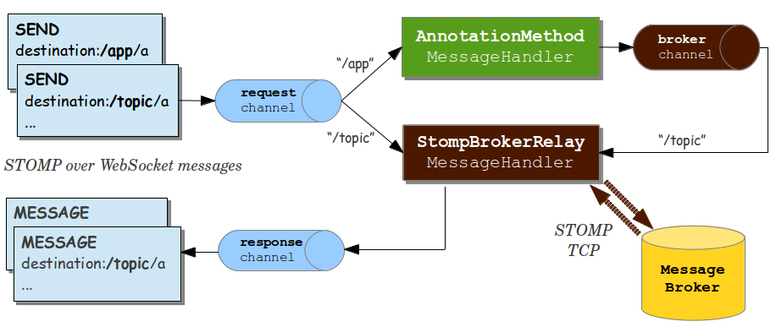

Slide 7
Socket Client
Socket Client
Multicaster
Socket Session
Socket Session
Outbound Flux <WebSocketMessage>
Inbound Flux <WebSocketMessage>
Inbound Flux <WebSocketMessage>
Outbound Flux <WebSocketMessage>
Socket Session DB

Slide 8
Socket Client
Socket Client
PubSubChannel (e.g FluxMessageChannel)
Socket Session
Socket Session
Outbound Flux <WebSocketMessage>
Inbound Flux <WebSocketMessage>
Inbound Flux <WebSocketMessage>
Outbound Flux <WebSocketMessage>
Socket Session DB

Slide 9
Socket Client
Socket Client
Socket Session
Socket Session
Outbound Flux <WebSocketMessage>
Inbound Flux <WebSocketMessage>
Inbound Flux <WebSocketMessage>
Outbound Flux <WebSocketMessage>
Socket Session DB
Publish Channel
Subscribe Channel

Slide 10
Socket Client
Socket Client
Socket Session
Socket Session
Outbound Flux <WebSocketMessage>
Inbound Flux <WebSocketMessage>
Inbound Flux <WebSocketMessage>
Outbound Flux <WebSocketMessage>
Socket Session DB
Subscribe Channel
Publish Channel
Publish Channel
Subscribe Channel
Exchange
Queue

