Slide 1
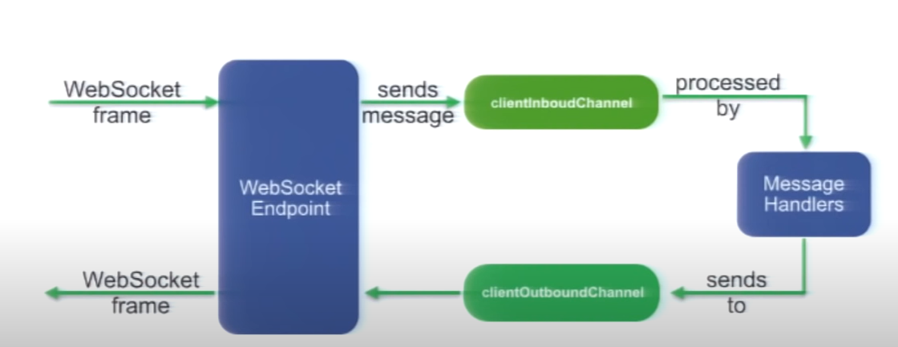
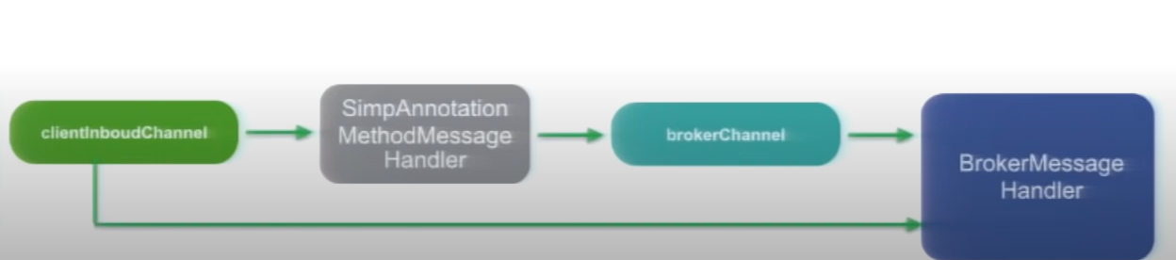

Slide 2
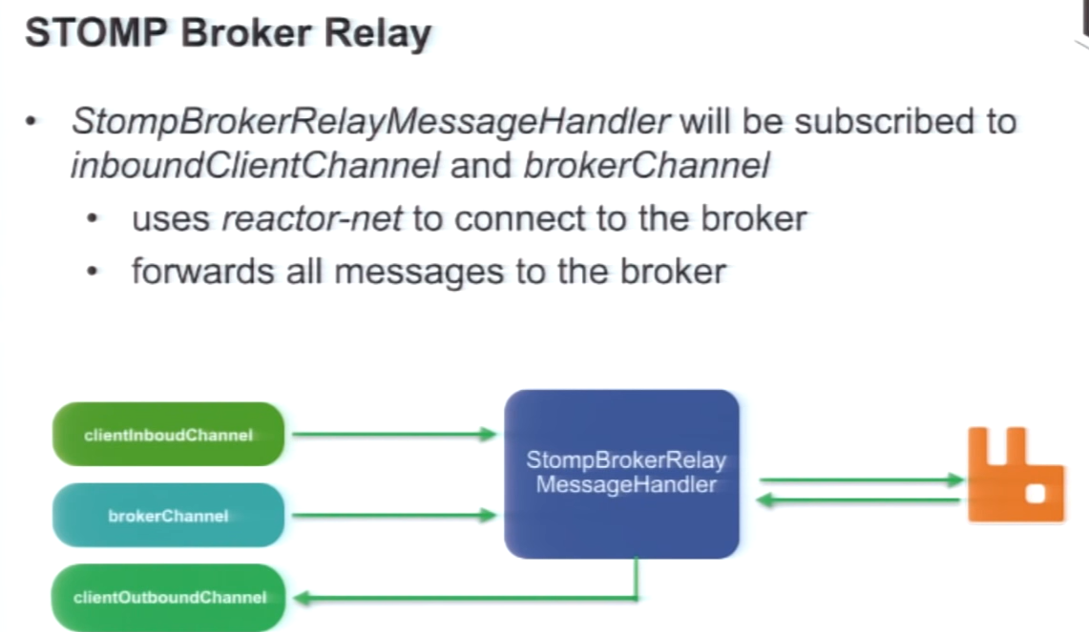

Slide 3
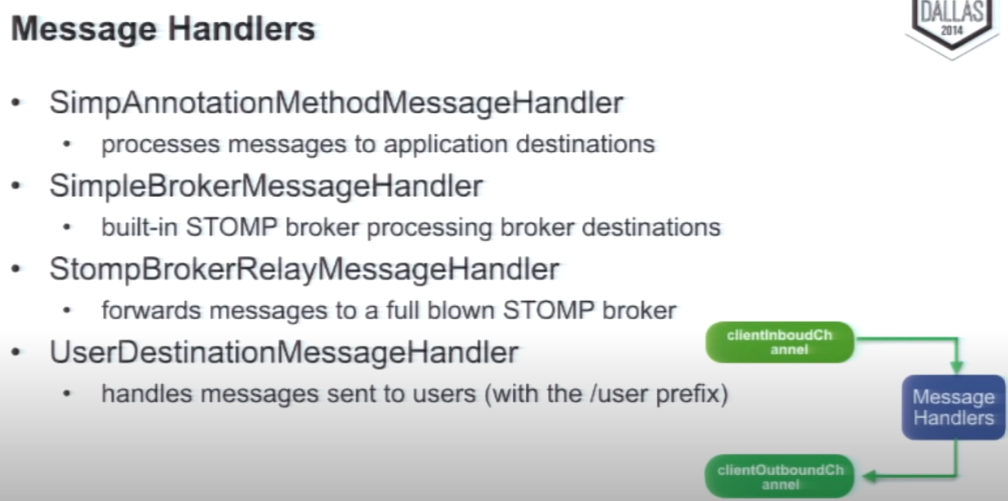

Slide 4
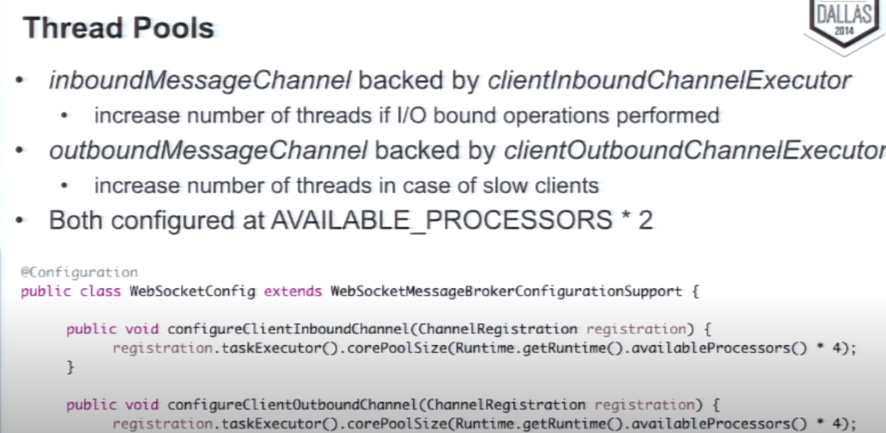

Slide 5
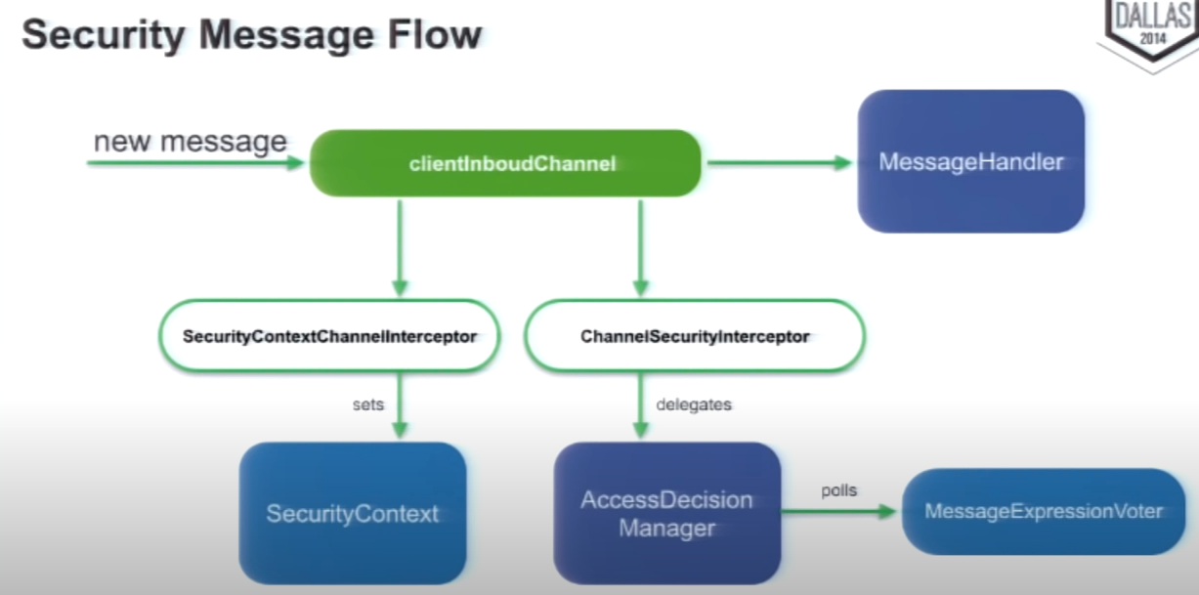

Slide 6
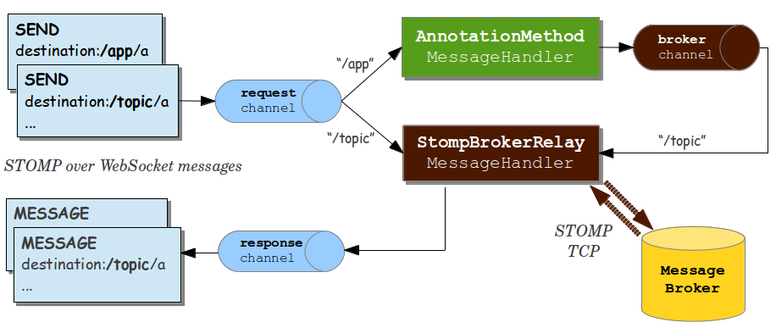

Slide 7
Socket Client
Socket Client
Multicaster
HTTP SESSION
SOCKET SESSION
Socket Session
Socket Session
Outbound Flux
Inbound Flux
Inbound Flux
Outbound Flux
Socket Session DB

Slide 8
Socket Client
Socket Client
PubSubChannel (e.g FluxMessageChannel)
HTTP SESSION
SOCKET SESSION
Socket Session
Socket Session
Outbound Flux
Inbound Flux
Inbound Flux
Outbound Flux
Socket Session DB

Slide 9
Socket Client
Socket Client
HTTP SESSION
SOCKET SESSION
Socket Session
Socket Session
Outbound Flux
Inbound Flux
Inbound Flux
Outbound Flux
Socket Session DB
Publish Channel
Subscribe Channel

Slide 10
Socket Client
Socket Client
HTTP SESSION
Socket Session
SOCKET SESSION
Socket Session
Outbound Flux
Inbound Flux
Inbound Flux
Outbound Flux
Socket Session DB
Subscribe Channel
Publish Channel
Publish Channel
Subscribe Channel
Exchange
Queue
AMQP

