Slide 1















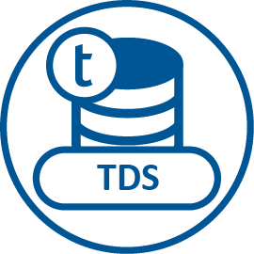
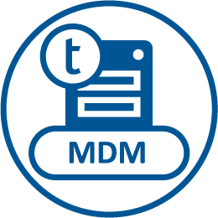


Solution Architecture - Data Lake
Data Sources
Data Lake
Data Warehouse
Information Insights
Data Ingestion
Raw Layer
Processing Layer
Refined Layer
Business Data Repositories
Advanced Analytics & Reporting
Source data ready for consumption by Data Scientists, Data Stewards and ETL Developers
Standardize on Corporate Governance
Apply Data Quality Rules and Policies
Apply Business Rules
Transformed Data required by Lines of Business Specific Views
Conformed data objects for business data repositories
Structured
ERP
Relational
Mainframe)
Batch
Unstructured
Machine sensor data
Web logs
Documents
Micro
Batch
Format
Regional Data Marts
Checks
Real Time
External Social
Sentiment
Vigilance
Trend shift
Filters
Data Governance
Metadata Management
Notes:
Enable the Data Lake implementation by understanding the inputs, outputs, processes, and policies within each Layer
Raw Layer
Inputs
Sources: RDBMS, File, Streaming, structured/unstructured, Social Media, External Data
Outputs
Processes
Policies

