Slide 1



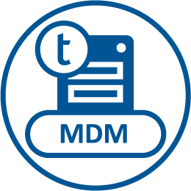


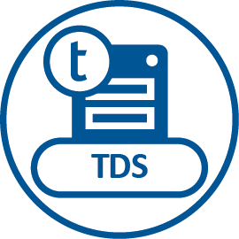
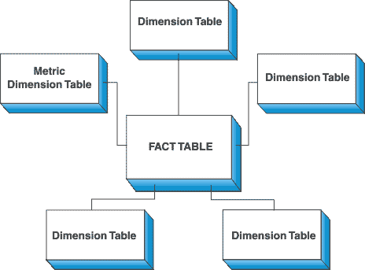






Solution Architecture – Batch /Real time DWH
Data Sources
Data Access
Staging Area
Data Governance
Data Warehouse /
Data Marts
Batch
Databases
Master Data
Master Data
Call Master Data Services
Applications
Master Data
Files
Real-time
Master Data
Event driven
Message Queues
Transactional Data
Metadata

