Slide 1
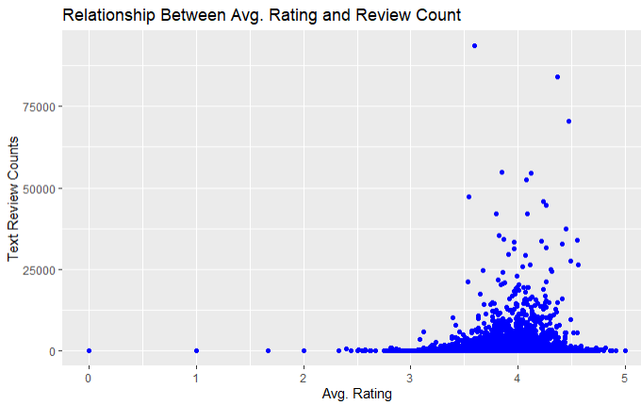
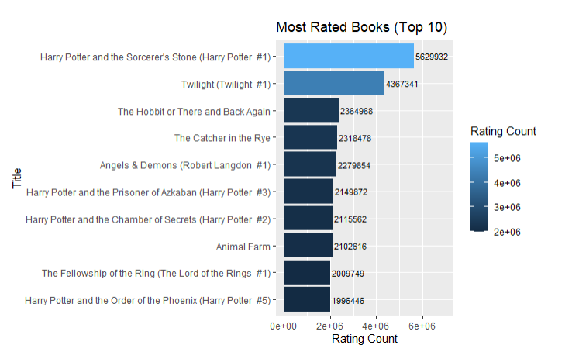
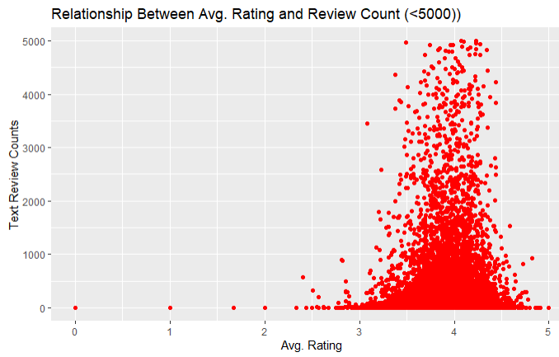
a
Author: Kapil Sahu
Analyzing Goodreads Dataset to gain interesting insights about factors impacting the popularity of Books
We can infer from the plot that most of the ratings for the books seems to lie near 3-4, with a heavy number of reviews lying mostly near 5000, approx.
Even after looking at a smaller scale, most text reviews for books still lie under 1000, making data results inconclusive. The reviews seem to be predominant amongst books with good ratings. Maybe this is pointing towards a possibility that these are all fake reviews. Since, most of the times bibliophiles share their honest reviews no matter its positive or negative to help the community grow.
The first book of any series usually have most of the ratings, i.e, Harry Potter and the Sorcerer’s Stone, Twilight #1, The Hobbit, Angels and Demons #1. A huge gap in ratings(approx. 50%) of Harry Potter(#1) and Harry Potter(#2) indicate that fiction enthusiasts did not pick up the sequel in the series as much as they liked the first one.
Sources: https://www.goodreads.com/api https://www.kaggle.com/hoshi7/goodreads-analysis-and-recommending-books/data

