Slide 1
Understanding Information needs in commodity supply chain
Kapil Thakkar (2014MCS2124)
Reshma Kumari (2014MCS2134)
Under the guidance of
Dr. Aaditeshwar Seth

Slide 2
Introduction
Supply chain- set of buy-sell interactions as goods flow from raw materials through production to the final retailer where consumers can buy them.
Value chain- whole ecosystem of players involved moving from the retailer backward to the producer.

Slide 3
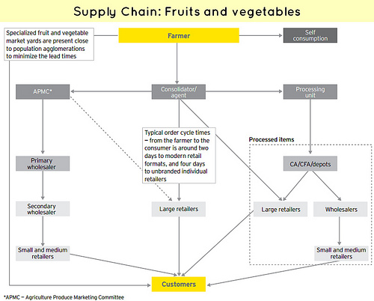
Supply Chain : Example

Slide 4
Possible options for farmers
APMC based mandi
Village level traders
Mega food parks
Rythu Baazar
Contract farming
Store in warehouse
Commodity exchanges(Spot/Future)

Slide 5
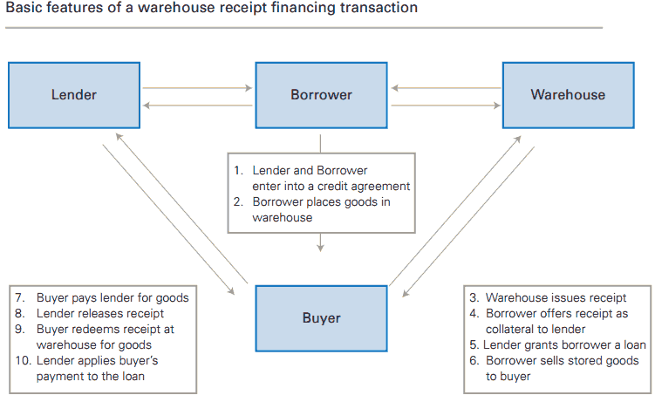

Slide 6
Problems
Lack of proper formal means to obtain price information
60.8 % of onion farmers in Karnataka depends on commission agents for price discovery
Low returns on produce for farmers
Price dispersion
Prices for Shankar 6 (B) 30MM variety during Mar-Jun, 06 for Rajkot & Chotila markets differs in the range of Rs 150-180/Quintal

Slide 7
Existing ICTD Solutions

Slide 8
e-Choupal
e-Choupal by ITC
Provide information about 60 mandi prices to soy farmers in the state
ITC’s own offer price at its 45 hubs
Increase in monthly mandi price of soybean by 1-3%
Dispersion of soybean prices across the affected mandis in Madhya Pradesh decreased after the intervention

Slide 9
RML (Reuters Market Light)
Provides price information to farmers across various mandis via text messages
80% farmers changed information sourcing behavior
5.2% reduction in price dispersion
During Ayodhaya verdict, when bulk SMS were banned ,a study showed that price dispersion went as high as about 12%

Slide 10
Objective
To design a decision support system for farmers to help them seek better prices for their produce by analyzing the available market conditions and other factors affecting production and cost determination of crop

Slide 11
Information for farmers
Commodity prices in nearby mandi’s
Retail Prices
Spot Exchange Price
Future Exchange Price
Minimum Support Price (MSP) (if applicable)
Trend in price of commodity over past years

Slide 12
Plan ahead
Collecting data about prices of commodities from web portals
Historical data about previous mandi prices and retail prices
Warehouse Information
Mandi names and their geographical locations
Data about possible factors affecting the price of commodity

Slide 13
Project Expectation
Dashboard suggesting prices through various possible alternatives
Data Visualization to indicate price trend of commodity
Comparison of Production, Market Prices and Retail Prices over the years
Comparison of prices with possible factors affecting them such as rain fall, amount exported/imported etc

Slide 14
Project benefits
Answering following questions of farmers with this solution
What price can I expect?
Which crop will I plant given my known input costs and expected harvest time prices?
Should I sell now or sell forward or store my crop?

Slide 15
Thank You!!

