Slide 1

ASSERTION-BASED VERIFICATION OF
SYNCHRONOUS FIFO USING
SYSTEMVERILOG
Design Project (PVL292)
M.Tech VLSI Design
Submitted by
Under supervision of
Kapil Tripathi
6025620017
Dr. Arnab Pattanayak
Dr. Lalit Kumar Baghel
SystemVerilog + SVA + Scoreboard + Fault Injection
Electronics and Communication Engineering Department
Thapar Institute of Engineering & Technology, Patiala
May 2026

Slide 2
Presentation Roadmap
Project flow
1
2
3
4
5
6
Problem and objective
DUT architecture
SV environment
SVA plan
Fault results
Conclusion
Why FIFO control must be verified before reuse.
Synchronous FIFO with separate RAM and controller.
Generator, driver, monitor, scoreboard, and interface.
Assertions bound to internal FIFO control signals.
Five injected issues with waveform/log evidence.
Findings, limitations, and UVM migration path.
The deck follows the same logic as the report, but keeps each result focused on what failed, which checker caught it, and what the waveform proves.
Assertion-Based Verification of Synchronous FIFO
02

Slide 3
Why FIFO Verification Matters
Motivation
A FIFO is simple in concept but sensitive at its boundaries: reset, empty, full, read/write overlap, and pointer wrap.
Data ordering
Producer
FIFO
queue
Consumer
Oldest accepted write must be the first valid read. A pointer bug can silently repeat or skip stored data.
Flow control
Reset safety
Debug observability
full and empty are not cosmetic flags. They directly block writes and reads to prevent overflow and underflow.
The FIFO must start from a known empty state so later traffic is not contaminated by stale count or pointer values.
Assertions expose internal control mistakes immediately, while the scoreboard checks visible data behavior.
Assertion-Based Verification of Synchronous FIFO
03

Slide 4
Why SystemVerilog Over Verilog
Language choice
SystemVerilog keeps Verilog-style RTL, but adds verification features that are directly useful for this FIFO project.
Verilog HDL
SystemVerilog
- Strong fit for synthesizable RTL modeling
- Modules, nets, registers, always blocks
- Basic procedural testbenches are possible
- Limited language support for reusable verification
- Assertions, classes, coverage, and constrained random are not the core Verilog model
- Unified design, specification, and verification language
- Assertions for protocol and temporal properties
- Classes, mailboxes, and virtual interfaces for testbench reuse
- Constrained random stimulus and functional coverage support
- Natural foundation for later UVM migration
IEEE 1800-2023 describes SystemVerilog support for RTL/gate modeling and testbenches using coverage, assertions, object-oriented programming, and constrained random verification.
Assertion-Based Verification of Synchronous FIFO
04

Slide 5
OOP Concepts in SystemVerilog
Basic definitions
SystemVerilog supports object-oriented testbench coding. The idea is to model verification activity as reusable objects instead of only toggling raw signals.
Class
Object
Encapsulation
Blueprint that groups data and tasks/functions.
Runtime instance created from a class.
Keep related fields and behavior in one unit.
class transaction; ... endclass
transaction tr = new();
transaction stores wr_en, rd_en, data, flags
Abstraction
Inheritance
Polymorphism
Use a simple method call while hiding internal steps.
Create a child class from a parent class.
Base handle can call child-specific behavior.
env.run(); driver.run();
class child extends parent;
virtual function / task
For this project, the most visible OOP features are classes, objects, encapsulation, abstraction, mailboxes, randomization, and virtual interfaces.
Assertion-Based Verification of Synchronous FIFO
05

Slide 6
How OOP Appears in This Testbench
Project mapping
Your SystemVerilog testbench uses objects to represent FIFO operations and verification components.
transaction
generator
driver
monitor
scoreboard
Object for one FIFO operation
rand oper, rand wr_data
constraints control stimulus
Creates transaction objects
randomizes them
sends using mailbox
Gets transaction from mailbox
calls write() or read()
drives virtual fifo_if
Samples DUT interface
creates observed transaction
sends to scoreboard
Stores expected queue
compares rd_data
counts mismatches
environment class
Benefit to testing
Creates and connects the component objects:
gen = new(gdmbx);
drv = new(gdmbx);
mon = new(msmbx);
sco = new(msmbx);
- Cleaner separation of stimulus, driving, monitoring, and checking
- Randomized transactions create many read/write cases
- Mailboxes decouple components and make data flow clear
- Same structure can be migrated naturally toward UVM
Short viva line: SystemVerilog OOP turns the testbench into reusable verification components instead of a single block of procedural signal toggling.
Assertion-Based Verification of Synchronous FIFO
06

Slide 7
Synchronous FIFO Basics
DUT behavior
First-in first-out rule
The FIFO accepts writes into the tail and reads from the head. Status flags are generated from occupancy count.
FIFO storage
Write side
Read side
wr_en
wr_data
wr_ptr advances
oldest data at front
fifo_count tracks occupancy
full / empty from count
rd_en
rd_data
rd_ptr advances
Key control equations
Project parameters
do_write = wr_en && !full;
do_read = rd_en && !empty;
full = (fifo_count == DEPTH);
empty = (fifo_count == 0);
DW = 8 data bits
AW = 4 address bits
DEPTH = 2^AW = 16 entries
fifo_count range = 0..16
Assertion-Based Verification of Synchronous FIFO
07

Slide 8
Design Under Test Architecture
sync_fifo_ram + sync_ram
The verified DUT separates control from storage: sync_fifo_ram manages pointers/count/flags, while sync_ram stores data.
Inputs
FIFO controller
Synchronous RAM
Outputs
rd_data
full
empty
clk, rst
wr_en, rd_en
wr_data
wr_ptr, rd_ptr
fifo_count
do_write, do_read
full, empty
waddr, raddr
din, dout
write enable
Bound SVA checker
Scoreboard model
observes internal pointers, count, and accepted operations
keeps expected FIFO order using a queue
Assertion-Based Verification of Synchronous FIFO
08

Slide 9
SystemVerilog Verification Environment
Class-based testbench
The environment separates stimulus generation, bus driving, monitoring, and result checking. This makes each failure easier to localize.
Generator
Driver
Interface
DUT
SVA
random
transaction
drives
fifo_if
clk/rst
signals
sync_fifo_ram
bind checker
Monitor
Scoreboard
samples bus
compares expected
vs actual data
SystemVerilog features used
class-based transaction, randomized generator, mailbox communication, virtual interface, bind-based assertions
Assertion-Based Verification of Synchronous FIFO
09

Slide 10
Assertion-Based Verification Plan
SVA checker
Assertions observe internal controller state and state exactly what must be true after each accepted operation.
RST_STATE
After reset: empty high, full low, pointers zero, count zero
FULL_FLAG / EMPTY_FLAG
Flags must match fifo_count == DEPTH and fifo_count == 0
COUNT_RANGE
fifo_count must stay within 0..DEPTH
WRITE_ONLY
write pointer increments, read pointer stable, count increments
READ_ONLY
read pointer increments, write pointer stable, count decrements
READ_WRITE
both pointers move while count remains stable
READ_EMPTY / WRITE_FULL
invalid requests must be blocked at boundaries
Example property intent
READ_ONLY:
(!do_write && do_read) |=>
wr_ptr == $past(wr_ptr) &&
rd_ptr == $past(rd_ptr) + 1'b1 &&
fifo_count == $past(fifo_count) - 1'b1;
Assertion-Based Verification of Synchronous FIFO
10

Slide 11
Fault Injection Methodology
Negative testing
Five faulty RTL copies were tested one at a time. The clean testbench and assertion module stayed unchanged.
1
2
3
4
Start clean
Insert one fault
Run simulation
Capture evidence
Run clean design and confirm zero errors
Copy one buggy design into EDA Playground design.sv
Keep testbench.sv and assert_fifo_ram.sv fixed
Save transcript failures and EPWave waveform
Issue 1
Reset count not cleared
Issue 2
Read accepted while empty
Issue 3
Full flag asserted too early
Issue 4
Empty flag asserted one count early
Issue 5
Read pointer does not advance
Assertion-Based Verification of Synchronous FIFO
11

Slide 12
Baseline Expected Behaviour
Clean RTL
Before negative testing, the clean FIFO must satisfy normal state transitions and boundary blocking rules.
0
16
5
SVA
expected scoreboard errors for clean run
FIFO depth when AW = 4
intentional faulty RTL versions
structural/protocol checks
Reset
wr_ptr = 0, rd_ptr = 0, fifo_count = 0, empty = 1
Write-only
wr_ptr increments and fifo_count increases
Read-only
rd_ptr increments and fifo_count decreases
Simultaneous read/write
both pointers move and fifo_count stays stable
Pointer update example
Boundary rules
read blocked when empty; write blocked when full
Correct RTL target:
rd_ptr <= rd_ptr + 1'b1;
Issue 5 bug changes this to:
rd_ptr <= rd_ptr;
Assertion-Based Verification of Synchronous FIFO
12

Slide 13
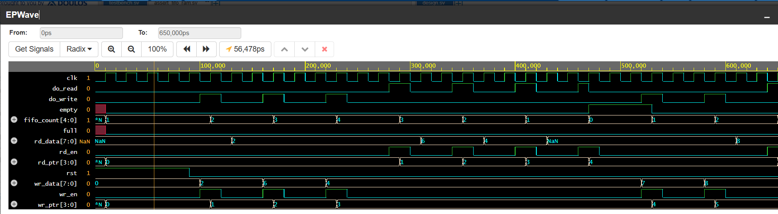
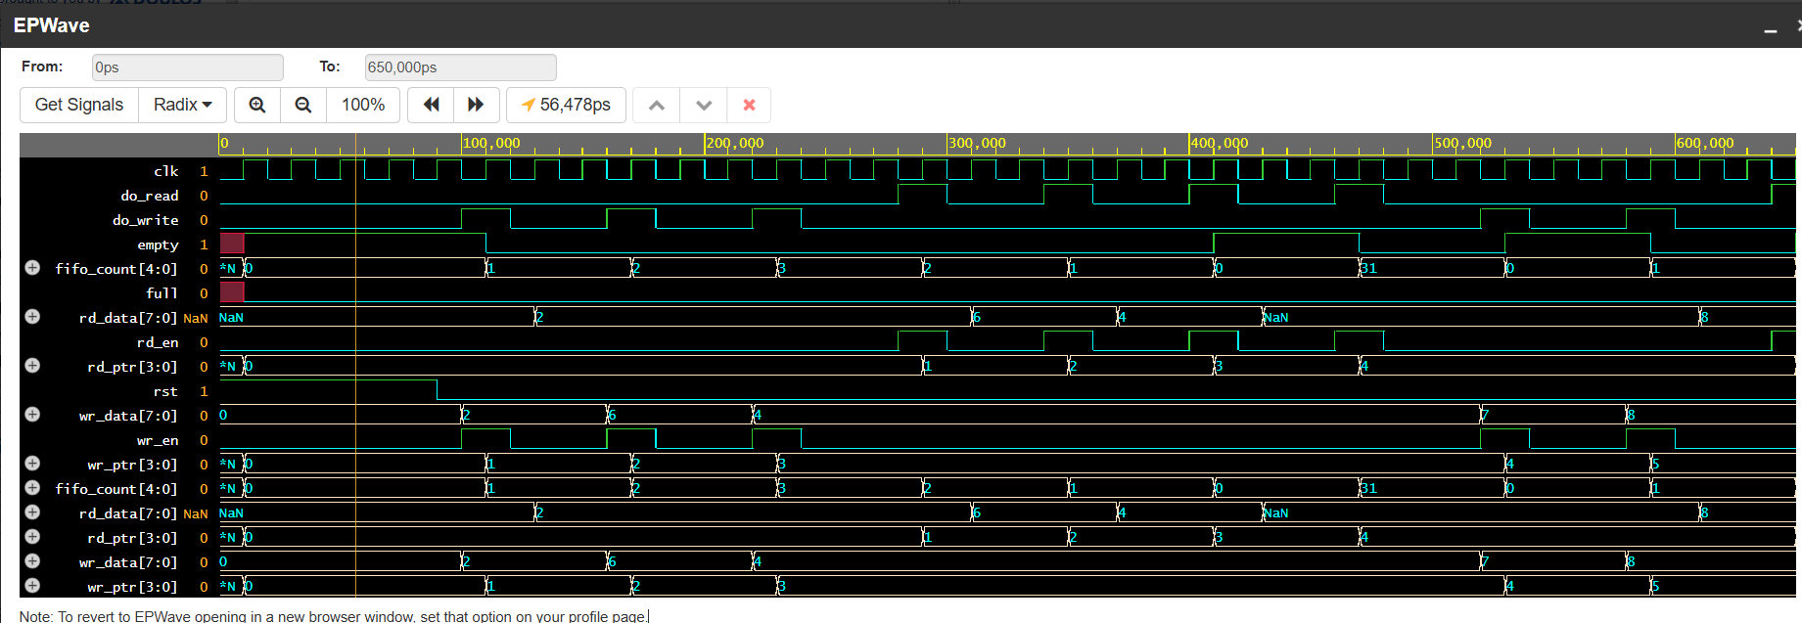
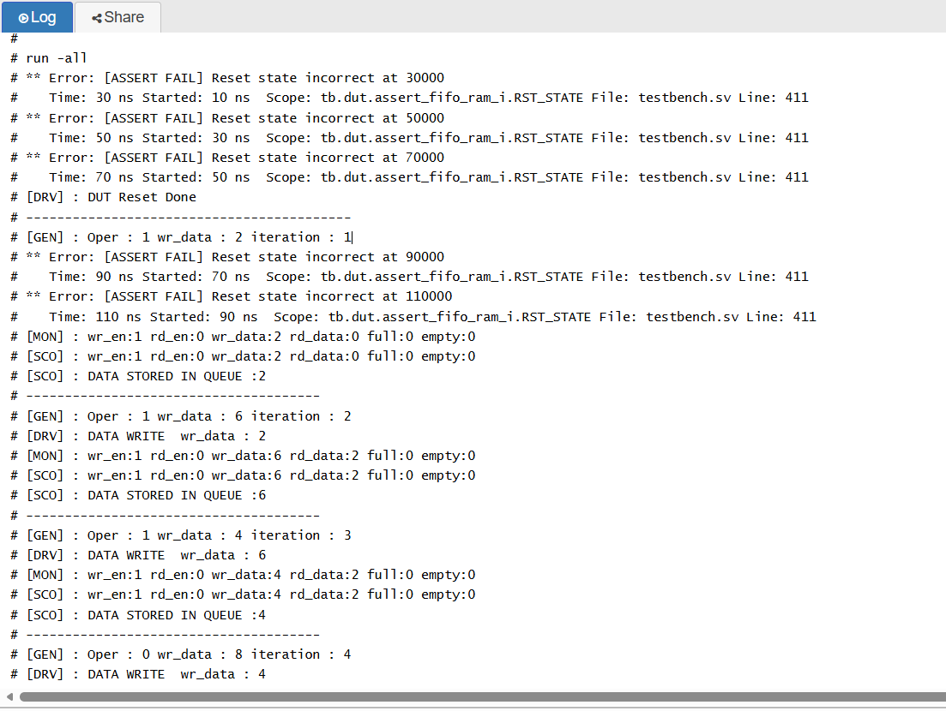
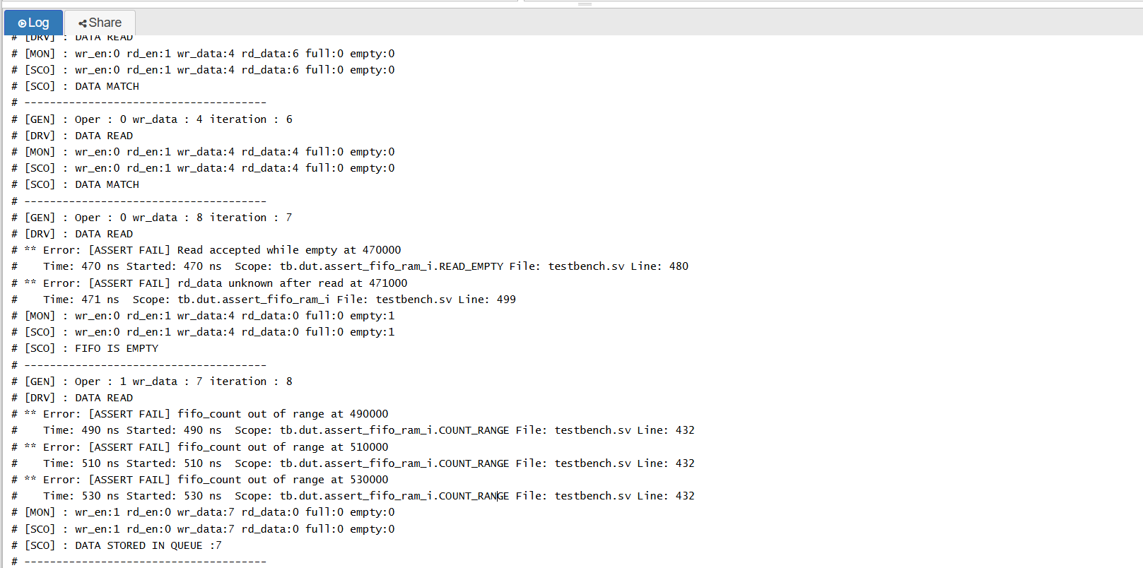
Fault Results: Issues 1 and 2
Reset and underflow protection
Issue 1: reset count not cleared
Issue 2: read while empty
Caught by: RST_STATE
Effect: empty flag wrong after reset
Bug: fifo_count <= 1;
Correct: fifo_count <= 0;
Caught by: READ_EMPTY
Effect: counter underflow / invalid data
Bug: assign do_read = rd_en;
Correct: assign do_read = rd_en && !empty;
Issue 1 waveform: fifo_count starts at 1 during reset
Issue 2 waveform: do_read accepted while empty
Issue 1 log: reset assertion failures
Issue 2 log: READ_EMPTY, unknown data, count range
Assertion-Based Verification of Synchronous FIFO
13

Slide 14
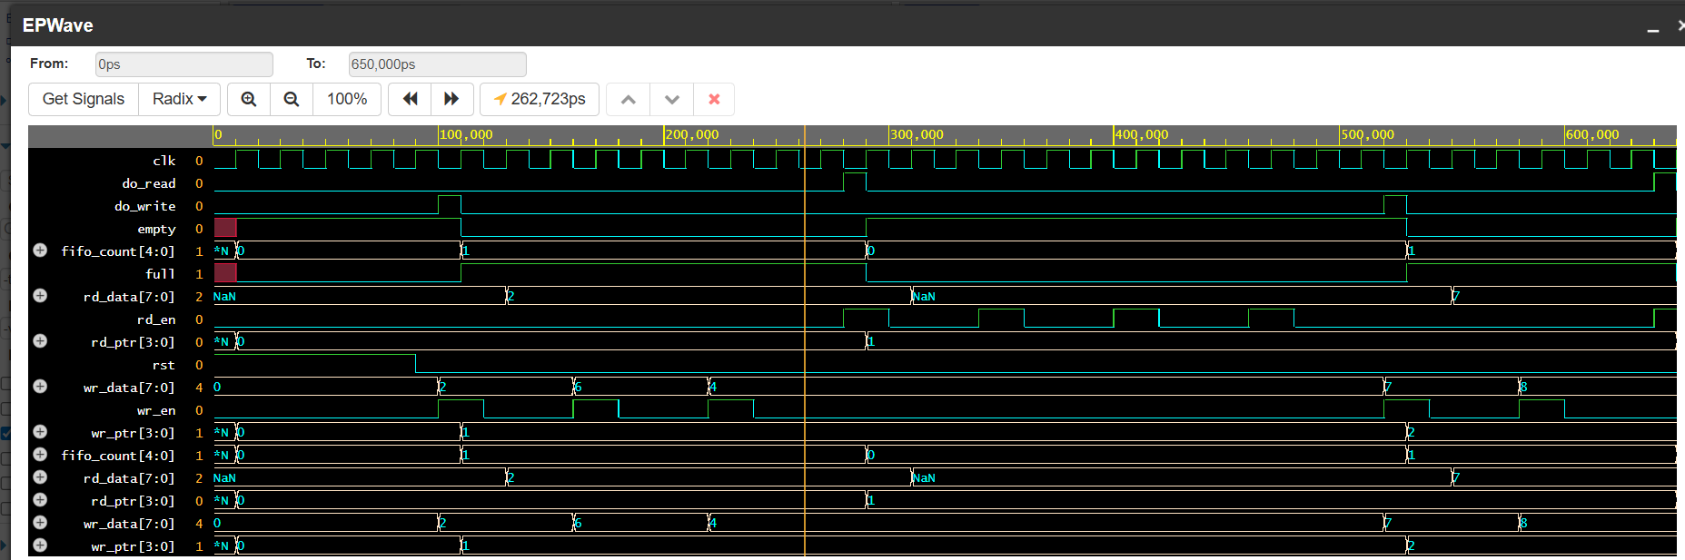
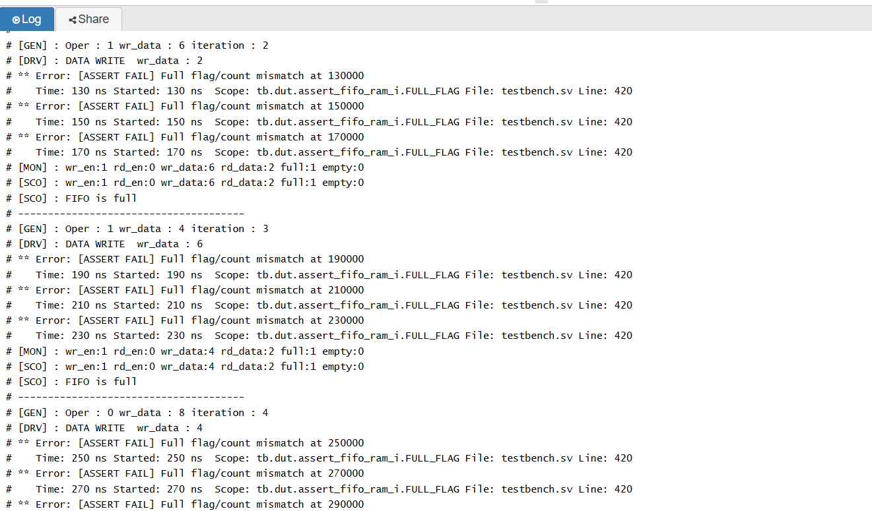
Fault Result: Issue 3
Full flag asserted too early
Bug inserted
Waveform: full asserted when fifo_count is one
Bug:
assign full = (fifo_count == 1);
Correct:
assign full = (fifo_count == DEPTH);
Observed failure
At fifo_count = 1, the DUT reports full even though 15 locations remain available.
Simulation log: repeated FULL_FLAG assertion failures
Checker response
FULL_FLAG assertion compares the flag against fifo_count == DEPTH and fails repeatedly.
Interpretation: this bug does not necessarily corrupt data immediately, but it destroys usable FIFO capacity and blocks valid writes too early.
Assertion-Based Verification of Synchronous FIFO
14

Slide 15
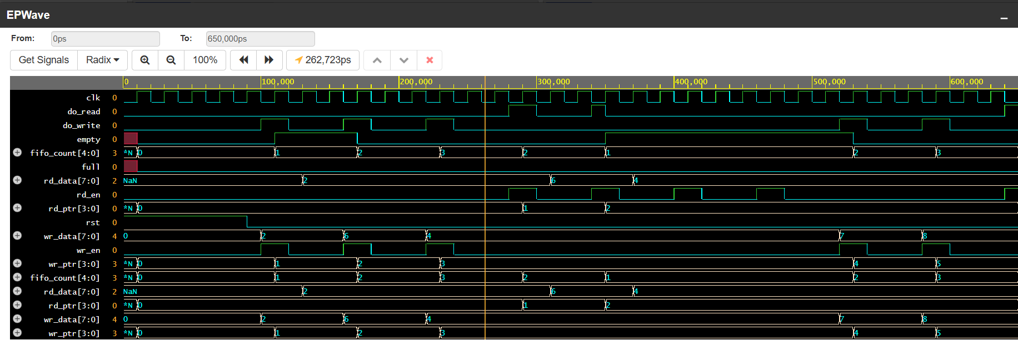
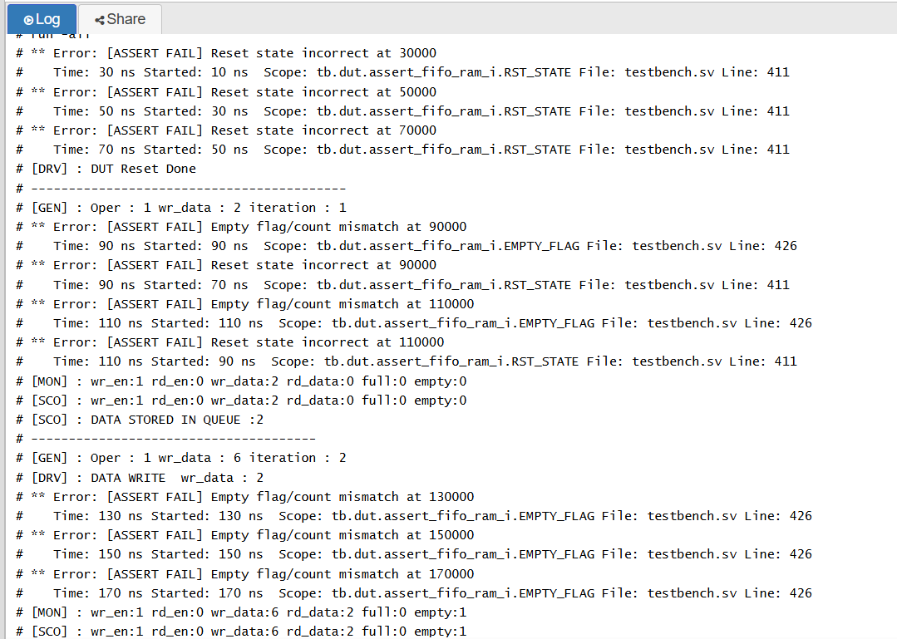
Fault Result: Issue 4
Empty flag asserted one count early
Bug inserted
Waveform: empty high while fifo_count equals one
Bug:
assign empty = (fifo_count == 1);
Correct:
assign empty = (fifo_count == 0);
Observed failure
The DUT reports empty while one valid FIFO entry still remains.
Simulation log: EMPTY_FLAG assertion failures
Checker response
EMPTY_FLAG assertion fails because empty no longer represents the true count-zero condition.
Interpretation: status flag correctness is part of functional correctness because empty directly controls whether reads are accepted.
Assertion-Based Verification of Synchronous FIFO
15

Slide 16
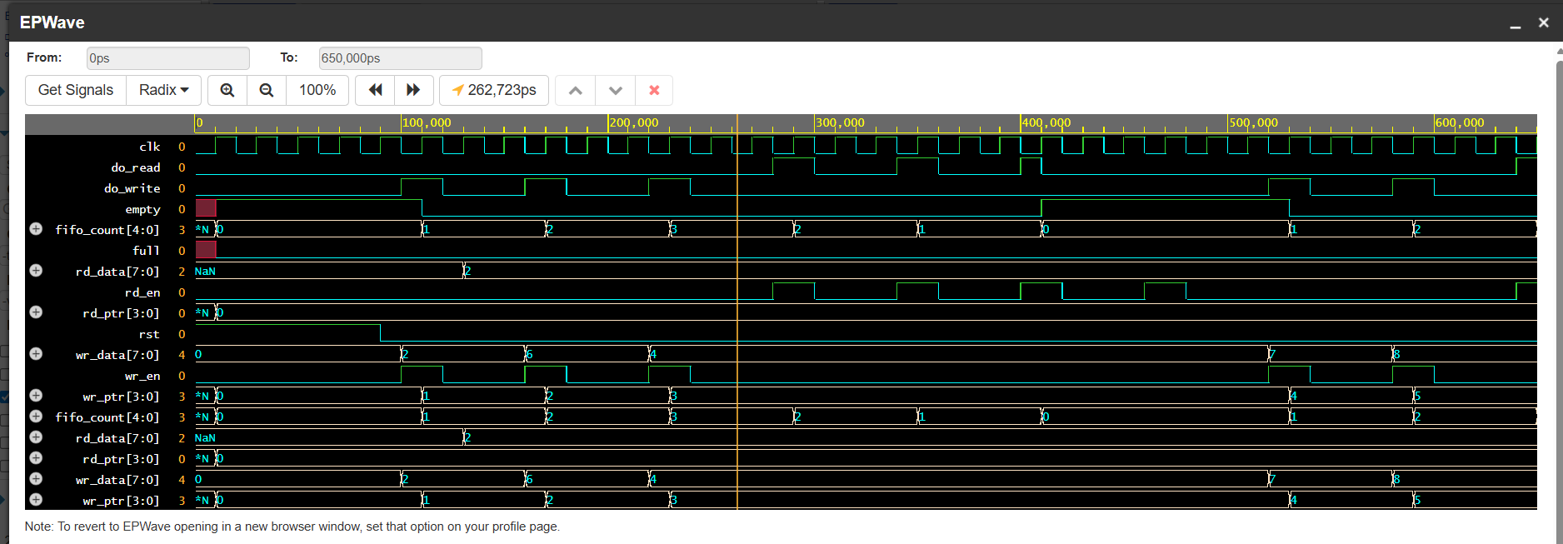
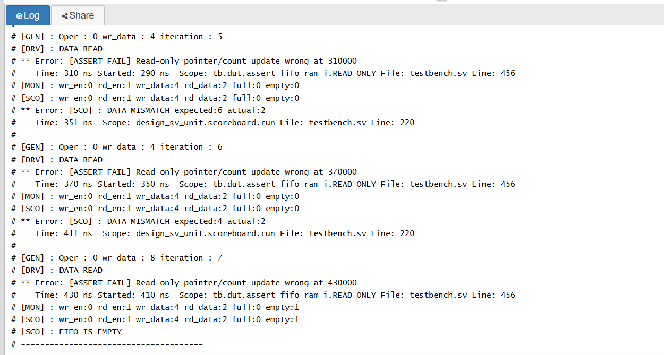
Fault Result: Issue 5
Read pointer does not advance
Real affected RTL file
Waveform: rd_ptr remains fixed while reads occur
rtl/sync_fifo_ram.sv
The selected write-side code is correct; the fault is in the read pointer update.
Issue 5 code focus
Bug:
if (do_read) begin
rd_ptr <= rd_ptr;
end
Correct:
rd_ptr <= rd_ptr + 1'b1;
Simulation log: READ_ONLY assertion and data mismatch
Effect
Valid reads are accepted and fifo_count changes, but rd_ptr remains fixed. The FIFO repeatedly reads the same RAM address.
Assertion localizes the internal pointer failure; scoreboard confirms the visible FIFO-order failure.
Assertion-Based Verification of Synchronous FIFO
16

Slide 17
Comparative Result Summary
Assertions + scoreboard
Issue
Fault injected
Primary assertion
Scoreboard effect
Conclusion
1
fifo_count not cleared on reset
RST_STATE
Queue/data mismatch later
reset state bug
2
do_read ignores empty
READ_EMPTY, COUNT_RANGE
Data mismatch after underflow
boundary bug
3
full high at count 1
FULL_FLAG
False full messages
capacity loss
4
empty high at count 1
EMPTY_FLAG
False empty messages
valid reads blocked
5
rd_ptr stuck during reads
READ_ONLY
Expected order breaks
pointer/data bug
Pattern: assertions catch control/protocol violations at the exact clocked condition; the scoreboard catches externally visible data-order consequences.
Assertion-Based Verification of Synchronous FIFO
17

Slide 18
Key Findings and Contribution
What the project demonstrates
The project demonstrates that assertion-based verification improves observability beyond transaction-level checking alone.
1. Assertions localize failures
2. Scoreboard validates behavior
3. Waveforms explain timing
Internal signals such as wr_ptr, rd_ptr, fifo_count, do_write, and do_read are checked at the clock where the rule is violated.
The queue-based reference model confirms whether the output data still follows FIFO order after control faults.
EPWave evidence connects assertion timestamps to signal transitions, making root cause analysis clear.
Main contribution
A parameterized synchronous FIFO was verified with a SystemVerilog class-based environment, bound SVA checker, scoreboard, and five intentional negative tests. The result is a reusable verification base that can be extended toward UVM.
Assertion-Based Verification of Synchronous FIFO
18

Slide 19
Conclusion, Future Work, and References
Close
Conclusion
Future improvements
The clean FIFO behavior was established first. Each injected RTL fault produced assertion or scoreboard failures, proving that the environment can detect reset, boundary, flag, pointer, and data-order bugs.
Migrate to UVM agents and sequences.
Add functional coverage bins for full/empty transitions.
Add constrained random regression tests.
Add coverage-driven closure and CI simulation scripts.
References
1. IEEE SA, IEEE 1800-2023: SystemVerilog - Unified Hardware Design, Specification, and Verification Language.
2. Accellera, Universal Verification Methodology community and standards pages.
3. Local project report: TIET_Assertion_Based_FIFO_Verification_Report.docx.
4. Project source files: rtl/sync_fifo_ram.sv, rtl/sync_ram.sv, tb/assert_fifo_ram.sv, tb/*.svh.
5. Simulation evidence: EPWave and transcript screenshots from images/issue1 through images/issue5.
Final message: SVA gives precise internal failure localization; the scoreboard proves whether the design still obeys FIFO data ordering.
Assertion-Based Verification of Synchronous FIFO
19

