Slide 1
Motivations of Parallel Computing
Faster execution times
  From days or months to hours or seconds
  E.g., climate modelling, bioinformatics
Large amount of data dictate parallelism
Parallelism more natural for certain kinds of problems, e.g., climate modelling
Due to computer architecture trends
  CPU speeds have saturated
  Slow memory bandwidths
Notes:
Lec22

Slide 2
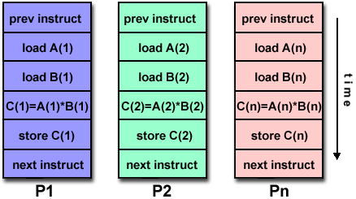
Classification of Architectures – Flynn’s classification
In terms of parallelism in instruction and data stream
Single Instruction Single Data (SISD): Serial Computers
Single Instruction Multiple Data (SIMD)
- Vector processors and processor arrays
- Examples: CM-2, Cray-90, Cray YMP, Hitachi 3600
Courtesy: http://www.llnl.gov/computing/tutorials/parallel_comp/

Slide 3
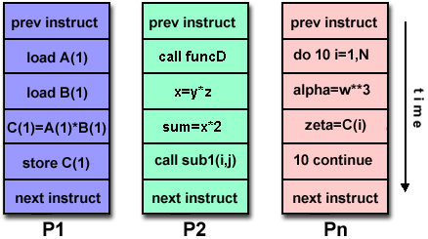
Classification of Architectures – Flynn’s classification
Multiple Instruction Single Data (MISD): Not popular
Multiple Instruction Multiple Data (MIMD)
- Most popular
- IBM SP and most other supercomputers,
clusters, computational Grids etc.
Courtesy: http://www.llnl.gov/computing/tutorials/parallel_comp/

Slide 4
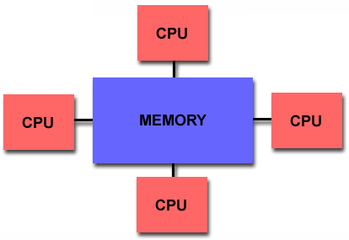
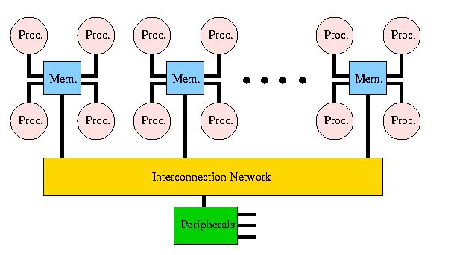
Classification of Architectures – Based on Memory
Shared memory
2 types – UMA and NUMA
NUMA
Examples: HP-Exemplar, SGI Origin, Sequent NUMA-Q
UMA
Courtesy: http://www.llnl.gov/computing/tutorials/parallel_comp/

Slide 5
Classification 2:
Shared Memory vs Message Passing
Shared memory machine: The n processors share physical address space
  Communication can be done through this shared memory
The alternative is sometimes referred to as a message passing machine or a distributed memory machine
P
P
P
P
P
P
P
M
M
M
M
M
M
M
P
P
P
P
P
Interconnect
P
P
Interconnect
Main Memory
Notes:
Lec22

Slide 6
Shared Memory Machines
The shared memory could itself be distributed among the processor nodes
  Each processor might have some portion of the shared physical address space that is physically close to it and therefore accessible in less time
  Terms: NUMA vs UMA architecture
    Non-Uniform Memory Access
    Uniform Memory Access
Notes:
Lec22

Slide 7
SHARED MEMORY AND CACHES

Slide 8
Shared Memory Architecture: Caches
P1
P2
Read X
Read X
Write X=1
Read X
Cache hit: Wrong data!!
X: 1
X: 0
X: 0
X: 0
X: 1
Notes:
Lec24

Slide 9
Cache Coherence Problem
If each processor in a shared memory multiple processor machine has a data cache
  Potential data consistency problem: the cache coherence problem
  Shared variable modification, private cache
Objective: processes shouldn’t read `stale’ data
Solutions
  Hardware: cache coherence mechanisms
Notes:
Lec24

Slide 10
Cache Coherence Protocols
Write update – propagate cache line to other processors on every write to a processor
Write invalidate – each processor gets the updated cache line whenever it reads stale data
Which is better?
Notes:
Lec24

Slide 11
Invalidation Based Cache Coherence
P1
P2
Read X
Read X
Write X=1
Read X
X: 1
X: 1
X: 0
X: 0
Invalidate
X: 1
X: 0
Notes:
Lec24

Slide 12
False Sharing
Cache coherence occurs at the granularity of cache lines – an entire cache line is invalidated
Modern day cache lines are 64 bytes in size
Consider a Fortran program dealing with a matrix
Assume each thread or process accessing a row of a matrix
Leads to false sharing

Slide 13
False sharing: Solutions
Reorganize the code so that each processor access a set of rows
Can still lead to overlapping of cache lines if matrix size not divisible by processors
In such cases, employ padding
Padding: dummy elements added to make the matrix size divisible

Slide 14
INTERCONNECTION NETWORKS

Slide 15
Interconnects
Used in both shared memory and distributed memory architectures
In shared memory: Used to connect processors to memory
In distributed memory: Used to connect different processors
Components
  Interface (PCI or PCI-e): for connecting processor to network link
  Network link connected to a communication network (network of connections)

Slide 16
Communication network
Consists of switching elements to which processors are connected through ports
Switch: network of switching elements
Switching elements connected with each other using a pattern of connections
Pattern defines the network topology
In shared memory systems, memory units are also connected to communication network

Slide 17
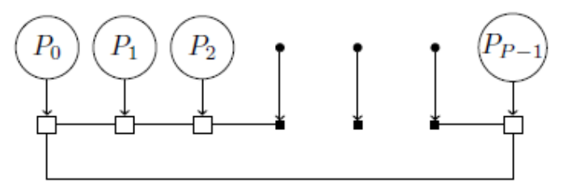
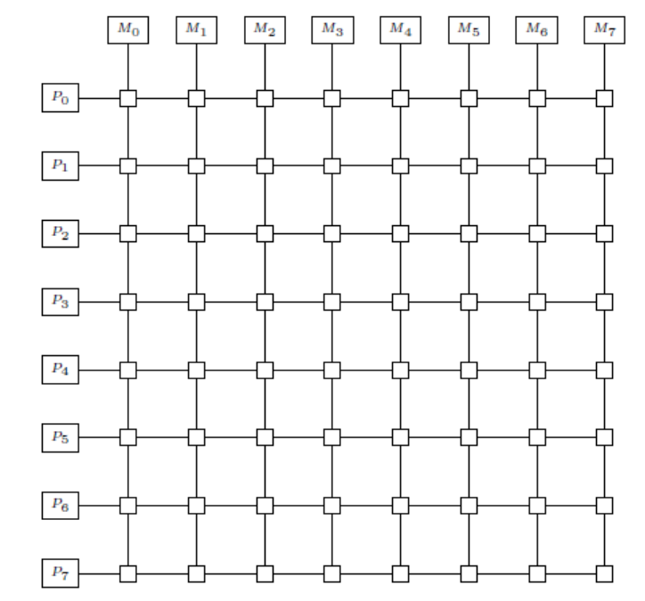
Network Topologies
Bus, ring – used in small-scale shared memory systems
Crossbar switch – used in some small-scale shared memory machines, small or medium-scale distributed memory machines

Slide 18
Crossbar Switch
Consists of 2D grid of switching elements
Each switching element consists of 2 input ports and 2 output ports
An input port dynamically connected to an output port through a switching logic

Slide 19
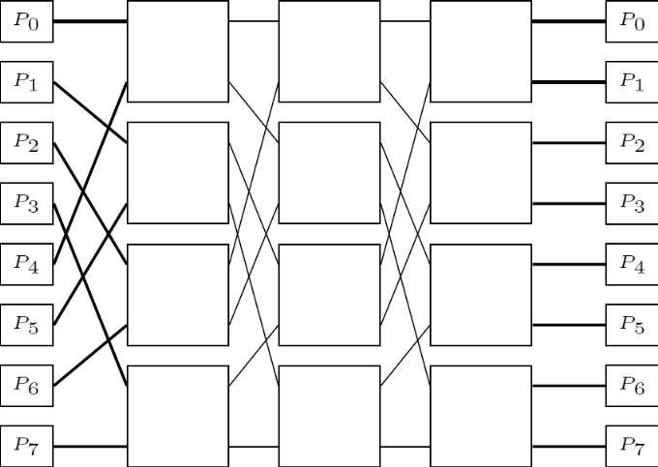
Multistage network – Omega network
To reduce switching complexity
Omega network – consisting of logP stages, each consisting of P/2 switching elements
Contention
  In crossbar – nonblocking
  In Omega – can occur during multiple communications to disjoint pairs

Slide 20
Mesh, Torus, Hypercubes, Fat-tree
Commonly used network topologies in distributed memory architectures
Hypercubes are networks with dimensions

Slide 21
Mesh, Torus, Hypercubes
2D
Mesh
Hypercube
(binary n-cube)
n=2
n=3
Torus
Notes:
Lec22

Slide 22
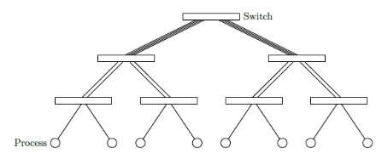
Fat Tree Networks
Binary tree
Processors arranged in leaves
Other nodes correspond to switches
Fundamental property: No. of links from a node to a children = no. of links from the node to its parent
Edges become fatter as we traverse up the tree

Slide 23
Fat Tree Networks
Any pairs of processors can communicate without contention: non-blocking network
Constant Bisection Bandwidth (CBB) networks
Two level fat tree has a diameter of four

Slide 24
Evaluating Interconnection topologies
Diameter – maximum distance between any two processing nodes
Connectivity – multiplicity of paths between 2 nodes. Miniimum number of arcs to be removed from network to break it into two disconnected networks
Bisection width – minimum number of links to be removed from network to partition it into 2 equal halves

Slide 25
Evaluating Interconnection topologies
channel width – number of bits that can be simultaneously communicated over a link, i.e. number of physical wires between 2 nodes
channel rate – performance of a single physical wire
channel bandwidth – channel rate times channel width
bisection bandwidth – maximum volume of communication between two halves of network, i.e. bisection width times channel bandwidth

