Slide 1
Outline
ILP
Compiler techniques to increase ILP
Loop Unrolling
Static Branch Prediction
Dynamic Branch Prediction
Overcoming Data Hazards with Dynamic Scheduling
(Start) Tomasulo Algorithm
Conclusion

Slide 2
Recall from Pipelining Review
Pipeline CPI = Ideal pipeline CPI + Structural Stalls + Data Hazard Stalls + Control Stalls
  Ideal pipeline CPI: measure of the maximum performance attainable by the implementation
  Structural hazards: HW cannot support this combination of instructions
  Data hazards: Instruction depends on result of prior instruction still in the pipeline
  Control hazards: Caused by delay between the fetching of instructions and decisions about changes in control flow (branches and jumps)

Slide 3
Instruction Level Parallelism
Instruction-Level Parallelism (ILP): overlap the execution of instructions to improve performance
2 approaches to exploit ILP:
  1) Rely on hardware to help discover and exploit the parallelism dynamically (e.g., Pentium 4, AMD Opteron, IBM Power) , and
  2) Rely on software technology to find parallelism, statically at compile-time (e.g., Itanium 2)
Next 4 lectures on this topic

Slide 4
Instruction-Level Parallelism (ILP)
Basic Block (BB) ILP is quite small
  BB: a straight-line code sequence with no branches in except to the entry and no branches out except at the exit
  average dynamic branch frequency 15% to 25%
  => 4 to 7 instructions execute between a pair of branches
  Plus instructions in BB likely to depend on each other
To obtain substantial performance enhancements, we must exploit ILP across multiple basic blocks
Simplest: loop-level parallelism to exploit parallelism among iterations of a loop. E.g.,
for (i=1; i<=1000; i=i+1)
x[i] = x[i] + y[i];

Slide 5
Loop-Level Parallelism
Exploit loop-level parallelism to parallelism by “unrolling loop” either by
dynamic via branch prediction or
static via loop unrolling by compiler
(Another way is vectors)
Determining instruction dependence is critical to Loop Level Parallelism
If 2 instructions are
  parallel, they can execute simultaneously in a pipeline of arbitrary depth without causing any stalls (assuming no structural hazards)
  dependent, they are not parallel and must be executed in order, although they may often be partially overlapped

Slide 6
Data Dependence and Hazards
Instr_{J} is data dependent (aka true dependence) on Instr_{I:}
  Instr_{J} tries to read operand before Instr_{I} writes it
  or Instr_{J} is data dependent on Instr_{K} which is dependent on Instr_{I}
If two instructions are data dependent, they cannot execute simultaneously or be completely overlapped
Data dependence in instruction sequence
⇒ data dependence in source code ⇒ effect of original data dependence must be preserved
If data dependence caused a hazard in pipeline,
called a Read After Write (RAW) hazard
I: add r1,r2,r3
J: sub r4,r1,r3

Slide 7
ILP and Data Dependencies,Hazards
HW/SW must preserve program order:
order instructions would execute in if executed sequentially as determined by original source program
  Dependences are a property of programs
Presence of dependence indicates potential for a hazard, but actual hazard and length of any stall is property of the pipeline
Importance of the data dependencies
  1) indicates the possibility of a hazard
  2) determines order in which results must be calculated
  3) sets an upper bound on how much parallelism can possibly be exploited
HW/SW goal: exploit parallelism by preserving program order only where it affects the outcome of the program

Slide 8
Name Dependence #1: Anti-dependence
Name dependence: when 2 instructions use same register or memory location, called a name, but no flow of data between the instructions associated with that name; 2 versions of name dependence
Instr_{J} writes operand before Instr_{I} reads it
Called an “anti-dependence” by compiler writers.
This results from reuse of the name “r1”
If anti-dependence caused a hazard in the pipeline, called a Write After Read (WAR) hazard
I: sub r4,r1,r3
J: add r1,r2,r3
K: mul r6,r1,r7

Slide 9
Name Dependence #2: Output dependence
Instr_{J} writes operand before Instr_{I} writes it.
Called an “output dependence” by compiler writers
This also results from the reuse of name “r1”
If anti-dependence caused a hazard in the pipeline, called a Write After Write (WAW) hazard
Instructions involved in a name dependence can execute simultaneously if name used in instructions is changed so instructions do not conflict
  Register renaming resolves name dependence for regs
  Either by compiler or by HW
I: sub r1,r4,r3
J: add r1,r2,r3
K: mul r6,r1,r7

Slide 10
Control Dependencies
Every instruction is control dependent on some set of branches, and, in general, these control dependencies must be preserved to preserve program order
  if p1 {
  S1;
  };
  if p2 {
  S2;
  }
S1 is control dependent on p1, and S2 is control dependent on p2 but not on p1.

Slide 11
Control Dependence Ignored
Control dependence need not be preserved
  willing to execute instructions that should not have been executed, thereby violating the control dependences, if can do so without affecting correctness of the program
Instead, 2 properties critical to program correctness are
  exception behavior and
  data flow

Slide 12
Exception Behavior
Preserving exception behavior
⇒ any changes in instruction execution order must not change how exceptions are raised in program
(⇒ no new exceptions)
Example:
DADDU R2,R3,R4
BEQZ R2,L1
LW R1,0(R2)
L1:
  (Assume branches not delayed)
Problem with moving LW before BEQZ?

Slide 13
Data Flow
Data flow: actual flow of data values among instructions that produce results and those that consume them
  branches make flow dynamic, determine which instruction is supplier of data
Example:
DADDU R1,R2,R3
BEQZ R4,L
DSUBU R1,R5,R6
L: …
OR R7,R1,R8
OR depends on DADDU or DSUBU?
Must preserve data flow on execution

Slide 14
Outline
ILP
Compiler techniques to increase ILP
Loop Unrolling
Static Branch Prediction
Dynamic Branch Prediction
Overcoming Data Hazards with Dynamic Scheduling
(Start) Tomasulo Algorithm
Conclusion

Slide 15
Software Techniques - Example
This code, add a scalar to a vector:
for (i=1000; i>0; i=i–1)
x[i] = x[i] + s;
Assume following latencies for all examples
  Ignore delayed branch in these examples
Instruction Instruction Latency stalls between
producing result using result in cycles in cycles
FP ALU op Another FP ALU op 4 3
FP ALU op Store double 3 2
Load double FP ALU op 1 1
Load double Store double 1 0
Integer op Integer op 1 0

Slide 16
FP Loop: Where are the Hazards?
First translate into MIPS code:
  -To simplify, assume 8 is lowest address
Loop: L.D F0,0(R1) ;F0=vector element
ADD.D F4,F0,F2 ;add scalar from F2
S.D 0(R1),F4 ;store result
DADDUI R1,R1,-8 ;decrement pointer 8B (DW)
BNEZ R1,Loop ;branch R1!=zero

Slide 17
FP Loop Showing Stalls
1 Loop: L.D F0,0(R1) ;F0=vector element
2 stall
3 ADD.D F4,F0,F2 ;add scalar in F2
4 stall
5 stall
6 S.D 0(R1),F4 ;store result
7 DADDUI R1,R1,-8 ;decrement pointer 8B (DW)
8 stall ;assumes can’t forward to branch
9 BNEZ R1,Loop ;branch R1!=zero
Instruction Instruction Latency in
producing result using result clock cycles
FP ALU op Another FP ALU op 3
FP ALU op Store double 2
Load double FP ALU op 1
9 clock cycles: Rewrite code to minimize stalls?

Slide 18
Revised FP Loop Minimizing Stalls
1 Loop: L.D F0,0(R1)
2 DADDUI R1,R1,-8
3 ADD.D F4,F0,F2
4 stall
5 stall
6 S.D 8(R1),F4 ;altered offset when move DSUBUI
7 BNEZ R1,Loop
Swap DADDUI and S.D by changing address of S.D
Instruction Instruction Latency in
producing result using result clock cycles
FP ALU op Another FP ALU op 3
FP ALU op Store double 2
Load double FP ALU op 1
7 clock cycles, but just 3 for execution (L.D, ADD.D,S.D), 4 for loop overhead; How make faster?
Notes:
3 clocks doing work, 3 overhead (stall, branch, sub)

Slide 19
Unroll Loop Four Times (straightforward way)
1 cycle stall
1 Loop: L.D F0,0(R1)
3 ADD.D F4,F0,F2
6 S.D 0(R1),F4 ;drop DSUBUI & BNEZ
7 L.D F6,-8(R1)
9 ADD.D F8,F6,F2
12 S.D -8(R1),F8 ;drop DSUBUI & BNEZ
13 L.D F10,-16(R1)
15 ADD.D F12,F10,F2
18 S.D -16(R1),F12 ;drop DSUBUI & BNEZ
19 L.D F14,-24(R1)
21 ADD.D F16,F14,F2
24 S.D -24(R1),F16
25 DADDUI R1,R1,#-32 ;alter to 4*8
26 BNEZ R1,LOOP
27 clock cycles, or 6.75 per iteration
(Assumes R1 is multiple of 4)
Rewrite loop to minimize stalls?
2 cycles stall

Slide 20
Unrolled Loop Detail
Do not usually know upper bound of loop
Suppose it is n, and we would like to unroll the loop to make k copies of the body
Instead of a single unrolled loop, we generate a pair of consecutive loops:
  1st executes (n mod k) times and has a body that is the original loop
  2nd is the unrolled body surrounded by an outer loop that iterates (n/k) times
For large values of n, most of the execution time will be spent in the unrolled loop

Slide 21
Unrolled Loop That Minimizes Stalls
1 Loop: L.D F0,0(R1)
2 L.D F6,-8(R1)
3 L.D F10,-16(R1)
4 L.D F14,-24(R1)
5 ADD.D F4,F0,F2
6 ADD.D F8,F6,F2
7 ADD.D F12,F10,F2
8 ADD.D F16,F14,F2
9 S.D 0(R1),F4
10 S.D -8(R1),F8
11 S.D -16(R1),F12
12 DSUBUI R1,R1,#32
13 S.D 8(R1),F16 ; 8-32 = -24
14 BNEZ R1,LOOP
14 clock cycles, or 3.5 per iteration

Slide 22
5 Loop Unrolling Decisions
Requires understanding how one instruction depends on another and how the instructions can be changed or reordered given the dependences:
Determine loop unrolling useful by finding that loop iterations were independent (except for maintenance code)
Use different registers to avoid unnecessary constraints forced by using same registers for different computations
Eliminate the extra test and branch instructions and adjust the loop termination and iteration code
Determine that loads and stores in unrolled loop can be interchanged by observing that loads and stores from different iterations are independent
  Transformation requires analyzing memory addresses and finding that they do not refer to the same address
Schedule the code, preserving any dependences needed to yield the same result as the original code

Slide 23
3 Limits to Loop Unrolling
Decrease in amount of overhead amortized with each extra unrolling
  Amdahl’s Law
Growth in code size
  For larger loops, concern it increases the instruction cache miss rate
Register pressure: potential shortfall in registers created by aggressive unrolling and scheduling
  If not be possible to allocate all live values to registers, may lose some or all of its advantage
Loop unrolling reduces impact of branches on pipeline; another way is branch prediction

Slide 24
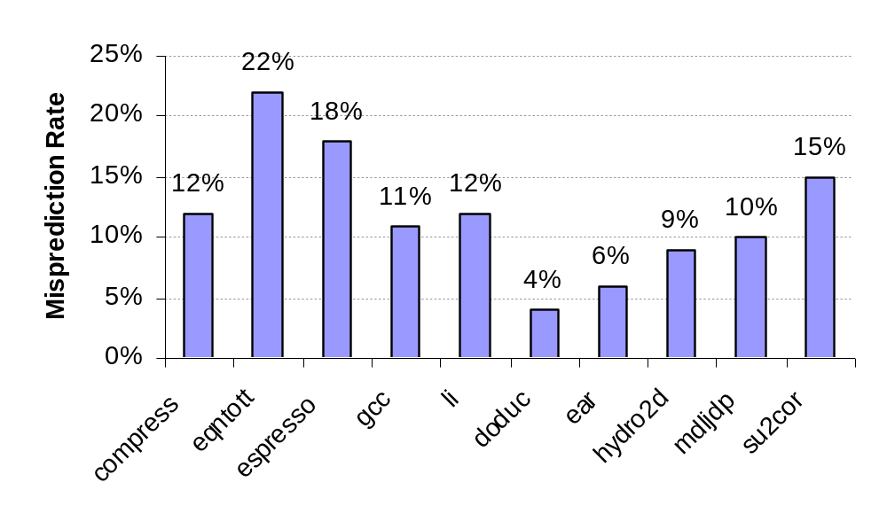
Static Branch Prediction
Previous lecture showed scheduling code around delayed branch
To reorder code around branches, need to predict branch statically when compile
Simplest scheme is to predict a branch as taken
  Average misprediction = untaken branch frequency = 34% SPEC
More accurate scheme predicts branches using profile information collected from earlier runs, and modify prediction based on last run:
Integer
Floating Point

Slide 25
Dynamic Branch Prediction
Why does prediction work?
  Underlying algorithm has regularities
  Data that is being operated on has regularities
  Instruction sequence has redundancies that are artifacts of way that humans/compilers think about problems
Is dynamic branch prediction better than static branch prediction?
  Almost always yes
  There are a small number of important branches in programs which have dynamic behavior

Slide 26
Dynamic Branch Prediction
Performance = ƒ(accuracy, cost of misprediction)
Branch History Table: Lower bits of PC address index table of 1-bit values
  Says whether or not branch taken last time
  No address check
Problem: in a loop, 1-bit BHT will cause two mispredictions (avg is 9 iterations before exit):
  End of loop case, when it exits instead of looping as before
  First time through loop on next time through code, when it predicts exit instead of looping

Slide 27
Dynamic Branch Prediction
Solution: 2-bit scheme where change prediction only if get misprediction twice
Red: stop, not taken
Green: go, taken
Adds hysteresis to decision making process
T
NT
Predict Taken
Predict Taken
T
T
NT
NT
Predict Not
Taken
Predict Not
Taken
T
NT

Slide 28
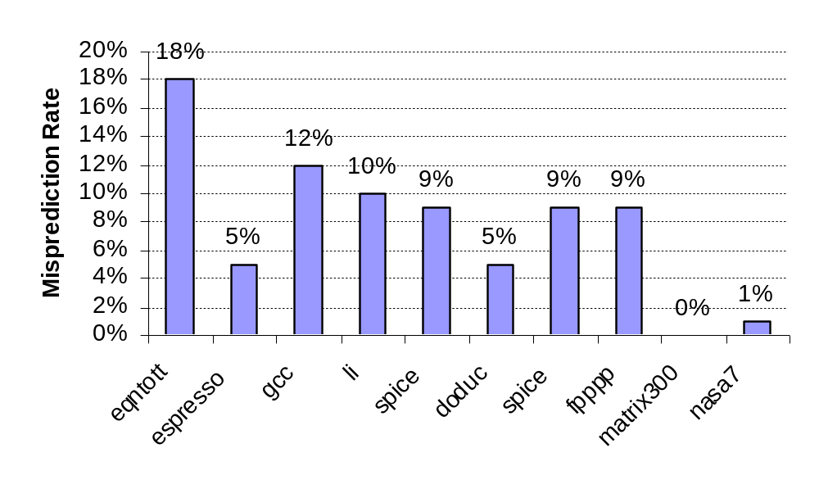
BHT Accuracy
Mispredict because either:
  Wrong guess for that branch
  Got branch history of wrong branch when index the table
4096 entry table:
Integer
Floating Point

Slide 29
Correlated Branch Prediction
Idea: record m most recently executed branches as taken or not taken, and use that pattern to select the proper n-bit branch history table
In general, (m,n) predictor means record last m branches to select between 2^{m} history tables, each with n-bit counters
  Thus, old 2-bit BHT is a (0,2) predictor
Global Branch History: m-bit shift register keeping T/NT status of last m branches.

Slide 30
Correlating Branches
(2,2) predictor
  – Behavior of recent branches selects between four predictions of next branch, updating just that prediction
Branch address
4
2-bits per branch predictor
Prediction
2-bit global branch history

Slide 31
Accuracy of Different Schemes
20%
4096 Entries 2-bit BHT
Unlimited Entries 2-bit BHT
1024 Entries (2,2) BHT
18%
16%
14%
12%
11%
Frequency of Mispredictions
10%
8%
6%
6%
6%
6%
5%
5%
4%
4%
2%
1%
1%
0%
0%
nasa7
matrix300
tomcatv
doducd
spice
fpppp
gcc
expresso
eqntott
li
4,096 entries: 2-bits per entry
Unlimited entries: 2-bits/entry
1,024 entries (2,2)

Slide 32
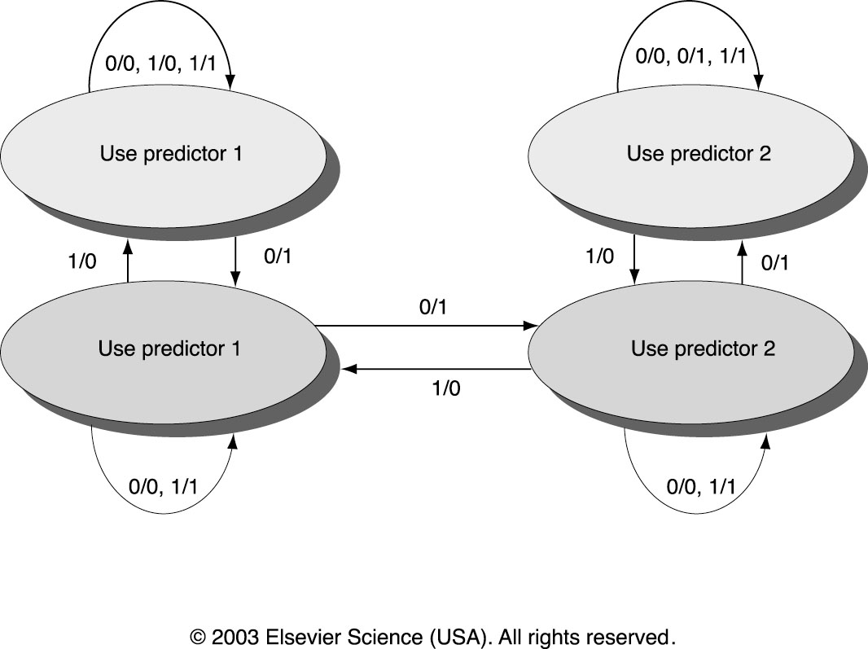
Tournament Predictors
Multilevel branch predictor
Use n-bit saturating counter to choose between predictors
Usual choice between global and local predictors

Slide 33
Tournament Predictors
Tournament predictor using, say, 4K 2-bit counters indexed by local branch address. Chooses between:
Global predictor
  4K entries index by history of last 12 branches (2¹² ⁼ 4K)
  Each entry is a standard 2-bit predictor
Local predictor
  Local history table: 1024 10-bit entries recording last 10 branches, index by branch address
  The pattern of the last 10 occurrences of that particular branch used to index table of 1K entries with 3-bit saturating counters

Slide 34
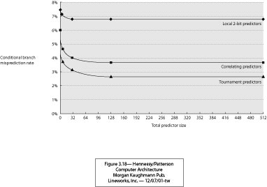
Comparing Predictors (Fig. 2.8)
Advantage of tournament predictor is ability to select the right predictor for a particular branch
  Particularly crucial for integer benchmarks.
  A typical tournament predictor will select the global predictor almost 40% of the time for the SPEC integer benchmarks and less than 15% of the time for the SPEC FP benchmarks

Slide 35
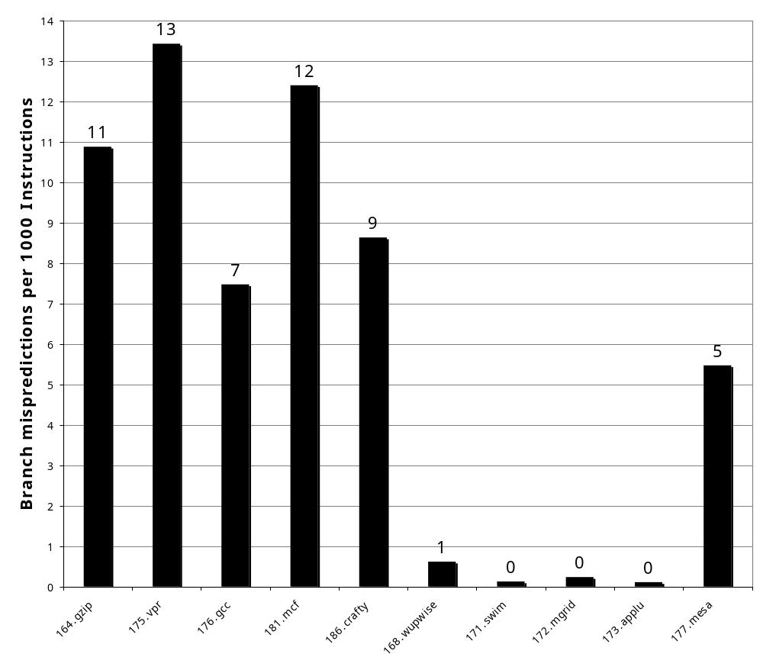
Pentium 4 Misprediction Rate
(per 1000 instructions, not per branch)
≈6% misprediction rate per branch SPECint
(19% of INT instructions are branch)
≈2% misprediction rate per branch SPECfp
(5% of FP instructions are branch)
SPECint2000
SPECfp2000

Slide 36
Branch Target Buffers (BTB)
Branch target calculation is costly and stalls the instruction fetch.
BTB stores PCs the same way as caches
The PC of a branch is sent to the BTB
When a match is found the corresponding Predicted PC is returned
If the branch was predicted taken, instruction fetch continues at the returned predicted PC

Slide 37
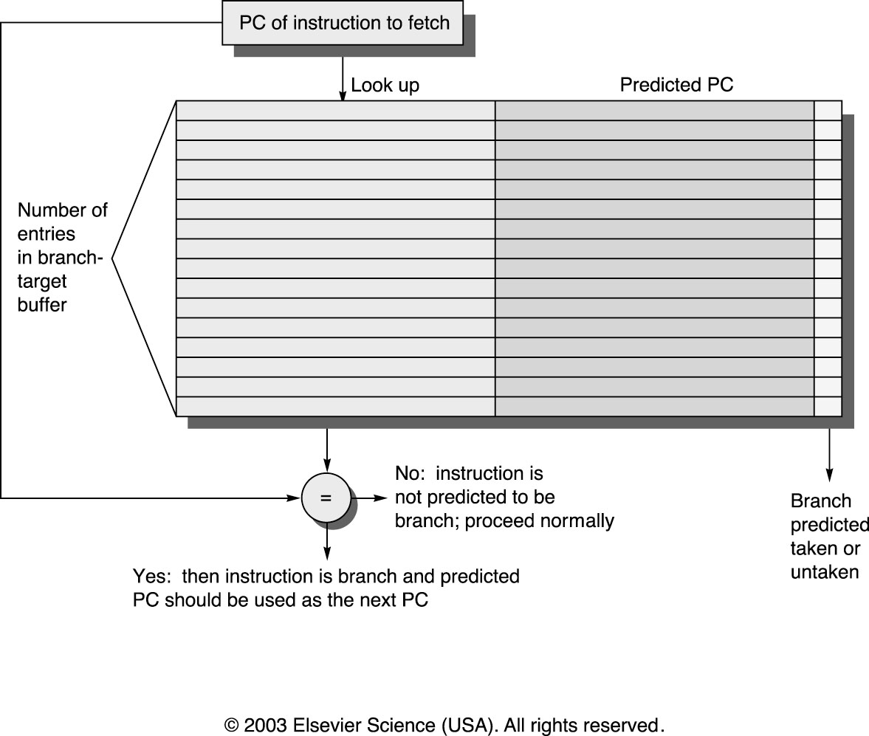
Branch Target Buffers

Slide 38
Dynamic Branch Prediction Summary
Prediction becoming important part of execution
Branch History Table: 2 bits for loop accuracy
Correlation: Recently executed branches correlated with next branch
  Either different branches (GA)
  Or different executions of same branches (PA)
Tournament predictors take insight to next level, by using multiple predictors
  usually one based on global information and one based on local information, and combining them with a selector
  In 2006, tournament predictors using ≈ 30K bits are in processors like the Power5 and Pentium 4
Branch Target Buffer: include branch address & prediction

Slide 39
Outline
ILP
Compiler techniques to increase ILP
Loop Unrolling
Static Branch Prediction
Dynamic Branch Prediction
Overcoming Data Hazards with Dynamic Scheduling
(Start) Tomasulo Algorithm
Conclusion

Slide 40
Advantages of Dynamic Scheduling
Dynamic scheduling - hardware rearranges the instruction execution to reduce stalls while maintaining data flow and exception behavior
It handles cases when dependences unknown at compile time
  it allows the processor to tolerate unpredictable delays such as cache misses, by executing other code while waiting for the miss to resolve
It allows code that compiled for one pipeline to run efficiently on a different pipeline
It simplifies the compiler
Hardware speculation, a technique with significant performance advantages, builds on dynamic scheduling (next lecture)

Slide 41
HW Schemes: Instruction Parallelism
Key idea: Allow instructions behind stall to proceed
DIVD F0,F2,F4
ADDD F10,F0,F8
SUBD F12,F8,F14
Enables out-of-order execution and allows out-of-order completion (e.g., SUBD)
  In a dynamically scheduled pipeline, all instructions still pass through issue stage in order (in-order issue)
Will distinguish when an instruction begins execution and when it completes execution; between 2 times, the instruction is in execution
Note: Dynamic execution creates WAR and WAW hazards and makes exceptions harder

Slide 42
Dynamic Scheduling Step 1
Simple pipeline had 1 stage to check both structural and data hazards: Instruction Decode (ID), also called Instruction Issue
Split the ID pipe stage of simple 5-stage pipeline into 2 stages:
Issue—Decode instructions, check for structural hazards
Read operands—Wait until no data hazards, then read operands

Slide 43
A Dynamic Algorithm: Tomasulo’s
For IBM 360/91 (before caches!)
  ⇒ Long memory latency
Goal: High Performance without special compilers
Small number of floating point registers (4 in 360) prevented interesting compiler scheduling of operations
  This led Tomasulo to try to figure out how to get more effective registers — renaming in hardware!
Why Study 1966 Computer?
The descendants of this have flourished!
  Alpha 21264, Pentium 4, AMD Opteron, Power 5, …

Slide 44
Tomasulo Algorithm
Control & buffers distributed with Function Units (FU)
  FU buffers called “reservation stations”; have pending operands
Registers in instructions replaced by values or pointers to reservation stations(RS); called register renaming ;
  Renaming avoids WAR, WAW hazards
  More reservation stations than registers, so can do optimizations compilers can’t
Results to FU from RS, not through registers, over Common Data Bus that broadcasts results to all FUs
  Avoids RAW hazards by executing an instruction only when its operands are available
Load and Stores treated as FUs with RSs as well
Integer instructions can go past branches (predict taken), allowing FP ops beyond basic block in FP queue

Slide 45
Tomasulo Organization
From Mem
FP Op
Queue
FP Registers
Load Buffers
Load1
Load2
Load3
Load4
Load5
Load6
Store
Buffers
Add1
Add2
Add3
Mult1
Mult2
Reservation
Stations
To Mem
FP adders
FP multipliers
Common Data Bus (CDB)
Notes:
Resolve RAW memory conflict? (address in memory buffers)
Integer unit executes in parallel

Slide 46
Reservation Station Components
Op: Operation to perform in the unit (e.g., + or –)
Vj, Vk: Value of Source operands
  Store buffers has V field, result to be stored
Qj, Qk: Reservation stations producing source registers (value to be written)
  Note: Qj,Qk=0 => ready
  Store buffers only have Qi for RS producing result
Busy: Indicates reservation station or FU is busy
Register result status—Indicates which functional unit will write each register, if one exists. Blank when no pending instructions that will write that register.
Notes:
What you might have thought
1. 4 stages of instruction executino
2.Status of FU: Normal things to keep track of (RAW & structura for busyl):
Fi from instruction format of the mahine (Fi is dest)
Add unit can Add or Sub
Rj, Rk - status of registers (Yes means ready)
Qj,Qk - If a no in Rj, Rk, means waiting for a FU to write result; Qj, Qk means wihch FU waiting for it
3.Status of register result (WAW &WAR)s:
which FU is going to write into registers
Scoreboard on 6600 = size of FU
6.7, 6.8, 6.9, 6.12, 6.13, 6.16, 6.17
FU latencies: Add 2, Mult 10, Div 40 clocks

Slide 47
Three Stages of Tomasulo Algorithm
1. Issue—get instruction from FP Op Queue
  If reservation station free (no structural hazard),
  control issues instr & sends operands (renames registers).
2. Execute—operate on operands (EX)
  When both operands ready then execute;
  if not ready, watch Common Data Bus for result
3. Write result—finish execution (WB)
  Write on Common Data Bus to all awaiting units;
  mark reservation station available
Normal data bus: data + destination (“go to” bus)
Common data bus: data + source (“come from” bus)
  64 bits of data + 4 bits of Functional Unit source address
  Write if matches expected Functional Unit (produces result)
  Does the broadcast
Example speed:
3 clocks for Fl .pt. +,-; 10 for * ; 40 clks for /

Slide 48
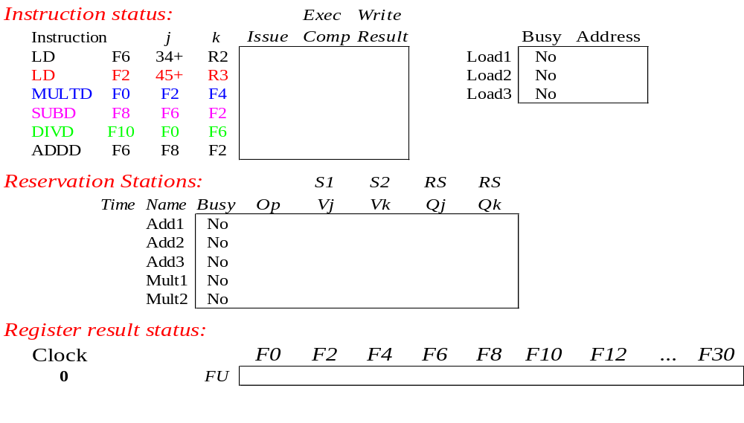
Tomasulo Example
Instruction stream
3 Load/Buffers
FU count
down
3 FP Adder R.S.
2 FP Mult R.S.
Clock cycle
counter

Slide 49
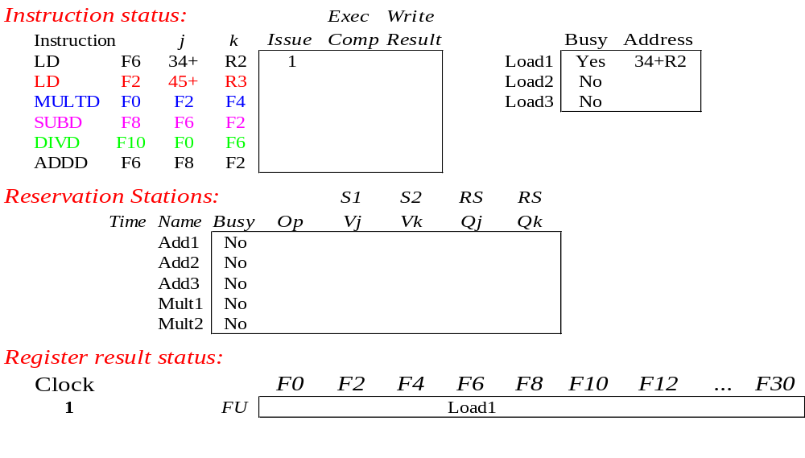
Tomasulo Example Cycle 1

Slide 50
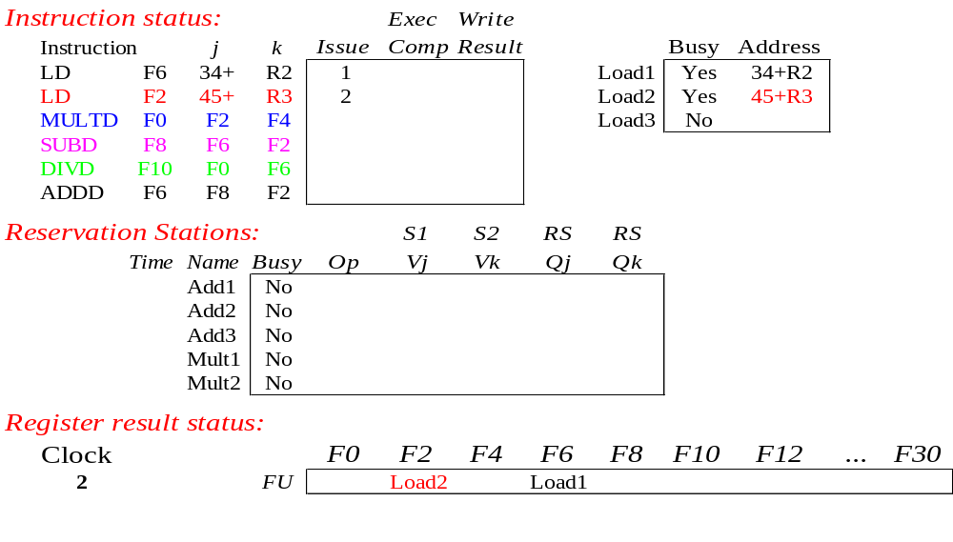
Tomasulo Example Cycle 2
Note: Can have multiple loads outstanding

Slide 51
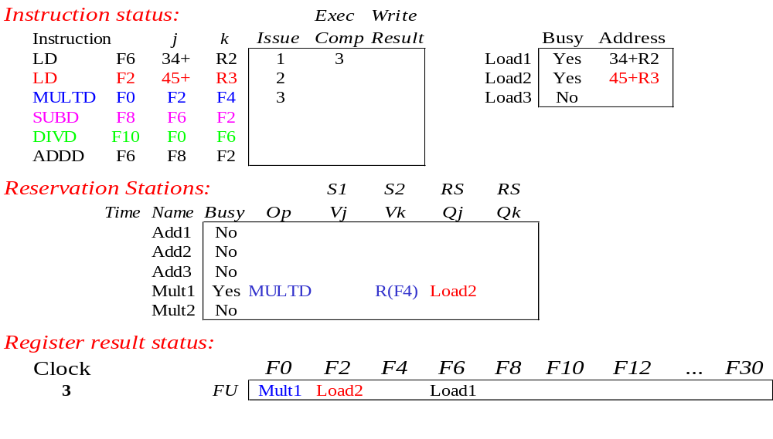
Tomasulo Example Cycle 3
Note: registers names are removed (“renamed”) in Reservation Stations; MULT issued
Load1 completing; what is waiting for Load1?

Slide 52
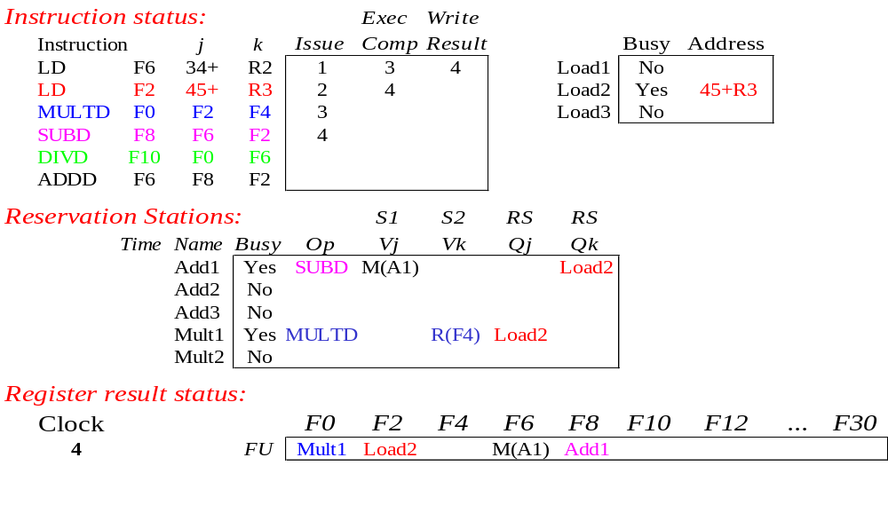
Tomasulo Example Cycle 4
Load2 completing; what is waiting for Load2?

Slide 53
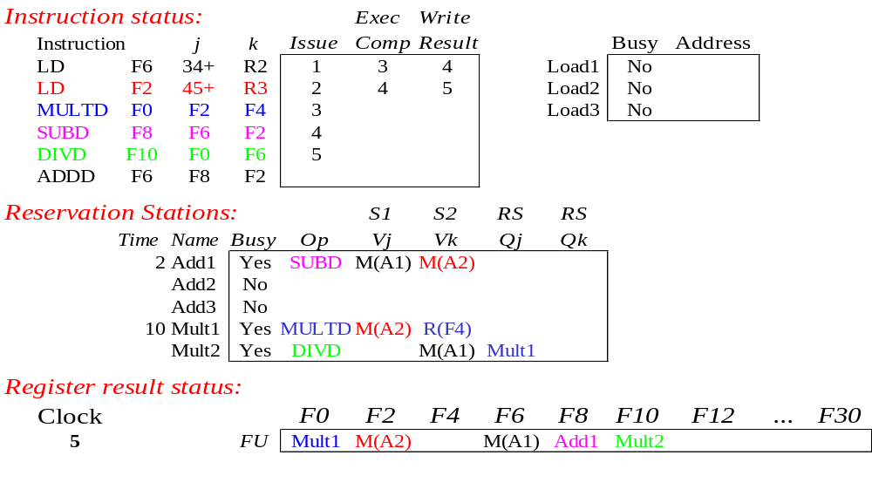
Tomasulo Example Cycle 5
Timer starts down for Add1, Mult1

Slide 54
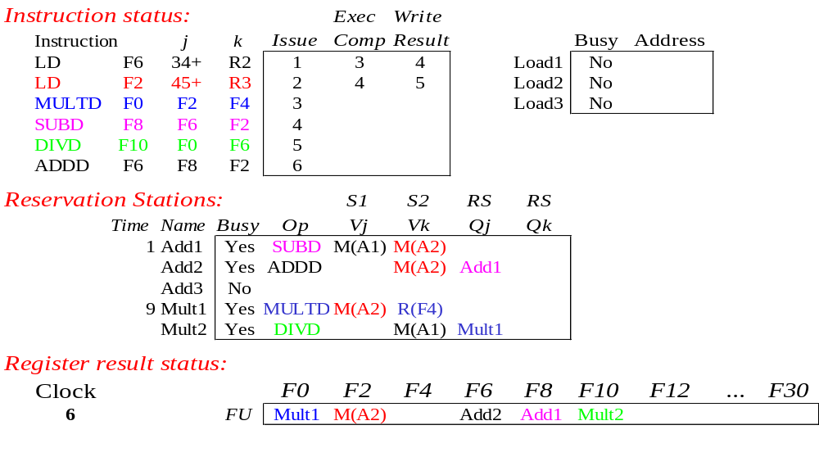
Tomasulo Example Cycle 6
Issue ADDD here despite name dependency on F6?

Slide 55

Tomasulo Example Cycle 7
Add1 (SUBD) completing; what is waiting for it?

Slide 56
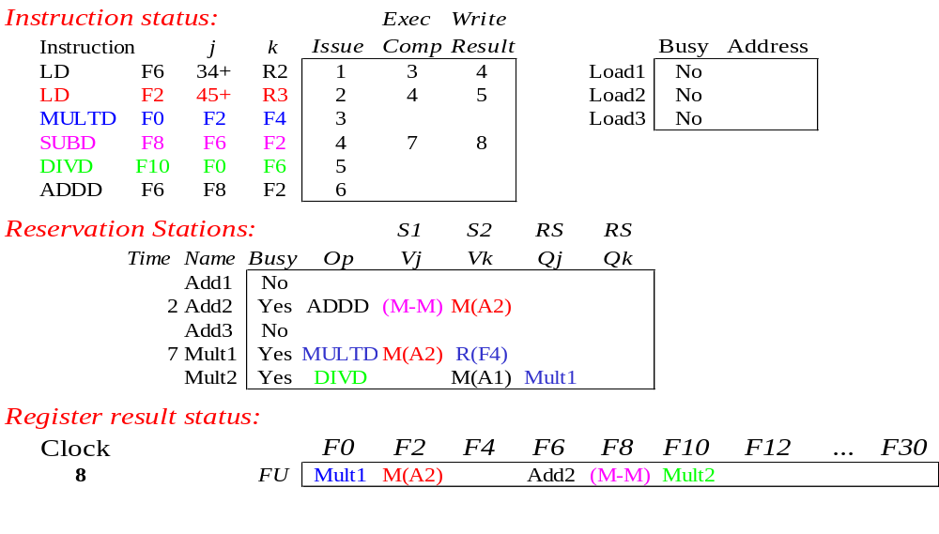
Tomasulo Example Cycle 8

Slide 57

Tomasulo Example Cycle 9

Slide 58

Tomasulo Example Cycle 10
Add2 (ADDD) completing; what is waiting for it?

Slide 59
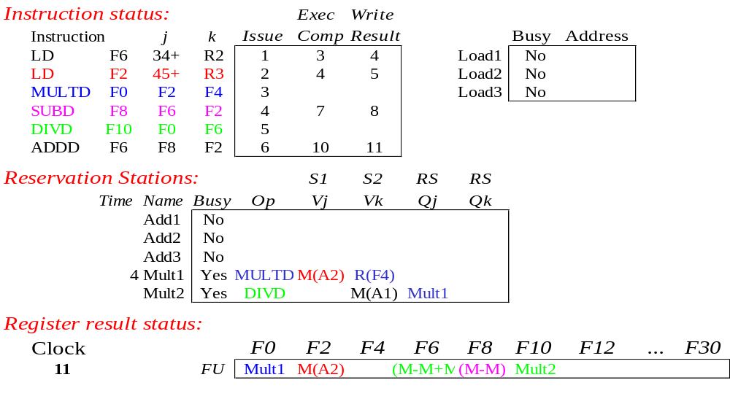
Tomasulo Example Cycle 11
Write result of ADDD here?
All quick instructions complete in this cycle!

Slide 60

Tomasulo Example Cycle 12

Slide 61

Tomasulo Example Cycle 13

Slide 62

Tomasulo Example Cycle 14

Slide 63
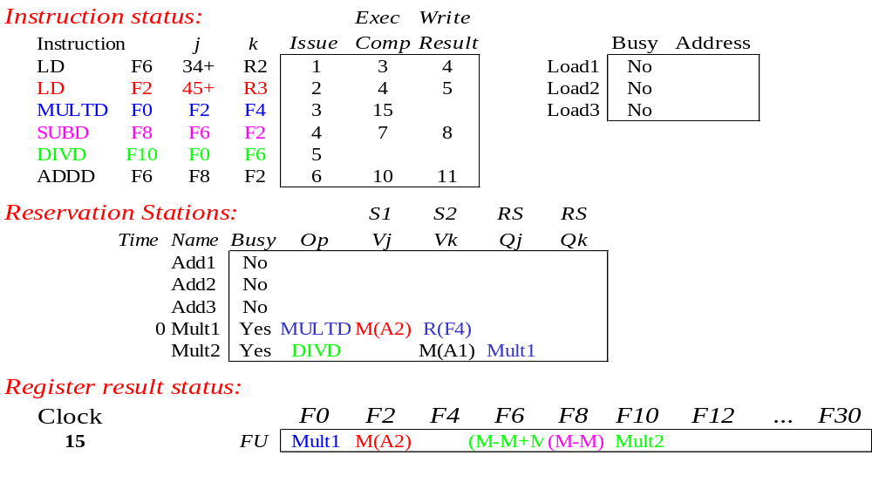
Tomasulo Example Cycle 15
Mult1 (MULTD) completing; what is waiting for it?

Slide 64
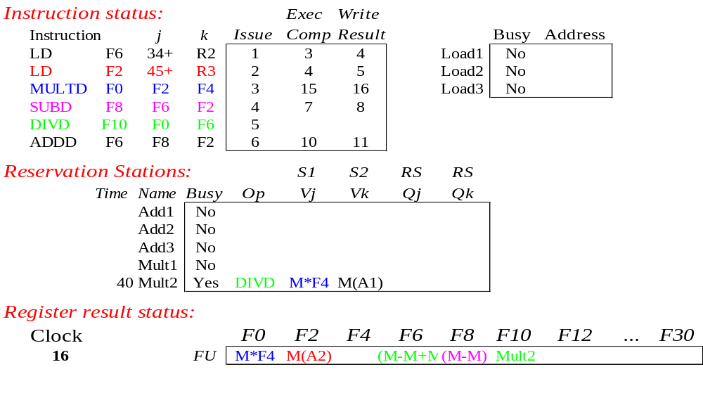
Tomasulo Example Cycle 16
Just waiting for Mult2 (DIVD) to complete

Slide 65
Faster than light computation
(skip a couple of cycles)

Slide 66
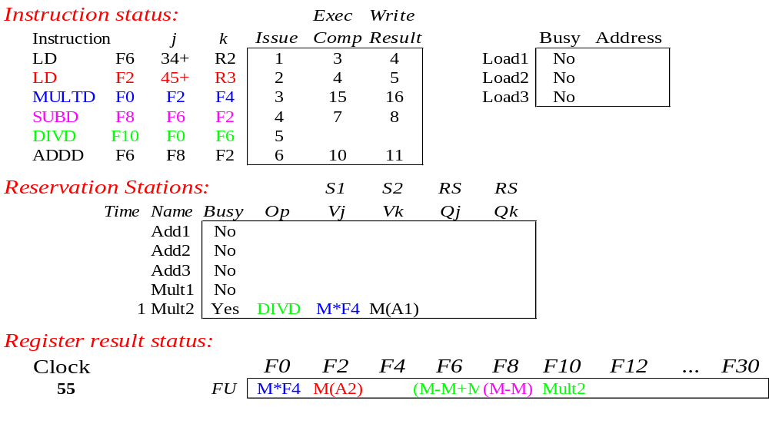
Tomasulo Example Cycle 55

Slide 67
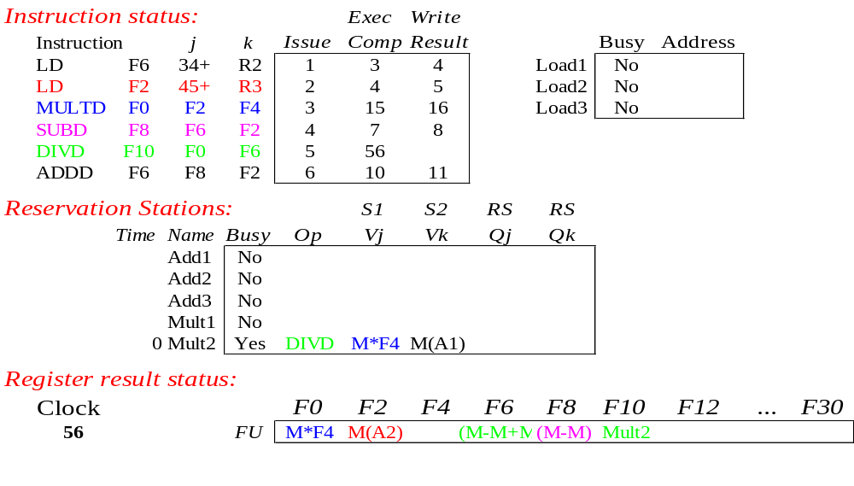
Tomasulo Example Cycle 56
Mult2 (DIVD) is completing; what is waiting for it?

Slide 68
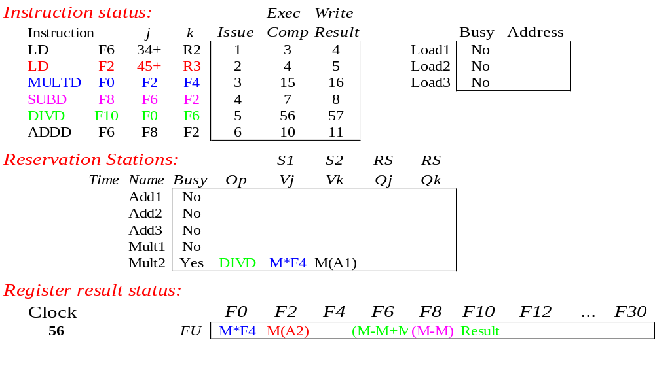
Tomasulo Example Cycle 57
Once again: In-order issue, out-of-order execution and out-of-order completion.

Slide 69
Why can Tomasulo overlap iterations of loops?
Register renaming
  Multiple iterations use different physical destinations for registers (dynamic loop unrolling).
Reservation stations
  Permit instruction issue to advance past integer control flow operations
  Also buffer old values of registers - totally avoiding the WAR stall
Other perspective: Tomasulo building data flow dependency graph on the fly

Slide 70
Tomasulo’s scheme offers 2 major advantages
Distribution of the hazard detection logic
  distributed reservation stations and the CDB
  If multiple instructions waiting on single result, & each instruction has other operand, then instructions can be released simultaneously by broadcast on CDB
  If a centralized register file were used, the units would have to read their results from the registers when register buses are available
Elimination of stalls for WAW and WAR hazards

Slide 71
Tomasulo Drawbacks
Complexity
  delays of 360/91, MIPS 10000, Alpha 21264,
  IBM PPC 620 in CA:AQA 2/e, but not in silicon!
Many associative stores (CDB) at high speed
Performance limited by Common Data Bus
  Each CDB must go to multiple functional units
  ⇒high capacitance, high wiring density
  Number of functional units that can complete per cycle limited to one!
    Multiple CDBs ⇒ more FU logic for parallel assoc stores
Non-precise interrupts!
  We will address this later

Slide 72
And In Conclusion … #1
Leverage Implicit Parallelism for Performance: Instruction Level Parallelism
Loop unrolling by compiler to increase ILP
Branch prediction to increase ILP
Dynamic HW exploiting ILP
  Works when can’t know dependence at compile time
  Can hide L1 cache misses
  Code for one machine runs well on another

Slide 73
And In Conclusion … #2
Reservations stations: renaming to larger set of registers + buffering source operands
  Prevents registers as bottleneck
  Avoids WAR, WAW hazards
  Allows loop unrolling in HW
Not limited to basic blocks
(integer units gets ahead, beyond branches)
Helps cache misses as well
Lasting Contributions
  Dynamic scheduling
  Register renaming
  Load/store disambiguation
360/91 descendants are Intel Pentium 4, IBM Power 5, AMD Athlon/Opteron, …

