Slide 1
Lecture 12 –Multiprocessor Introduction
Notes:
CS258 S99

Slide 2
Outline
MP Motivation
SISD v. SIMD v. MIMD
Centralized vs. Distributed Memory
Challenges to Parallel Programming
Consistency, Coherency, Write Serialization
Write Invalidate Protocol
Example
Conclusion

Slide 3
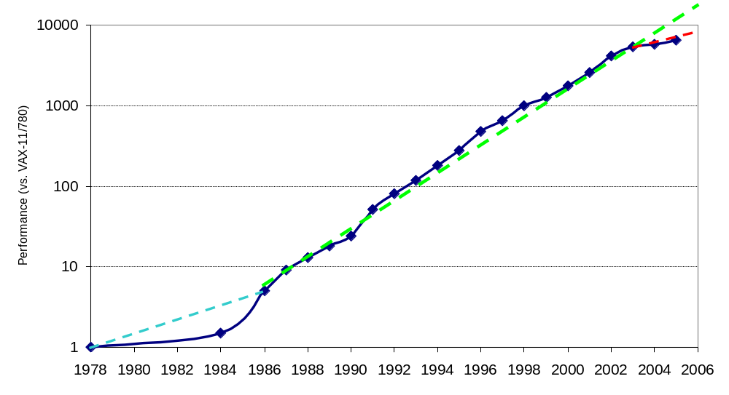
Uniprocessor Performance (SPECint)
3X
From Hennessy and Patterson, Computer Architecture: A Quantitative Approach, 4th edition, 2006
VAX : 25%/year 1978 to 1986
RISC + x86: 52%/year 1986 to 2002
RISC + x86: ??%/year 2002 to present
Notes:
CS258 S99

Slide 4
Limits to ILP
Doubling issue rates above today’s 3-6 instructions per clock, say to 6 to 12 instructions, probably requires a processor to
  Issue 3 or 4 data memory accesses per cycle,
  Resolve 2 or 3 branches per cycle,
  Rename and access more than 20 registers per cycle, and
  Fetch 12 to 24 instructions per cycle.
Complexities of implementing these capabilities likely means sacrifices in maximum clock rate
  E.g, widest issue processor is the Itanium 2, but it also has the slowest clock rate, despite the fact that it consumes the most power!

Slide 5
Limits to ILP
Most techniques for increasing performance increase power consumption
The key question is whether a technique is energy efficient: does it increase power consumption faster than it increases performance?
Multiple issue processors techniques all are energy inefficient:
  Issuing multiple instructions incurs some overhead in logic that grows faster than the issue rate grows
  Growing gap between peak issue rates and sustained performance
Number of transistors switching = f(peak issue rate), and performance = f( sustained rate),
growing gap between peak and sustained performance
⇒ increasing energy per unit of performance

Slide 6
Commentary
Itanium architecture does not represent a significant breakthrough in scaling ILP or in avoiding the problems of complexity and power consumption
Instead of pursuing more ILP, architects are increasingly focusing on TLP implemented with single-chip multiprocessors
In 2000, IBM announced the 1st commercial single-chip, general-purpose multiprocessor, the Power4, which contains 2 Power3 processors and an integrated L2 cache
  Since then, Sun Microsystems, AMD, and Intel have switch to a focus on single-chip multiprocessors rather than more aggressive uniprocessors.
Right balance of ILP and TLP is unclear today
  Perhaps right choice for server market, which can exploit more TLP, may differ from desktop, where single-thread performance may continue to be a primary requirement

Slide 7
And in conclusion …
Limits to ILP (power efficiency, compilers, dependencies …) seem to limit to 3 to 6 issue for practical options
Explicitly parallel (Data level parallelism or Thread level parallelism) is next step to performance
Coarse grain vs. Fine grained multihreading
  Only on big stall vs. every clock cycle
Simultaneous Multithreading if fine grained multithreading based on OOO superscalar microarchitecture
  Instead of replicating registers, reuse rename registers
Itanium/EPIC/VLIW is not a breakthrough in ILP
Balance of ILP and TLP unclear in marketplace

Slide 8
Déjà vu all over again?
“… today’s processors … are nearing an impasse as technologies approach the speed of light..”
David Mitchell, The Transputer: The Time Is Now (1989)
Transputer had bad timing (Uniprocessor performance↑)
⇒ Procrastination rewarded: 2X seq. perf. / 1.5 years
“We are dedicating all of our future product development to multicore designs. … This is a sea change in computing”
Paul Otellini, President, Intel (2005)
All microprocessor companies switch to MP (2X CPUs / 2 yrs)
⇒ Procrastination penalized: 2X sequential perf. / 5 yrs
Manufacturer/Year | AMD 05/08 | Intel 06/08 | IBM/’04 | Sun/’05
Processors/chip | 2/4 | 2/4 | 2 | 8
Threads/Processor | 1/1 | 2/4 | 2 | 4
Threads/chip | 2/4 | 4/4 | 4 | 32
Notes:
CS258 S99

Slide 9
Performance beyond single thread ILP
There can be much higher natural parallelism in some applications
(e.g., Database or Scientific codes)
Explicit Thread Level Parallelism or Data Level Parallelism
Thread: process with own instructions and data
  thread may be a process part of a parallel program of multiple processes, or it may be an independent program
  Each thread has all the state (instructions, data, PC, register state, and so on) necessary to allow it to execute
Data Level Parallelism: Perform identical operations on data, and lots of data

Slide 10
Thread Level Parallelism (TLP)
ILP exploits implicit parallel operations within a loop or straight-line code segment
TLP explicitly represented by the use of multiple threads of execution that are inherently parallel
Goal: Use multiple instruction streams to improve
  Throughput of computers that run many programs
  Execution time of multi-threaded programs
TLP could be more cost-effective to exploit than ILP

Slide 11
Multiprocessors
Growth in data-intensive applications
  Data bases, file servers, …
Growing interest in servers, server perf.
Increasing desktop perf. less important
  Outside of graphics
Improved understanding in how to use multiprocessors effectively
  Especially server where significant natural TLP
Advantage of leveraging design investment by replication
  Rather than unique design

Slide 12
Flynn’s Taxonomy
M.J. Flynn, "Very High-Speed Computers",
Proc. of the IEEE, V 54, 1900-1909, Dec. 1966.
Flynn classified by data and control streams in 1966
SIMD ⇒ Data Level Parallelism
MIMD ⇒ Thread Level Parallelism
MIMD popular because
  Flexible: N pgms and 1 multithreaded pgm
  Cost-effective: same MPU in desktop & MIMD
Single Instruction Single Data (SISD) (Uniprocessor) | Single Instruction Multiple Data SIMD (single PC: Vector, CM-2, SSE)
Multiple Instruction Single Data (MISD) (????) | Multiple Instruction Multiple Data MIMD (Clusters, SMP servers)

Slide 13
Back to Basics
“A parallel computer is a collection of processing elements that cooperate and communicate to solve large problems fast.”
Parallel Architecture = Computer Architecture + Communication Architecture
2 classes of multiprocessors WRT memory:
Centralized Memory Multiprocessor
  < few processor chips (and < 100 cores) in 2008
  Small enough to share single, centralized memory
Physically Distributed-Memory multiprocessor
  Larger number chips and cores than 1.
  BW demands ⇒ Memory distributed among processors

Slide 14
Centralized vs. Distributed Memory
Scale
P
P
P
1
n
P
n
1
$
$
$
$
Mem
Mem
Inter
connection network
Inter
connection network
Mem
Mem
Centralized Memory
Distributed Memory

Slide 15
Centralized Memory Multiprocessor
  Also called symmetric multiprocessors (SMPs) because single main memory has a symmetric relationship to all processors
  Large caches ⇒ single memory can satisfy memory demands of small number of processors
  Can scale to a few dozen processors by using a switch and by using many memory banks
  Although scaling beyond that is technically conceivable, it becomes less attractive as the number of processors sharing centralized memory increases

Slide 16
Distributed Memory Multiprocessor
  Pro: Cost-effective way to scale memory bandwidth
    If most accesses are to local memory
  Pro: Reduces latency of local memory accesses
  Con: Communicating data between processors more complex
  Con: Must change software to take advantage of increased memory BW

Slide 17
2 Models for Communication and Memory Architecture
Communication occurs by explicitly passing messages among the processors:
message-passing multiprocessors
Communication occurs through a shared address space (via loads and stores):
shared memory multiprocessors either
  UMA (Uniform Memory Access time) for shared address, centralized memory MP
  NUMA (Non Uniform Memory Access time multiprocessor) for shared address, distributed memory MP
In past, confusion whether “sharing” means sharing physical memory (Symmetric MP) or sharing address space

Slide 18
Challenges of Parallel Processing
First challenge is % of program inherently sequential
Suppose 80X speedup from 100 processors. What fraction of original program can be sequential?
  10%
  5%
  1%
  <1%

Slide 19
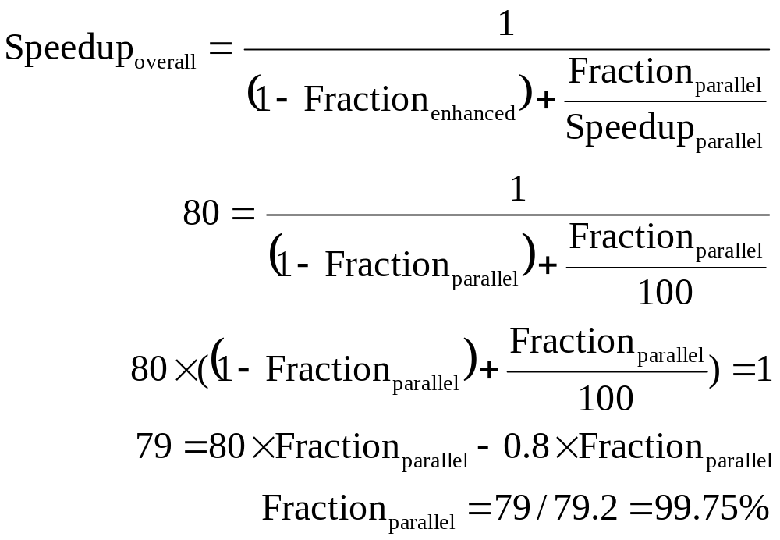
Amdahl’s Law Answers

Slide 20
Challenges of Parallel Processing
Second challenge is long latency to remote memory
Suppose 32 CPU MP, 2GHz, 200 ns remote memory, all local accesses hit memory hierarchy and base CPI is 0.5. (Remote access = 200/0.5 = 400 clock cycles.)
What is performance impact if 0.2% instructions involve remote access?
  1.5X
  2.0X
  2.5X

Slide 21
CPI Equation
CPI = Base CPI +
Remote request rate
x Remote request cost
CPI = 0.5 + 0.2% x 400 = 0.5 + 0.8 = 1.3
No communication is 1.3/0.5 or 2.6 faster than 0.2% instructions involve local access

Slide 22
Challenges of Parallel Processing
Application parallelism ⇒ primarily via new algorithms that have better parallel performance
Long remote latency impact ⇒ both by architect and by the programmer
For example, reduce frequency of remote accesses either by
  Caching shared data (HW)
  Restructuring the data layout to make more accesses local (SW)
Today’s lecture on HW to help latency via caches

Slide 23
Symmetric Shared-Memory Architectures
From multiple boards on a shared bus to multiple processors inside a single chip
Caches both
  Private data are used by a single processor
  Shared data are used by multiple processors
Caching shared data
⇒ reduces latency to shared data, memory bandwidth for shared data,
and interconnect bandwidth
⇒ cache coherence problem

Slide 24
Example Cache Coherence Problem
P
P
2
P
1
3
u
= ?
u
= ?
3
$
4
$
5
$
u
:5
u
:5
u
= 7
1
I/O devices
u
:5
2
Memory
  Processors see different values for u after event 3
  With write back caches, value written back to memory depends on happenstance of which cache flushes or writes back value when
    Processes accessing main memory may see very stale value
  Unacceptable for programming, and its frequent!

Slide 25
Intuitive Memory Model
P
Reading an address should return the last value written to that address
  Easy in uniprocessors, except for I/O
L1
100:67
L2
100:35
Memory
Disk
100:34
Too vague and simplistic; 2 issues
Coherence defines values returned by a read
Consistency determines when a written value will be returned by a read
Coherence defines behavior to same location, Consistency defines behavior to other locations

Slide 26
Defining Coherent Memory System
Preserve Program Order: A read by processor P to location X that follows a write by P to X, with no writes of X by another processor occurring between the write and the read by P, always returns the value written by P
Coherent view of memory: Read by a processor to location X that follows a write by another processor to X returns the written value if the read and write are sufficiently separated in time and no other writes to X occur between the two accesses
Write serialization: 2 writes to same location by any 2 processors are seen in the same order by all processors
  If not, a processor could keep value 1 since saw as last write
  For example, if the values 1 and then 2 are written to a location, processors can never read the value of the location as 2 and then later read it as 1

Slide 27
Write Consistency
For now assume
A write does not complete (and allow the next write to occur) until all processors have seen the effect of that write
The processor does not change the order of any write with respect to any other memory access
⇒ if a processor writes location A followed by location B, any processor that sees the new value of B must also see the new value of A
These restrictions allow the processor to reorder reads, but forces the processor to finish writes in program order

Slide 28
Basic Schemes for Enforcing Coherence
Program on multiple processors will normally have copies of the same data in several caches
  Unlike I/O, where its rare
Rather than trying to avoid sharing in SW,
SMPs use a HW protocol to maintain coherent caches
  Migration and Replication key to performance of shared data
Migration - data can be moved to a local cache and used there in a transparent fashion
  Reduces both latency to access shared data that is allocated remotely and bandwidth demand on the shared memory
Replication – for shared data being simultaneously read, since caches make a copy of data in local cache
  Reduces both latency of access and contention for read shared data

Slide 29
2 Classes of Cache Coherence Protocols
Directory based — Sharing status of a block of physical memory is kept in just one location, the directory
Snooping — Every cache with a copy of data also has a copy of sharing status of block, but no centralized state is kept
  All caches are accessible via some broadcast medium (a bus or switch)
  All cache controllers monitor or snoop on the medium to determine whether or not they have a copy of a block that is requested on a bus or switch access

Slide 30
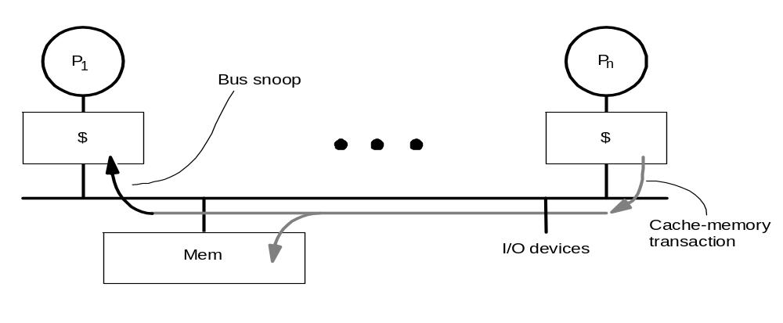
Snoopy Cache-Coherence Protocols
State
Address
Data
Cache Controller “snoops” all transactions on the shared medium (bus or switch)
  relevant transaction if for a block it contains
  take action to ensure coherence
    invalidate, update, or supply value
  depends on state of the block and the protocol
Either get exclusive access before write via write invalidate or update all copies on write

Slide 31
Example: Write-thru Invalidate
P
P
2
P
1
3
u
= ?
u
= ?
3
$
4
$
5
$
u
:5
u
:5
u
= 7
1
I/O devices
u
:5
2
u = 7
Memory
Must invalidate before step 3
Write update uses more broadcast medium BW
⇒ all recent MPUs use write invalidate

Slide 32
Architectural Building Blocks
Cache block state transition diagram
  FSM specifying how disposition of block changes
    invalid, valid, dirty
Broadcast Medium Transactions (e.g., bus)
  Fundamental system design abstraction
  Logically single set of wires connect several devices
  Protocol: arbitration, command/addr, data
  Every device observes every transaction
Broadcast medium enforces serialization of read or write accesses ⇒ Write serialization
  1st processor to get medium invalidates others copies
  Implies cannot complete write until it obtains bus
  All coherence schemes require serializing accesses to same cache block
Also need to find up-to-date copy of cache block

Slide 33
Locate up-to-date copy of data
Write-through: get up-to-date copy from memory
  Write through simpler if enough memory BW
Write-back harder
  Most recent copy can be in a cache
Can use same snooping mechanism
  Snoop every address placed on the bus
  If a processor has dirty copy of requested cache block, it provides it in response to a read request and aborts the memory access
  Complexity from retrieving cache block from a processor cache, which can take longer than retrieving it from memory
Write-back needs lower memory bandwidth
⇒ Support larger numbers of faster processors
⇒ Most multiprocessors use write-back

Slide 34
Cache Resources for WB Snooping
Normal cache tags can be used for snooping
Valid bit per block makes invalidation easy
Read misses easy since rely on snooping
Writes ⇒ Need to know if know whether any other copies of the block are cached
  No other copies ⇒ No need to place write on bus for WB
  Other copies ⇒ Need to place invalidate on bus

Slide 35
Cache Resources for WB Snooping
To track whether a cache block is shared, add extra state bit associated with each cache block, like valid bit and dirty bit
  Write to Shared block ⇒ Need to place invalidate on bus and mark cache block as private (if an option)
  No further invalidations will be sent for that block
  This processor called owner of cache block
  Owner then changes state from shared to unshared (or exclusive)

Slide 36
Cache behavior in response to bus
Every bus transaction must check the cache-address tags
  could potentially interfere with processor cache accesses
A way to reduce interference is to duplicate tags
  One set for caches access, one set for bus accesses
Another way to reduce interference is to use L2 tags
  Since L2 less heavily used than L1
  ⇒ Every entry in L1 cache must be present in the L2 cache, called the inclusion property
  If Snoop gets a hit in L2 cache, then it must arbitrate for the L1 cache to update the state and possibly retrieve the data, which usually requires a stall of the processor

Slide 37
Example Protocol
Snooping coherence protocol is usually implemented by incorporating a finite-state controller in each node
Logically, think of a separate controller associated with each cache block
  That is, snooping operations or cache requests for different blocks can proceed independently
In implementations, a single controller allows multiple operations to distinct blocks to proceed in interleaved fashion
  that is, one operation may be initiated before another is completed, even through only one cache access or one bus access is allowed at time

Slide 38
Write-through Invalidate Protocol
2 states per block in each cache
  as in uniprocessor
  state of a block is a p-vector of states
  Hardware state bits associated with blocks that are in the cache
  other blocks can be seen as being in invalid (not-present) state in that cache
Writes invalidate all other cache copies
  can have multiple simultaneous readers of block,but write invalidates them
PrRd/ --
PrWr / BusWr
V
BusWr / -
PrRd / BusRd
I
PrWr / BusWr
State Tag Data
State Tag Data
PrRd: Processor Read
PrWr: Processor Write
BusRd: Bus Read
BusWr: Bus Write
P
P
1
n
$
$
Bus
Mem
I/O devices

Slide 39
Is 2-state Protocol Coherent?
Processor only observes state of memory system by issuing memory operations
Assume bus transactions and memory operations are atomic and a one-level cache
  all phases of one bus transaction complete before next one starts
  processor waits for memory operation to complete before issuing next
  with one-level cache, assume invalidations applied during bus transaction
All writes go to bus + atomicity
  Writes serialized by order in which they appear on bus (bus order)
  => invalidations applied to caches in bus order
How to insert reads in this order?
  Important since processors see writes through reads, so determines whether write serialization is satisfied
  But read hits may happen independently and do not appear on bus or enter directly in bus order
Let’s understand other ordering issues

Slide 40
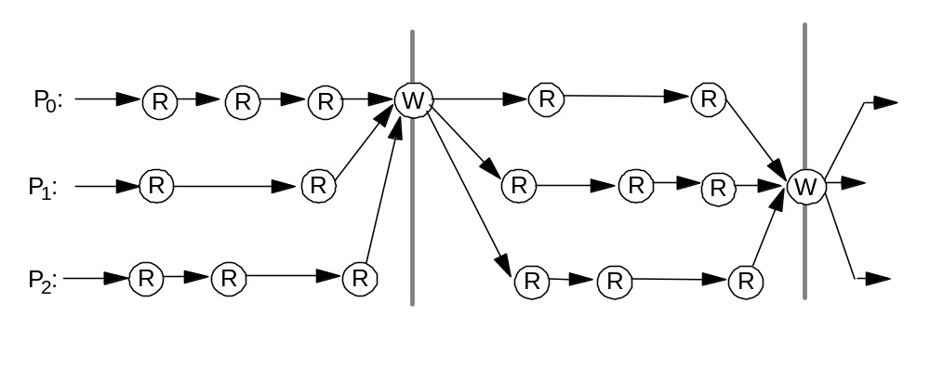
Ordering
Writes establish a partial order
Doesn’t constrain ordering of reads, though
shared-medium (bus) will order read misses too
  any order among reads between writes is fine,
  as long as in program order

Slide 41
Example Write Back Snoopy Protocol
Invalidation protocol, write-back cache
  Snoops every address on bus
  If it has a dirty copy of requested block, provides that block in response to the read request and aborts the memory access
Each memory block is in one state:
  Clean in all caches and up-to-date in memory (Shared)
  OR Dirty in exactly one cache (Exclusive)
  OR Not in any caches
Each cache block is in one state (track these):
  Shared : block can be read
  OR Exclusive : cache has only copy, its writeable, and dirty
  OR Invalid : block contains no data (in uniprocessor cache too)
Read misses: cause all caches to snoop bus
Writes to clean blocks are treated as misses

Slide 42
Write-Back State Machine - CPU
CPU Read hit
State machine
for CPU requests
for each
cache block
Non-resident blocks invalid
CPU Read
Shared
(read/only)
Invalid
Place read miss
on bus
CPU Write
Place Write
Miss on bus
CPU Write
Place Write Miss on Bus
Cache Block
State
Exclusive
(read/write)
CPU read hit
CPU write hit
CPU Write Miss (?)
Write back cache block
Place write miss on bus
Notes:
CS258 S99
Invalid:
read => shared
write => dirty
shared looks the same

Slide 43
Write-Back State Machine- Bus request
State machine
for bus requests
for each
cache block
Write miss
for this block
Invalid
Shared
(read/only)
Write miss
for this block
Write Back
Block; (abort
memory access)
Read miss
for this block
Write Back
Block; (abort
memory access)
Exclusive
(read/write)

Slide 44
Block-replacement
CPU Read hit
State machine
for CPU requests
for each
cache block
CPU Read
Shared
(read/only)
Invalid
Place read miss
on bus
CPU Write
Place Write
Miss on bus
CPU read miss
Write back block,
Place read miss
on bus
CPU Read miss
Place read miss
on bus
CPU Write
Place Write Miss on Bus
Cache Block
State
Exclusive
(read/write)
CPU read hit
CPU write hit
CPU Write Miss
Write back cache block
Place write miss on bus
Notes:
CS258 S99
Invalid:
read => shared
write => dirty
shared looks the same

Slide 45
Write-back State Machine-III
CPU Read hit
State machine
for CPU requests
for each
cache block and
for bus requests
for each
cache block
Write miss
for this block
CPU Read
Shared
(read/only)
Invalid
Place read miss
on bus
CPU Write
Place Write
Miss on bus
Write miss
for this block
CPU read miss
Write back block,
Place read miss
on bus
CPU Read miss
Place read miss
on bus
Write Back
Block; (abort
memory access)
CPU Write
Place Write Miss on Bus
Cache Block
State
Read miss
for this block
Write Back
Block; (abort
memory access)
Exclusive
(read/write)
CPU read hit
CPU write hit
CPU Write Miss
Write back cache block
Place write miss on bus
Notes:
CS258 S99
Invalid:
read => shared
write => dirty
shared looks the same

Slide 46
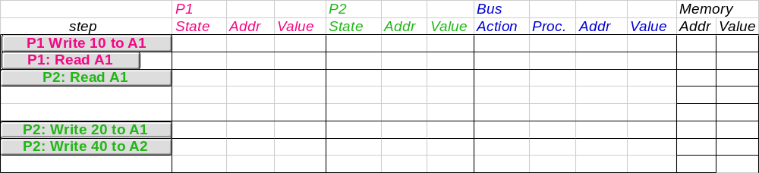
Example
Assumes A1 and A2 map to same cache block,
initial cache state is invalid

Slide 47
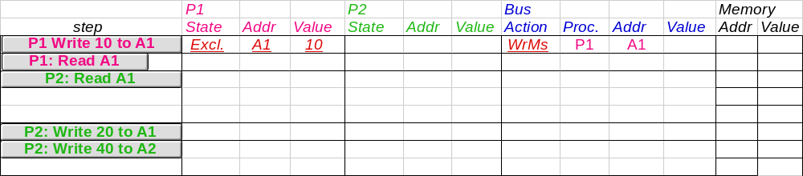
Example
Assumes A1 and A2 map to same cache block

Slide 48
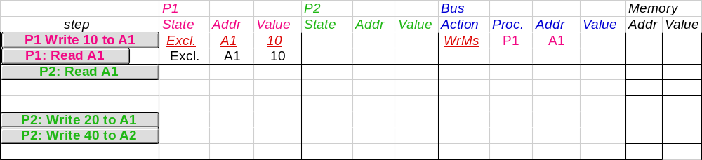
Example
Assumes A1 and A2 map to same cache block

Slide 49
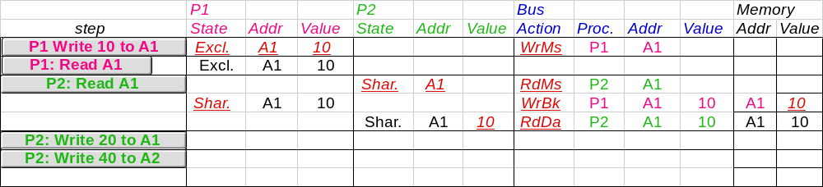
Example
Assumes A1 and A2 map to same cache block

Slide 50
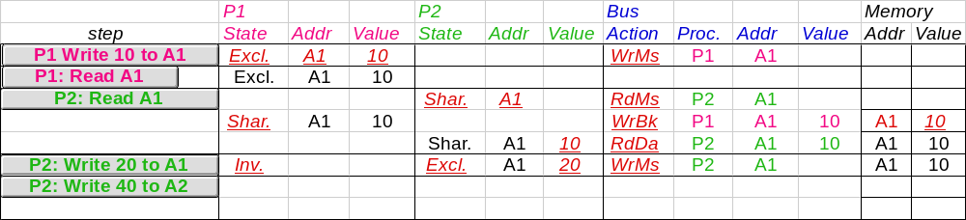
Example
Assumes A1 and A2 map to same cache block

Slide 51
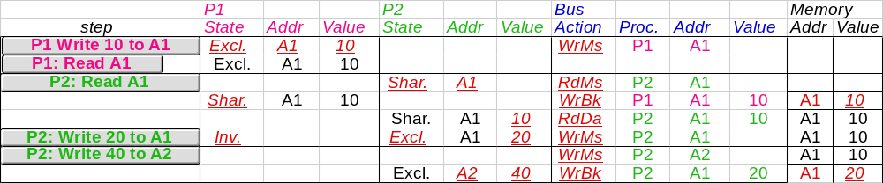
Example
Assumes A1 and A2 map to same cache block,
but A1 != A2
Notes:
CS258 S99
Why write miss first?
Because in general, only write a piece of block, may need to read it first so that can have a full vblock; therefore, need to get
Write back is low priority event.

Slide 52
And in Conclusion …
“End” of uniprocessors speedup => Multiprocessors
Parallelism challenges: % parallalizable, long latency to remote memory
Centralized vs. distributed memory
  Small MP vs. lower latency, larger BW for Larger MP
Message Passing vs. Shared Address
  Uniform access time vs. Non-uniform access time
Snooping cache over shared medium for smaller MP by invalidating other cached copies on write
Sharing cached data ⇒ Coherence (values returned by a read), Consistency (when a written value will be returned by a read)
Shared medium serializes writes
⇒ Write consistency

