Slide 1
A MULTI-TENANT DATA STORE USING COLUMN BASED NOSQL DATABASE
-Aditi Sharma, Parmeet Kaur
Jaypee Institute of Information Technology
Noida, India
Kapil Wagh
1911065
SY COMPS A

Slide 2
1.
ABSTRACT
2.
INTRODUCTION
3.
RELATED WORK
TABLE OF CONTENTS
4.
PROPOSED SYSTEM
5.
RESULTS
6.
CONCLUSION
7.
BIBLIOGRAPHY

Slide 3
ABSTRACT
As the world is frantically moving towards digitization, handling huge volumes of data is becoming complex and difficult to optimize. This is mainly because of increasing dimensions of data, its un-structuredness and increased need for storage space. To cope up with this problem, many service providers have moved towards multitenant architecture. In a multi-tenant architecture, a number of individual applications termed as tenants work under a shared environment and the data of one tenant is isolated from that of other tenants. With these considerations, this paper proposes a multi-tenant database architecture for applications using a column-based NoSQL data store. The architecture has been implemented with the NoSQL database, Cassandra.

Slide 4
INTRODUCTION
With exponential increase in the data being generated, it is quite impossible to store and compute the humungous data on a single machine.
Thus there is a need of distributed data storage.
Data being stored in distributed environment requires large storage space to handle it. Storage of the data for each application in the cloud leads to data that is usually redundant, due to multiple copies of the same datasets.
Multitenancy, in the context of data storage, is employed to reduce wastage of resources. Moreover, this leads to additional benefits such as lowering the requirements of maintenance and backups.

Slide 5
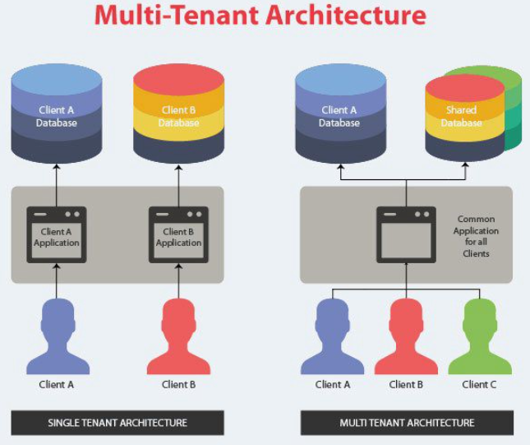
INTRODUCTION
It is also necessary that data of multiple tenants is isolated from each other. This isolation is required for security as well as protection from unwarranted modifications of data.
Thus, a successful implementation of multitenant data store should ensure optimal use of storage space as well as isolation of data of tenants from each other.
This paper proposes the implementation of a multi-tenant data store using a column based NoSQL database. Cassandra has been employed for implementation of the proposed multi-tenant datastore.

Slide 6
RELATED WORK
Multi-tenant database architecture has been discussed in literature in recent times. Most of the proposed systems are, however, implemented using relational databases. There are different data storage strategies in multi-tenant architecture.

Slide 7
Separate application, separate database
Different storage strategies in multitenancy
Shared application, separate database
Maintenance cost of this model is quite high as compared to others as all the tenants function independently, are isolated from each other
Software is shared between all the tenants and it can be customized according to the individual tenant’s requirement but their databases are different
Shared application, shared database
Shared database, same schema
Each tenant has different collection of tables i.e. schemas in the same database
All tenants share same tables in the same database

Slide 8
RELATED WORK
After performing systematic mapping study, it was found that Shared application-Shared database storage strategy is the most popular strategy to be used in the multi-tenant architecture.
Number of factors contributed in this decision, foremost is the low cost involved in this storage strategy. Other factors are safety features and characteristics of tenants i.e. number, size of the database and the number of users per tenant.
There are different challenges associated with multi-tenant architecture such as scalability, ease of development & maintenance, isolation etc.
Authors have listed challenges affecting Multi-tenant architecture, namely: configuration and extensibility. In the multi-tenant environment, though all the tenants share resources, some components or features can be customized according to tenant specific needs.

Slide 9
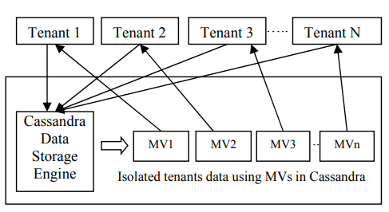
PROPOSED SYSTEM
Traditional relational databases are not well equipped to handle large volume of unstructured data. It is here that NoSQL databases are appropriate. The current work uses Apache Cassandra; a column based NoSQL database management system which is a distributed, scalable and highly available data store. It does not have a single point of failure. The design of a multitenant architecture using Cassandra has been illustrated below and described next taking an event booking system as a SaaS application.

Slide 10
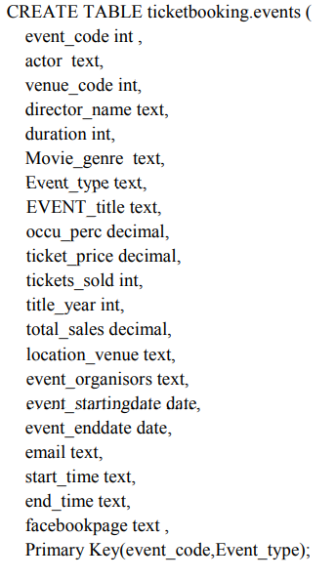
Proposed system
Extracting data from the data source and design table schema: The proposed system follows a Shared Database, Same Schema Multitenancy model for an Event booking system.

Slide 11
PROPOSED SYSTEM
2. Import the extracted data into the Cassandra datastore:
The data for the multiple tenants is imported into the Cassandra database from the application.
3. Isolate tenants’ data by creation of Materialized Views (MV):
Cassandra provides a feature to create materialized views. This feature is used by the proposed system to isolate a tenant’s data from other tenants. Use of one MV for one tenant also allows for flexibility in schema being used by each tenant. Further, Cassandra is apt at handling sparseness in data. This is required as some columns values can be NULL for a particular tenant. For instance, for an event type “Conference”, value of columns movie_genre, director_name, duration, actor will be NULL. Thus, each row can have multiple NULL values, to handle such sparse data we have used Cassandra’s storage engine. Materialized views can be created which only store the columns present in that row for each tenant.

Slide 12
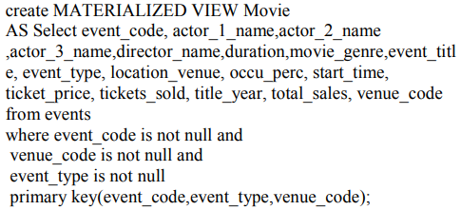
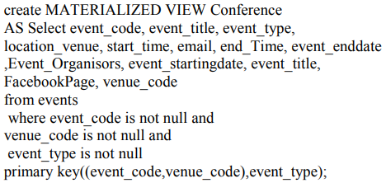
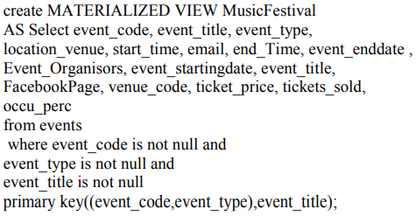
Materialized View of some Tenants
MV for Tenant MOVIE
MV for Tenant Conference/Workshop
MV for Tenant Music Festival

Slide 13
RESULTS
The Materialized views created are then used to process queries for different tenants in Cassandra data store engine, thus giving a sense of isolation to each tenant.
Unlike MySQL, Cassandra does not explicitly displays time taken to execute a query
Command TRACING ON/OFF is used to calculate the timestamp in Cassandra.
Cassandra is good for large datasets, for small datasets Cassandra is much slower than MySQL
The results obtained show that multitenant architecture give desired results for large dataset in less time but it is not advisable to use Multitenant architecture for small dataset.
Dataset used in the proposed system comprised of 360 rows, among these some were sparse i.e. maximum values of columns were null.

Slide 14
CONCLUSION
The paper has presented a NoSQL based architecture for a multi-tenant data store.
A column based NoSQL family database, Cassandra has been used for the implementation of the data store.
The advantage of the proposed system lies in its ease of implementing data isolation among tenants while allowing flexibility of schema design or extension.
Results of implementation show that the proposed Multitenant architecture provides desired data isolation to its tenant as well as performs well for large datasets but for small datasets, query processing time increases.

Slide 15
BIBLIOGRAPHY
Original Paper: https://ieeexplore.ieee.org/document/8844906

Slide 16
THANKS

