Slide 1


BLACKBERRY
A concise analysis of strategy, product, and market shifts

Slide 2
Why did it fail?
• Google’s Android devices quickly followed iPhone with large multitouch screens and no physical keyboard—plus more customization.
• BlackBerry believed physical QWERTY keyboards were irreplaceable for professionals.
• Focused heavily on productivity, not entertainment or media consumption.
• Design philosophy: small screen + keyboard = best professional device.

Slide 3
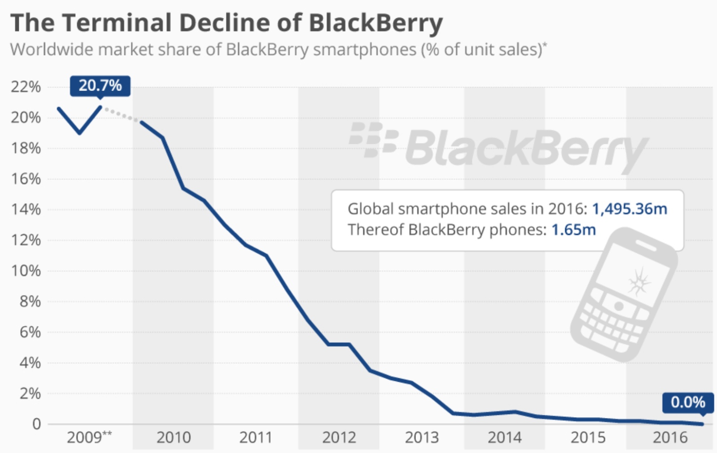
Major three reasons for the failure
• Slow adaptation to touchscreens and modern smartphone trends
• Strategic missteps in the app ecosystem
• Overconfidence in enterprise market dominance

Slide 4
1) Slow Adaptation to Touchscreens & Modern Smartphone Trends
• Relied on physical keyboards while iPhone & Android embraced large touchscreens.
• Underestimated consumer demand for multimedia, apps, and gesture-based navigation.
• First touchscreen phone (BlackBerry Storm, 2008) had poor performance and clunky “SurePress” screen.
• Delayed response allowed rivals to capture both consumer and enterprise markets.
• Developers shifted focus to iOS/Android, widening BlackBerry’s innovation gap.
• Failure to redesign OS for touch led to an awkward, outdated user experience.

Slide 5
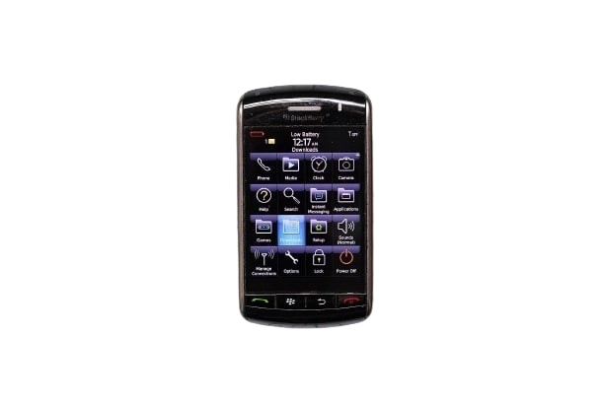
BlackBerry Storm (“SurePress”)
• First touchscreen phone (BlackBerry Storm, 2008): tried to mimic pressing a real key.
• Major Flaws:
• Touch response lag
• Clicks felt unnatural and tiring
• OS not designed for touch → awkward navigation
• App support was weak vs Apple App Store
• Result: negative reviews, high return rates, and product failure.

Slide 6
2) BlackBerry’s Strategic Missteps in the App Ecosystem
• Prioritized secure email and BBM, neglecting a modern, user-friendly app store.
• Did not recognize early enough that a wide variety of mobile apps was becoming crucial.
• Provided limited tools/incentives for third-party developers → slow innovation & fewer apps.
• Overlooked the speed of iOS/Android platform evolution to attract users and developers.

Slide 7
Consequences of Underestimating the App Ecosystem
• Most developers shifted to iOS and Android → a “BlackBerry app gap.”
• Users faced restricted choices for social, entertainment, productivity, and lifestyle apps.
• Frustrated by missing/outdated apps, many migrated to competitors with richer ecosystems.
• This app shortfall drove loss of relevance and a steep decline in global market share.

Slide 8
3) Overconfidence in Enterprise Market Dominance
• 2009 Peak: Controlled 50% of the U.S. smartphone market, with 20% globally (Forbes).
• Government/Corporate Reliance: Used by 90% of Fortune 500 companies and governments (BBC).
• Assumption: Believed businesses would prioritize security over employee preferences (WSJ).
• Why it failed:
• Ignored BYOD: By 2012, 78% of companies allowed employees to use personal devices (Gartner).
• Slow to Adapt: BlackBerry’s CEO called BYOD a 'passing trend' in 2012 (The Verge).
• Security Myth: iOS/Android adopted MDM (Mobile Device Management), matching BlackBerry’s security (CNBC).

Slide 9
How BYOD Killed BlackBerry
1. The Rise of BYOD (2010–2015):
• Employees wanted iPhones & Android phones (better apps, touchscreens).
• Companies allowed it due to cost savings and higher employee satisfaction.
• By 2012, 78% of companies supported BYOD.
2. Blackberry's mistake - Ignoring BYOD:
• Assumed enterprises would stick with BlackBerry for security.
• Reality: Apple & Google rapidly improved mobile security and MDM.
• Employees disliked carrying two phones (work BlackBerry + personal iPhone).
• Outcome: rapid migration to iOS/Android, erosion of BlackBerry’s enterprise base.

Slide 10
Final Takeaways
• BlackBerry’s fall was not due to one mistake, but a series of missed shifts.
• Failure to adapt to consumer trends and app ecosystems proved fatal.
• Lesson: In technology, adaptability and user experience matter as much as security and performance.

