Slide 1
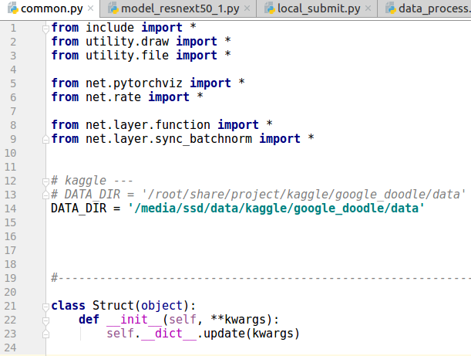
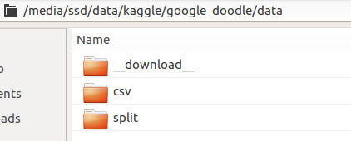
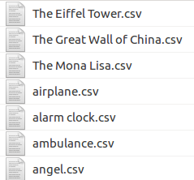

0. Data setup
1. Set data directory in common.py
2. To split the train data for training and validation, use make_split() in data_process.py

Slide 2
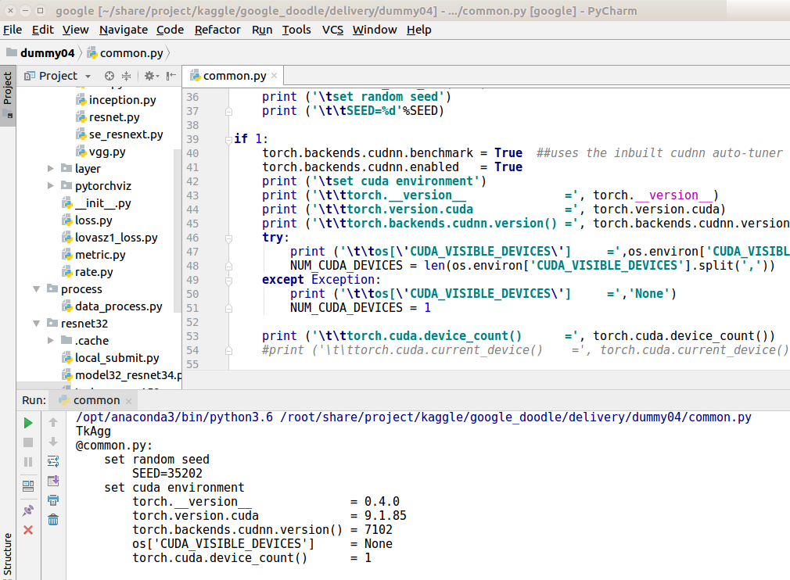
1. Train a model
1. Software setup:
IDE = pycharm, python 3.6
pytorch 0.4.0

Slide 3
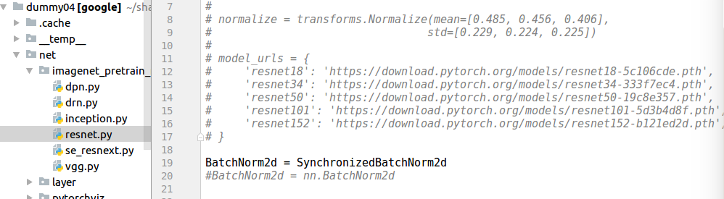
2. For example implementation, we use resnet34.
Download imagenet pretrain model:
if you use pytorch 0.4.1 and above and has error in "BatchNorm2d = SynchronizedBatchNorm2d", use "BatchNorm2d = nn.BatchNorm2d" instead

Slide 4
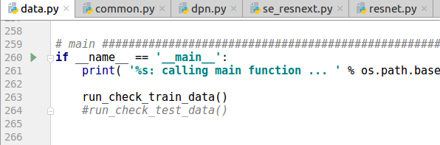
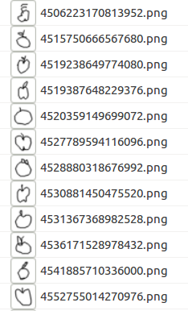
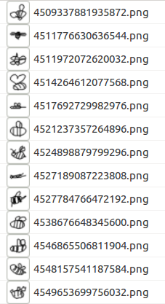
- model32_resnet34.py : model definition
- data.py : data loader
use this function to try drawing to image conversion

Slide 5
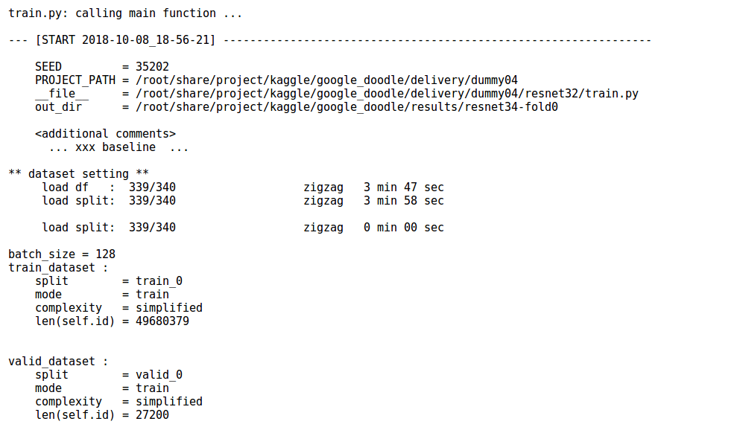
- train.py : learn a model
As an example, we will train for 4000 iterations and make a submission
train log
time to load data

Slide 6
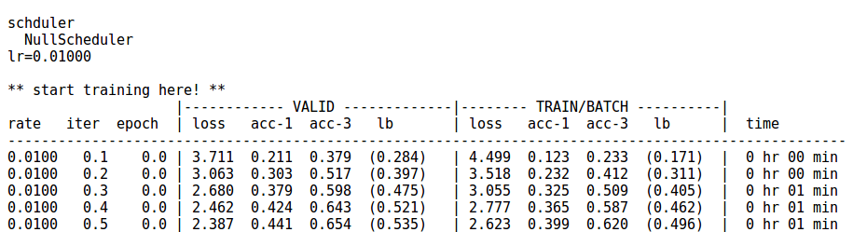
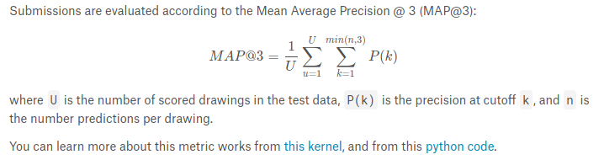
local LB (MAP@3)
top-3 accuracy
https://www.kaggle.com/c/quickdraw-doodle-recognition#evaluation
bce loss
num of iterations ( 1 unit is 1000 iterations)

Slide 7
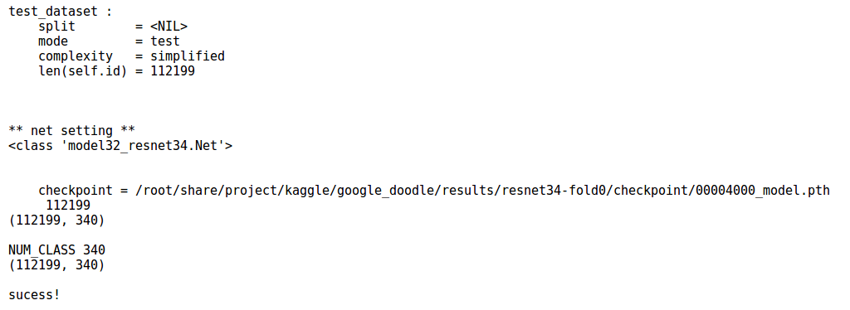
2. Make a submission
- local_submit.py :
make_npy_file_from_model() : load a model and make prediction probability as npy file
npy_file_to_sbmit_csv() : make submission csv file

Slide 8
