Slide 1



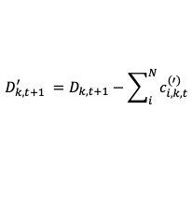










(a)
Fractions $q_{i,k,t}$
(b)
Change factors $a_{i,k,t}^{(′)}$
Relative suitability $r_{i,k,t}^{(′)}$
Change $m_{i,k,t}^{(′)}$
Suitability
Algorithm
0.3
1.13
0.0012
12
0.18
1.38
0.0045
16
0.15
1
0.022
0
0.37
0.67
0.0099
Additional demand
$$D_{k,t+1}$$
-28
Environmental drivers $X_{i,t}$
$$D_{k,t+1}^{′} =D_{k,t+1}−\sum_{i}^{N}{c_{i,k,t}^{(′)}}$$
$$if D_{k,t+1}^{′}≄0$$
18
30
25
34
30
30
42
0.42
15
C = 100
15
C = 100
34
$$if{ D}_{k,t+1}^{′}≈0$$
0.34
Enrichment factors $F_{i,t}$
15
0.15
37
26
9
0.09
Counts $c_{i,k,t}$
Suitability $s_{i,k,t}$
Candidate counts $c_{i,k,t}^{′}$
New fractions $q_{i,k,t+1}$

