Slide 1
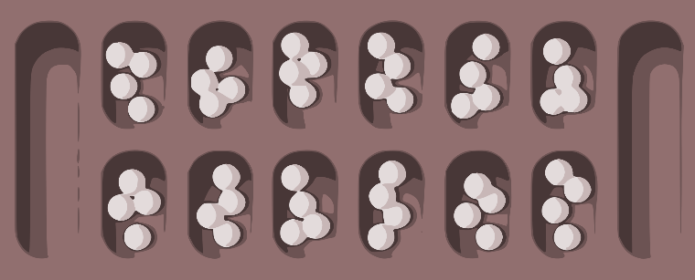
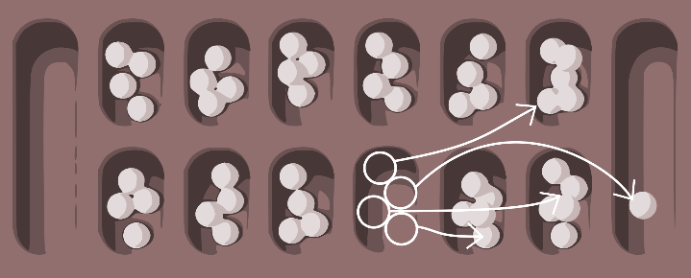
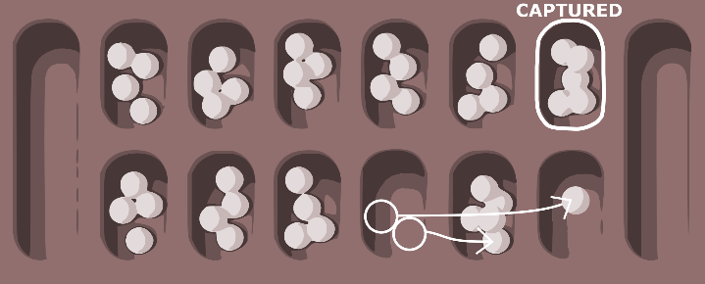
Mancala rules
Mancala is one of the oldest games known today which was originated either in Egypt or in some other middle east country and has a lot of versions. We will implement a classical one in our project.
OPPONENT’S MANCALA
GAME BOARD
YOUR MANCALA
Acts like a storage for your seeds
OBJECTIVE OF THE GAME
TO HAVE MORE SEEDS IN YOUR MANCALA THAN IN OPPONENT’S
HOLES WITH SEEDS
CAPTURE
DURING YOUR TURN YOU CAN CAPTURE OPPONENT’S SEEDS IF YOUR LAST SEED DROPS INTO AN EMPTY HOLE ON YOUR SIDE
TURN
DURING YOUR TURN YOU CHOOSE A HOLE AND PLANT ALL ITS SEEDS INTO NEXT N HOLES
IF YOUR LAST SEED DROPS INTO YOUR MANCALA YOU GET AN EXTRA TURN
ALL CAPTURED SEEDS ARE MOVED INTO YOUR MANCALA

