Slide 1
Polarization-Wavelength Dependence

Slide 2
Polarization Stability
Send different wavelengths utilizing tunable laser
1549-1550nm
Measure the polarization after sending light of different wavelengths through the loop over multiple hours

Slide 3
Polarization Stability

Slide 4
Polarization Stability
Single polarization correction not viable for different wavelengths

Slide 5
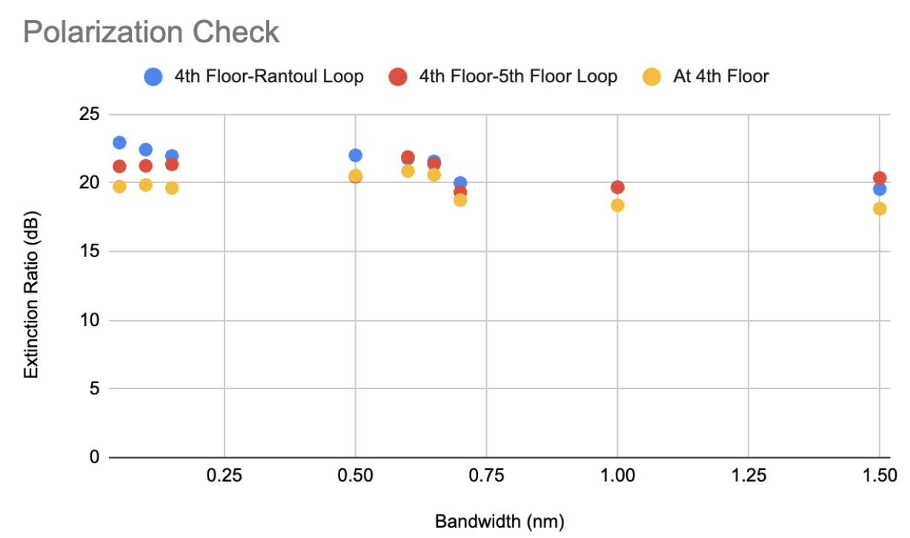
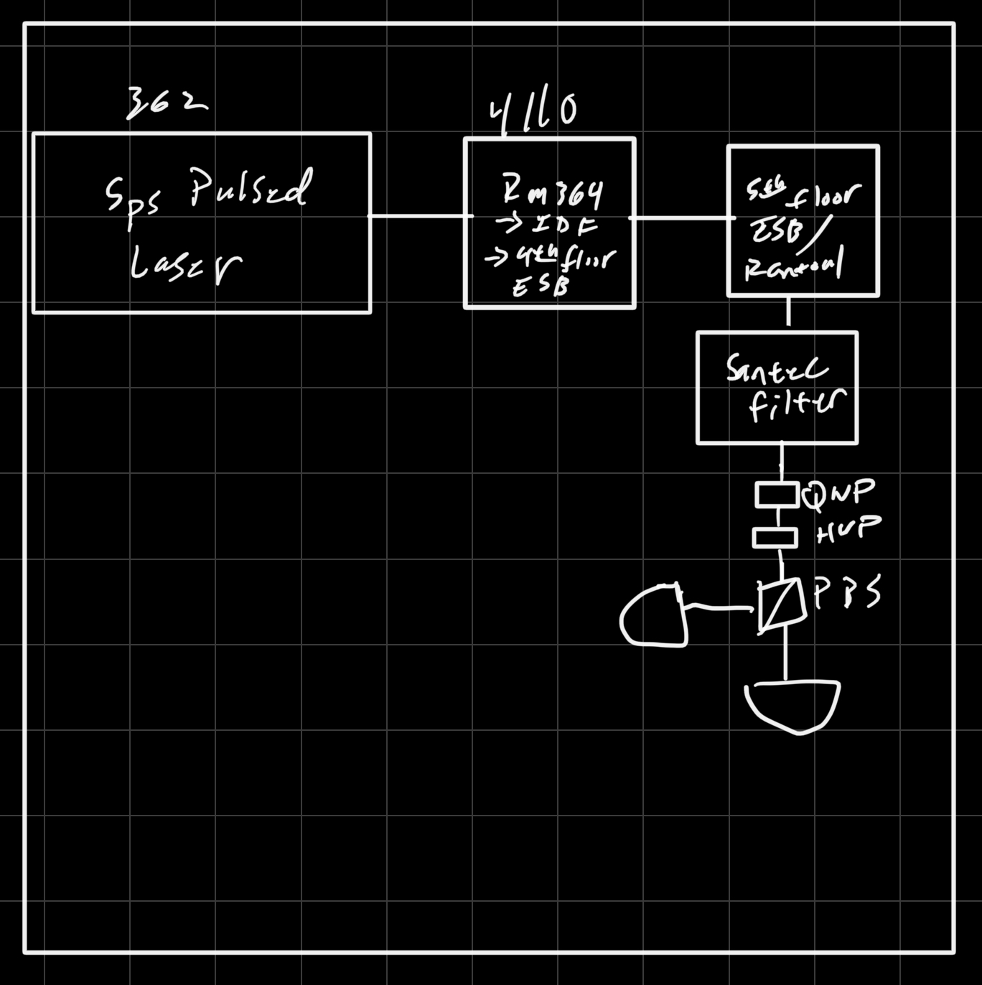
Polarization Check Method 2

