Slide 1
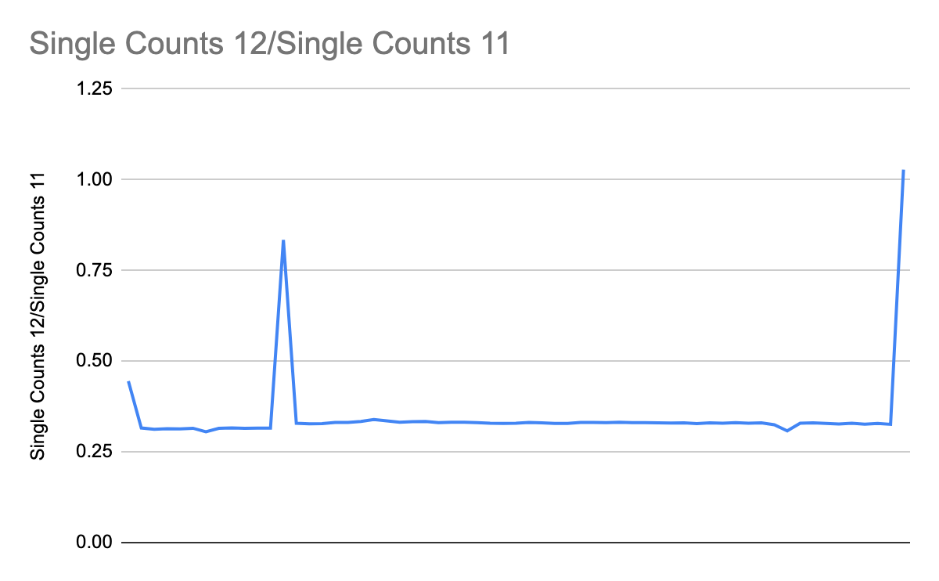
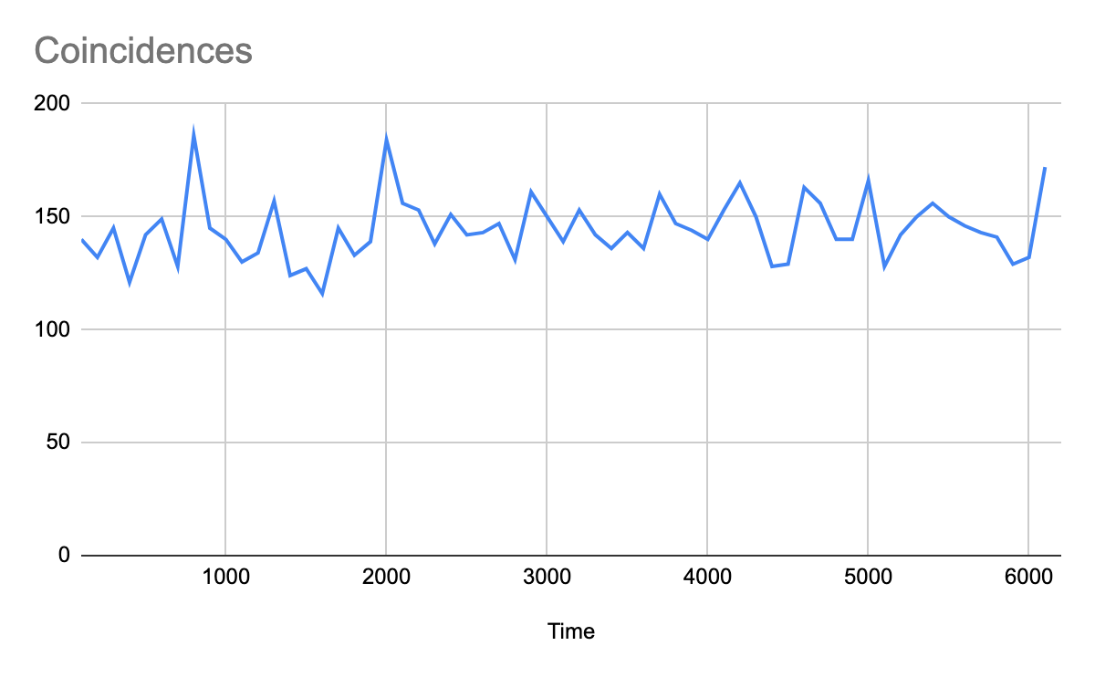
Fiber Network
Measured loss for 810nm light inn SF28 fiber
About 30% loss between 4th and 5th floor of ESB (2km of fiber)
Tested polarization stability of the SMF28 fiber connecting 4th and 5th floors of ESB
810nm light from BiBO source
No significant single/coincidence count drift over 1:40 hours
Next Steps:
Repeat stability tests for 1550nm light
Implement QKD in preparation for other nodes like Urbana Public Library and Rantoul

