Slide 1
SecureWebApp
Flask/Python App for secure file sharing
By: Kuber Kapuriya
CS 419

Slide 2






Project Overview
Problem
Core Features
Some organizations may need to share sensitive documents without exposing them to unauthorized users, tampering, or data leaks.
Hashed password authentication (uses python bcrypt)
Fernet encryption for all stored documents
Role based access control: Admin, Normal User, Guest
Solution
Document versioning and secure sharing
A Flask web app that provides authenticated, encrypted document storage with RBAC sharing and audit traces.
Audit logging, Security Logs, Access Logs
TLS encrypted transport (self signed certificate)

Slide 3
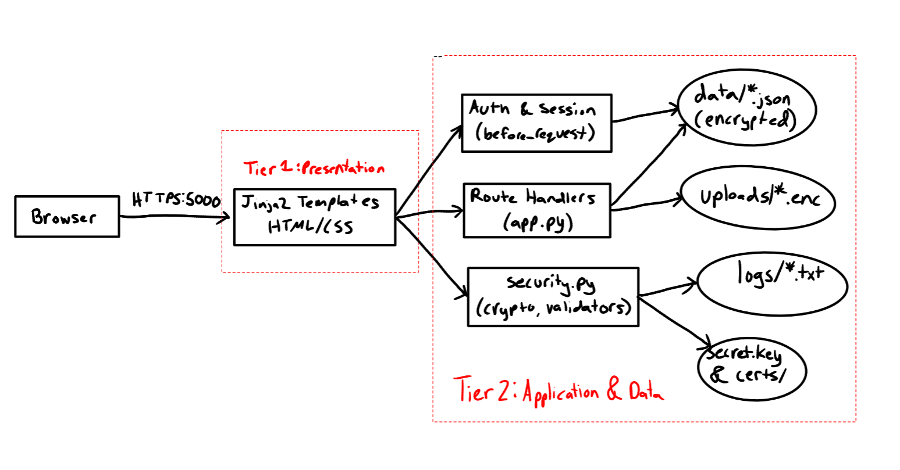
Security & System Architecture
Security Architecture
General System Architecture
CLIENT LAYER
Browser, HTTPS request
TRANSPORT LAYER
TLS 1.2+, Self signed cert
APPLICATION LAYER
Authentication, Authorization (RBAC), Audit Logger
STORAGE LAYER
Fernet encrypted documents, JSON metadata

Slide 4

Authentication & Access Control
Authentication
Permissions Matrix
Role | Create Content | Edit own Content | Delete Own Content | View All Content | Manage Users | View Shared Docs | Share own Doc | Change Own Password
Admin | ✓ | ✓ | ✓ | ✓ | ✓ | ✓ | ✓ | ✓
User | ✓ | ✓ | ✓ | X | X | ✓ | ✓ | ✓
Guest | X | X | X | X | X | ✓ | X | X
bcrypt password hashing with salt
Session based login using Flask secure cookies
No plaintext credentials ever stored or logged
Role Based Access Control
Admin: full control, user & document management, guest account creation
User: download and upload new versions only
Guest: read only access to shared documents
2 Document Share Modes: View Only(See audit trail & download, Editor

Slide 5
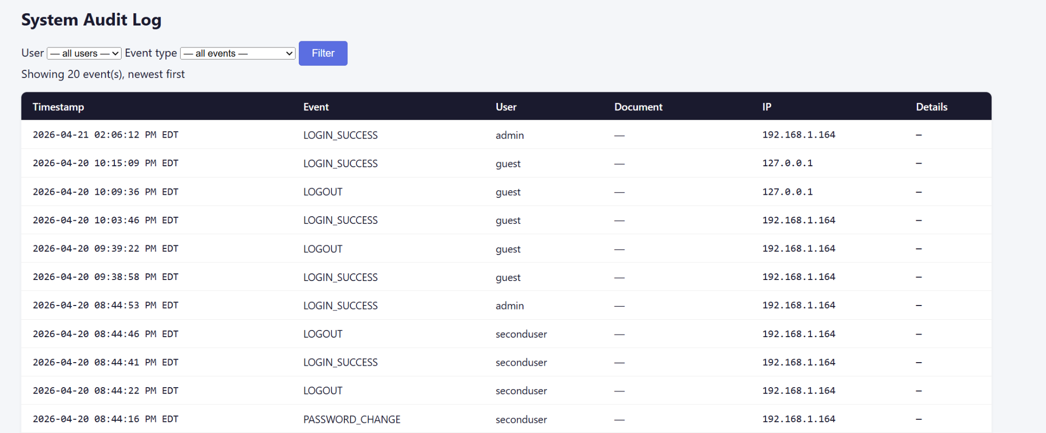



Encryption & Audit Trail
Encryption at Rest
Audit Trail
Fernet symmetric encryption (AES-128-CBC + HMAC-SHA256)
Key stored outside the repo, in .gitignore
Documents decrypted only in memory on authorized access
Logs security events only like auth, access decisions, doc actions
Each entry: timestamp, user, action, resource, outcome
Supports forensic review and accountability
→
→
plaintext
Fernet key
ciphertext

Slide 6

Challenges & Lessons Learned
.gitignore Encoding Trap
Getting Rid of Git History to hide keys/certs
Early in development, PowerShell saved .gitignore as UTF-16 so Git silently ignored it. Keys and certs were committed from this mistake.
Deleting files from the working tree leaves them in Git history. Required git filter-repo to fully purge.
Lesson: TDefaults of tools are important and encoding is a security concern.
Lesson: In version control, deletion doesnt mean removal.
Unnecessary Logs Noise
Local Development Warnings
Initial audit logging fired on every request, hiding security events in irrelevant noise.
A self signed TLS cert produces ERR_CERT_AUTHORITY_INVALID warning which is fine for localhost, not for production.
Lesson: Make audit logs trigger for meaningful events, not every HTTP hit.
Lesson: Cert management is a full discipline of its own.

Slide 7
Conclusion
Successfully made a secure document sharing system with defense in depth but for public deployment there are more steps:
Next Steps:
Migrate from JSON file storage to PostgreSQL scalability and also column specific encryption
Put Cloudflare in front of the app for DDoS protection, bot detection, and automatic TLS with a trusted CA
Replace the self-signed certificate with a commercial CA certificate tied to a real domain
Can add MFA
Implement a forgot password reset flow with email verification
Do encryption key rotation
Move the Fernet key into a dedicated secrets manager instead of a local file
Ship structured JSON audit logs to a SIEM app
Set up automated backups of the database

