Slide 1
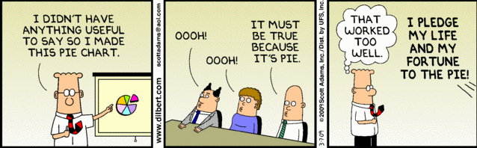
Data Visualization:
Techniques and Tools
Snyder Institute Science Communication Workshop
November 2nd, 2022
Instructor: Dr. Lindsay Hracs

Slide 2
Territorial Acknowledgement
In the spirit of respect, reciprocity, and truth, I honour and acknowledge Mohʹkinsʹtsis and the traditional territories of the people of the Treaty 7 region, which includes the Blackfoot confederacy, comprising the Siksika, Piikani, and Kainai First Nations, as well as the Tsuut’ina First Nation, and the Stoney Nakoda, including the Chiniki, Bearspaw, and Wesley First Nations. I acknowledge that this territory is home to the Métis Nation of Alberta, Region 3 within the historical Northwest Métis homeland. Finally, I acknowledge all Nations – Indigenous and non – who live, work, and play on this land, and who honour and celebrate this territory.
Finally, I highlight the necessity of action to go along with these words, including learning from those who choose to share their lived experiences, working to understand roles in colonialism, and challenging our biases related to race and identity as we move forward.

Slide 3
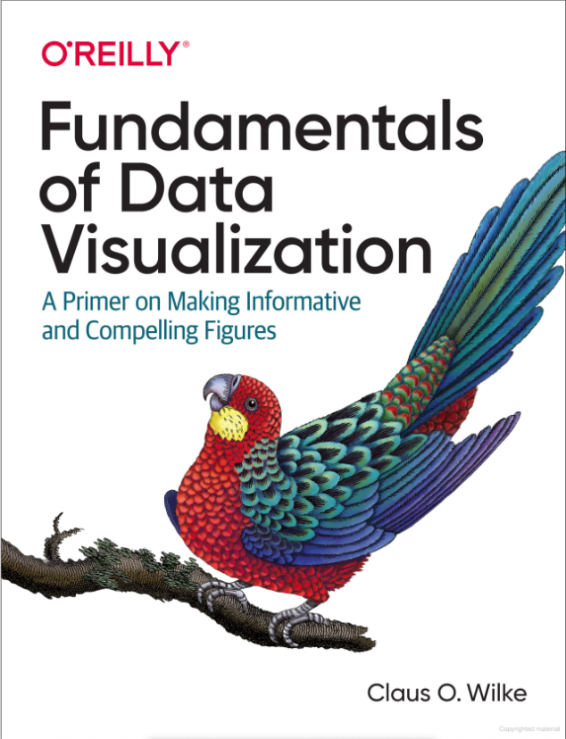
What is data visualization?
“Data visualization is part art and part science.”
- Claus O. Wilke (2019)
Notes:
Formally, we think of data visualization as the graphical representation of data. Meaning, using image to convey information.
Art in the sense that we are trying to appeal to the visual senses, and science in that our goal is to provide precise information.
Wilke goes on to say that the challenge is getting the art right, without getting the science wrong. And vice versa.

Slide 4
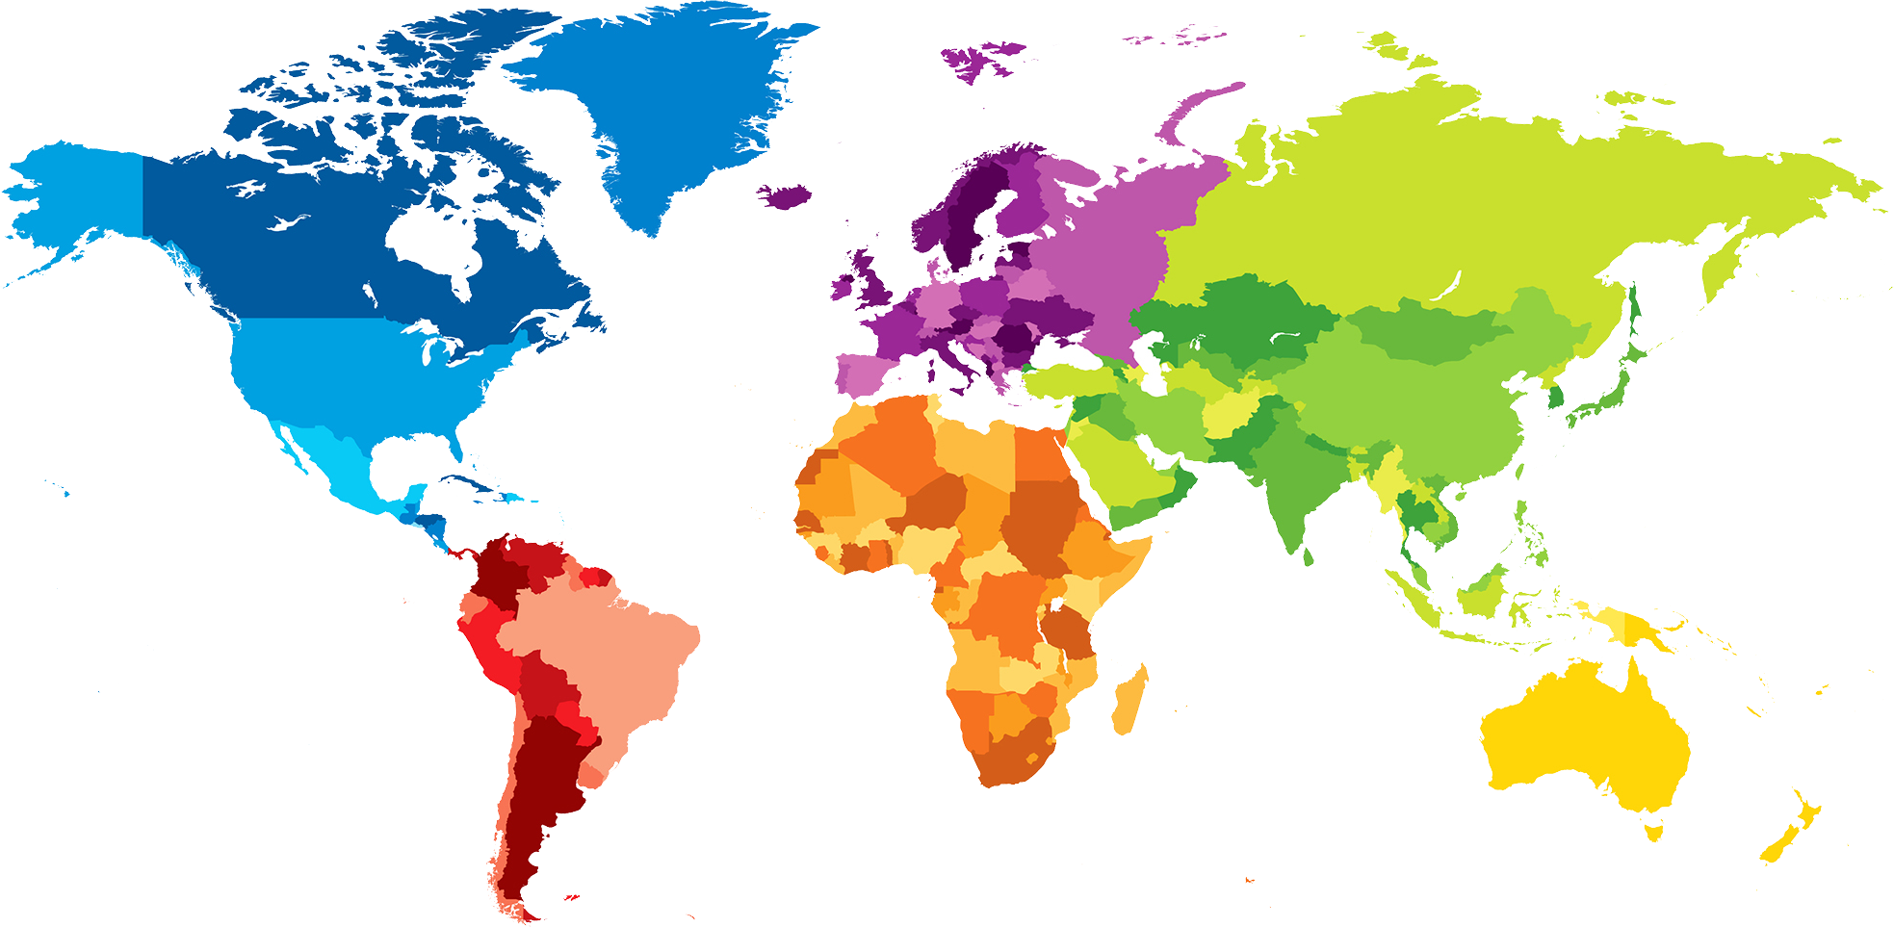
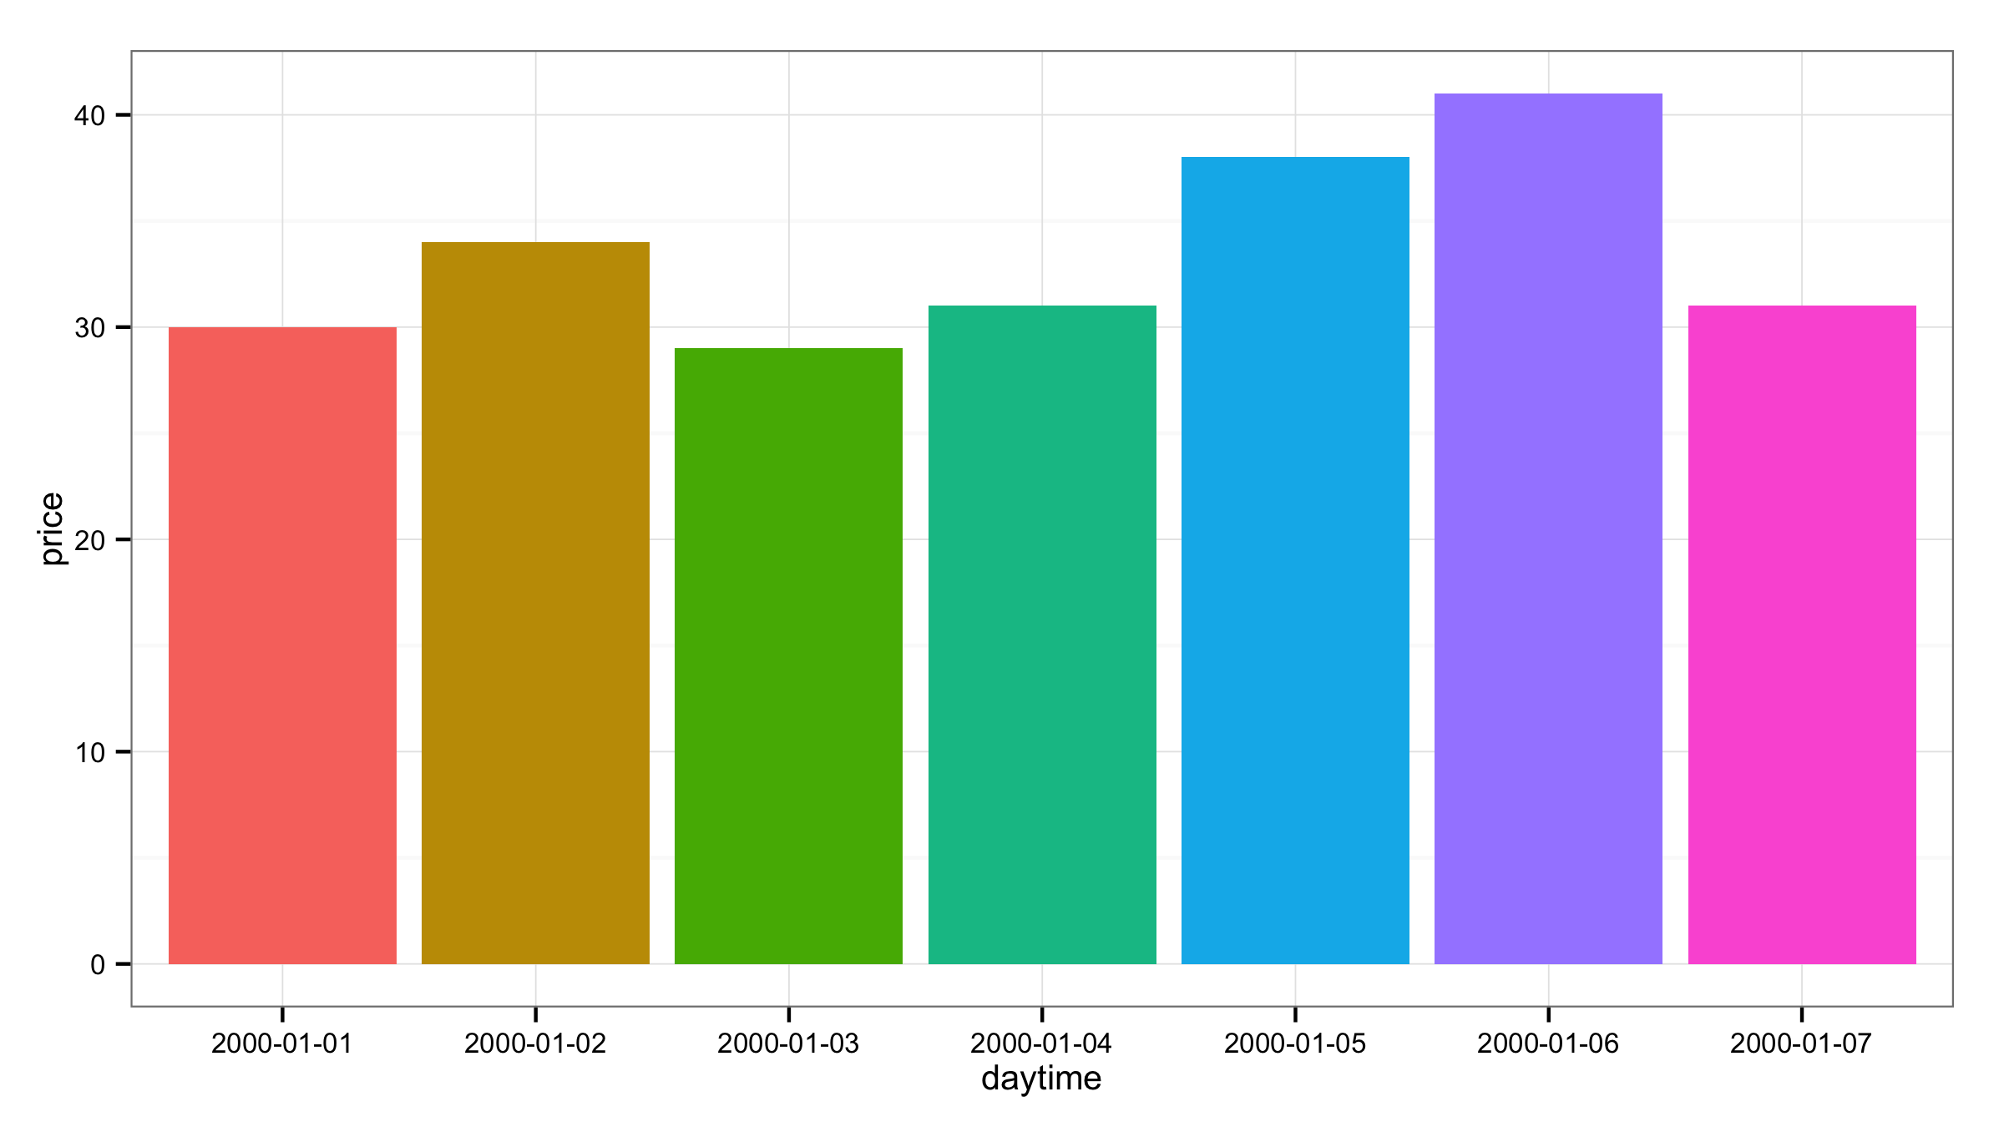
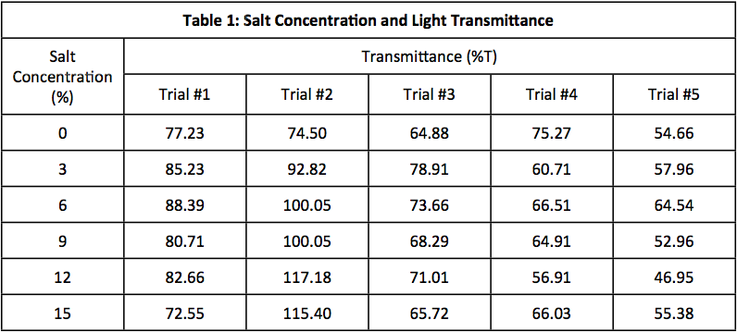
What are some different ways to visually represent data?
Tables, bar plots, maps, histograms, scatter plots, line graphs, Venn diagrams, area graphs, pyramids, pie charts, box and whisker plots, radial bar plots, tally plots, cluster plots, density plots, heatmaps, violin plots, stem and leaf tables, stream graph, candlestick charts, radar charts, arc diagrams, network diagrams, tree diagrams, progress bars, word clouds, pictograms, error bars, flow charts, calendars, bubble charts...
Question: How do you choose which visualization to use?
Answer: It depends on the story you want to tell. (And your research questions.)
Notes:
Table, bar plot, map
List
Question and Answer: And unfortunately we don’t have time to

Slide 5
Why do we visualize data?
“The frustrating part of building a good visualization is that once you see the thing you needed to see, you don't need the visualization anymore.”
- Richard Biddle, Carleton University
(John Aycock, UCalgary CPSC, p.c. 25-May-22)
Notes:
Dilbert was wrong that we use visualizations when we have nothing useful to say
Richard Biddle professor of Human-Computer Interaction at Carleton
This is ultimately our goal.

Slide 6
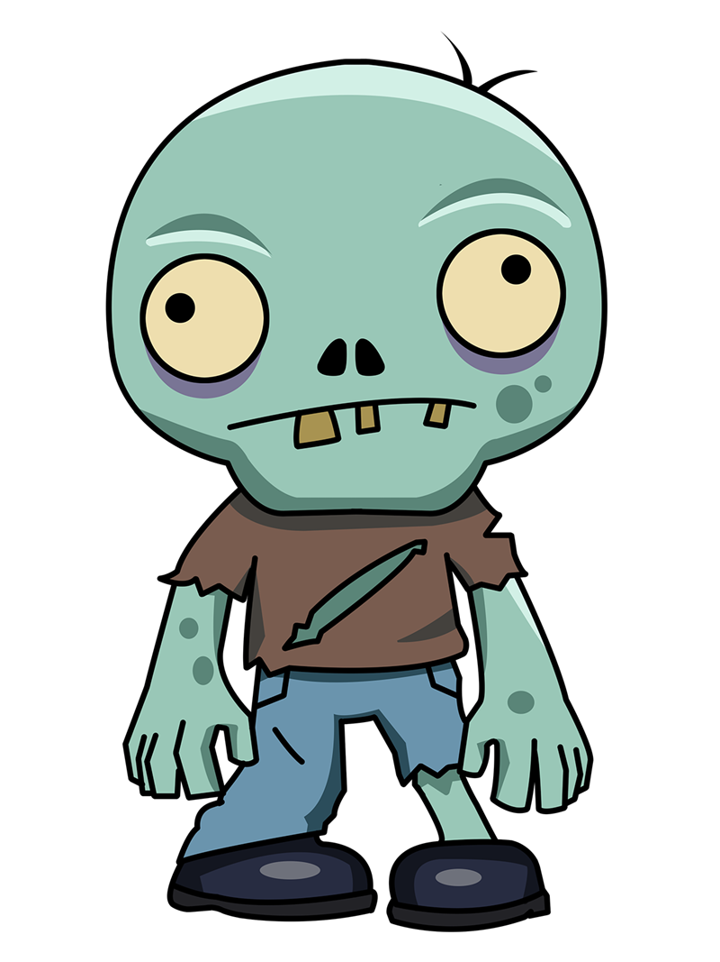
We use data visualizations to...
tell a (precise, accurate, and complete) story
summarize numbers and text
take everything Joey taught us and make it obsolete (except maybe the exterminating zombies part...)
    reduce structure; conserve energy
    focus readers’ attention
    in reality, it should pair well with the text and enhance the overall discussion
Notes:
1. A visualization should be able to stand alone

Slide 7
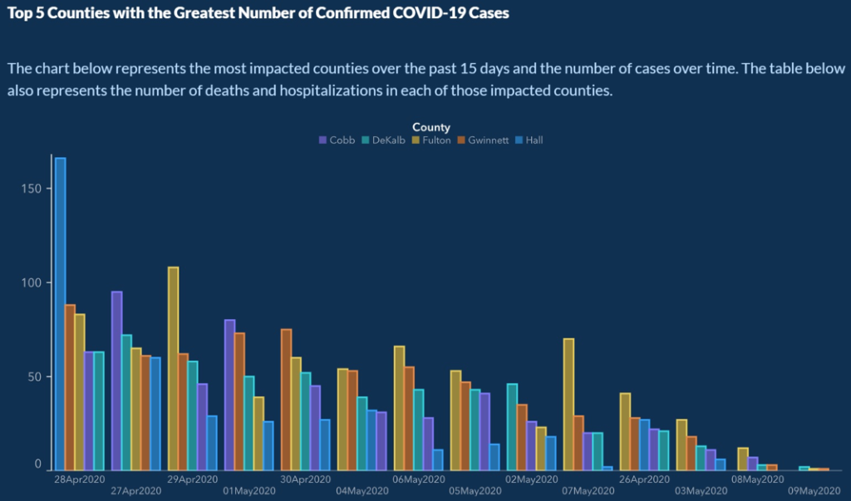
Original source: Georgia Department of Public Health
Source: https://anderson-review.ucla.edu/graphic-presentation-of-covid-19-data-can-skew-perceptions-of-risk/
Notes:
Table, bar plot, map
List
Question and Answer: And unfortunately we don’t have time to

Slide 8
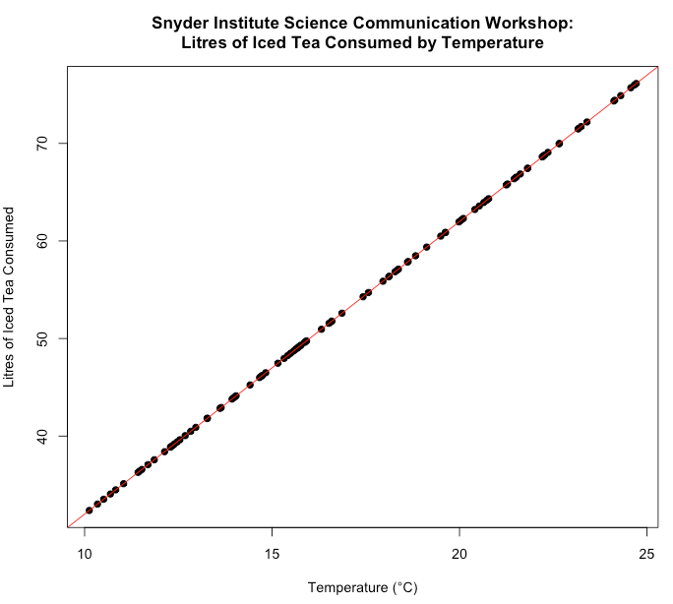
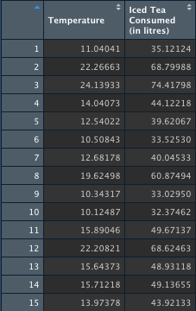
A good visualization should...
  increase the ability to discover Insights about the data

Slide 9
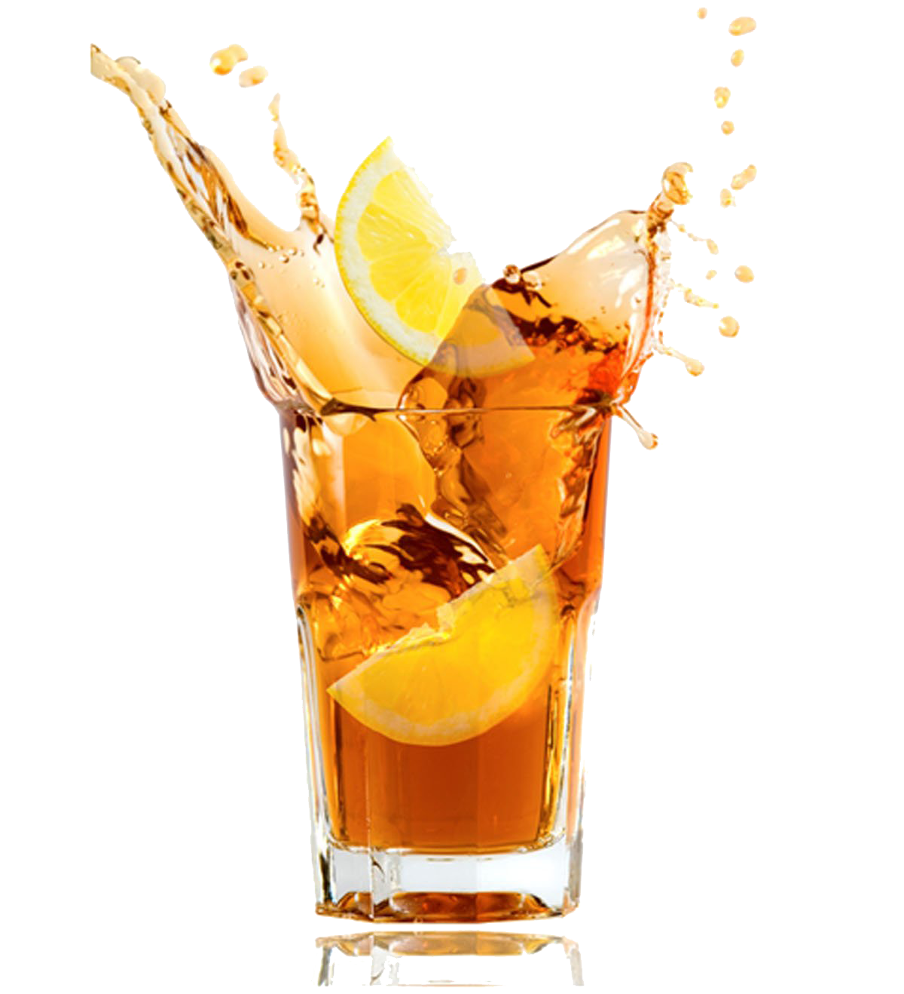
A good visualization should...
  increase the ability to discover Insights about the data
  generate Confidence in the data
  convey the Essence of the data
  minimize the Time needed to answer questions about the data
  → ICE-T model for determining the value of a visualization
Wall E et al. A heuristic approach to value-driven evaluation of visualizations. IEEE Trans. on Visualization and Computer Graphics. 2019;25:491–500.

Slide 10
we want to increase the ability of others interact with data while reducing the cognitive load placed on them, but we can also use visualizations as a tool in data exploration
(and get the most out of meetings with your PIs and supervisors!)
  trends in the data
  before analysis (e.g., are your data normally distributed?)
    → quick and dirty functions in R: hist(), qqplot(), qqline()
  identify outliers, help with data cleaning
Notes:
From my experience, my supervisory committee was always happiest when I shared my data in graphical formats

Slide 11
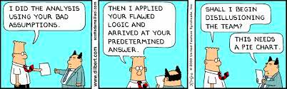
What information can/should we visualize?

Slide 12

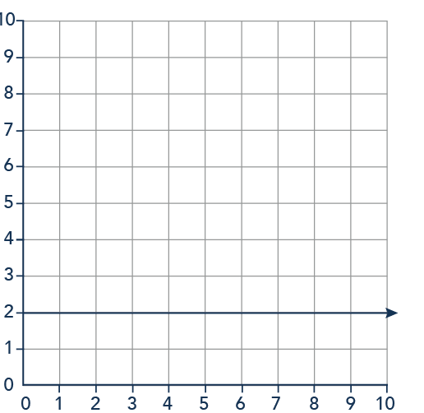

there is probably a visualization for any type of information/data you have, but it is important to keep in mind:
GARBAGE IN, GARBAGE OUT (GIGO)
you will likely spend most of your time prepping your data either outside or inside of the statistics/analysis/visualization software

Slide 13
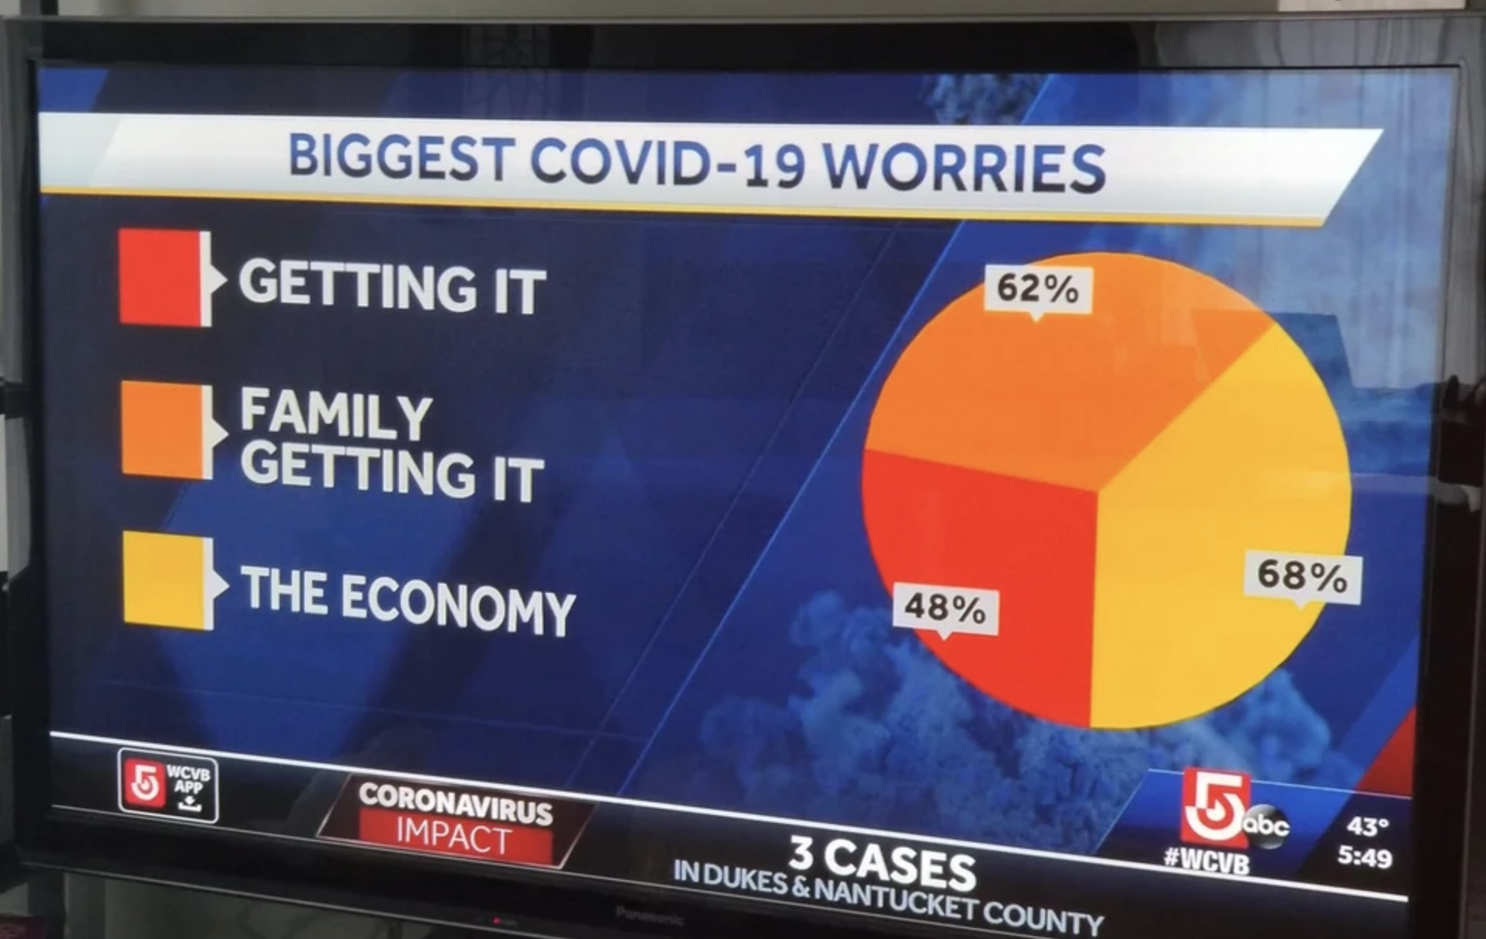
Choosing the right visualization
Source: https://venngage.com/blog/misleading-graphs/
Notes:
Choosing the right visualization is often harder than know what the wrong visualization is

Slide 14
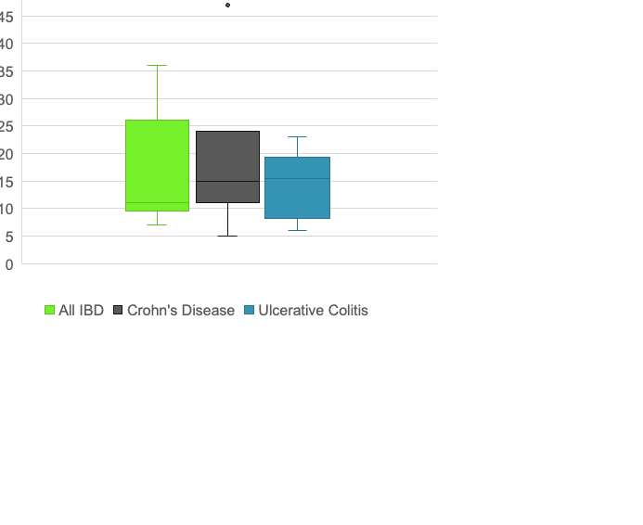
Box plots
use when you want to compare distributions of a continuous variable that is split by category
compare multiple distributions at a time
line = median
top of box = upper quartile
bottom of box = lower quartile
top whisker = upper extreme
bottom whisker = lower extreme

Slide 15
Scatter plots
use when you have two continuous variables
  is age a continuous variable?
you are interested in finding out whether there is a relationship between the variables

Slide 16
Line plots
use when you have two continuous variables that are connected or even grouped somehow
you are interested in finding out whether there is a relationship between the variables
often used with dates or times on the x-axis

Slide 17
Bar plots
similar use case to box plots, but does not give you distributional information
use when you are interested in comparing counts or percentages of a categorical variable

Slide 18
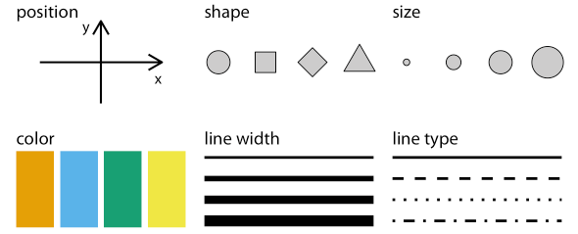
How does visual information convey meaning?
Wilke (2019: 8)

Slide 19
all graphical elements have a size, a shape, and a colour
  on plots, graphical elements also have a position (cartesian, sequential, etc.)
  lines have a width and a type
  text has a font family and face
aesthetics are a combination of personal preference and best practices

Slide 20
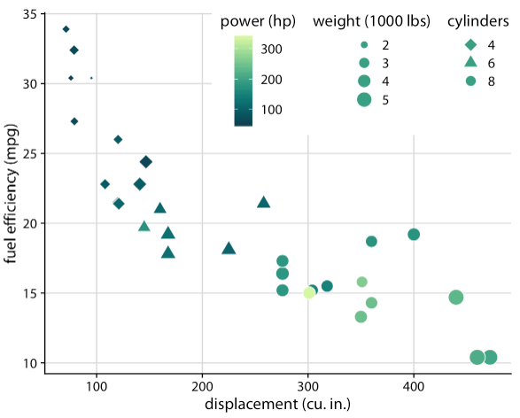
Wilke argues that aesthetics fall into two categories: those that can represent continuous data, and those that cannot
Continuous Data Aesthetics
position
size
colour
line width
Discrete Data Aesthetics
shape
line type
NOTE: darker shades and more saturated colours should be used for larger quantities!

Slide 21
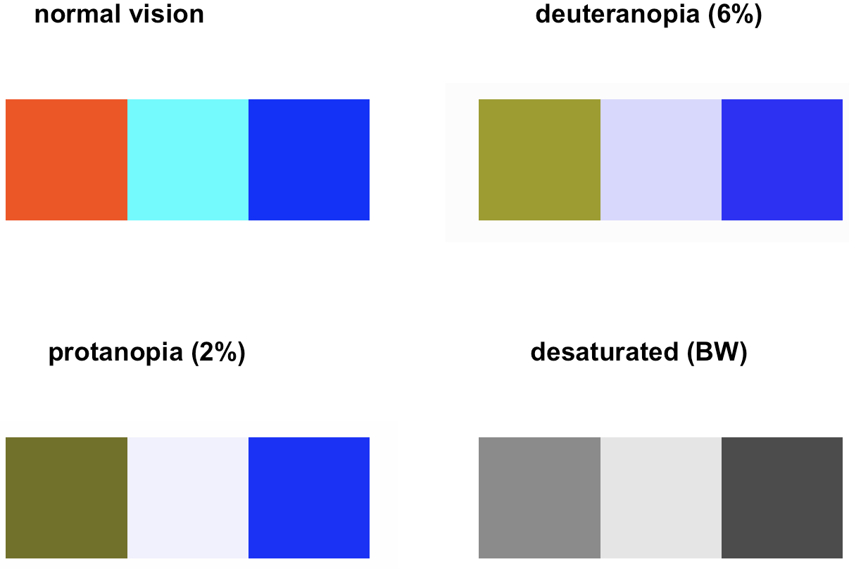
additional design considerations to make:
  add Image Alternative Text using knitr package in R; search best practices for Image Alt Text
    limitations regarding which output types knitr works with, but since R is open-source this is actively being worked on
  use colour-blind friendly colour palettes from packages such as colorBlindness, munsell, viridis, RColorBrewer, dichromat, colorblindr, shades, or ggsci

Slide 22
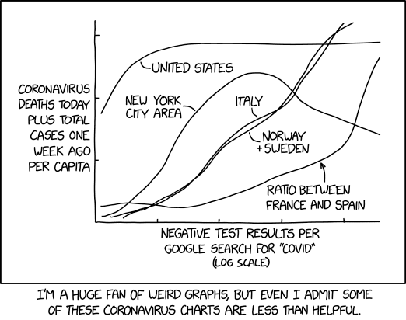
What else can we do with data visualization?
(Hint: Not this.)
https://xkcd.com/2294/

Slide 23

three-dimensional (3D) plots?
  the rule of thumb is to avoid 3D visualizations when using a 2D medium (e.g., journal article, PowerPoint presentation, etc.)
Notes:
Table, bar plot, map
List
Question and Answer: And unfortunately we don’t have time to

Slide 24
web-based interactive visualizations increase usability of 3D plots
shiny applications for dynamic, interactive data visualization
  STOP COVID-19 in IBD dashboard
  Global Hospitalization Trends for Crohn’s Disease and Ulcerative Colitis in the 21st Century

Slide 25
Additional Resources
  Fundamentals of Data Visualization
  https://clauswilke.com/dataviz/
  knitr
  https://cran.r-project.org/web/packages/knitr/index.html
  https://yihui.org/knitr/
  colorBlindness Guide
  https://cran.r-project.org/web/packages/colorBlindness/vignettes/colorBlindness.html
Notes:
Dilbert was wrong that we use visualizations when we have nothing useful to say

Slide 26

For the second half of today’s workshop, you will want to access files here:
https://github.com/kaplan-gi/Snyder-Institute-Science-Communication-Workshop
(type out the URL somewhere and keep it handy)
With any remaining time today I would like to learn more about your data
and discuss what you would like to do with the second Data Visualization workshop.

