Slide 1



Technical Interview 101
FALL 2026 · WEDNESDAYS 5:30–7:00 P.M.
A free workshop series at the University of Florida, built on peer support, real-time feedback, and AI assistance.
UF Herbert Wertheim College of Engineering

Slide 2
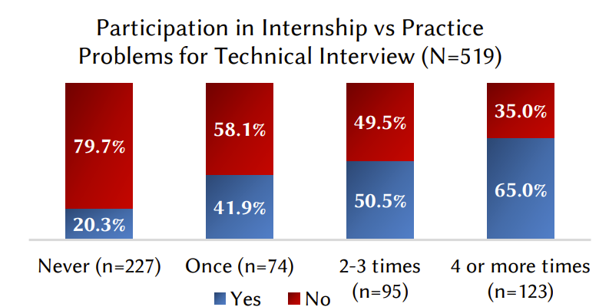
Interview skill is practiced, not absorbed
WHY IT MATTERS
Landed internships
Deliberately practiced interview questions and set aside time for career preparation.
519
CS undergraduates at three U.S. universities, studied in Kapoor & Gardner-McCune, SIGCSE ’20
Did not
Relied on their coursework alone.
Peer mock interviews
Three students who interviewed each other at whiteboards all received Big Five offers.
Technical Interview 101
02

Slide 3
What a technical interview entails
THE INTERVIEW
Typically 45–60 minutes with an engineer: one or two problems, solved live in a shared editor or on a whiteboard, while you think out loud.
01
02
03
04
05
Clarify
Plan
Code
Test
Analyze
Ask questions. Pin down inputs, outputs, and edge cases.
State a brute force, then improve it before you code.
Write clean, working code and narrate your choices.
Trace examples by hand and catch your own bugs.
Give time and space complexity, and discuss tradeoffs.
Technical Interview 101
03

Slide 4
Interviewers score the process as much as the answer
WHAT THEY ASSESS
Problem solving
Coding
Picking the right data structure and finding an efficient approach.
Correct, readable code written without an IDE to lean on.
Communication
Verification
Explaining your thinking out loud and using hints well.
Testing your own code and reasoning about complexity.
Technical Interview 101
04

Slide 5
A guided path from fundamentals to interview day
THE PROGRAM
Designed at UF and delivered on Edugator: taught live, practiced out loud, and backed by weekly problem sets.
MEETS
WORKSHOPS
FORMAT
Wednesdays, 5:30–7:00 p.m.
6 in fall · 10 in spring
In person, or self-paced remote
WEEKLY EFFORT
BACKGROUND
COST
5–6 hours
Python basics · CS1
Free
Technical Interview 101
05

Slide 6
What ninety minutes looks like
A SINGLE SESSION
Every session follows the same shape, so you always know what you are walking into.
FIRST 15–20 MIN
REST OF THE SESSION
DURING THE WEEK
Core content, taught
3–4 worked problems
3 problems on your own
Examples solved together, out loud, start to finish.
Assigned on Edugator, due before the next session.
A focused lesson on the week’s topic, from the ground up.
Technical Interview 101
06

Slide 7
Fall 2026: seven workshops
SCHEDULE
No meeting Nov 11 or Nov 25 (UF holidays). Spring 2027 runs ten sessions, Jan 20 – Mar 31, adding Dynamic Programming and Greedy Algorithms.
# | Date | Topic | Problems
01 | Oct 14 | Introduction + Arrays | 8
02 | Oct 21 | Strings | 7
03 | Oct 28 | Hash Tables | 7
04 | Nov 4 | Trees | 7
05 | Nov 18 | Priority Queues + Heaps | 7
06 | Dec 2 | Graphs | 7
Technical Interview 101
07

Slide 8
What we ask of you, and what you get
EXPECTATIONS
01
Show up every Wednesday, ready to solve problems out loud.
FROM US
02
Budget 5–6 hours a week, session included.
Live lessons on each week’s topic
Worked problems, solved together
Real-time feedback on your approach
A structured path on Edugator
Mock interview practice
03
Finish the 3 Edugator problems before the next session.
04
Use AI as a study partner, never as an answer key.
05
Practice with peers, taking turns as interviewer and candidate.
Technical Interview 101
08

Slide 9
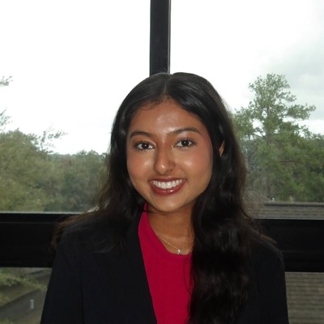
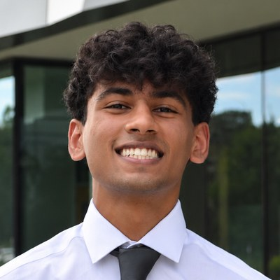
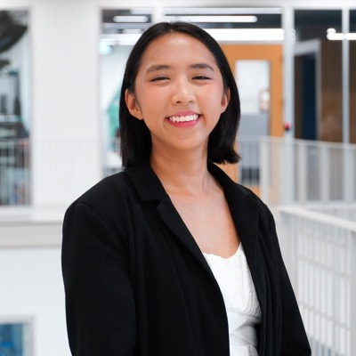
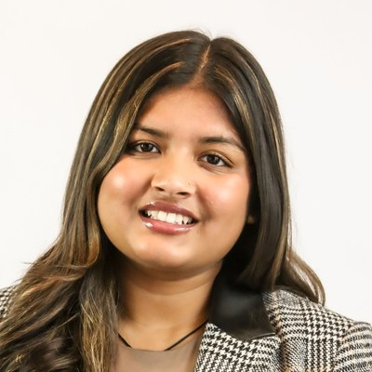
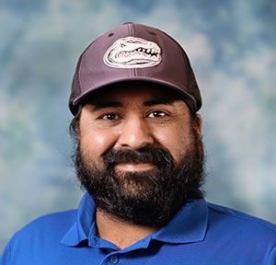
The team
WHO WE ARE
Built by students and faculty at the University of Florida.
Krina Parikh
Rishi Gandhi
Isabelle Gomez
Jahnavi Tripathi
Amanpreet Kapoor, Ph.D.
Past contributors · Anthony Perez · Justin Brown · Elizabeth Gonzalez · Sai Preethi Kota
Technical Interview 101
09

Slide 10

Get in touch
QUESTIONS?
Amanpreet Kapoor, Ph.D. · kapooramanpreet@ufl.edu
Sponsored by the Procter & Gamble Higher Education Grant, in collaboration with UF CISE and UF Engineering Education.

