Slide 1
Bluestock Mutual Fund Analytics Platform
Data Analyst Internship Capstone Project
Prepared By: Anushika Kapoor
Technologies: Python | SQL | SQLite | Tableau | Git
June 2026

Slide 2
Problem Statement & Objectives
Problem Statement
The mutual fund industry generates large volumes of data related to NAVs, investor transactions, fund performance, and SIP investments. Extracting actionable insights from this data requires a structured analytics platform.
Objectives
Analyze industry growth trends
Evaluate fund performance
Study investor behavior
Monitor SIP trends
Build interactive dashboards
Develop recommendation systems

Slide 3
Data Sources
Datasets Used
Fund Master Data
NAV History
AUM by Fund House
Monthly SIP Inflows
Category Inflows
Industry Folio Count
Scheme Performance
Investor Transactions
Portfolio Holdings
Benchmark Indices
Total Records
80,000+ records analyzed
10 integrated datasets

Slide 4
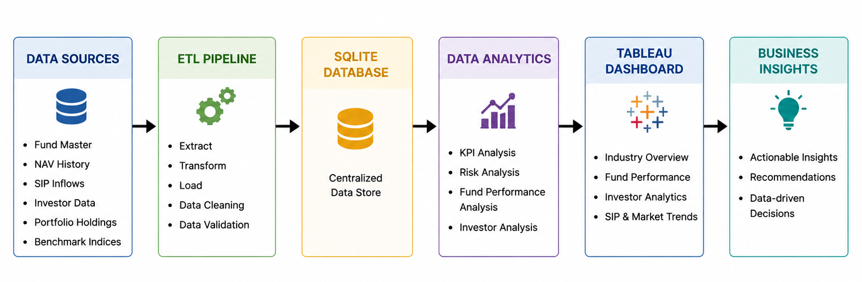
System Architecture
The platform integrates multiple mutual fund datasets through an ETL pipeline for data cleaning, transformation, and validation. The processed data is stored in a centralized SQLite database, analyzed using Python, and visualized through Tableau dashboards to generate actionable business insights and investment recommendations.

Slide 5
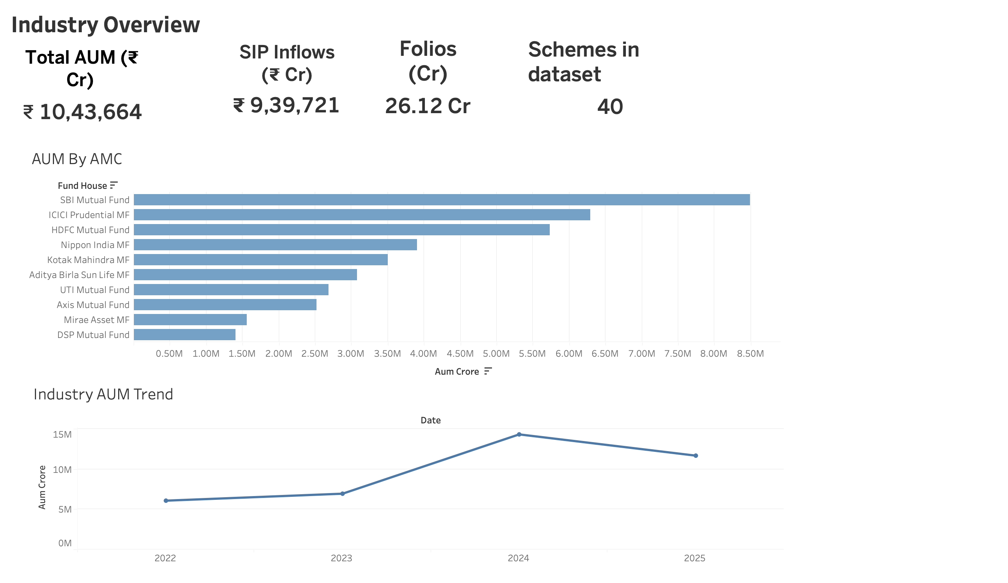
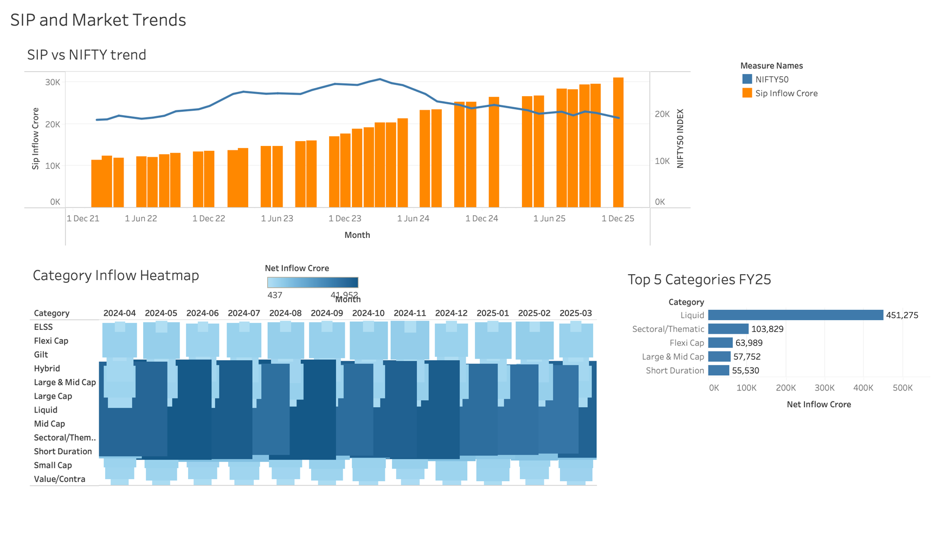
Exploratory Data Analysis – Industry Trends
Industry Trend Analysis
The Industry AUM Trend indicates steady growth in the mutual fund industry, reaching its highest level in 2024 before experiencing a slight correction.
The SIP vs NIFTY Trend shows a continuous increase in SIP inflows despite market fluctuations, highlighting growing investor confidence and long-term investment behavior.
Rising SIP participation reflects increased awareness of systematic investing and the expansion of retail investors in the mutual fund industry.
Key Finding-
Mutual fund investments continued to grow consistently, driven by increasing SIP adoption and sustained investor participation even during market volatility.

Slide 6
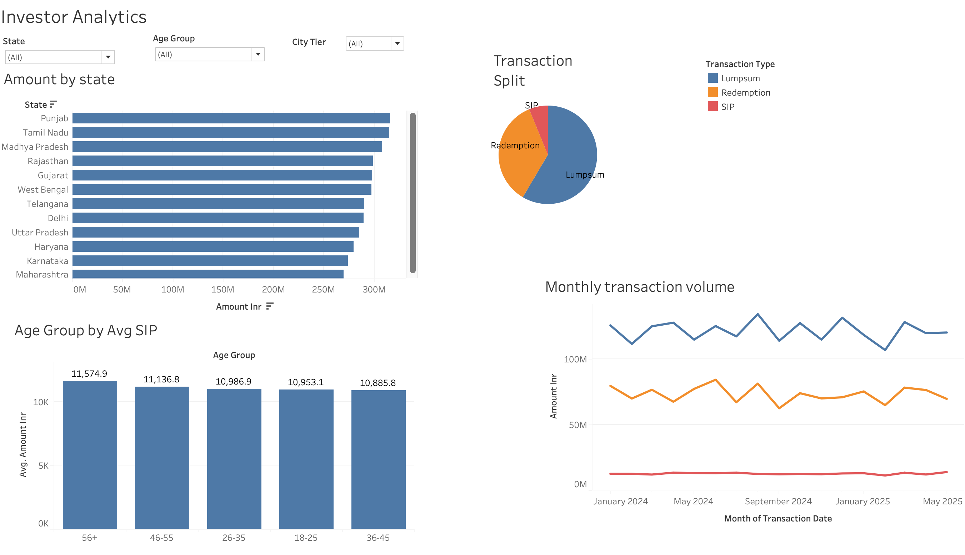
Exploratory Data Analysis – Investor Insights
Investor Insights Analysis
The Age Group Analysis shows that investment participation is distributed across all age groups, with higher average SIP contributions observed among experienced and senior investors.
The State-wise Investment Analysis highlights the geographical distribution of investments, indicating strong participation from multiple states across India.
The results demonstrate widespread adoption of mutual fund investments and growing investor awareness across different demographic segments.
Key Findings
Investors from all age groups actively participate in mutual fund investments.
Senior investors contribute comparatively higher average SIP amounts.
Investment activity is geographically diversified across several Indian states.
Mutual funds are increasingly being adopted as a preferred long-term investment option.

Slide 7
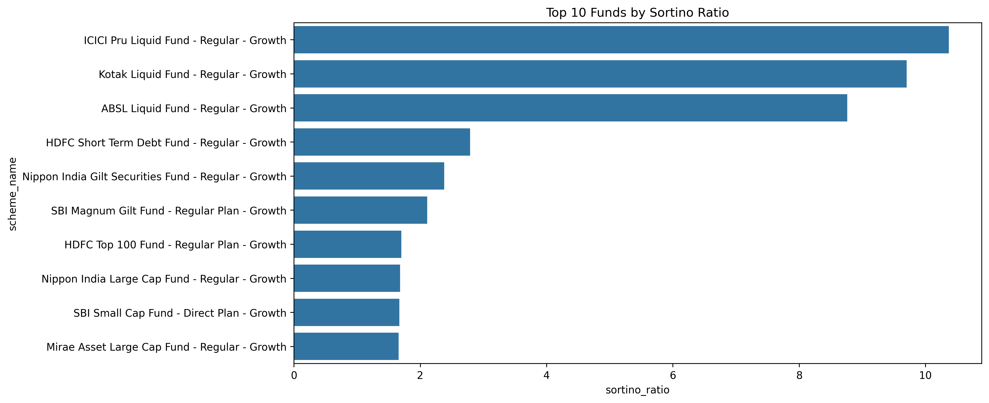
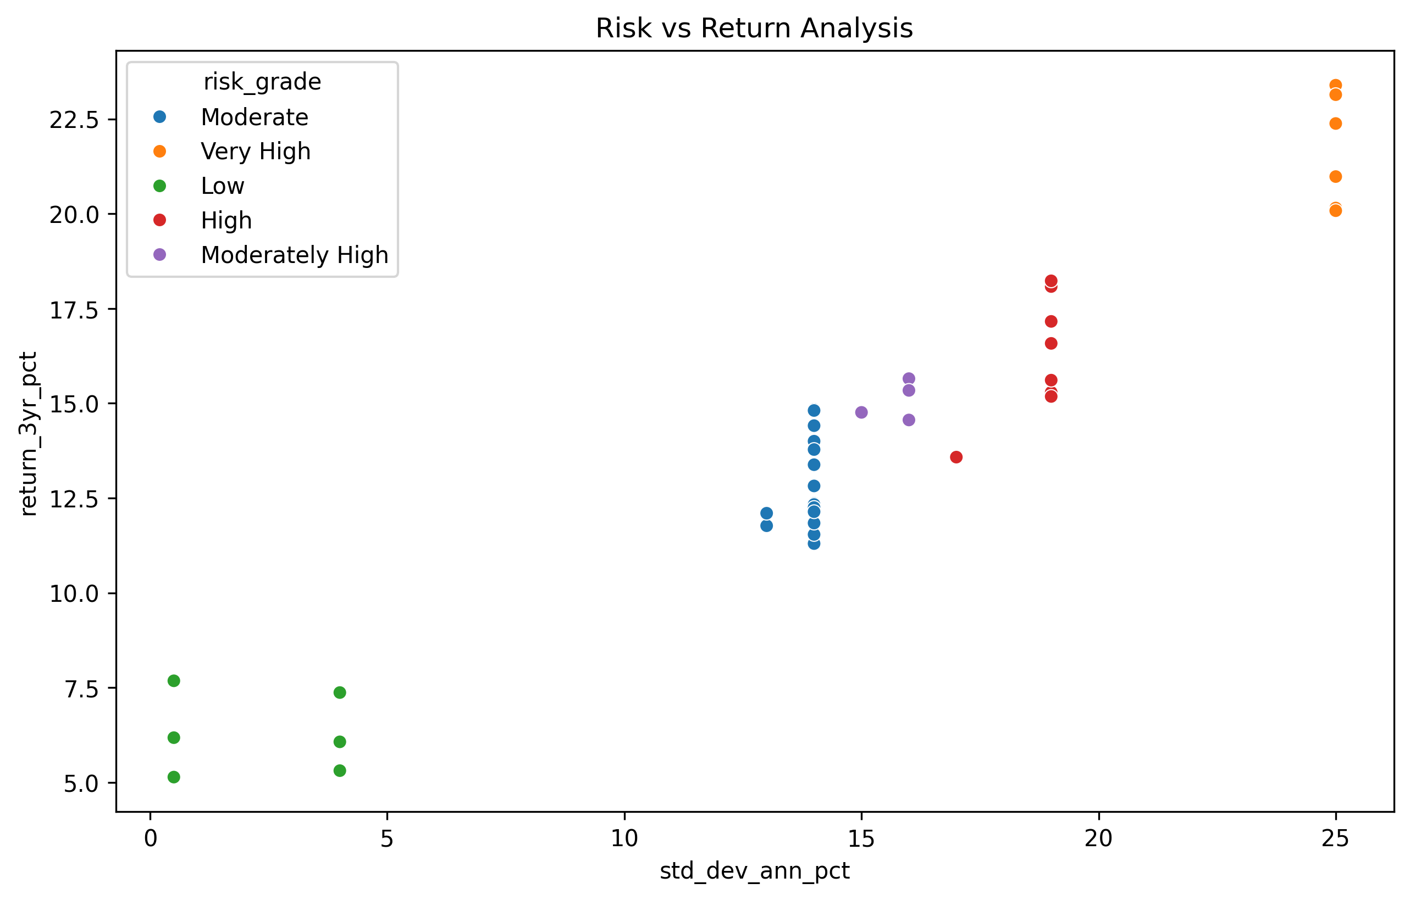
Performance Metrics Analysis
Performance Metrics Analysis
Risk-adjusted performance was evaluated using advanced financial metrics.
The Sortino Ratio identifies funds that generate higher returns while minimizing downside risk.
The Risk-Return Scatter Plot compares expected returns against portfolio risk, helping identify efficient investment options.
These metrics provide a more comprehensive evaluation than absolute returns alone.
Key Findings
Several funds consistently achieved superior risk-adjusted returns.
Higher returns are generally associated with higher risk levels.
Investors should balance risk and return when selecting mutual funds.

Slide 8
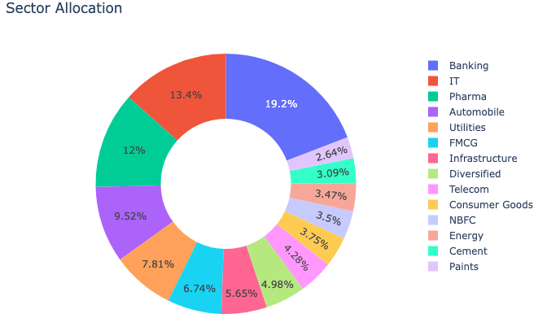
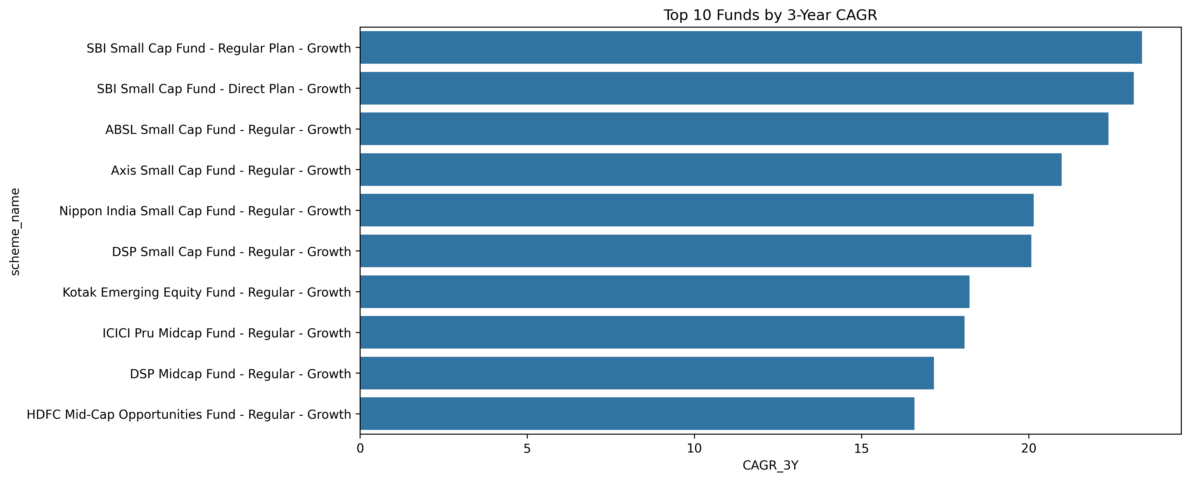
Advanced Analytics & Portfolio Insights
Advanced Analytics & Portfolio Insights
Sector Allocation Analysis evaluates portfolio diversification across different market sectors.
The Herfindahl-Hirschman Index (HHI) helps identify concentration risk within mutual fund portfolios.
CAGR (Compound Annual Growth Rate) analysis highlights funds that have delivered consistent long-term growth.
These analytics provide deeper insights into portfolio quality and investment sustainability.
Key Findings
Banking, IT, and Pharma sectors represent major portfolio allocations.
Most portfolios maintain diversified sector exposure, reducing concentration risk.
Top-performing funds achieved strong long-term CAGR, indicating consistent wealth creation potential.
Diversification and long-term performance are important factors for fund selection.

Slide 9
Dashboard 1 – Industry Overview
Industry Overview Dashboard
The dashboard provides a consolidated view of the Indian mutual fund industry.
Key performance indicators such as Total AUM, Monthly SIP Inflows, and Active SIP Accounts are displayed for quick analysis.
Fund house comparison enables evaluation of market leaders based on assets under management.
The dashboard supports monitoring of industry growth and investor participation trends.
Key Findings
Industry AUM has grown significantly over the analysis period.
SIP inflows continue to increase, indicating strong retail investor participation.
Leading fund houses contribute a substantial share of total industry assets.
Growth in active SIP accounts reflects increasing investor confidence.

Slide 10
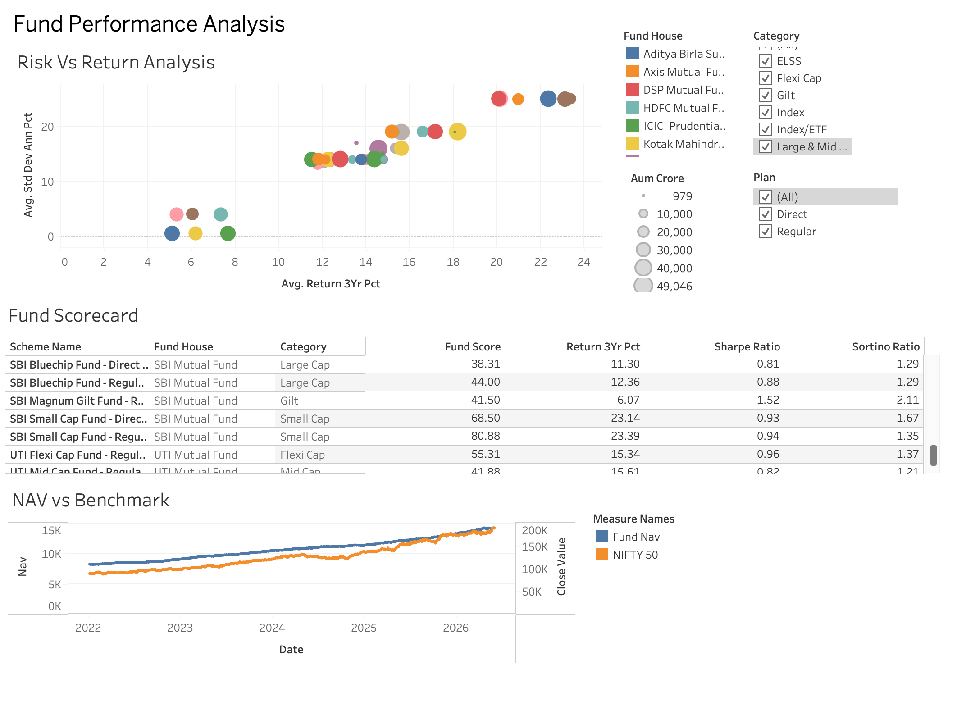
Dashboard 2 – Fund Performance Analysis
The Fund Performance Dashboard evaluates mutual fund schemes using key financial performance indicators such as returns, Sharpe Ratio, Alpha, Beta, and risk categories. It enables comparison of different schemes and helps identify funds delivering superior risk-adjusted performance.
Key Findings
Several funds outperformed their benchmark returns over the analysis period.
Higher Sharpe Ratio funds demonstrated better risk-adjusted performance.
Large-cap funds showed relatively stable returns with moderate risk.
Small-cap funds generated higher returns but were associated with greater volatility.
Performance metrics provide a comprehensive basis for fund selection.

Slide 11
Dashboard 3 – Investor Analytics
The Investor Analytics Dashboard provides insights into investor demographics, transaction behavior, income distribution, and geographic participation. It helps understand investment patterns across different age groups, regions, and investor segments.
Key Findings
Investors aged 26–45 years represented a significant share of investment activity.
Mutual fund participation was observed across multiple states and regions.
Digital payment methods were widely adopted for investment transactions.
Investors from different income groups actively contributed to mutual fund investments.
Growing retail participation indicates increasing awareness of financial planning and wealth creation.

Slide 12
Key Findings and Recommendations
Key Findings
Industry AUM demonstrated consistent growth.
SIP inflows increased significantly over the analysis period.
Retail investor participation expanded across multiple age groups and regions.
Risk-adjusted metrics provided deeper insights into fund performance.
Diversified portfolios showed lower concentration risk.
Data analytics enables more informed investment decision-making.
Recommendations
Encourage long-term SIP investing.
Promote portfolio diversification.
Use risk-adjusted metrics while evaluating funds.
Improve investor awareness and financial education initiatives.

Slide 13
Thank You
Bluestock Mutual Fund Analytics Platform
Prepared By Anushika Kapoor
GitHub Repository: https://github.com/kapooranushika0512/bluestock-mf-capstone

