Slide 1
An Empirical Comparison of Dynamic Impact Analysis Algorithms
Alessandro Orso,‡ Taweesup Apiwattanapong,‡ James Law,† Gregg Rothermel,† and Mary Jean Harrold,‡
‡College of Computing, Georgia Institute of Technology, Atlanta, Georgia
†Computer Science Department, Oregon State University, Corvallis, Oregon
26th International Conference on Software Engineering (ICSE’04)
Kunal Kapoor ~ Kxk140330@utdallas.edu

Slide 2
Software evolves and changes
Software evolution is the on-going enhancement of existing software systems, involving both development and maintenance.
Software maintenance has been recognized as the most costly and difficult phase in software life cycle.
Software change management is one of the most essential tasks in software maintenance.

Slide 3
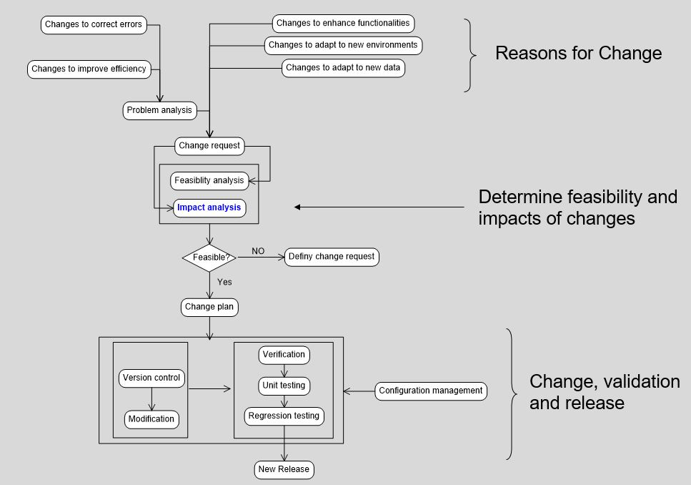
Software Change Management
Notes:
Changes can cause ripple impact
Software modules are interactive with each other. Changes to one module can produce ripple impacts through its interactive behaviors.
Making software changes without understanding their effects and proper change management can lead to
poor effort estimates
delays in release schedules
degraded software design
unreliable software products
the premature retirement of the software system.

Slide 4
Impact Analysis
Impact analysis is a process that predicts and determines the parts of a software system that can be affected by changes to the system.
Change Set: The parts of the software system that are to be changed
Impact Set: Parts of the software system that are affected by the changes

Slide 5
Impact Analysis is Essential
Impact analysis is a systematic approach to understanding impacts of software changes and is essential to:
Identify the parts that require retesting
Improve estimation of time, labor and money required for maintenance
Reduce potential errors due to unknown change impacts
Improve overall efficiency in software maintenance

Slide 6
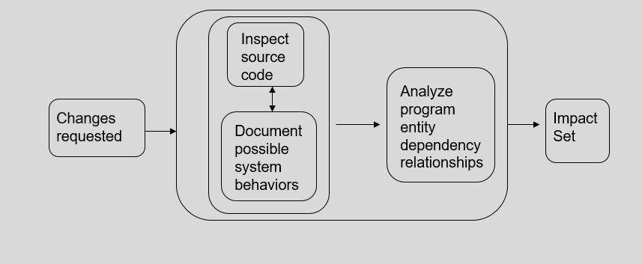
Static Impact Analysis
Depends on analysis of source code
Based on assumptions of all possible software runtime behaviors
Results can include most of the software system in the impact set

Slide 7
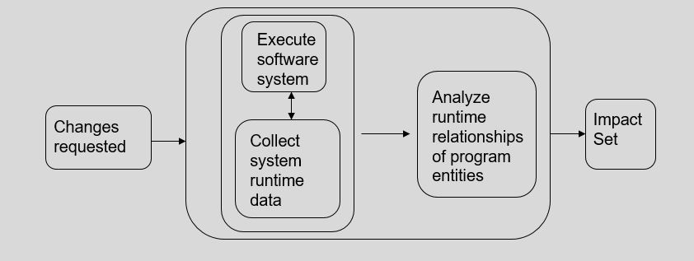
Dynamic Impact Analysis
Based on software runtime data and dynamic interactive behaviors of the software system
Depends on a set of executions of the system
Tend to produce more precise results than static approaches

Slide 8
Techniques we are covering today
Comes from Dependency Base impact analysis techniques
CoverageImpact
PathImpact
These techniques perform impact analysis based on data gathered about program behavior relative to specific inputs, such as inputs gathered from field data, operational profile data, or test-suite executions
Due to various characteristics of the algorithms they employ, CoverageImpact and PathImpact are expected to differ in terms of cost and precision
Notes:
Due to various characteristics of the algorithms they employ, CoverageImpact and PathImpact are expected to differ in terms of cost and precision
Dependency-based impactanalysis techniques rely on static analysis based on forward slicing - The forward slice at program point p is the program subset that may be affected by p

Slide 9
What have they done?
For each version they performed impact analysis using both techniques and compared -
The precision of the results.
The cost of the analyses in terms of space.
The cost of the analyses in terms of time.
The results of the study support the analytical claim that tradeoffs exist between the two techniques, and provide data on the extent to which these tradeoffs actually surface in practice. The results also show that the techniques have complementary strengths.

Slide 10
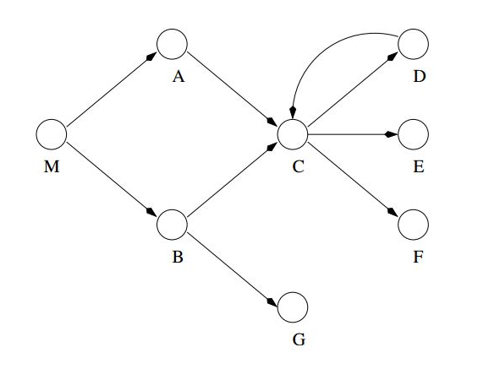
Dynamic Impact Analysis
Exec1: M B G r G r r A C E r r r x
Exec2: M B C r G r r x
Exec3: M A C E r D r r r x
Exec4: M B C E r F r D r r ... C E r F r D r r r x
Traces for P. The dots in the last trace indicate that the sequence CErFrDrr is repeated several times.
Call graph for program P.

Slide 11
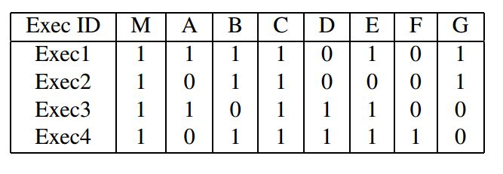
Coverage-Based Dynamic Impact Analysis
1 for m cover
0 for m not covered
Coverage bit vectors for the execution traces
Notes:
The bit vectors contain one bit per method. A value of 1 in the bit for method m in the vector for execution e indicates that m was covered in e, and a value of 0 indicates that m was not covered in e

Slide 12
CoverageImpact computes each dynamic slice in three steps –
Using the coverage information, it identifies the executions that traverse m and adds the methods covered by such executions to a set of covered methods. Eg – {M, A, B, C, D, E, and G}
It computes a static forward slice from m and adds the methods included in the slice to a set of slice methods. Eg - {M, A, C, D, E, and F}
It takes the intersection of covered methods and slice methods. The result of the intersection is the impact set. Eg – {M, A, C, D, E}

Slide 13
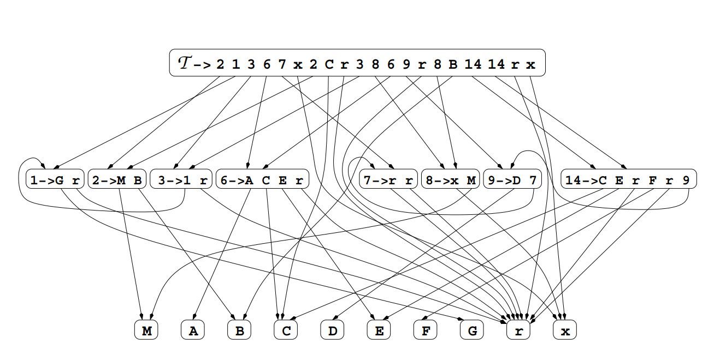
Path-Based Dynamic Impact Analysis
Whole-path DAG for the execution traces

Slide 14
PathImpact walks the DAG to determine an impact set given a set of changes.
One way to visualize its operation is to consider beginning at a changed method’s node in the DAG, walking through the DAG by performing recursive forward and backward inorder traversals at each node, and stopping when any trace termination symbol, x, is found.
By traversing forward in the DAG, the algorithm finds all methods that execute after the change and therefore could be affected by the change.
By traversing backward in the DAG, the algorithm determines all methods into which execution can return

Slide 15
Yes, they Differ
CoverageImpact and PathImpact can differ, in terms of precision and cost
Where precision is concerned, PathImpact is expected to be more precise than CoverageImpact
Where cost is concerned, PathImpact is analytically more expensive than CoverageImpact in terms of both space and time.

Slide 16
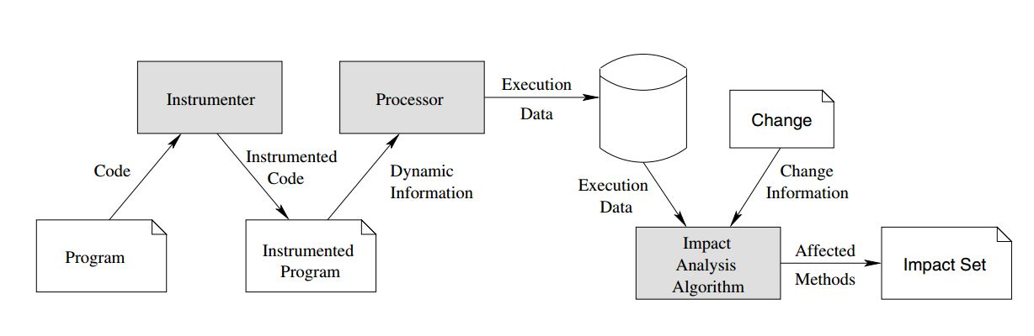
Empirical Study
Model of the dynamic impact analysis process

Slide 17
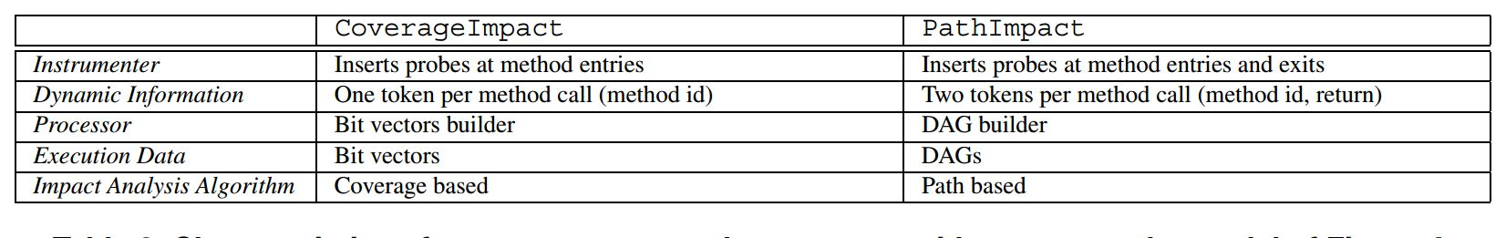
Characteristics of CoverageImpact and PathImpact with respect to the model

Slide 18
To evaluate the precisions of CoverageImpact and PathImpact, they measured the relative sizes of the impact sets computed by the techniques on a given program, change set, and set of program executions. They report and compare such sizes in relative terms, as a percentage over the total number of methods in the sets.
To evaluate the relative space usage of CoverageImpact and PathImpact, they measure and compare these sizes, in terms of disk space required to store bit vectors and DAGs respectively for CoverageImpact and PathImpact.
To evaluate relative execution costs for CoverageImpact and PathImpact, they measured the time required to execute an instrumented program on a
set of test cases, gathered the execution data (bit vectors or DAGs) needed or subsequent impact analysis, and output that information to disk.

Slide 19
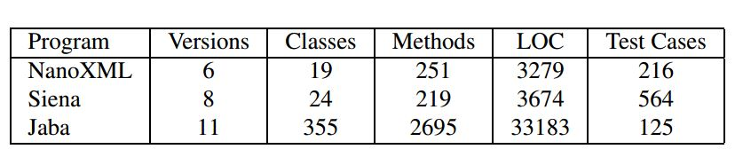
Experiment Setup - Object of Analysis
As change sets for use in assessing impacts, they used the actual sets of changes from each version of our subject programs to each subsequent version.
Notes:
we report two different sets of results: individual test execution results and test-suite execution results. Individual test execution results are the results
that we computed by considering each test case in a test suite independently and then averaging the results across all test executions. Test suite execution results are the results that we computed considering the entire test suite at once.

Slide 20
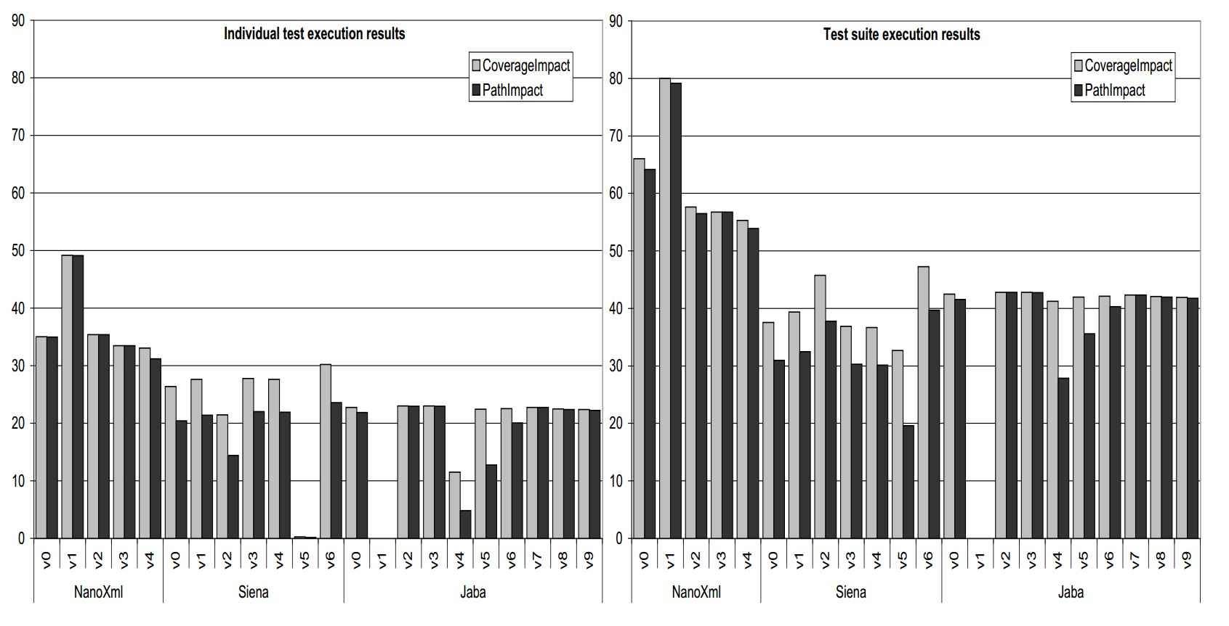
Results and Analysis - Precision
Precision results, expressed as percentage of methods in the impact sets
Notes:
In both graphs, each version of each program occupies a position along the horizontal axis, and the relative impact set size for that program and version are represented by a vertical bar — grey for the CoverageImpact technique and black for the PathImpact technique.
The graphs show that, in many cases, PathImpact is more precise than CoverageImpact

Slide 21
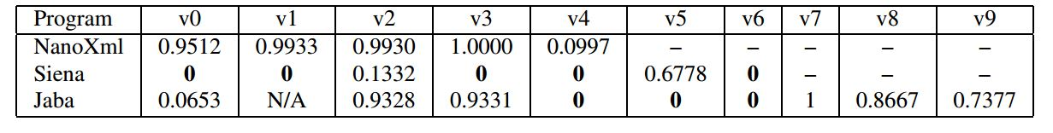
ρ-values from t-tests on individual test execution precision results, per program and version
The null hypothesis was that the mean of the impact set sizes for the two techniques was equal.
T-tests for which the ρ-value is less than or equal to a level of significance α of 0.05 are statistically significant.
The ρ-values in the table indicate that there are statistically significant differences in the impact sets computed by CoverageImpact and PathImpact on eight out of 21 cases (38%) — for five versions of Siena and three versions of JABA. For the other 13 cases (62%), the results are not statistically significantly different for an α of 0.05.

Slide 22
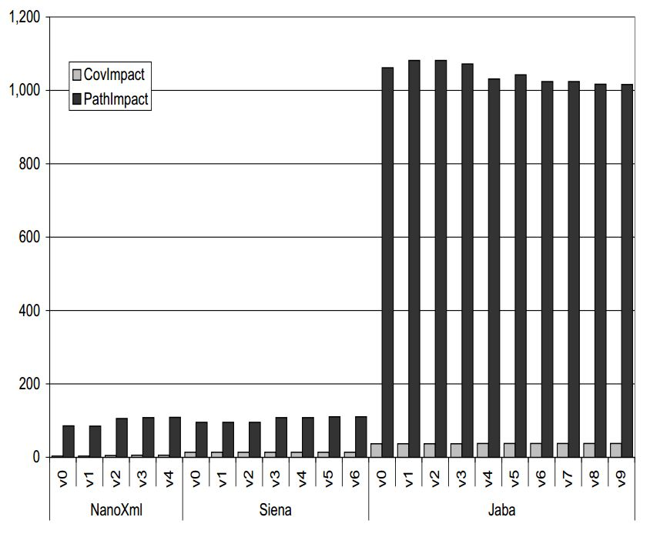
Results and Analysis - Space Cost
The graph shows that, for all programs and versions, CoverageImpact requires from 7 to 30 times less space than PathImpact to store execution data.
The size required by PathImpact is never larger than 1.1 MB per suite.
Space cost results, in KB
Notes:
For space cost, we do not show a graph for individual test execution results because, for those results, the differences are even more extreme.
This is because PathImpact can generate a more compressed DAG when processing traces for a whole test-suite than when processing traces for executions of single test cases individually.
Conversely, CoverageImpact always computes a bit vector of fixed size, per execution. Therefore, only when gathering bit vectors for a whole test suite does their cumulative size become comparable to the size of a DAG for the same suite.

Slide 23
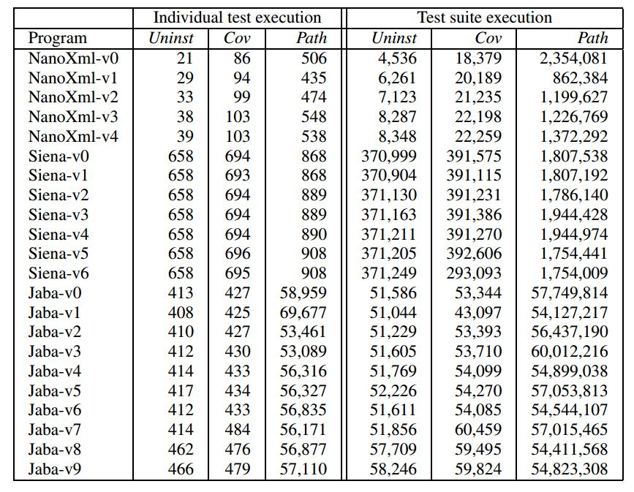
Results and Analysis - Time Overhead
Uninstrumented program (Uninst)
The execution times for PathImpact are consistently higher than those for CoverageImpact
Time cost results, in ms
Notes:
Table 5 reports both individual test results, in which we gather the execution times for each test case independently and then average them across all test cases, and test-suite results, in which we gather the execution time required to execute the whole test suite at once

Slide 24
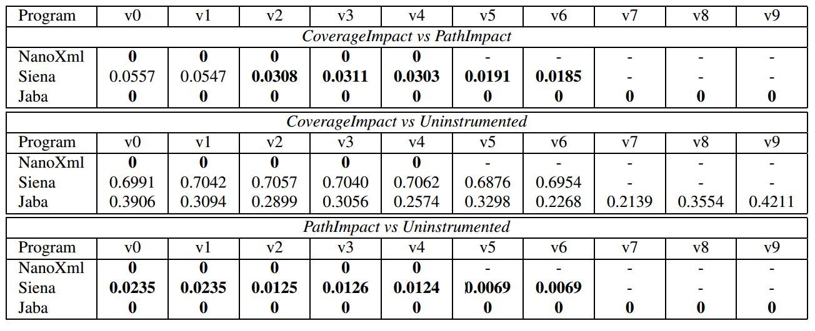
The null hypotheses for these three t-tests are that (1) the time costs of the two impact analysis techniques are equal, (2) the time cost of CoverageImpact is negligible with respect to the time cost of running the uninstrumented program, and (3) the time cost of PathImpact is negligible with respect to the time cost of running the uninstrumented program

Slide 25
The ρ-values in the first part of the table show that the differences in time costs of CoverageImpact and PathImpact are statistically significant in 20 out of 22 cases.
The ρ-values in the second part of the table show that there is no significant difference in the time cost of running CoverageImpact and the time cost of running the uninstrumented program for SIENA and JABA, whereas the difference is significant for NANOXML.
Finally, the ρ-values in the third part of the table show that there is a significant difference in the time cost of running PathImpact and the time cost of running the uninstrumented program for all programs and versions.

Slide 26
Conclusion
Results of the study show that tradeoffs do exist for the two techniques, and that the techniques have complementary strengths and weaknesses.
PathImpact, at least as currently defined, may not be practical for use with programs that generate large execution traces.
CoverageImpact appears to be practical for the programs that they considered in our experiment, but could be a waste of resouces for others.
Empirical comparisons of PathImpact and CoverageImpact to an implementation of static slicing have shown that the Static slicing can identify much larger impact sets than the Dynamic slicing.
PathImpact and CoverageImpact have such complementary cost benefits, in future, a hybrid approach that is not as expensive as PathImpact, yet is more precise than CoverageImpact can be defined.

Slide 27
Quiz
In your opinion, how important it is to do impact analysis for an organization.
Why would you choose forward Slicing?
Do you think the cost is still a significant factor in impact analysis, as the research is dated back to 2004?
Notes:
The backward slice at program point p is the program subset that may affect p
The forward slice at program point p is the program subset that may be affected by p

Slide 28
Thank You! Questions?

