Slide 1
Getting Started with C#
Bhawna Gunwani
Corporate Trainer and Consultant

Slide 2
Introduction to C#

Slide 3
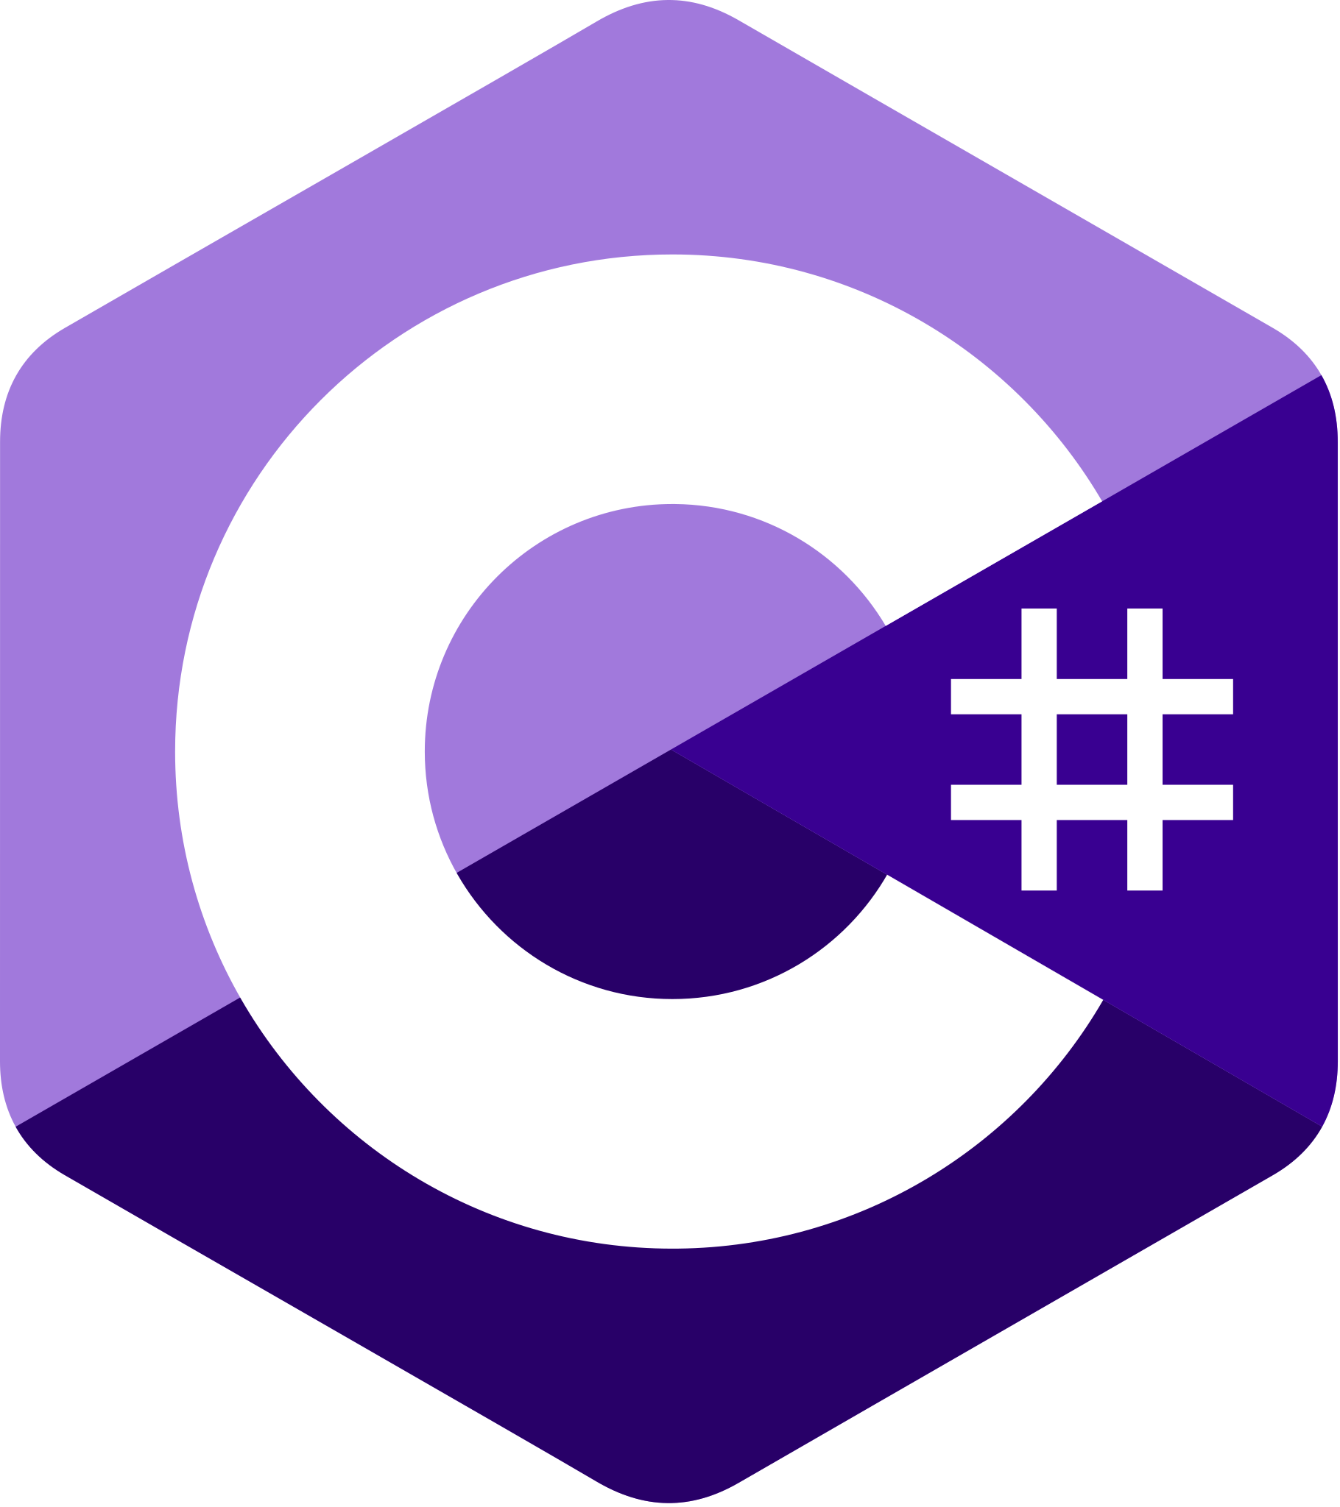
Introducing C#
An object-oriented programming language developed by Microsoft
Introduced in 2002 by .NET Foundation.
Familiar syntax for C/C++ and Java developers
Used for developing web application, windows application, mobile apps and games etc.

Slide 4
Key Features of C#
1
5
Type Safe
Cross Platform
2
Object Oriented
6
Object Oriented
Automatic Garbage Collection
3
7
Multi-Threading
Rich Set of Features

Slide 5
C# Version History
C# 1.0 2002
C# 2.0 2005
C# 3.0 2007
C# 4.0 2010
C# 5.0 2013
C# 6.0 2015
C# 7.0 2017
C# 8.0 2018
C# 9.0 2020
C# 10.0 2021
C# 11.0 2022
C# 12.0 2023

Slide 6
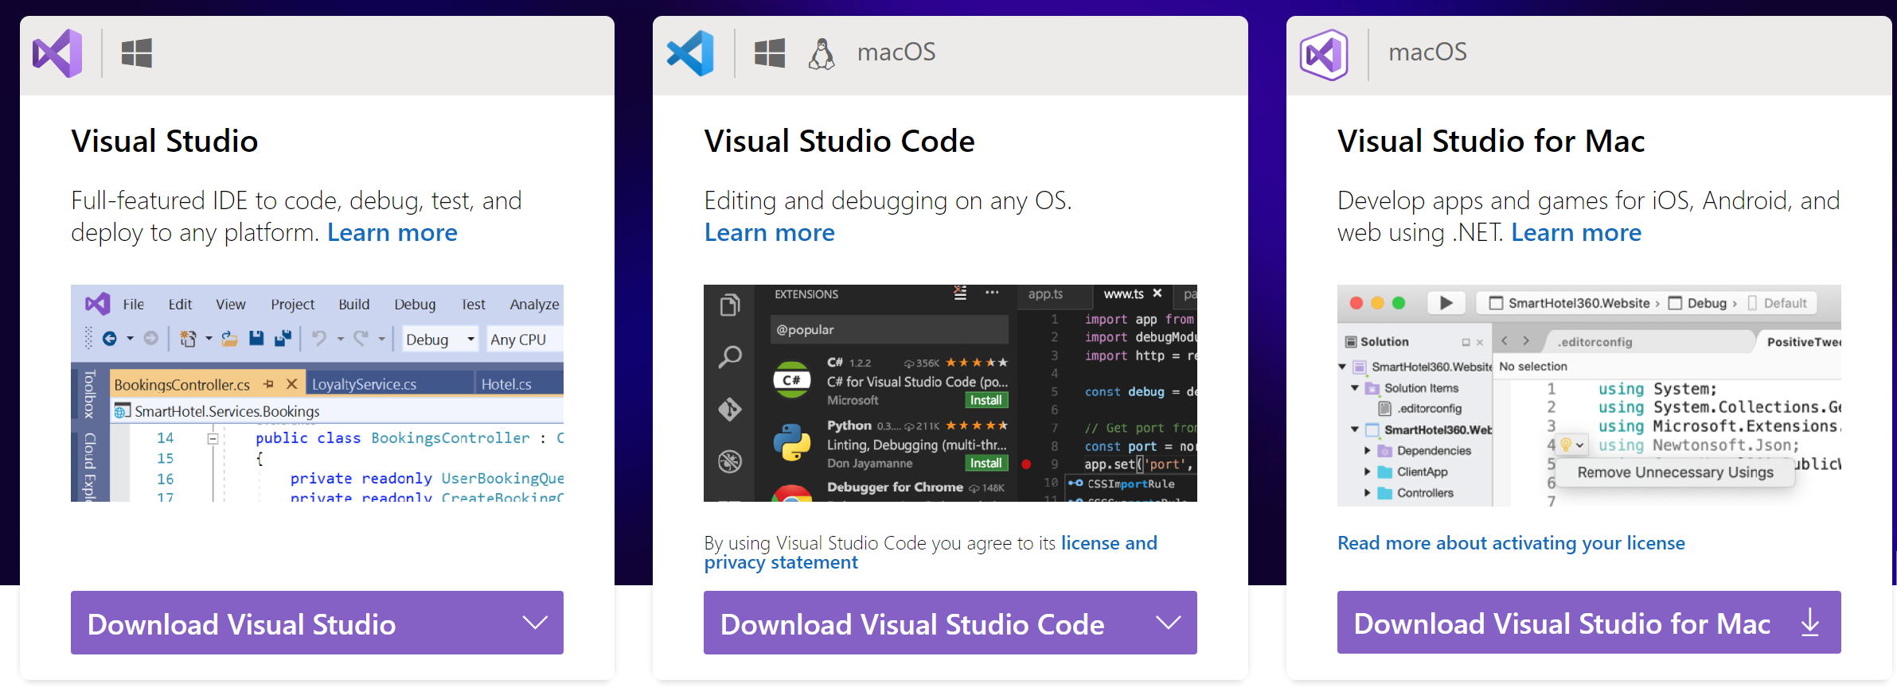
Dev Environment on Windows/Linux/Mac
https://visualstudio.microsoft.com/

Slide 7
C# Code Execution

Slide 8
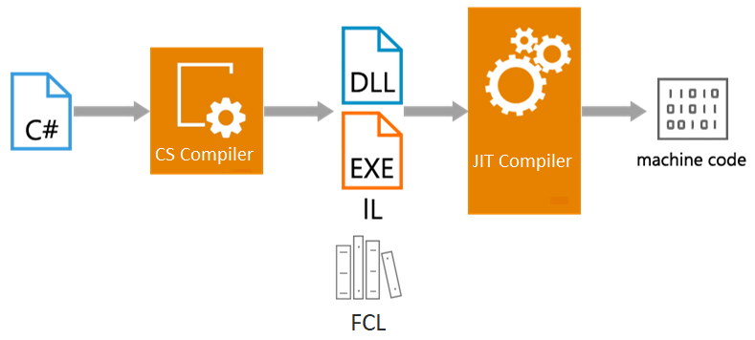
C# Code Execution: .NET Framework

Slide 9
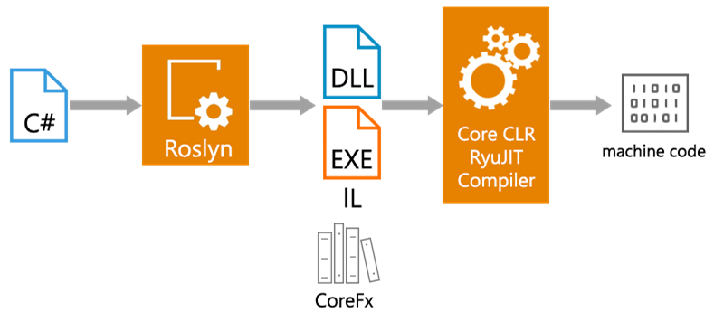
C# Code Execution: .NET Core

Slide 10
DEMO Your First C# Program

Slide 11
Variables

Slide 12
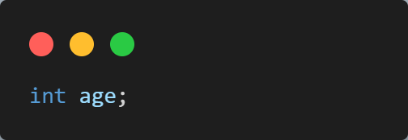
Variables
A variable is a name of memory location.
It is used to store data.
Its value can be changed and it can be reused many times.
A way to represent memory location through symbol so that it can be easily identified.

Slide 13
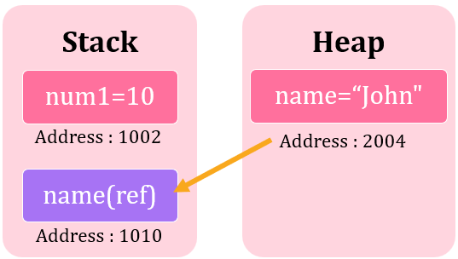
Variables

Slide 14
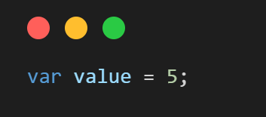
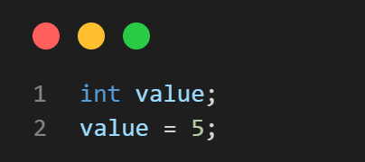
Implicitly Typed Variables
We can declare a variable without knowing its type using var keyword.
Such variables are called implicitly typed local variables.
Variables declared using var must be initialized at the time of declaration.
Is equivalent to

Slide 15
Rules for Naming a Variable
The variable name can contain:
- letters (uppercase/lowercase), underscore( _ ) and digits only.
The variable name must start with either letter, underscore or @ symbol.
C# is case sensitive.
It means age and Age refers to 2 different variables.
A variable name must not be a C# keyword.

Slide 16
Data Types

Slide 17
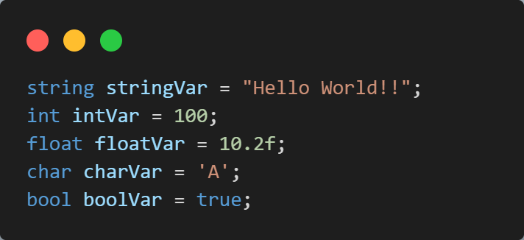
Data Types
A Data Type specifies the type of data that a variable can store.
The following declares and initialized variables of different data types.

Slide 18
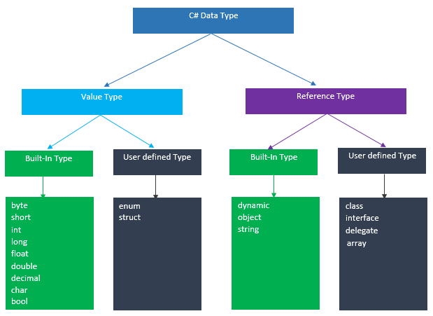
Data Types
C# mainly categorized data types in two types:

Slide 19
Value Types
It holds a data value within its own memory space.
It means the variables of these data types directly contain values.
For Example, Consider integer variable int i = 100;
The system stores 100 in the memory space allocated for the variable i.
The following image illustrates how 100 is stored at some hypothetical location in the memory (0x239110) for 'i':
0x239110
int i = 100;
100
RAM

Slide 20
Value Types
Data Types | Memory Size | Range
char | 1 byte | -128 to 127
short | 2 byte | -32,768 to 32,767
signed short | 2 byte | -32,768 to 32,767
unsigned short | 2 byte | 0 to 65,535
int | 4 byte | -2,147,483,648 to -2,147,483,647
signed int | 4 byte | -2,147,483,648 to -2,147,483,647
unsigned int | 4 byte | 0 to 4,294,967,295
long | 8 byte | ?9,223,372,036,854,775,808 to 9,223,372,036,854,775,807
float | 4 byte | 1.5 * 10⁻⁴⁵ - 3.4 * 10³⁸, 7-digit precision
double | 8 byte | 5.0 * 10⁻³²⁴ - 1.7 * 10³⁰⁸, 15-digit precision
decimal | 16 byte | at least -7.9 * 10^{?28} - 7.9 * 10²⁸, with at least 28-digit precision

Slide 21
Reference Types
Unlike value types, a reference type doesn't store its value directly.
Instead, it stores the address where the value is being stored.
Contains a pointer to another memory location that holds the data.
For example, consider the following string variable:
RAM
0x803200
0x600000
string s = “Hello World!”;
0x600000
Hello World!
Reference type variable contains address where the value is stored.
Actual Value

Slide 22
Reference Types
The followings are reference type data types:
String
Arrays (even if their elements are value types)
Class
Delegate

Slide 23
Operators

Slide 24
Operators
Special symbols that are used to perform specific operations and return a result.
They are taken from other languages and behave as expected.
They can be categorized into following groups:
Assignment Operator
Arithmetic Operator
Relational Operator
Logical Operator
Unary Operator
Ternary Operator
Bitwise Operator

Slide 25
Assignment Operators
The assignment operators are used to assign values to variables.
Operator | Description | Example | Is The Same As
= | Assign | x = y | x = y
+= | Add and assign | x += y | x = x + y
-= | Subtract and assign | x -= y | x = x - y
*= | Multiply and assign | x *= y | x = x * y
/= | Divide and assign quotient | x /= y | x = x / y
%= | Divide and assign modulus | x %= y | x = x % y

Slide 26
Arithmetic Operators
Used to perform common arithmetical operations:
- such as addition, subtraction, multiplication etc.
Operator | Description | Example | Result
+ | Addition | x + y | Sum of x and y
- | Subtraction | x - y | Difference of x and y.
* | Multiplication | x * y | Product of x and y.
/ | Division | x / y | Quotient of x and y
% | Modulus | x % y | Remainder of x divided by y

Slide 27
Relational Operators
Used to compare two values in a Boolean fashion.
Operator | Name | Example | Result
== | Equal | x == y | True if x is equal to y
=== | Identical | x === y | True if x is equal to y, and they are of the same type
!= | Not equal | x != y | True if x is not equal to y
!== | Not identical | x !== y | True if x is not equal to y, or not of same type
< | Less than | x < y | True if x is less than y
> | Greater than | x > y | True if x is greater than y
>= | Greater than or equal to | x >= y | True if x is greater than or equal to y
<= | Less than or equal to | x <= y | True if x is less than or equal to y

Slide 28
Logical Operators
Typically used to combine conditional statements.
Operator | Name | Example | Result
&& | And | x && y | True if both x and y are true
|| | Or | x || y | True if either x or y is true
! | Not | !x | True if x is not true

Slide 29
Unary Operators
Unlike other operators, the unary operates on a single operand.
Operator | Name | Effect
++x | Pre-increment | Increments x by one, then returns x
x++ | Post-increment | Returns x, then increments x by one
--x | Pre-decrement | Decrements x by one, then returns x
x-- | Post-decrement | Returns x, then decrements x by one

Slide 30
Bitwise Operators
Used to perform bit manipulation operations.
Operator | Name
- | Bitwise Complement
& | Bitwise AND
| | Bitwise OR
^ | Bitwise Exclusive OR
<< | Bitwise Left Shift
>> | Bitwise Right Shift

Slide 31
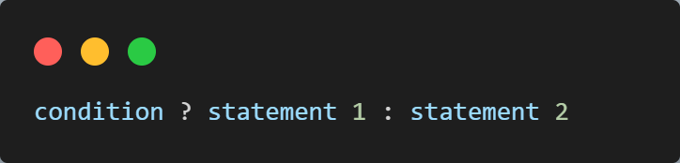
Ternary Operator (?:)
Operates on a conditional expression that returns a Boolean value.
If the conditional expression is true then the first expression would be evaluated
Otherwise the second expression would be evaluated.

Slide 32
Operator Precedence

Slide 33
Conditional Statements

Slide 34
Conditional Statements
Helps you to make decision based on certain conditions.
Conditions are specified by Boolean expressions.
Boolean expressions are evaluated to a Boolean value true or false.
Conditional Statements
If Statement
If-Else Statement
If-Else-If or Ladder
Switch

Slide 35
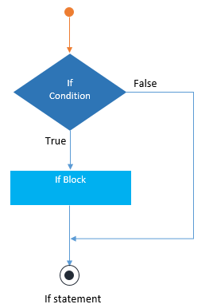
If Statement
Consists of a Boolean expression which is evaluated to a Boolean value.
If the value is true, then if block is executed otherwise next statement would be executed.

Slide 36
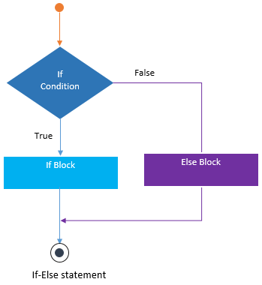
If-Else Statement
Consists of two statements:
- if statement and else statement.
When the expression in an if-statement is evaluated to true, the if block is executed,
Otherwise the else block would be executed.

Slide 37
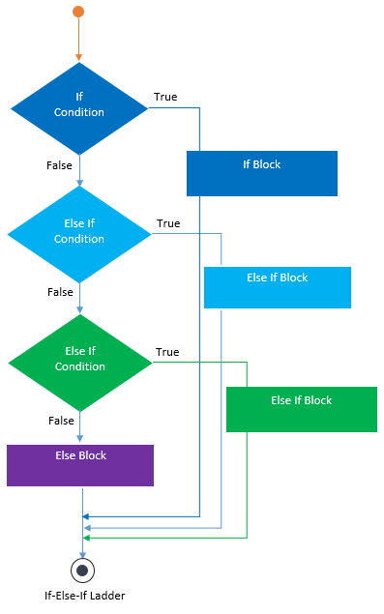
If-Else-If or Ladder Statement
Test a series of conditions with:
- multiple if-elseif-else statements.
Statement which meet the result, would be executed.
When no condition meet the result, default else statement would be executed.

Slide 38
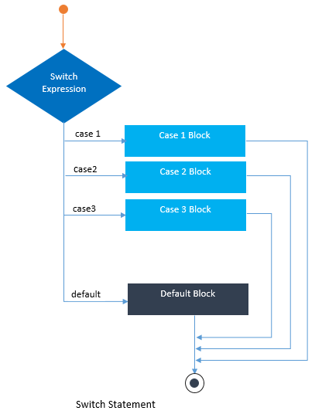
Switch Statement
Test a series of conditions with one or more cases which are tested against the switch expression.
The case which meet the result, would be executed.
When no case meet the result, default case would be executed.

Slide 39
Loops

Slide 40
Loops
Powerful tools for performing repetitive tasks efficiently.
Loops execute a block of code again and again while the condition is true.
For example, if you want to show a “Hello!” for 30 times, then you can use a loop.
Below are the types of loops:
Loops
For loop
While Loop
Do..While Loop

Slide 41
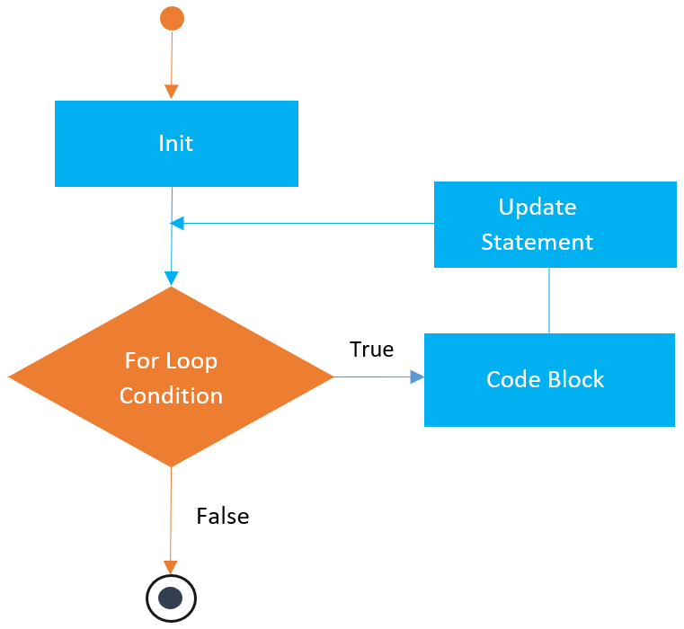
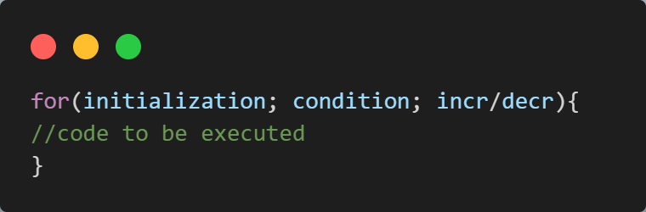
For Loop
Used to iterate a part of the program several times.
If number of iteration is fixed, it is recommended to use for loop than while or do-while loops.

Slide 42
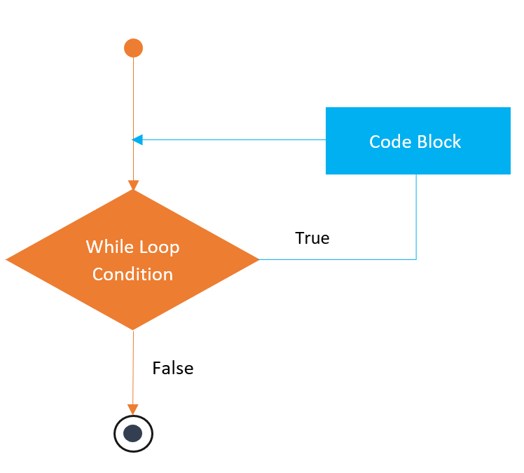
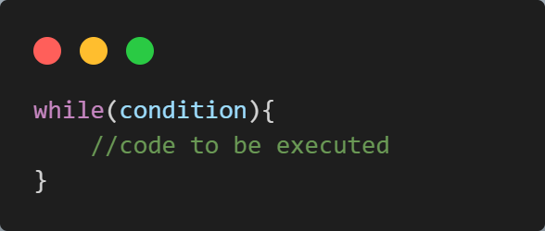
While Loop
Executes statements until the specified expression evaluates to false.
Typically, while loop is useful when you are not aware of the exact number of iterations

Slide 43
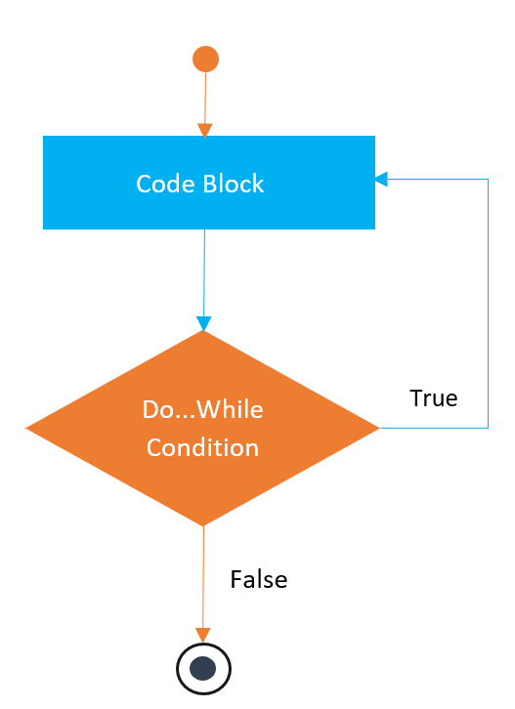
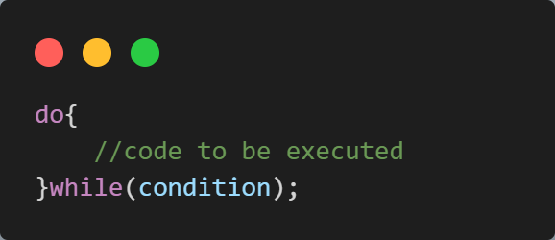
Do..While Loop
If the number of iteration is not fixed and you must have to execute the loop at least once, it is recommended to use do-while loop.

Slide 44
Jump Statements

Slide 45
Jump Statements
Used to alter the normal flow of control within loops and switch statements.
They allow you to either terminate the execution or skip a specific iteration.
There are three main Jump Statements:
Jump Statements
break
continue
Goto

Slide 46
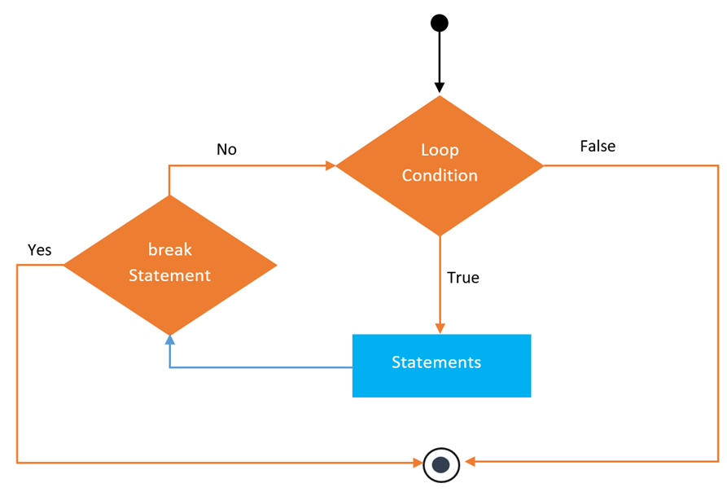
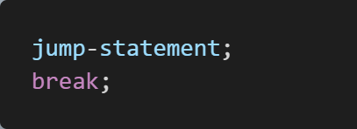
Break Statement
Terminates the execution of a loop or switch.
Transfers program control to next statement which is placed immediately after the loop or switch.

Slide 47
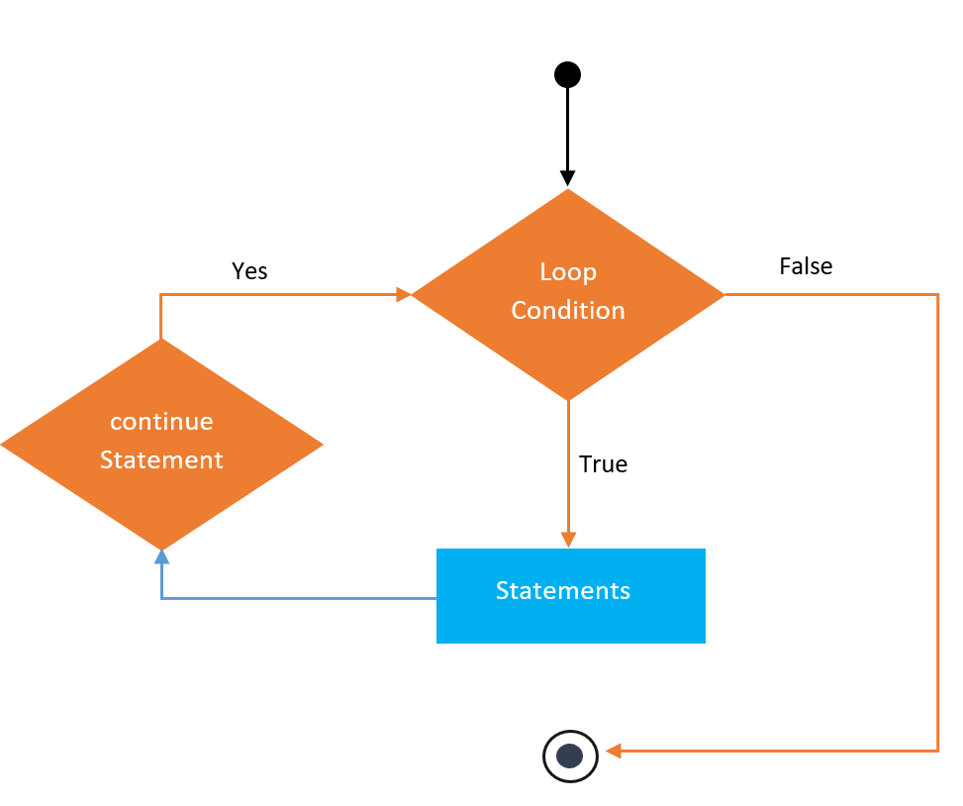
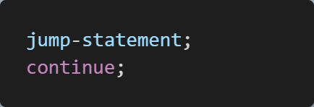
Continue Statement
Skips current iteration of loop and passes program control to next iteration.
Unlike break statement, it never terminates the loop execution.

Slide 48
Goto Statement
Used to transfer control to the other part of the program.
It unconditionally jumps to the specified label.
Can be used to transfer control from deeply nested loop or switch case label.
It is avoided to use goto statement because it makes the program complex.

Slide 49
Functions

Slide 50
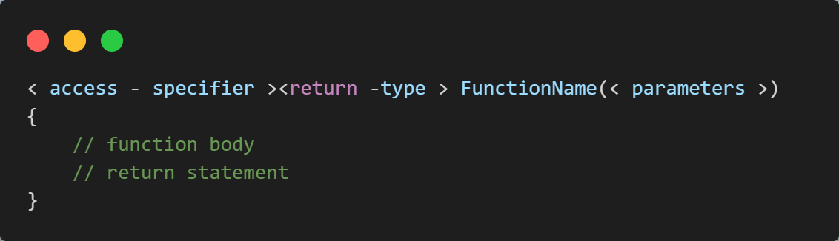
Functions
Function is a block of code that has a signature.
Function is used to execute statements specified in the code block.
A function can accept 0 or more parameters to perform task.

Slide 51
Call By Value
Value-type parameters pass a copy of original value rather than reference.
It does not modify the original value.
A change made in passed value does not alter the actual value.
Value types like int, float, char, etc., are passed by value by default

Slide 52
Call By Reference
C# provides a ref keyword to pass argument as reference-type.
Passes reference of arguments to function rather than copy of original value.
The changes in passed values are permanent and modify the original variable value.

Slide 53
Out Parameter
C# provides out keyword to pass arguments as out-type.
It is like reference-type, except that it does not require variable to initialize before passing.
We must use out keyword to pass argument as out-type.
It is useful when we want a function to return multiple values.

Slide 54
Arrays

Slide 55
Arrays
A group of similar types of elements that have contiguous memory location.
In C#, array is an object of base type System.Array.
In C#, array index starts from 0.
We can store only fixed set of elements in C# array.
Data
10
20
30
40
Index
0 1 2 3

Slide 56
Advantages of Arrays
1
Code Optimization (Less Code)
2
Random Access
3
Easy to traverse data
4
Easy to manipulate data
5
Easy to sort data

Slide 57
Types of Arrays
There are three types of Arrays in C# Programming:
Single-Dimensional Array
Multi-Dimensional Array
Jagged Array

Slide 58
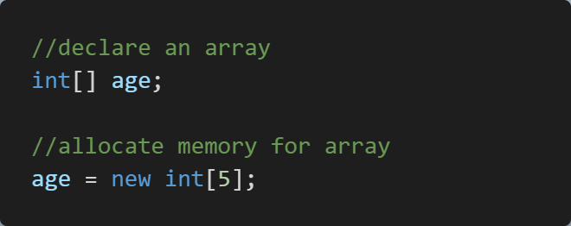
Single-Dimensional Array
It is the simplest type of array that contains only one row for storing data.
It has single set of square bracket (“[]”).
To declare single dimensional array in Java, you can write the following code.
For example, to declare an array of integers named “age" that can hold 5 elements in a single row, you would write:
int age = new int [5];
a[0] | a[1] | a[2] | a[3] | a[4]

Slide 59

Multi-Dimensional Array
This Array contains more than one row to store data on it.
Also known as rectangular array because it has the same length of each row.
It can be two-dimensional array or three-dimensional array or more.
Contains more than one comma (,) within single rectangular brackets (“[ , , ,]”).
Example:
int s[ ] [ ]= new int [3][3];
S[0][1] | S[0][1] | S[0][2]
S[1][0] | S[1][1] | S[1][2]
S[2][0] | S[2][0] | S[2][2]

Slide 60
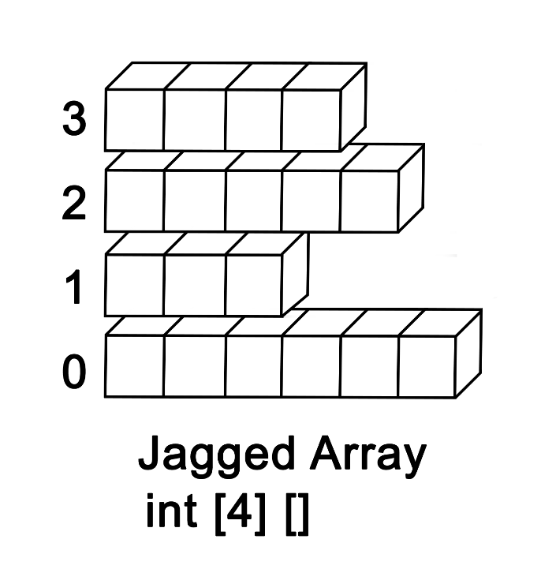
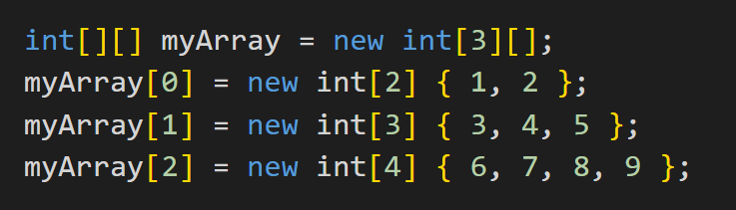
Jagged Array
An array of arrays, where each sub-array can have a different length.
Useful when you need to store a collection of arrays of different sizes.
For example, to declare and initialize a jagged array named myArray that contains 3 sub-arrays of integers with different lengths:

Slide 61
Object Oriented Programming

Slide 62
Object Oriented Programming
OOPs stands for Object-Oriented Programming (OOP) concepts.
Object Oriented Concepts provides a clear modular structure of programs.
This makes easy to maintain the existing code.
Codes can be reused without any redundancy.
The main aim of OOP is to bind together the data and the functions that operate on them so that no other part of the code can access this data except that function.

Slide 63
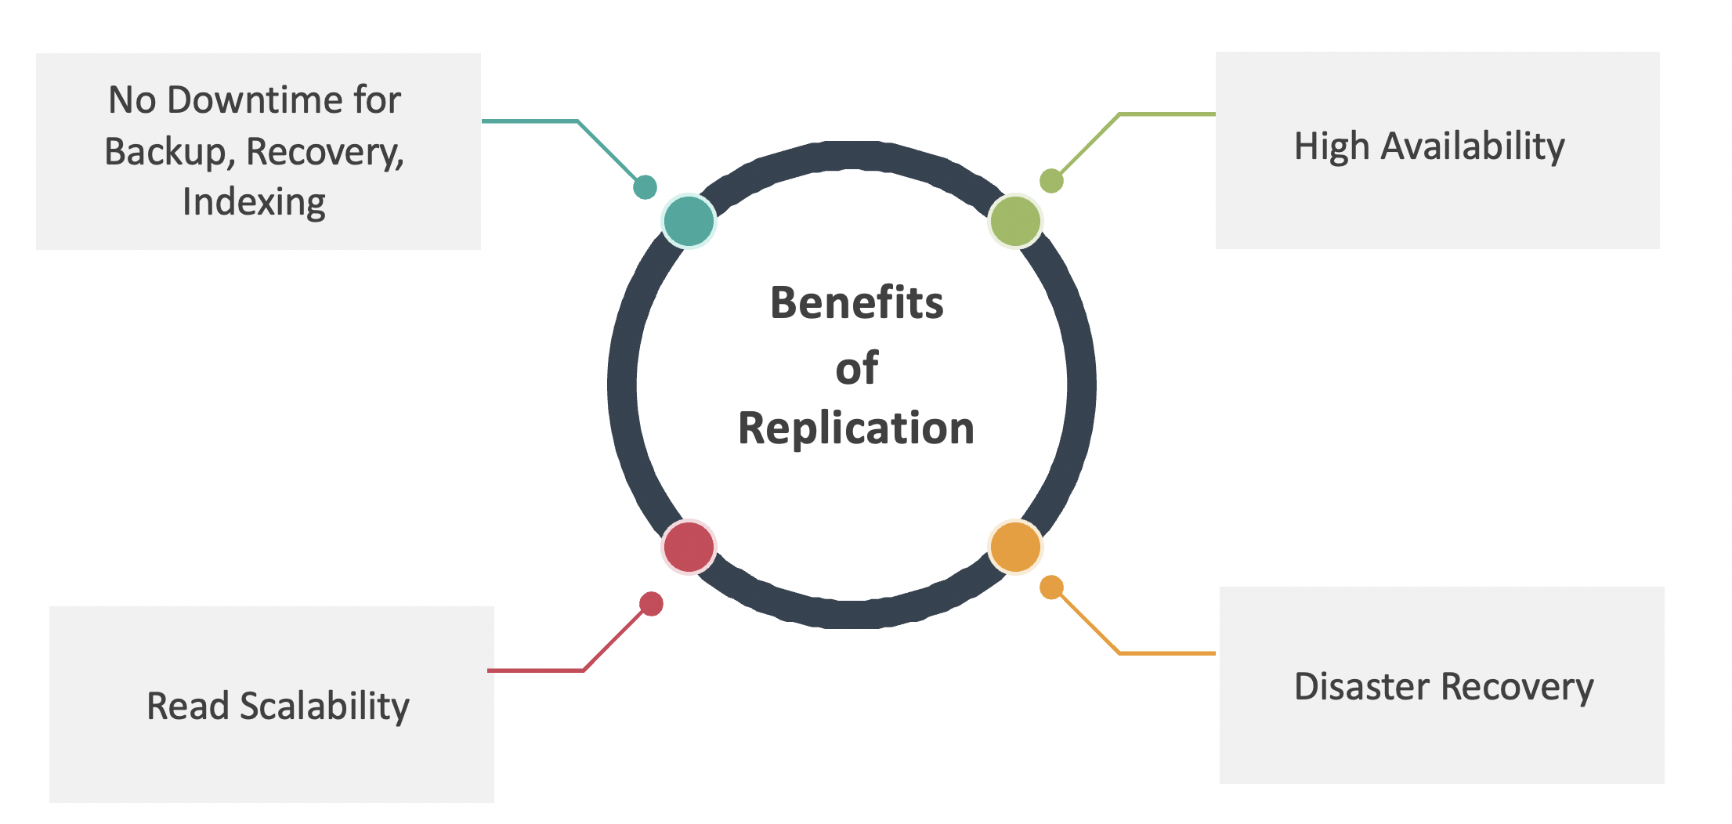
Object Oriented Programming
Classes
Abstraction
Object Oriented Programming
Objects
Inheritance
Encapsulation
Polymorphism

Slide 64
Classes and Objects

Slide 65
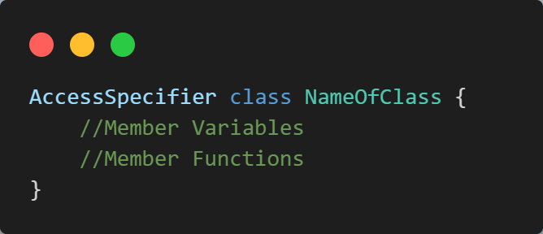
Classes
A class is a blueprint or a template for creating objects.
It defines the properties and behavior of an object.
A class can have fields, properties, methods, and events,
They collectively define the data and behavior of an object.

Slide 66
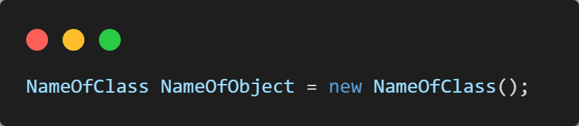
Objects
An object is a dynamically created instance of the class.
Created at runtime so it can also be called a runtime entity.
All the members of the class can be accessed using the object.
The object definition starts with the class name followed by the object name.
Then the new operator is used to create the object.

Slide 67



Classes and Objects
Vehicle
Class
Car
Cycle
Truck
Objects

Slide 68
Encapsulation

Slide 69
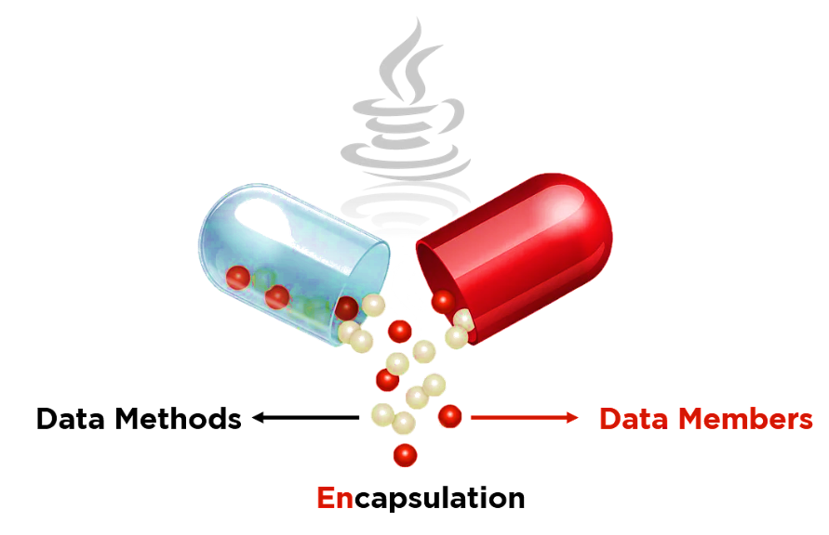
Encapsulation
Encapsulation is wrapping up of data under a single unit.
A Mechanism that binds together code and the data it manipulates.
A protective shield that prevents data from being accessed by the code outside.
Data in a class is hidden from other classes, so it is also known as data-hiding.
It can be achieved by: Declaring all the variables in the class as private.

Slide 70
Encapsulation
For Example: the Student class has the following members:
FirstName, MiddleName, LastName, and FullName are data members,
Save(), Subscribe(), GetSubscribedCourses() are methods.
Student
+ FirstName
+ MiddleName
+ LastName
+ FullName
+ Courses
+ Save()
+ Subscribe()
+ GetSubscribedCourses()

Slide 71
Abstraction

Slide 72
Abstraction
The property by virtue of which only essential details are exhibited to user.
Abstraction can be achieved with either abstract classes or interfaces.
The abstract keyword is used for classes and methods:
Abstract class:
- A restricted class that cannot be used to create objects.
Abstract Method:
- It can only be used in an abstract class, and it does not have a body.

Slide 73
Abstraction Example
For Example: Consider a real-life scenario of withdrawing money from ATM.
The user only knows that in ATM machine first enter ATM card,
then enter the pin code of ATM card,
and then enter amount to withdraw and at last, he/she gets their money.
The user does not know about the inner mechanism of the ATM.
The user just simply knows how to operate the ATM machine, this is called abstraction.

Slide 74
Constructors

Slide 75
Constructors
A constructor is a special method that is used to initialize an object of a class
It is similar to a method that is invoked when an object of the class is created.
However, unlike methods, a constructor:
Has the same name as that of the class
Does not have any return type

Slide 76
Types of Constructors
Constructor | Description
Default | A constructor with no parameters is called a default constructor.
Parameterized | This constructor can also accept parameters.
Copy | Used to create an object by copying data from another object.
Private | Once constructor is private, we cannot create objects of class in other classes.
Static | This constructor is initialized static fields or data of the class and to be executed only once.

Slide 77
Constructor Overloading
Allows you to define multiple constructors for a class, each with a different set of parameters.
This allows you to create objects of the class with different initial states, depending on the arguments passed to the constructor.
Also allows you to make your code more flexible and reusable.

Slide 78
Access Modifiers

Slide 79
Access Modifier
Access modifiers or specifiers are the keywords.
Used to specify accessibility or scope of field, method, constructor or class.
We can change the access level of fields, constructors, methods, and class by applying the access modifier on it.
Public is not restricted and Private is most restricted.

Slide 80
Access Modifiers
public
01
private
02
protected
03
internal
04
Protected internal
05

Slide 81
Access Modifiers
Access Specifier | Description
Public | Specifies that access is not restricted.
Protected | Specifies that access is limited to the containing class or in derived class.
Internal | Specifies that access is limited to the current assembly.
Protected internal | Specifies that access is limited to the current assembly or types derived from the containing class.
Private | Specifies that access is limited to the containing type.

Slide 82
Methods

Slide 83
Methods
A method is a block of code that performs a specific task.
Suppose you need to create a program to create a circle and color it.
You can create two methods to solve this problem:
a method to draw the circle
a method to color the circle
Dividing a complex problem into smaller chunks makes your program easy to understand and reusable.

Slide 84
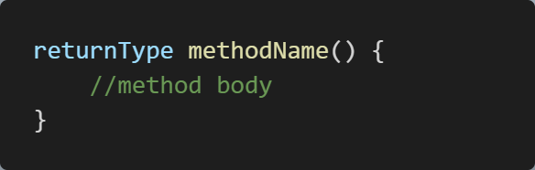
Declaring a Method
returnType - It specifies what type of value a method returns.
methodName: Used to refer to the particular method in a program.
method body - It includes the programming statements that are used to perform some tasks.

Slide 85
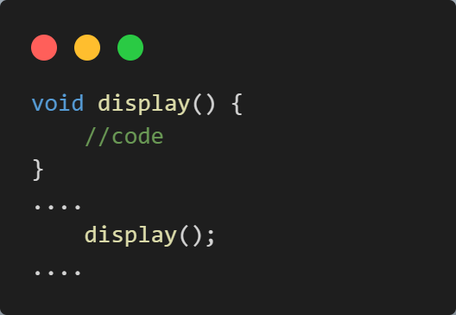
Calling a Method
Suppose we have a method named display().
Now, to use the method, we need to call it.
Method call

Slide 86
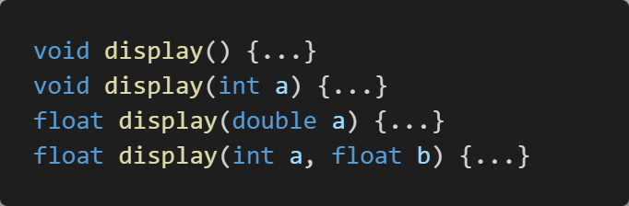
Method Overloading
We can create two or more methods with same name but different parameters.
Here, display() method is overloaded.
These methods have the same name but accept different arguments.
The return types of the above methods are not the same.
It is because method overloading is not associated with return types.

Slide 87
Method Overloading
Method Overloading can be done by changing:
The number of parameters in two methods.
The data types of the parameters of methods.
The Order of the parameters of methods.

Slide 88

What Happens when method signature is same and the return type is different?
The compiler will give error as the return value alone is not sufficient for the compiler to figure out which function it has to call. Only if both methods have different parameter types (so, they have the different signature), then Method overloading is possible.

Slide 89
Inheritance

Slide 90
Inheritance
In C#, it is possible to inherit fields and methods from one class to another.
Allows us to define a new class based on an existing class.
The new class inherits the properties and methods of the existing class.
Can also add new properties and methods of its own.
Promotes code reuse, simplifies code, and improves code Organizations.

Slide 91





Inheritance
Vehicle
Bikes
Cars
Buses
Trucks

Slide 92
Types of Inheritance
Hierarchical Inheritance
Single Inheritance
Multilevel Inheritance
A
A
A
Base Class
Base Class
Base Class
inherits
inherits
inherits
B
Intermediary Class
B
C
B
inherits
Derived Class
Derived Class
Derived Class
C
Derived Class

Slide 93
Types of Inheritance
Multiple Inheritance
Hybrid Inheritance
Base Class
Base Class
A
A
B
Base Class
inherits
B
Derived Class
inherits
inherits
C
C
D
Derived Class
Derived Class
Derived Class

Slide 94
Polymorphism

Slide 95
Polymorphism
Polymorphism is a Greek word that means multiple forms or shapes.
You can use polymorphism if you want to have multiple forms of one or more methods of a class with the same name.
In C#, Polymorphism can be achieved in two ways:
Compile-time Polymorphism / Static Polymorphism
Runtime Polymorphism / Dynamic Polymorphism

Slide 96


Polymorphism
When one task is performed by different ways, then it is called Polymorphism.
Person
Student
pay_bill()
Millionaire
pay_bill()

Slide 97
Compile-Time Polymorphism
In this, the compiler identifies which method is being called at the compile time.
Compile-time Polymorphism can be achieved in two ways:
Method Overloading
Operator Overloading

Slide 98
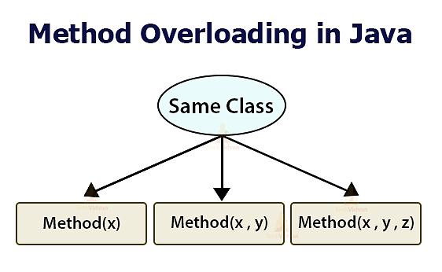
Method Overloading
In a class, we can create methods with the same name in a class if they have:
different numbers of parameter
types of parameter
Method overloading is also known as early binding or static binding,
because which method to call is decided at compile time, early than the runtime.
We can overload method, constructors and indexed properties.
It is because these members have parameters only.

Slide 99
Method Overriding
Derived class defines same method as defined in its base class.
It is used to achieve runtime polymorphism.
Provide implementation of method which is already provided by its base class.
You need to use virtual keyword with base class method and override keyword with derived class method.

Slide 100
Structures

Slide 101
Structures
Structure is a group of elements having different data types.
Structure is similar to a class.
Because both class and structures are user-defined type.
It can be created using the reversed word struct.
Like class, it contains variables and methods.
Also includes constants, methods and properties, indexers and events.
It’s members accepts only three access modifiers i.e., private, public and internal.
Protected modifier is not permitted for the members of structure.

Slide 102
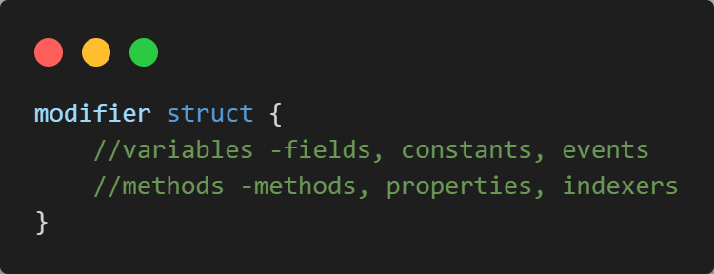
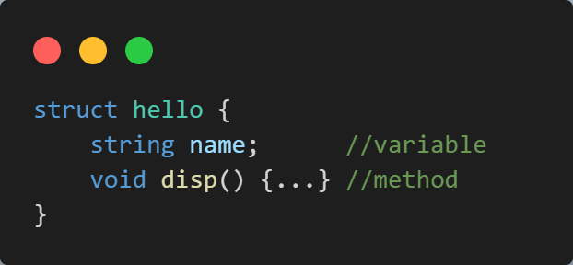
Structures
Syntax: Example:

Slide 103
Class vs. Structures
Class | Structure
Reference type and therefore stored on heap. | Value type and therefore stored on stack.
Supports inheritance. | Does not support inheritance.
Default value of a class type is null. | Default value is the value produced by ‘zeroing out’ the fields of the struct.
Permit initialization of instance fields. | Does not permit initialization of instance fields.

Slide 104
Abstract Class

Slide 105
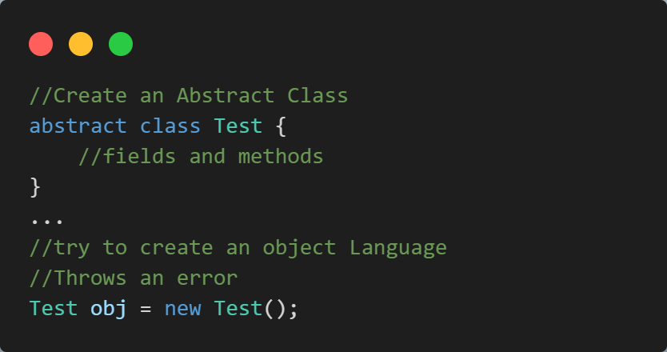
Abstract Class
An abstract class is a class that cannot be instantiated.
Instead, it serves as a base class for other classes to inherit from.
Used to define a common set of properties that derived classes should have.
“abstract” keyword is used to create an abstract class.

Slide 106
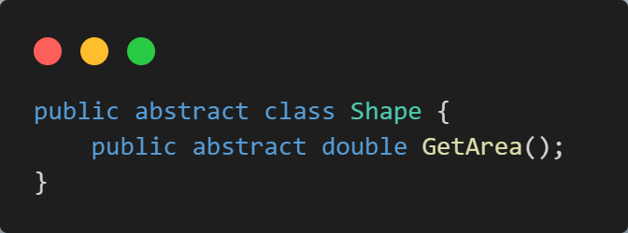
Abstract Method
A method that does not have a body is known as an abstract method.
The abstract keyword is used to indicate that a method is abstract.
An abstract method is a method that is declared, but not defined in a base class.
It’s implementation is left to the derived classes.
An abstract method must be declared in an abstract class.

Slide 107
Interface

Slide 108
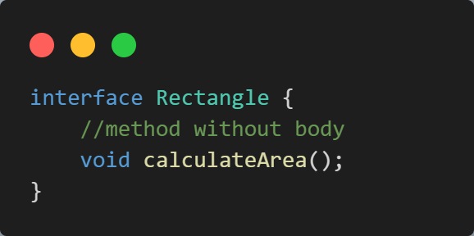
Interface
An interface is similar to abstract class.
All methods of an interface are fully abstract (method without body).
We use the interface keyword to create an interface.
For Example:
Here,
Rectangle is the name of the interface.
By convention, interface starts with I so that we can identify it just by seeing its name.
We cannot use access modifiers inside an interface.
All members of an interface are public by default.
An interface doesn't allow fields.

Slide 109
Interface
Interfaces specify what a class must do and not how.
Interfaces can’t have private members.
By default all the members of Interface are public and abstract.
Interface cannot contain fields;
- because they represent a particular implementation of data.
Multiple inheritance is possible with the help of Interfaces but not with classes.

Slide 110
Advantages of Interface
It is used to achieve loose coupling.
It is used to achieve total abstraction.
To achieve component-based programming.
To achieve multiple inheritance and abstraction.
Interfaces add a plug and play like architecture into applications.

Slide 111
Interface vs. Abstract Class

Slide 112
Abstract Class vs. Interface
Abstract Class | Interface
The special class which cannot be instantiated | Determines functionality but cannot implement that.
Abstract classes have static members. | Interface does not have static members.
They have a constructor. | They don’t have a constructor.
It includes both a declaration and an explanation. | It includes only a declaration.
Here the performance is fast. | Here the performance is slow.
A class has the liberty to only utilize a single abstract class. | Here a class has the liberty to utilize multiple interfaces.
Includes methods, fields, constants, etc. | Only includes methods .
Can be fully, partially or not implemented. | Can be fully implemented.

Slide 113
Static Class

Slide 114
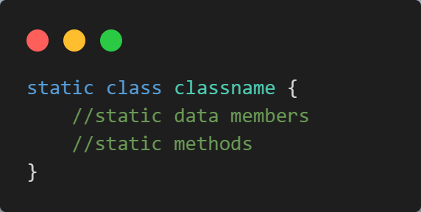
Static Class
Static means something which cannot be instantiated.
You cannot create an object of a static class,
and cannot access static members using an object.
C# static class cannot contain instance constructors.

Slide 115
Extension Methods

Slide 116
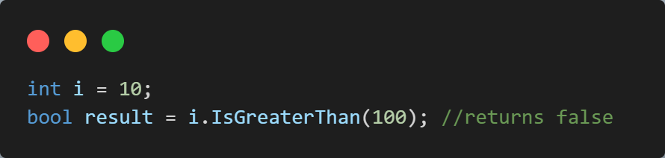
Extension Methods
Extension methods, as the name suggests, are additional methods.
Creates and adds new methods to existing class without creating new child class.
A Special type of the static methods that can be called as instance methods.
We can add extension methods in both predefined classes and user created custom classes.

Slide 117
Extension Methods
We need to consider the following points to define an extension method.
An extension method should be a static method.
It must have this keyword associate with class name.
The class name should be the first parameter in the parameter list.

Slide 118
Partial Class

Slide 119
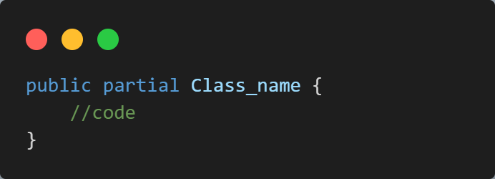
Partial Class
Partial Class is a unique feature of C#.
You can split the implementation of a class, a struct, a method, or an interface in multiple .cs files.
The compiler will combine all the implementation from .cs files when compiled.
The partial keyword is used to build a partial class.

Slide 120
Partial Methods

Slide 121
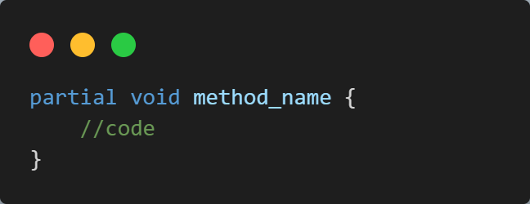
Partial Methods
A partial class may contain a partial method.
One part of the class contains the signature of the method.
An optional implementation may be defined in the same part or another part.
If the implementation is not supplied;
- then method and all calls are removed at compile time.

Slide 122
Partial Methods
There are some rules and restrictions apply to the partial method.
The signature of partial method must be same in both partial classes.
The partial method must return void.
No access modifiers are allowed.
Partial methods are implicitly private.

Slide 123

It’s a Wrap!

