Slide 1
This is a Sample Stump Speech!
This is the first slide...

Slide 2
Wanna See a Picture?

Slide 3
There's One on the next Slide:

Slide 4
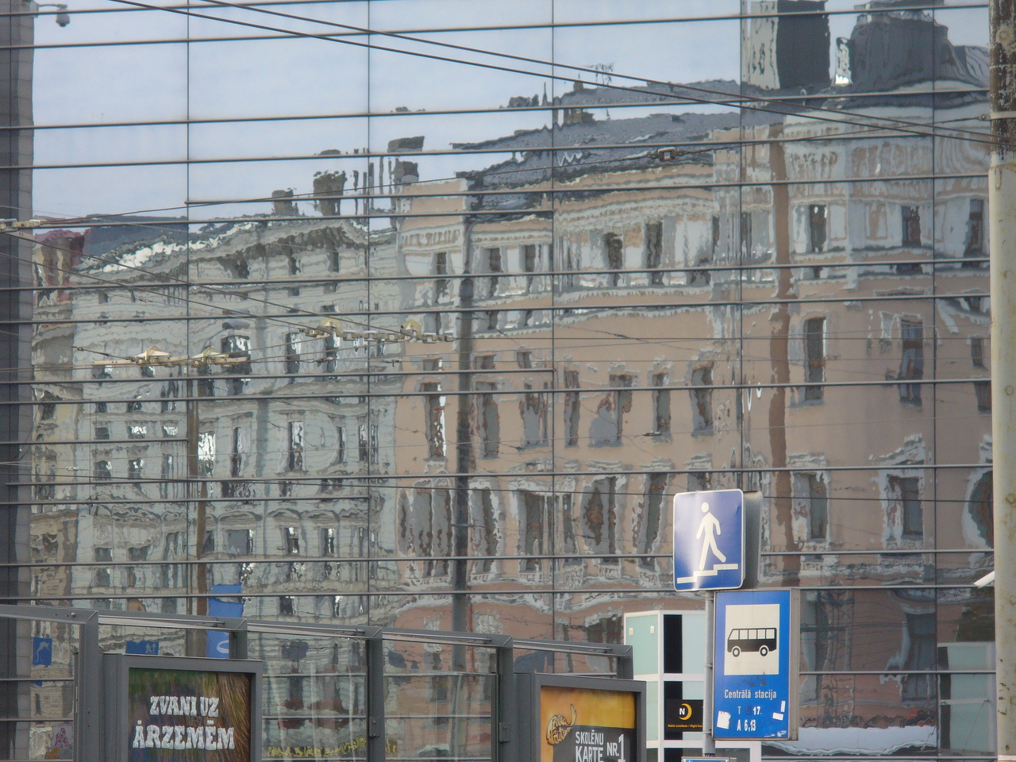

Slide 5
Words
Get
Centered

Slide 6
Colors
Are
Nice

Slide 7
# This is some Perl code:
sub foo {
say "Hi!";
}

Slide 8
The End
Any Questions?

