Slide 1


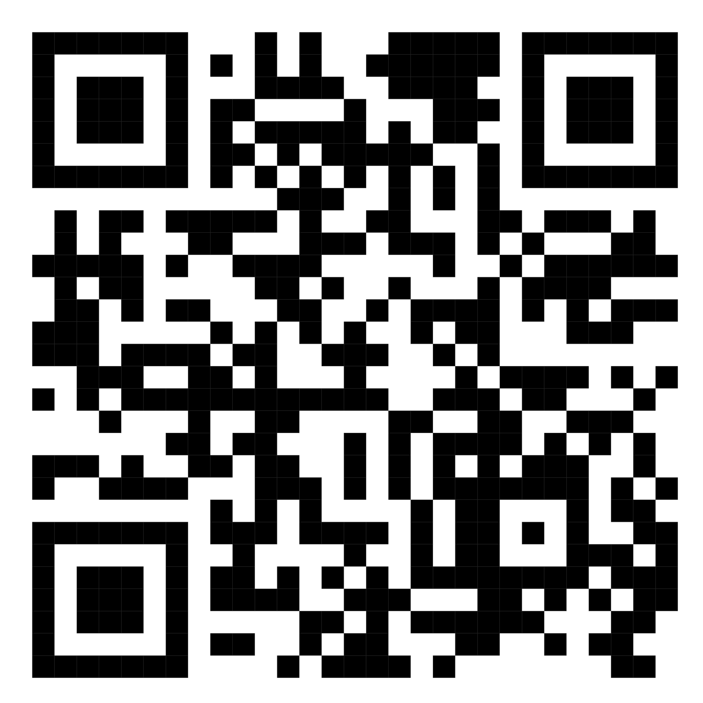
A university forum to share information and personal notes!
Web technologies project 6 cfu
Prof. Raffaele Montella
A.Y 2022/2023
Aniello Genovese 0124002145
Crescenzo Esposito 0124002375
Riccardo Aiello 0124002251

Slide 2
IDEA
ParthenoAnswer is a forum accessible to all students enrolled at Parthenope, so that posts or communications can be created according to year, subject and comment on posts, all according to the category chosen. Categories can also include communications, sharing notes and more
In addition, everything will be managed by the representatives (ADMINs) who can in turn choose other admins who, like the representative, will be able to these categories, but will also be able to add sub-categories, post and delete posts, comments or obsolete categories but will not be able to delete things created by the representatives. Users will be able to post according to the subject matter of their chosen category and comment on a post made by a different user.

Slide 3
Languages and methodologies used
The languages that have been used in this project are:
HTML;
CSS;
JAVASCRIPT;
PYTHON;
While we can find particular techniques and methodologies that characterise our code such as:
API Parthenope to allow access only to Parthenope members and personal information;
FLASK to connect to the database and keep users connected;
MongoDB where we created the database to hold the data entered by users;
AJAX for greater speed and speed with the generation of tables;
Bootstrap for the frontend part.

Slide 4
USER SIGN-IN
The Parthenope API was used to sign-in
There will be no registration format, but simply log in with the esse3 cineca tax code and password
If you forgot to log in, however, there will be a sort of home guest that will only let you click on categories but you won't be able to click on subcategories to see posts, users and comments

Slide 5
Creation of Categories
For the creation of categories, you must be a representative or an admin
You can create a category by adding the category name and description
The category will be created, where if you click on the name you will see the sub-categories in turn.
Next to the category name, you will also see the last post that was published with its belonging subcategory. By clicking on it, you can go directly to the post
If there are no posts, a 'No posts yet' message will be displayed

Slide 6
Creation of Subcategories
For the creation of subcategories, you must be a representative or an admin
To create the sub-category, simply click on add sub-category and you will be taken to a screen where you simply add the sub-category name and press add
Once the subcategory has been created, you will be able to view the subcategory and, of course, the last post created in that subcategory.
You can also click on the sub-category name to view all the posts created

Slide 7
Creating Posts and Comments
All users will be able to create a post
After creating it, it will be placed within the sub-category with the title of the post, who created it and when
If you click on the post you are interested in, you can also comment on it by giving answers or asking further questions
You will be able to see the author of the comment and when it was created

Slide 8
Search and other small curiosities!
To search for posts or users, you can use the search function. Please note that it is important to enter tropic for the topic and user for the user!
Other features you can find on the website are:
The go back arrow;
The sign-out, to be able to leave the site;
The user's profile with the examinations he/she has taken;
The two buttons showing recommended developers and contacts;
If you click on the logo, you can go to the website's home page.

Slide 9
Future implementations and conclusions
But we don't want to stop there, in the future we plan to add more features or else:
the sharing of images;
the use of a chat between two persons;
the deletion or updating of posts;
useful information such as time or available appeals;
notification of post replies (synchronisation).
Ours is a forum that aims to help students understand the information they need by resolving doubts or perplexities. We can say that ParthenoAnswer differs from other university sites because its purpose is to help students improve their university life after so many sacrifices due to the things that have happened in the world.

Slide 10

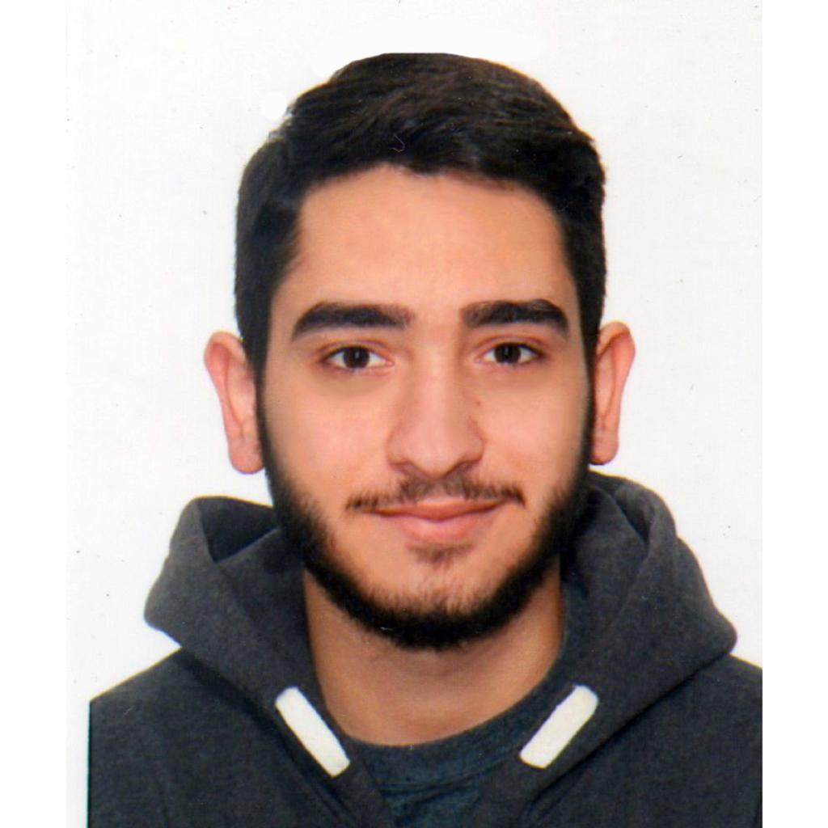

Developers
Aniello Genovese Crescenzo Esposito Riccardo Aiello
0124002145 0124002375 0124002251
The project github can be found here!

