Slide 1
Starshot
By Mr Kapptie

Slide 2
Overview
History

Slide 3
History or Background
project was announced on 12 April 2016
in New York City by physicist and venture capitalist Yuri Milner,
Notes:
The project was announced on 12 April 2016 in an event held in New York City by physicist and venture capitalist Yuri Milner, together with cosmologist Stephen Hawking, who was serving as board member of the initiatives. Other board members include Meta Platforms (then known as Facebook, Inc.) CEO Mark Zuckerberg. The project has an initial funding of US$100 million. Milner places the final mission cost at $5–10 billion, and estimates the first craft could launch by around 2036.^{[6]} Pete Worden is the project's executive director and Harvard Professor Avi Loeb chairs the advisory board for the project

Slide 4
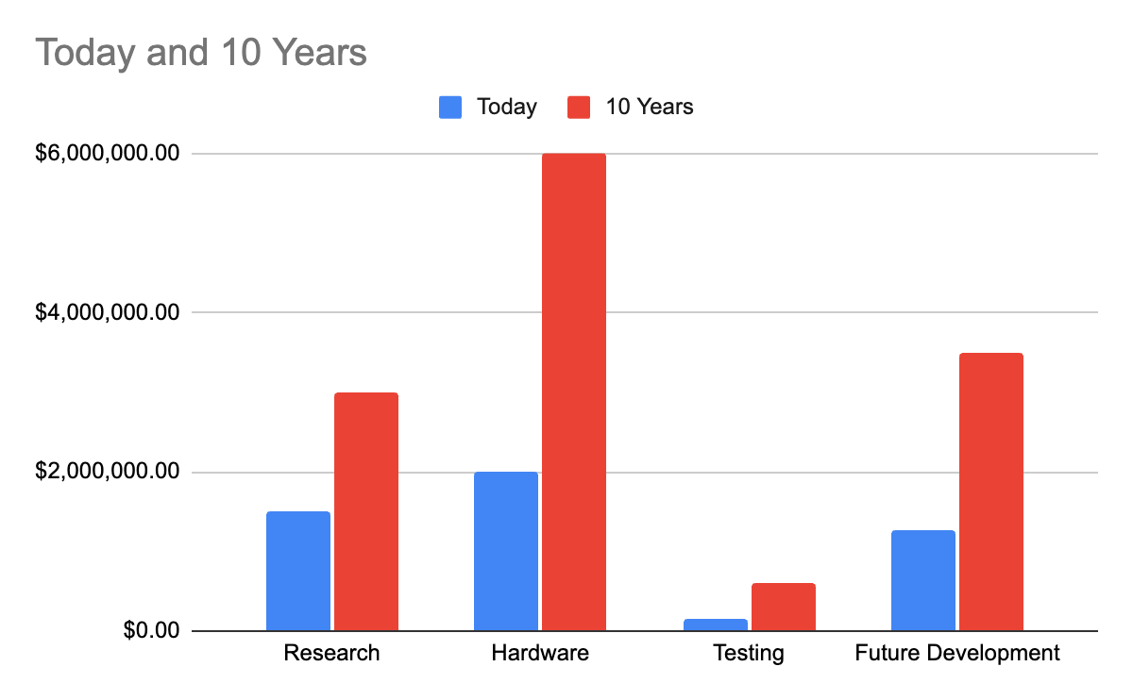
Implementation

Slide 5
Pros

Slide 6
Cons

Slide 7
Summary

Slide 8
Reference
Reaching for the Stars, Across 4.37 Light-Years - New York Times

