Slide 1
Asteroid mining
Mr Kapptie

Slide 2
Overview
History
Implementation
Pro
Cons
Title

Slide 3
History
asteroid to collect samples
Notes:
Aug. 24 between the National Aeronautics & Space Administration’s OSIRIS-REx spacecraft and the Japan Aerospace Exploration Agency’s Hayabusa2 spacecraft is just one example of the friendly banter passing between the explorers in recent months. These spacecraft, each approaching a different asteroid to collect samples and return them to Earth, have been cheering each other on as they venture deeper into space, aiming to accomplish technical and scientific feats that have never before been attempted. The week C&EN went to press with this story, Hayabusa2 deployed two MINERVA-II rovers to the surface of Ryugu and was poised to send another rover, MASCOT, some weeks later. OSIRIS-REx is set to rendezvous with Bennu in December.

Slide 4
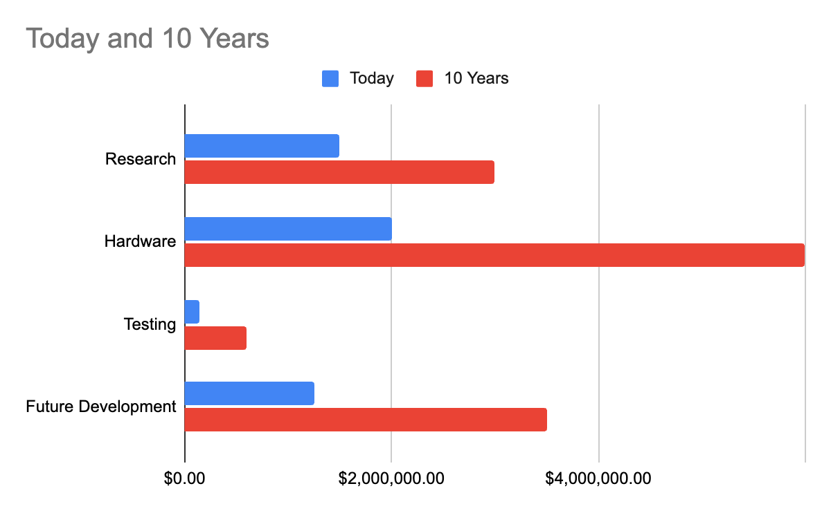
Implementation

Slide 5
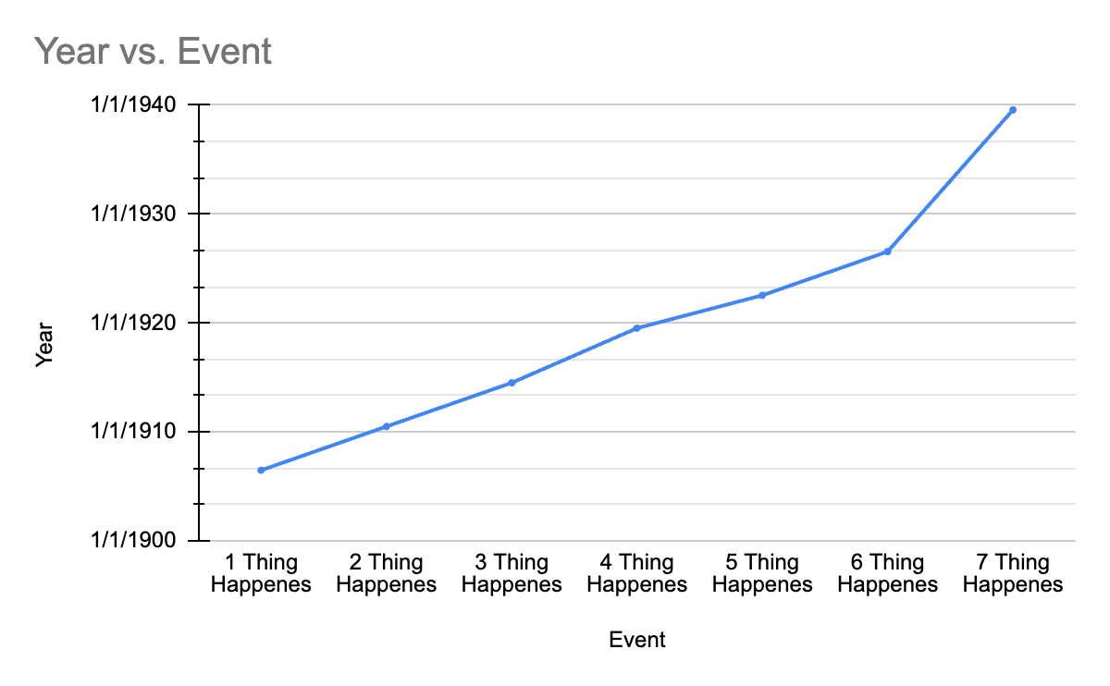
History
expected to cost $1.16 billion
$588.5 million was spent on spacecraft
Notes:
The OSIRIS-REx mission is expected to cost $1.16 billion. $588.5 million was spent on spacecraft development and $183.5 million on its launch vehicle. Nine years of prime mission operations are expected to cost approximately $283 million.
New Horizons accounted for 0.0031% of all spending by the United States during the 7-year period covering its development and launch.

Slide 6
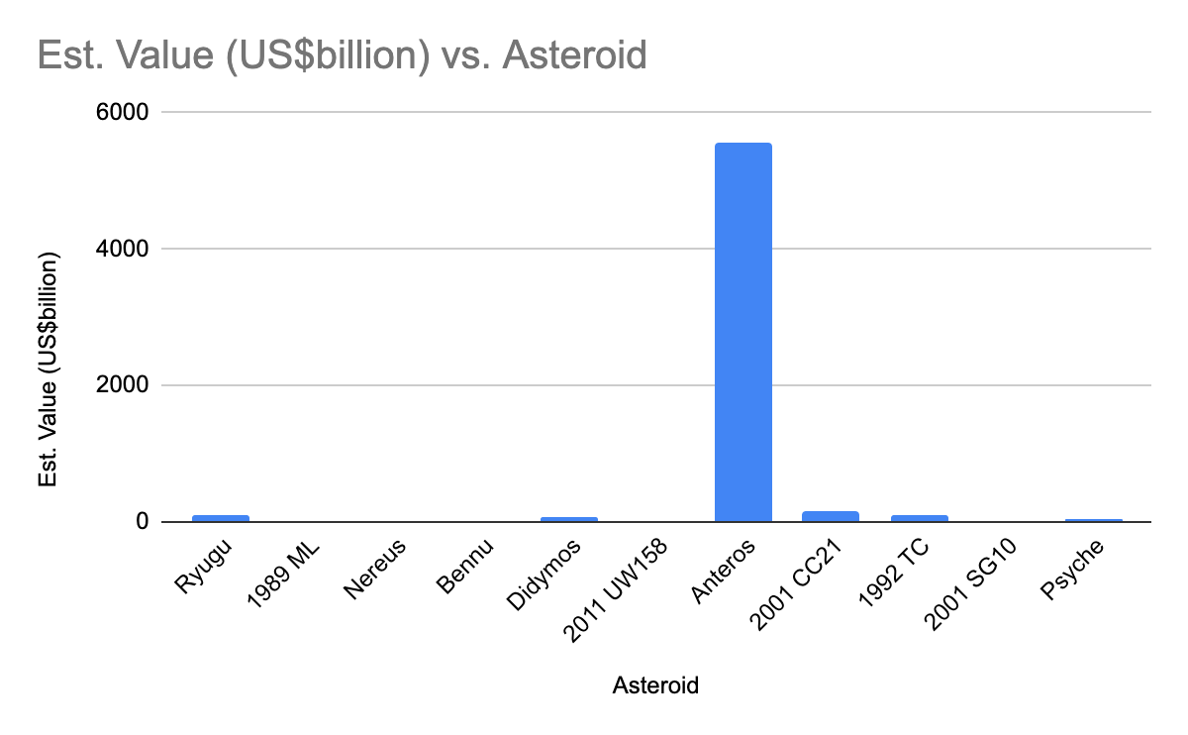
Summary

Slide 7
Cons
Notes:
The OSIRIS-REx mission is expected to cost $1.16 billion. $588.5 million was spent on spacecraft development and $183.5 million on its launch vehicle. Nine years of prime mission operations are expected to cost approximately $283 million.
New Horizons accounted for 0.0031% of all spending by the United States during the 7-year period covering its development and launch.

Slide 8
References
Cost of OSIRIS-REx by Planetary.org
The tale of 2 asteroid sample-return missions
A captured asteroid by ScienceDirect

