Slide 1

Minor Project on Fruit recognition
Prepared By-
Kapil Sharma(9917102141)
Sanchit Gupta (9917102167)
Satyam Gupta (9917102181)
Under the guidance of - Mr. Varun Goel

Slide 2
Content
Objective
Why we choose this project
Introduction
Comparison with others
Advantages and disadvantages
Software required
Implementation
Conclusion and Future Scope
References

Slide 3
Objective
Eﬀorts are being geared up towards the replacement of human operator with automated systems, as human operators are inconsistent and less eﬃcient. So automatic grading of fruit is essential before packaging and possible transportation to diﬀerent distance according to the number of days left to get mature. The objective of this work is to make this fruit grading systems automatic and fast with the help of computer vision, image processing and fuzzy logic technique.

Slide 4
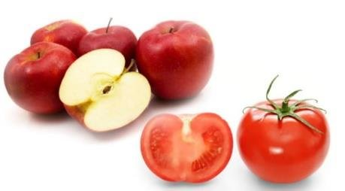
Why We Choose This Project
Developing a perfect fruit detection and recognition system is that it needs extra eﬀort in the detection part where in an image, the diﬀerence between two diﬀerent fruit is very limited like apple and tomato.
Fig 1: Fruits of similar color and shape
Fruits are likely to be found in groups and inside of an image they might appear overlapping one another within a same region.

Slide 5
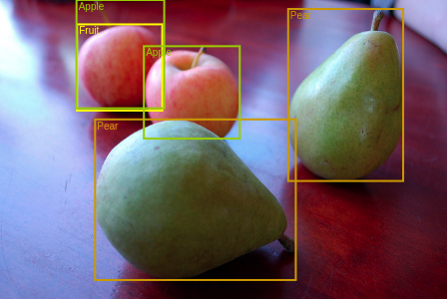
Introduction
YOLO
You Only Look Once (YOLO) at an image to predict what objects are present and where they are. A single convolutional network simultaneously predicts multiple bounding boxes and class probabilities for those boxes.
YOLO trains on full images and directly optimizes detection performance. This unified model has several benefits over traditional methods of object detection.
Fig 2:Image detection[3]

Slide 6
Comparison with others
Deformable parts models-
Deformable parts models (DPM) use a sliding window approach to object detection. DPM uses a disjoint pipeline to extract static features,classify regions, predict bounding boxes for high scoring regions, etc.[1]
R-CNN-
R-CNN and its variants use region proposals instead of sliding windows to find objects in images. Selective Search generates potential bounding boxes, a convolutional network extracts features, an SVM scores the boxes, a linear model adjusts the bounding boxes, and non-max suppression eliminates duplicate detections.[2]

Slide 7
Advantages
It is extremely fast. Since we frame detection as a regression problem we don’t need a complex pipeline. We simply run our neural network on a new image at test time to predict detections.
It reasons globally about the image when making predictions. Unlike sliding window and region proposal-based techniques, YOLO sees the entire image during training and test time so it implicitly encodes contextual information about classes as well as their appearance.
It learns generalizable representations of objects. When trained on natural images and tested on artwork, YOLO outperforms top detection methods like DPM and R-CNN by a wide margin.

Slide 8
Disadvantage
It lags behind state-of-the-art detection systems in accuracy.
While it can quickly identify objects in images it struggles to precisely localize some objects, especially small ones.

Slide 9
Software Required
Operating System:
An operating system (OS) is a system software that manages computer hardware, software resources, and provides common services for computer programs. Every computer must have at least one OS to run other programs. Eg:-Windows (64- bit), Mac, Linux.
Anaconda Navigator:
Anaconda is a free and open source distribution of the Python and R programming languages for scientiﬁc computing that aims to simplify package management and deployment. Package versions are managed by the package management system conda

Slide 10
Python:
Python is an example of a high level language such as C++, PHP, Pascal, C#, and Java. It is a powerful programming language which is easy to learn, which has a simple but eﬀective approach to object-oriented programming.

Slide 11
Implementation
In this project we pre-process/prepare our dataset as well as train/save our model with YOLOv3 using GOOGLE COLAB.
The dataset required to train a detector with YOLOv3 contains 2 components: images and labels. Each image will be associated with a label ﬁle (normally a txt ﬁle) which deﬁnes the object class and coordinates of object in the image.
We used labelImg Software to label our images and then we trained our model on google colab due to free gpu feature.

Slide 12
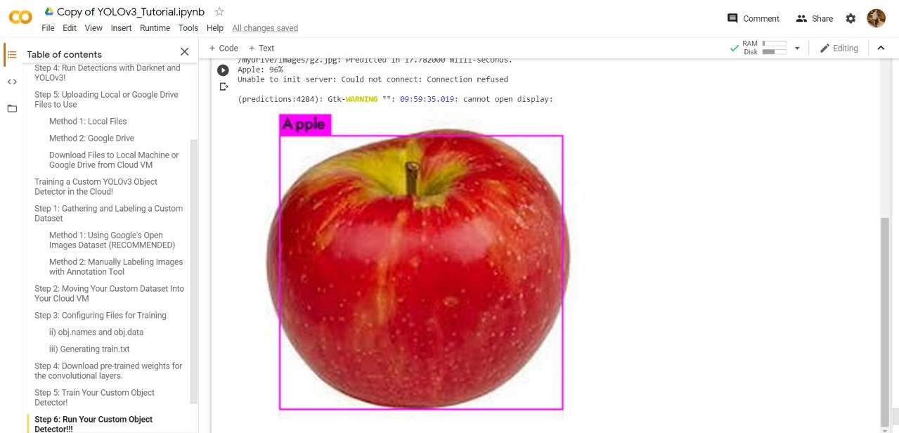

Slide 13
Conclusion and Future Scope
The software classiﬁed the apple image as good Apple/Rotten with an accuracy of 92% and 96.47% respectively. Thus, the developed system will be helpful for the former and agriculture industry in eﬀectively sorting the Apple Fruit.
The outcomes in this research are based on results that involve only sample datasets. It is necessary that additional datasets should be considered for the evaluation of different classiﬁcation problems .So further, We would try to improve the accuracy in real time detection of Apple Fruit.

Slide 14
References
D. M. D. R. Pedro F Felzenszwalb Ross B Girshick, “Object detection with discriminatively trained part based models”, IEEE transactions on pattern analysis and machine intelligence, vol. 32, no. 9, pp. 1627–1645, 2010.
T. G. J. R. Uijlings K. E. van de Sande and A. W. Smeulders., “Selective search for object recognition.”, International journal of computer vision, vol. 104, no. 2, pp. 154–171, 2013.
https://algorithmia.com/blog/deep-dive-into-object-detection-with-open-images-using-tensorflow

