Slide 1


M.Tech Program
Advanced Industry Integrated Programs
Jointly offered by University and LTIMindTree
Review II
Project Title:
CI/CD Pipeline for Aircraft Engines (Predictive Maintenance)
Team Member
Name: Kapilesh Simha
TID: T8630

Slide 2
CI/CD Pipeline for Aircraft Engines (Predictive Maintenance)
Recap (from Review 1)
NGAFID dataset used previously
Data ingestion, preprocessing, merging
Initial visualizations (RPM, OilT, IAS)
Maintenance event identification

Slide 3
CI/CD Pipeline for Aircraft Engines (Predictive Maintenance)
Modules to cover
Module | Description
Data Ingestion | Collect sensor data from aircraft engines (like temperature, pressure, RPM)
Preprocessing | Clean, normalize, and structure time-series data and plot the graphs
Model Training | Week 1 (with simulated data) + Train ML model (XGBoost and LSTM) on the data
Model Evaluation | Validate accuracy, precision, and RUL predictions
Deployment | Using Streamlit and Jenkins
Feedback with audit logging | Use dashboards and logs model performance and retrain as needed
Week 1{
Week 2{
Week 3{

Slide 4
CI/CD Pipeline for Aircraft Engines (Predictive Maintenance)
Motivation for Simulated Data
NGAFID -> Historic data
NGAFID contains csv and hundreds of parquet files to process
X-Plane 11 -> Simulator -> Collect engine data (as one text file)
Data collected – almost instantaneously, for (at least) one hour of flight time
Using the Boeing 787-800

Slide 5
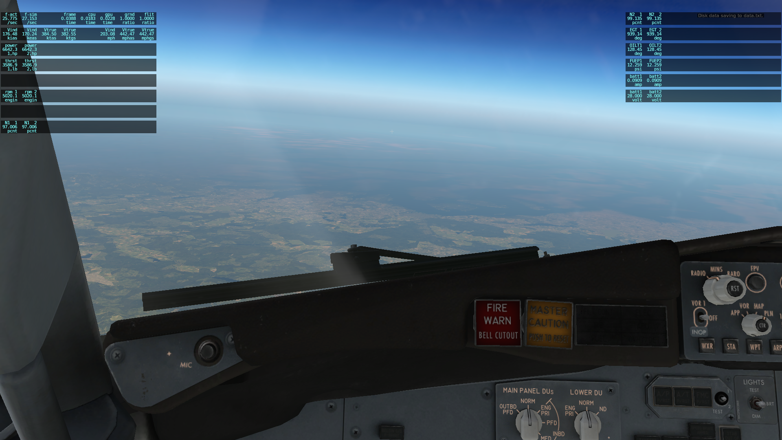
CI/CD Pipeline for Aircraft Engines (Predictive Maintenance)
Simulation Screenshot

Slide 6
CI/CD Pipeline for Aircraft Engines (Predictive Maintenance)
Objective (after NGAFID)
Simulate Aircraft Engine Sensor Data
Develop a Predictive Maintenance Framework
Design a CI/CD Pipeline
Ensure Real-Time Monitoring and Feedback

Slide 7
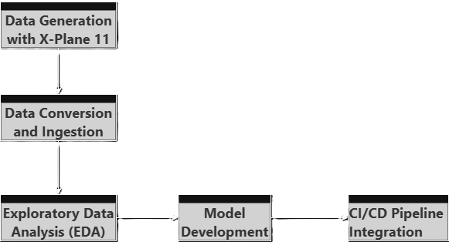
CI/CD Pipeline for Aircraft Engines (Predictive Maintenance)
Methodology

Slide 8
CI/CD Pipeline for Aircraft Engines (Predictive Maintenance)
Methodology
Data Generation with X-Plane 11
Simulated realistic flight scenarios using X-Plane 11.
Captured engine sensor data as follows:
Frame rate, airspeed, engine power, thrust, torque
Engine RPM, propeller RPM, N1 (low pressure), N2 (high pressure)
Exhaust Gas Temperature (EGT), oil temperature, fuel pressure
Battery amperage and voltage
Data exported as .txt files from X-Plane's logging system.

Slide 9
CI/CD Pipeline for Aircraft Engines (Predictive Maintenance)
Methodology
Data Conversion & Ingestion
Converted .txt files to .csv format using pandas.
Exploratory Data Analysis (EDA)
Cleaned and normalized time-series data.
Visualized key features like IAS vs TAS and plotted a correlation Heatmap of the Engine Variables using Matplotlib and Seaborn.

Slide 10
CI/CD Pipeline for Aircraft Engines (Predictive Maintenance)
Methodology (on-the-run)
Model Development
To train XGBoost and LSTM to predict:
Engine failures
Remaining Useful Life (RUL)
To validate using metrics like accuracy, precision, and F1-Score.
CI/CD Pipeline Integration
To deploy using Streamlit for interactive dashboards.
Automate workflows with Jenkins for continuous integration and deployment.
Implement audit logging and feedback loops for model retraining.

Slide 11
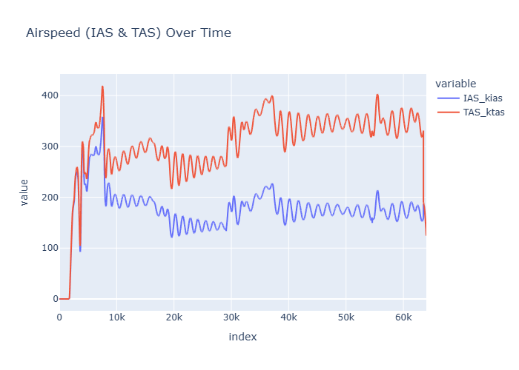
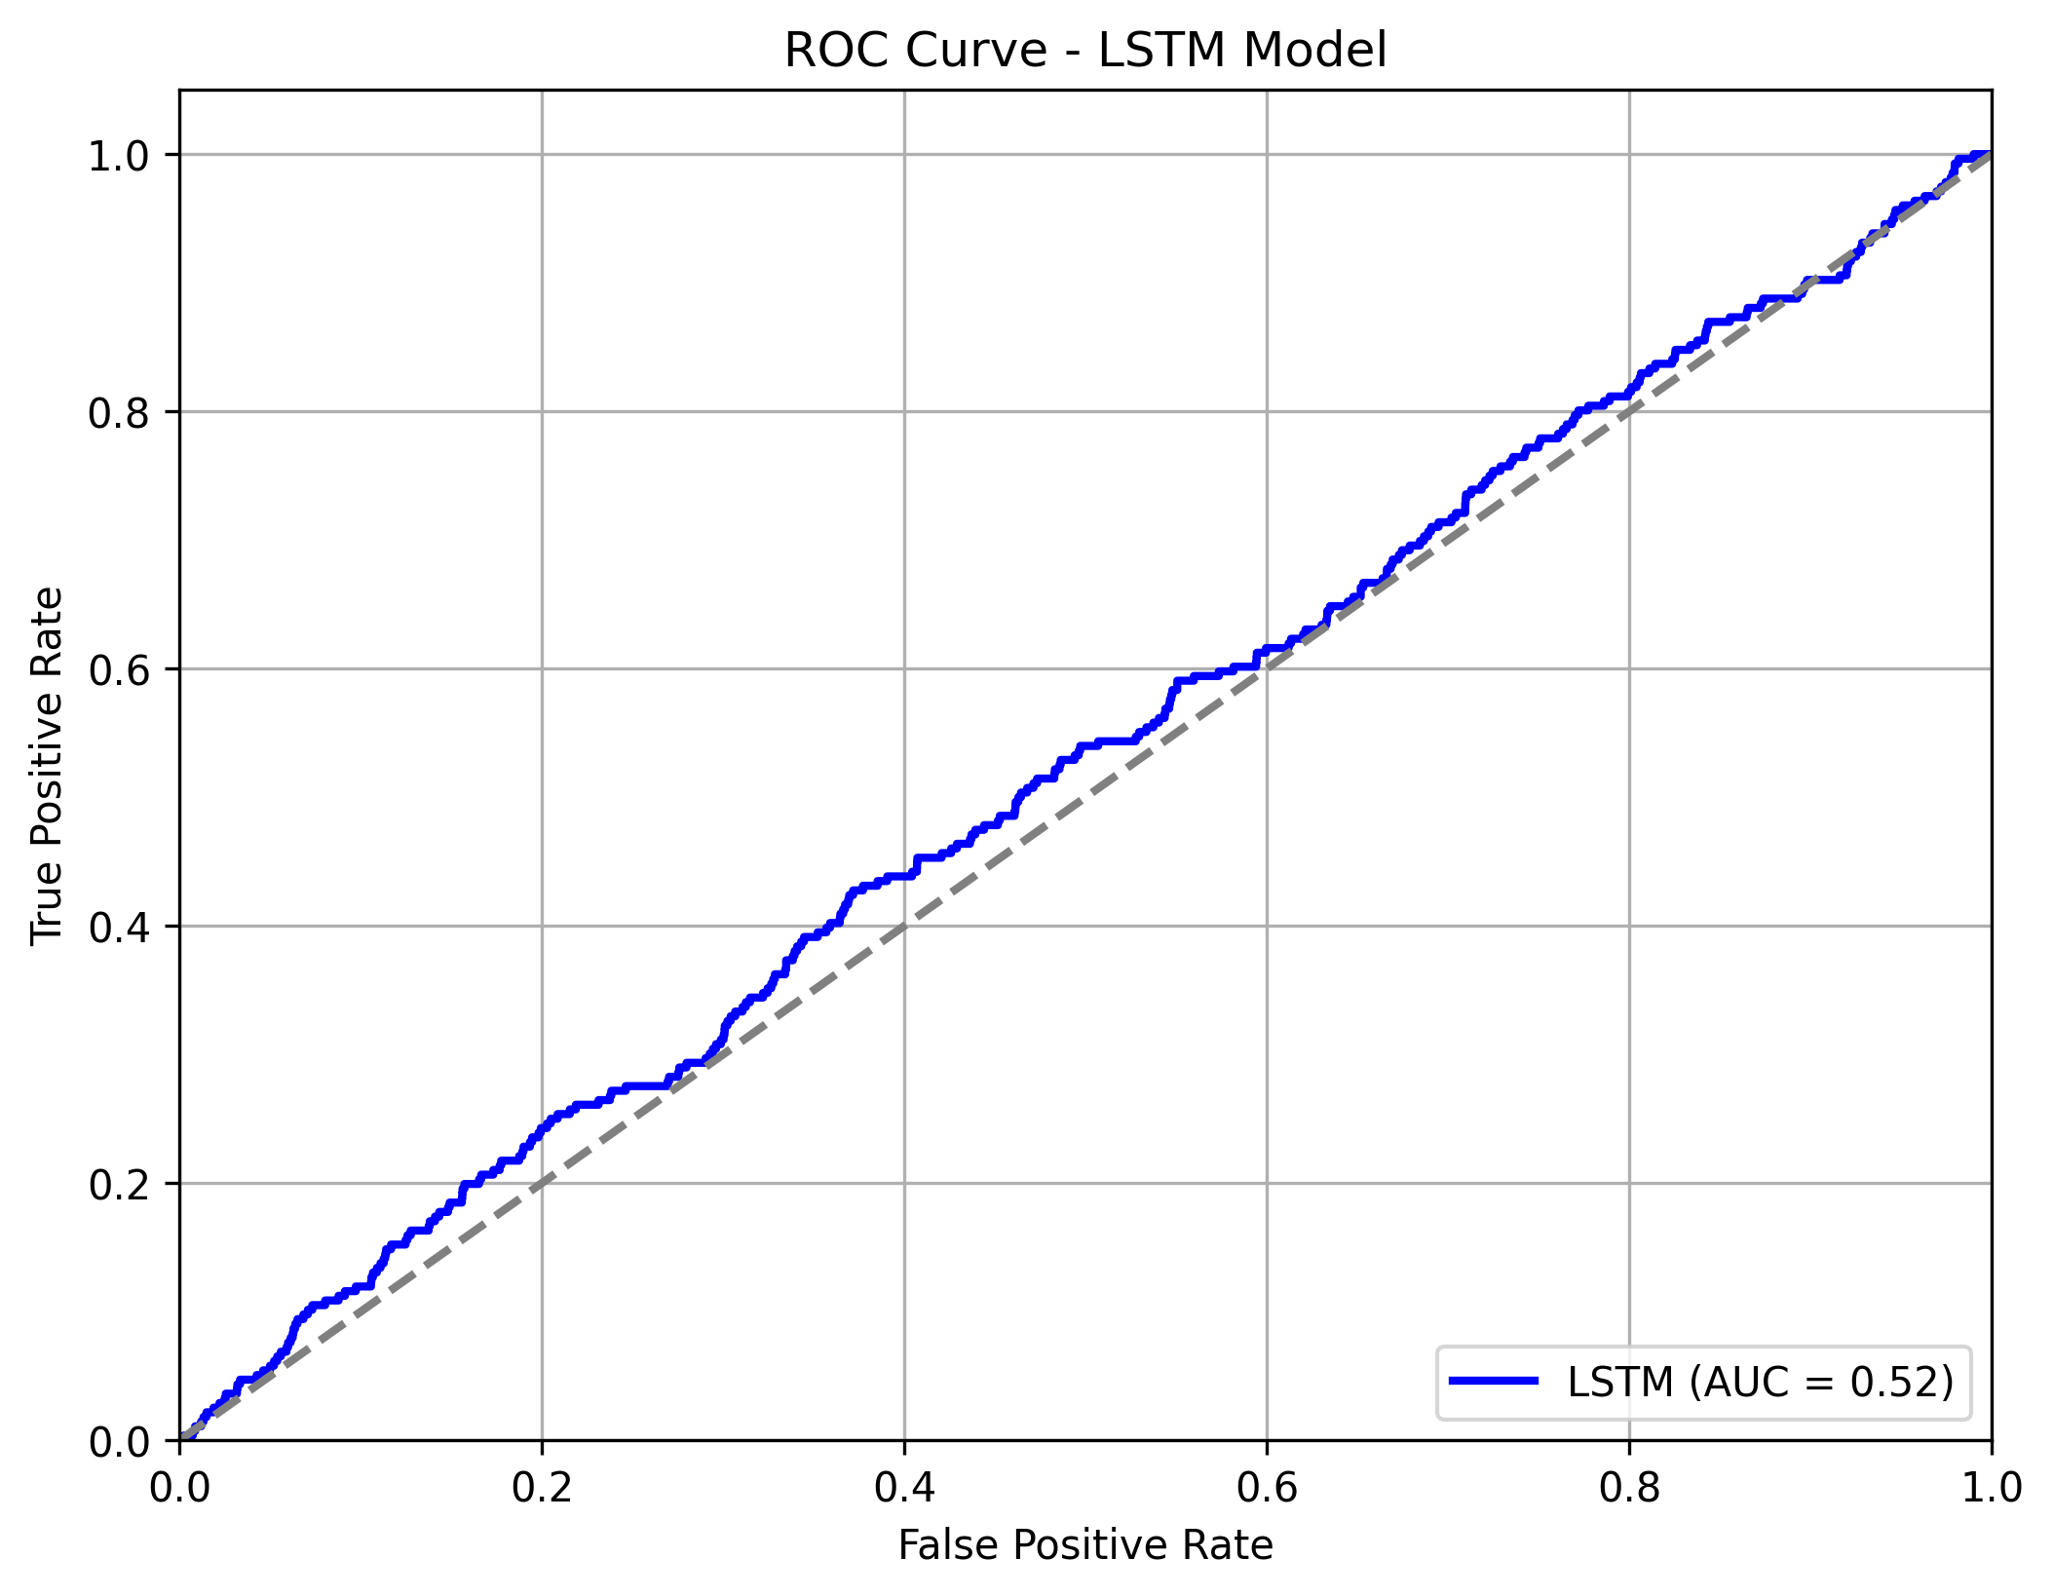
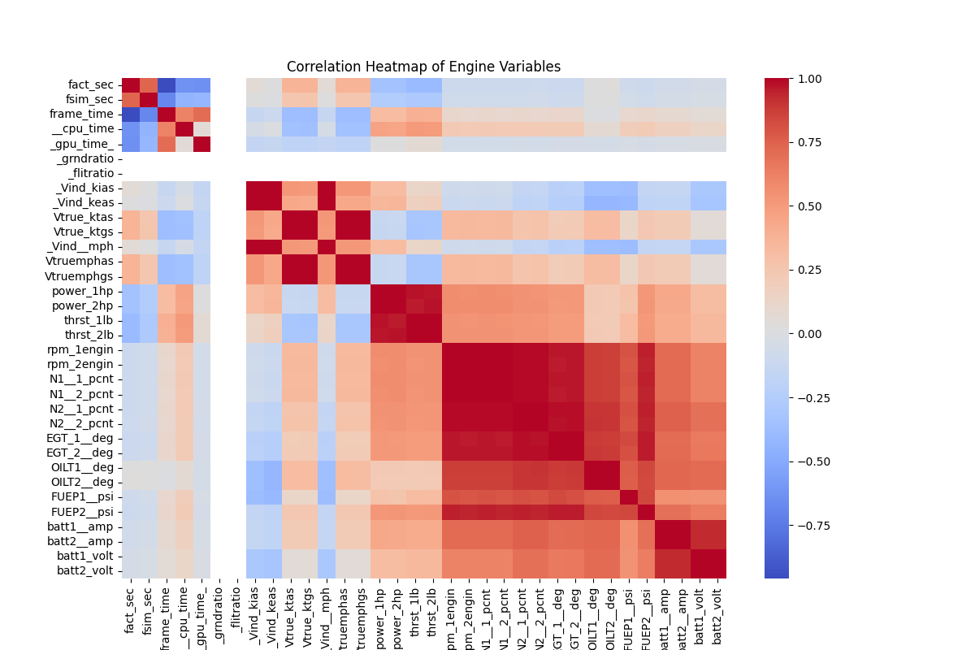
CI/CD Pipeline for Aircraft Engines (Predictive Maintenance)
Data Preprocessing and EDA

Slide 12
CI/CD Pipeline for Aircraft Engines (Predictive Maintenance)
Algorithms and Tools
XGBoost (Extreme Gradient Boosting) and LSTM (Long Short-Term Memory)
Used for regression to estimate Remaining Useful Life (RUL)
To handle multivariate time-series data efficiently
Robust to missing values and outliers
LSTM shows potential improvement with more data
Tool | Purpose
X-Plane 11 | Simulate realistic aircraft engine sensor data
Python | Core programming language for data processing
Pandas | Data ingestion, cleaning, and transformation
Matplotlib & Seaborn | Visualization of sensor trends and correlation
Streamlit | Interactive dashboard for model outputs
Jenkins | CI/CD automation for model deployment

Slide 13
CI/CD Pipeline for Aircraft Engines (Predictive Maintenance)
Goals Hit (as of now)
Data loading: Replacing the NGAFID dataset with data of Boeing 787-800 from the X-Plane 11 simulator (simulated real-time data)
Preprocessing:
Removing the null and unwanted values
EDA: Visualized IAS vs TAS over the time of flight and plotted a correlation heatmap of the Engine variables
Model Trained: Trained XGBoost (~86% accuracy) and LSTM model (98% accuracy) with the simulated dataset

Slide 14
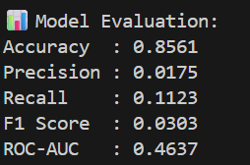
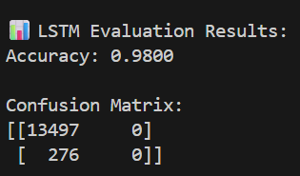
CI/CD Pipeline for Aircraft Engines (Predictive Maintenance)
XGBoost vs LSTM metrics

Slide 15
CI/CD Pipeline for Aircraft Engines (Predictive Maintenance)
Project Pipeline
1. Data Collection
Source: X-Plane 11 simulator (engine sensor logs).
Format: .txt logs → converted into .csv.
Features captured:
Engine RPM, N1, N2
Thrust, Fuel flow, EGT, Oil temp/pressure
Electricals (voltage, amps)
Flight parameters (altitude, IAS, climb rate)

Slide 16
CI/CD Pipeline for Aircraft Engines (Predictive Maintenance)
Project Pipeline
2. Data Preprocessing
Parse .txt logs into structured CSV.
Clean dataset:
Remove duplicate & constant columns.
Handle missing values.
Labeling:
Inject synthetic failures when thresholds exceeded (e.g., EGT > 700°C, meaning EGT too high, or N1 and N2 >80%).
Create failure target column.

Slide 17
CI/CD Pipeline for Aircraft Engines (Predictive Maintenance)
Project Pipeline
3. Exploratory Data Analysis (EDA)
Visualize sensor distributions (through Heatmap and ROC Curve).
Correlation heatmaps (to find key predictors).
Time-series plots (RPM, N1, Oil Temp vs timestep).
Identify anomalies/spikes before failures.
4. Feature Engineering
Create rolling averages (5-step moving average of RPM).
Calculate deltas (e.g., ∆ Oil Temp per second).
Normalize/scale continuous features.
Save processed dataset (data/processed/xplane_features.csv).

Slide 18
CI/CD Pipeline for Aircraft Engines (Predictive Maintenance)
Project Pipeline
5. Modeling
XGBoost (baseline)
Handles tabular data well.
Train/Test split with stratification.
Handle imbalance with:
scale_pos_weight
SMOTE (if needed).
Save trained model (models/xplane_xgboost.pkl)

Slide 19
CI/CD Pipeline for Aircraft Engines (Predictive Maintenance)
Project Pipeline
LSTM (time-series)
Input: sequential sensor values.
Architecture: LSTM → Dense → Sigmoid.
Train on sequences with failure labels.
Save trained model (models/xplane_lstm.h5).

Slide 20
CI/CD Pipeline for Aircraft Engines (Predictive Maintenance)
Project Pipeline
6. Evaluation
Metrics:
Accuracy, Precision, Recall, F1, ROC-AUC.
Visualizations:
Confusion Matrix (XGBoost + LSTM).
ROC Curves (LSTM).
Store plots in reports/figures/.

Slide 21
CI/CD Pipeline for Aircraft Engines (Predictive Maintenance)
Project Pipeline (on-the-run)
7. Deployment
Wrap best model into API/Dashboard:
Streamlit → Live dashboard for predictions.
Integrate CI/CD (Jenkins) for automation.
8. Monitoring
Track model drift with new simulator logs.
Retrain pipeline if accuracy drops.
Collect predictions & feedback for improvement.

Slide 22
CI/CD Pipeline for Aircraft Engines (Predictive Maintenance)
Project structure
xplane_predictive_project/
├── data/ # raw, processed
├── src/ # data_loader.py, eda.py, features.py, modeling_xgboost.py, modeling_lstm.py
├── models/ # saved models (from XGBoost and LSTM)
├── reports/
│ ├── figures/ # correlation heatmap, ROC
│ └── summary/ # final_report.md
├── jenkinsfile # Jenkins pipeline (on-the-run)
└── streamlit_app.py # deployment dashboard (on-the-run)

Slide 23
THANK YOU!

