Slide 1


M.Tech Program
Advanced Industry Integrated Programs
Jointly offered by University and LTIMindTree
Review III
Project Title:
CI/CD Pipeline for Aircraft Engines (Predictive Maintenance)
Team Member
Name: Kapilesh Simha
TID: T8630

Slide 2
CI/CD Pipeline for Aircraft Engines (Predictive Maintenance)
Recap (from Review 1 and Review 2)
Aviation industry -> seen many aircraft-related incidents
Predictive maintenance in aviation aims to forecast engine failures before they occur.
Observations:
NGAFID -> Historical Flight Dataset
X-Plane 11 -> Real-time simulated dataset
Initial visualizations (RPM, OilT, IAS)
Maintenance event identification

Slide 3
CI/CD Pipeline for Aircraft Engines (Predictive Maintenance)
Modules to cover
Module | Description
Data Ingestion | Collect sensor data from aircraft engines (like temperature, pressure, RPM)
Preprocessing | Clean, normalize, and structure time-series data and plot the graphs
Model Training | Week 1 (with simulated data) + Train ML model (XGBoost and LSTM) on the data
Model Evaluation | Validate accuracy, precision, and RUL predictions
Dashboard and Deployment | Using Streamlit and Jenkins
Logging | Save log file of the status as .csv file
Week 1{
Week 2{
Week 3{

Slide 4
CI/CD Pipeline for Aircraft Engines (Predictive Maintenance)
Motivation for Simulated Data
NGAFID -> Historic data
NGAFID contains csv and hundreds of parquet files to process
X-Plane 11 -> Simulator -> Collect engine data (as one text file)
Data collected – almost instantaneously, for (at least) one hour of flight time
Using the Boeing 737-800

Slide 5
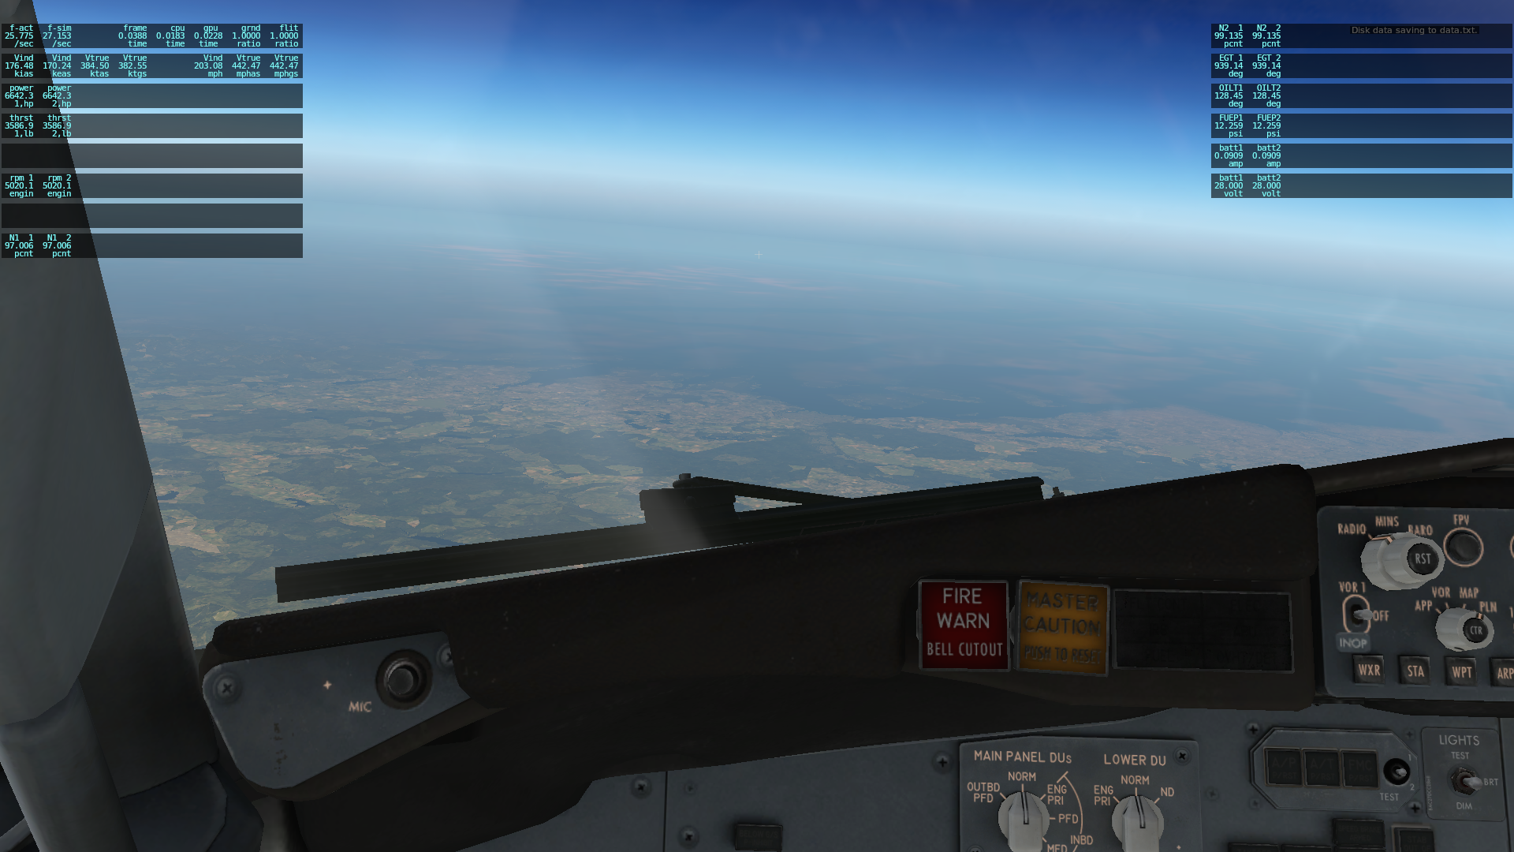
CI/CD Pipeline for Aircraft Engines (Predictive Maintenance)
Simulation Screenshot

Slide 6
CI/CD Pipeline for Aircraft Engines (Predictive Maintenance)
Objective (after NGAFID)
Simulate Aircraft Engine Sensor Data
Develop a Predictive Maintenance Framework
Design a CI/CD Pipeline
Ensure Real-Time Monitoring and Feedback

Slide 7
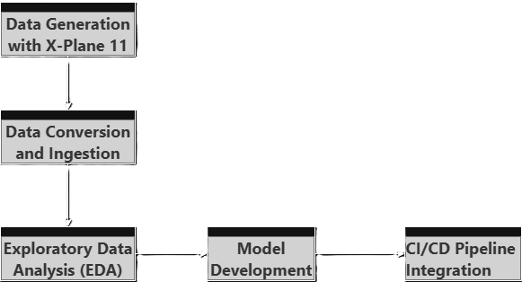
CI/CD Pipeline for Aircraft Engines (Predictive Maintenance)
Methodology

Slide 8
CI/CD Pipeline for Aircraft Engines (Predictive Maintenance)
Methodology
Data Generation with X-Plane 11
Simulated realistic flight scenarios using X-Plane 11.
Captured engine sensor data as follows:
Frame rate, airspeed, engine power, thrust, torque
Engine RPM, propeller RPM, N1 (low pressure), N2 (high pressure)
Exhaust Gas Temperature (EGT), oil temperature, fuel pressure
Battery amperage and voltage
Data exported as .txt files from X-Plane's logging system.

Slide 9
CI/CD Pipeline for Aircraft Engines (Predictive Maintenance)
Methodology
Data Conversion & Ingestion
Converted .txt files to .csv format using pandas.
Exploratory Data Analysis (EDA)
Cleaned and normalized time-series data.
Visualized key features like IAS vs TAS and plotted a correlation Heatmap of the Engine Variables using Matplotlib and Seaborn.

Slide 10
CI/CD Pipeline for Aircraft Engines (Predictive Maintenance)
Methodology
Model Development
To train XGBoost and LSTM to predict:
Engine failures
Remaining Useful Life (RUL)
To validate using metrics like accuracy, precision, and F1-Score.
CI/CD Pipeline Integration
To create a dashboard using Streamlit.
Deploy using with Jenkins for continuous integration and deployment.

Slide 11
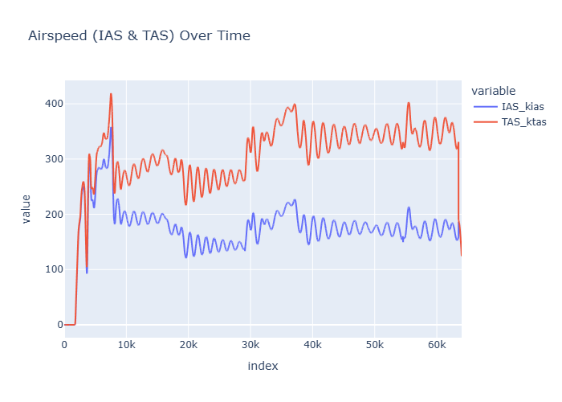
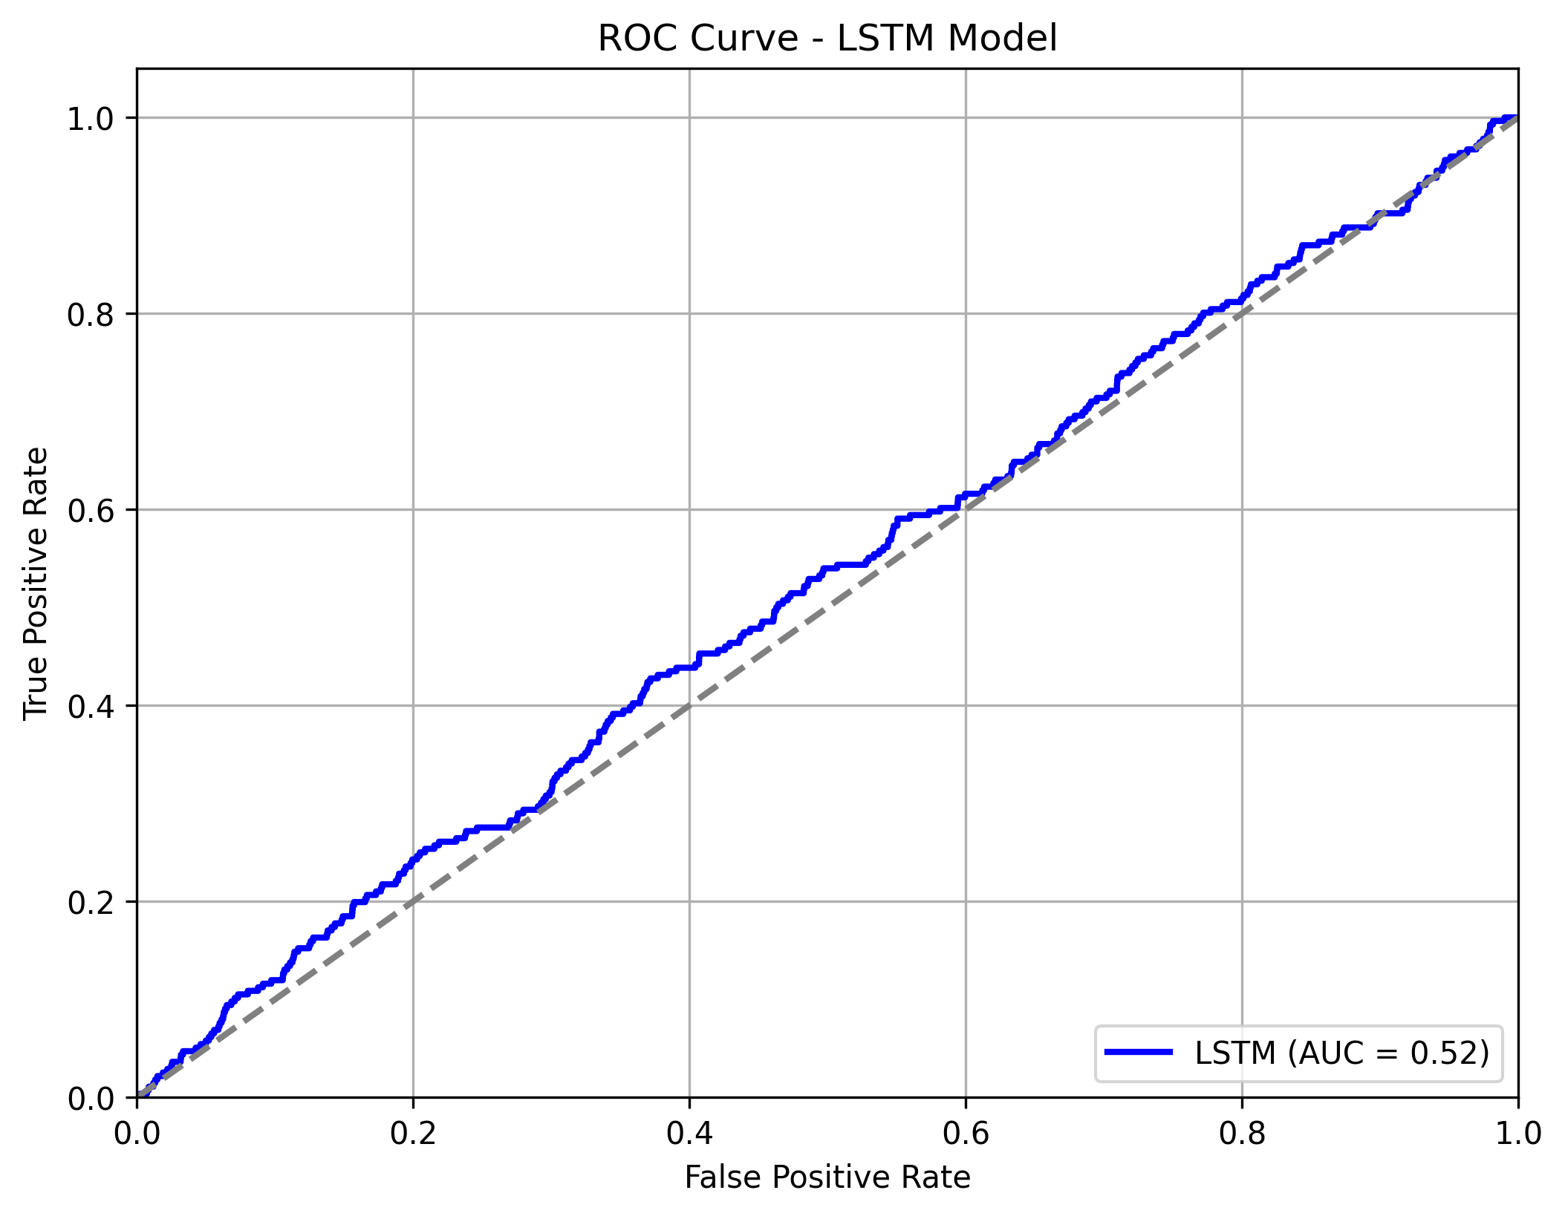
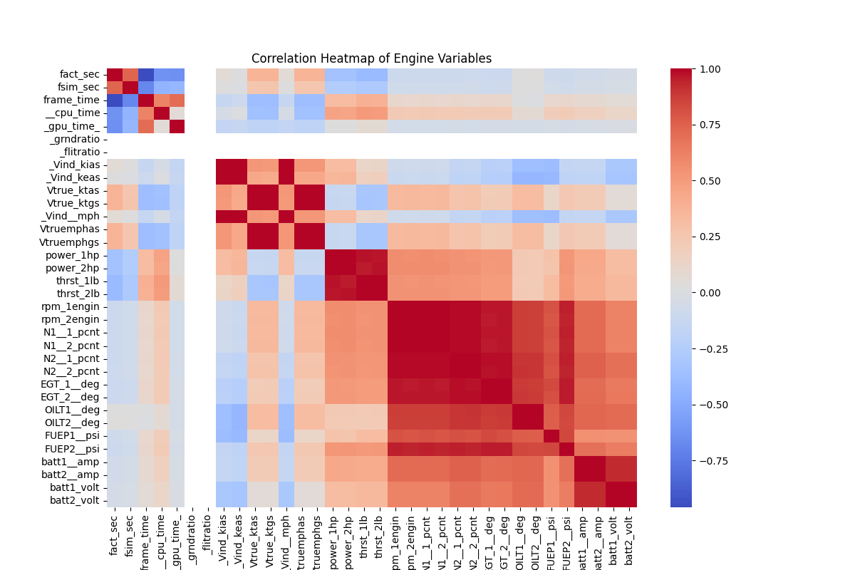
CI/CD Pipeline for Aircraft Engines (Predictive Maintenance)
Data Preprocessing and EDA

Slide 12
CI/CD Pipeline for Aircraft Engines (Predictive Maintenance)
Algorithms and Tools
XGBoost (Extreme Gradient Boosting) and LSTM (Long Short-Term Memory)
Used for regression to estimate Remaining Useful Life (RUL)
To handle multivariate time-series data efficiently
Robust to missing values and outliers
LSTM shows potential improvement with more data
Tool | Purpose
X-Plane 11 | Simulate realistic aircraft engine sensor data
Python | Core programming language for data processing
Pandas | Data ingestion, cleaning, and transformation
Matplotlib & Seaborn | Visualization of sensor trends and correlation
Streamlit | Interactive dashboard for model outputs
Jenkins | CI/CD automation for model deployment

Slide 13
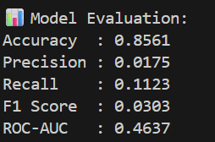
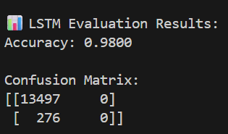
CI/CD Pipeline for Aircraft Engines (Predictive Maintenance)
XGBoost vs LSTM metrics

Slide 14
CI/CD Pipeline for Aircraft Engines (Predictive Maintenance)
Project Pipeline
1. Data Collection
Source: X-Plane 11 simulator (engine sensor logs).
Format: .txt logs → converted into .csv.
Features captured:
Engine RPM, N1, N2
Thrust, Fuel flow, EGT, Oil temp/pressure
Electricals (voltage, amps)
Flight parameters (altitude, IAS, climb rate)

Slide 15
CI/CD Pipeline for Aircraft Engines (Predictive Maintenance)
Project Pipeline
2. Data Preprocessing
Parse .txt logs into structured CSV.
Clean dataset:
Remove duplicate & constant columns.
Handle missing values.
Labeling:
Inject synthetic failures when thresholds exceeded (e.g., EGT > 700°C, meaning EGT too high, or N1 and N2 >80%).
Create failure target column.

Slide 16
CI/CD Pipeline for Aircraft Engines (Predictive Maintenance)
Project Pipeline
3. Exploratory Data Analysis (EDA)
Visualize sensor distributions (through Heatmap and ROC Curve).
Correlation heatmaps (to find key predictors).
Time-series plots (RPM, N1, Oil Temp vs timestep).
Identify anomalies/spikes before failures.
4. Feature Engineering
Create rolling averages (5-step moving average of RPM).
Calculate deltas (e.g., ∆ Oil Temp per second).
Normalize/scale continuous features.
Save processed dataset (data/processed/xplane_features.csv).

Slide 17
CI/CD Pipeline for Aircraft Engines (Predictive Maintenance)
Project Pipeline
5. Modeling
XGBoost (baseline)
Handles tabular data well.
Train/Test split with stratification.
Handle imbalance with:
scale_pos_weight
SMOTE (if needed).
Save trained model (models/xplane_xgboost.pkl)

Slide 18
CI/CD Pipeline for Aircraft Engines (Predictive Maintenance)
Project Pipeline
LSTM (time-series)
Input: sequential sensor values.
Architecture: LSTM → Dense → Sigmoid.
Train on sequences with failure labels.
Save trained model (models/xplane_lstm.h5).

Slide 19
CI/CD Pipeline for Aircraft Engines (Predictive Maintenance)
Project Pipeline
6. Evaluation
Metrics:
Accuracy, Precision, Recall, F1, ROC-AUC.
Visualizations:
Confusion Matrix (XGBoost + LSTM).
ROC Curves (LSTM).

Slide 20
CI/CD Pipeline for Aircraft Engines (Predictive Maintenance)
Project Pipeline
7. Dashboard and Deployment
Wrap-up as Dashboard:
Streamlit → Live dashboard for predictions.
Integrate Jenkins for deployment.

Slide 21
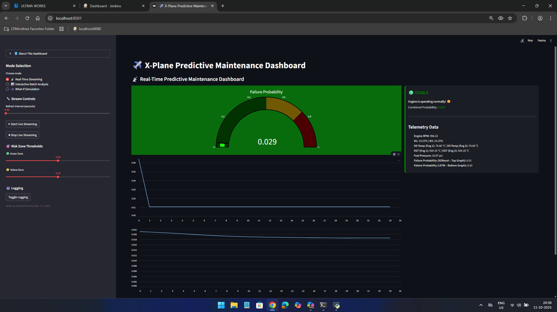
CI/CD Pipeline for Aircraft Engines (Predictive Maintenance)
Dashboard Demonstration
Stable

Slide 22
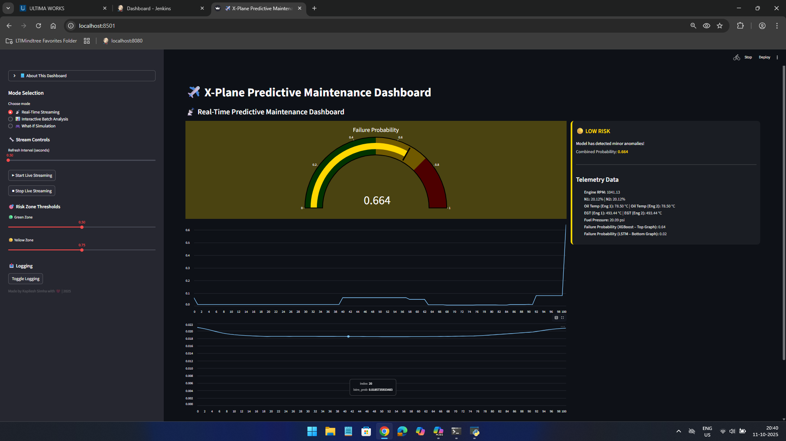
CI/CD Pipeline for Aircraft Engines (Predictive Maintenance)
Dashboard Demonstration
Low risk

Slide 23
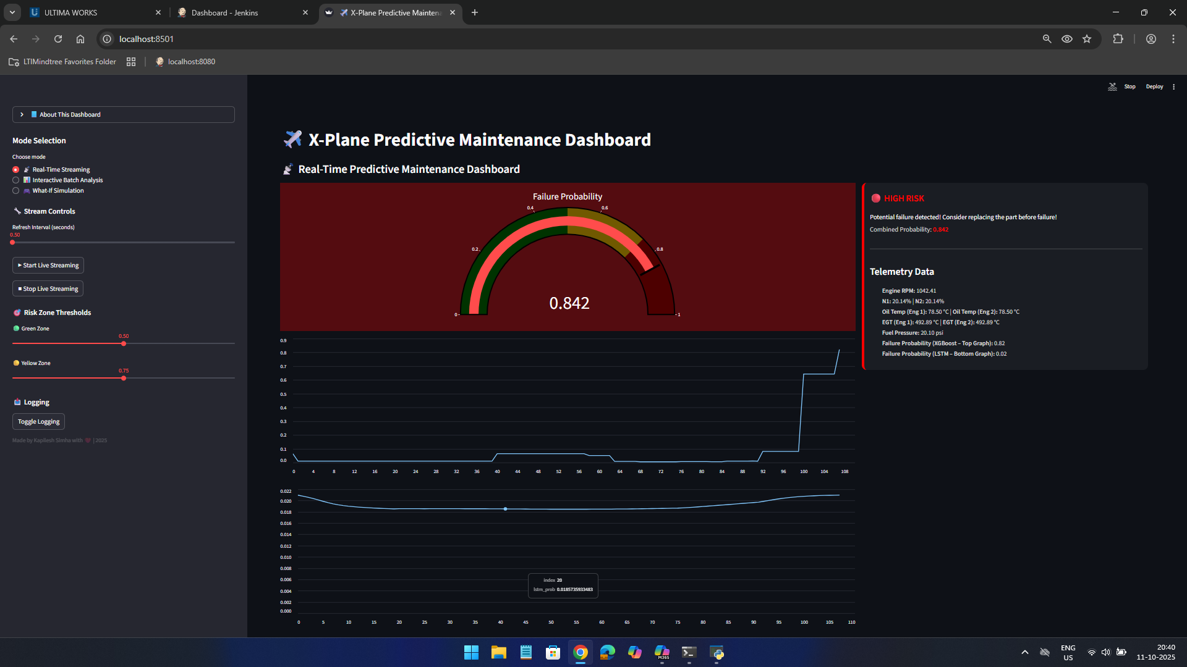
CI/CD Pipeline for Aircraft Engines (Predictive Maintenance)
Dashboard Demonstration
High risk

Slide 24
CI/CD Pipeline for Aircraft Engines (Predictive Maintenance)
Project structure
xplane_predictive_project/
├── data/ # raw, processed
├── src/ # data_loader.py, eda.py, features.py, modeling_xgboost.py, modeling_lstm.py, live_app.py
├── models/ # saved models (from XGBoost and LSTM)
├── reports/
│ ├── figures/ # correlation heatmap, ROC
│ └── summary/ # final_report.md
├── jenkinsfile # deployed in Jenkins
└── streamlit_app.py # dashboard creation

Slide 25
CI/CD Pipeline for Aircraft Engines (Predictive Maintenance)
Conclusion
Shift from NGAFID to X-Plane 11 enabled real-time predictive maintenance.
ML models successfully forecast failures and RUL.
CI/CD pipeline ensures scalable, automated deployment and monitoring.

Slide 26
CI/CD Pipeline for Aircraft Engines (Predictive Maintenance)
Acknowledgement
Special thanks to the SMEs at LTIMindtree, Mr. Hari Prasath under whom, I was able to complete my project and for providing me with creative suggestions that I could add in my project.
Furthermore, I would like to thank my mentors at LTIMindtree, Mr. Rathinavelu Arumugam and Vasudha Kodirekka ma’am, and faculty members of my university, Vellore Institute of Technology, Vellore for supporting me throughout the project training session.

Slide 27
THANK YOU!

