Slide 1
Medical Imaging - Computed Tomography CT Image Deconvolution in the Presence of Poisson Noise YongHwan Lee and Tony Storey
ECE565 Estimation Filtering and Detection

Slide 2
Computed Tomography Background
Many diseases and tissue anomalies, such as cancer, can be diagnosed through modern, high-resolution, X-ray Computed Tomography (CT) scans.
At higher radiation levels the signal-to-noise ratio is high, producing highly detailed images, but this leads to higher patient radiation exposure.
At low level radiation dosages, the recovered image suffers from a phenomenon known as shot noise.
Shot noise can cause image anomalies which can be misconstrued and cause false diagnoses.

Slide 3
Framing the Problem
The first step to improving the CT image, we observe that this “shot noise” follows a Poisson distribution [1].
We can derive a maximum likelihood estimator to reduce the noise recovered in the CT scan.
For a better understanding of how the CT images are captured we will be looking at the problem on a small, 3x3 pixel scale.
In practice 512x512, 1024x1024, and 2048x2048 images are used [2]. This means the cross section of the area of interest in a patient would contain up to 4,194,304 voxels.
Our simplified system contains 9.

Slide 4
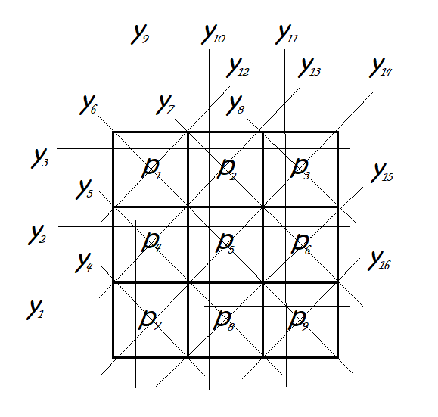
System Model
For a 3x3 pixel image, there must be at least 16 particle rays, or line integrals, to provide enough equations to solve for all the unknown absorption coefficients.
Recovering the absorption coefficients gives us the variation in tissue densities that show up in a CT image.

Slide 5
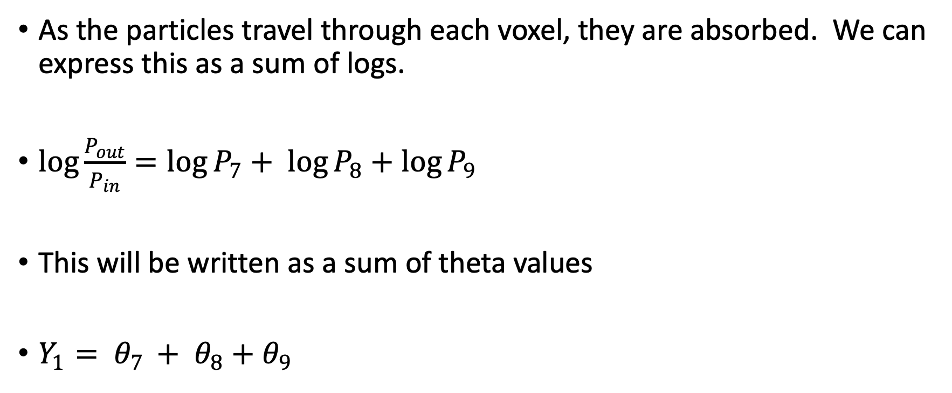
System Model (cont)
As the particles travel through each voxel, they are absorbed. We can express this as a sum of logs.
$\log{\frac{P_{out}}{P_{in}}}=\log{P_{7}+ \log{P_{8}+\log{P_{9}}}}$
This will be written as a sum of theta values
$Y_{1}= θ_{7 }+ θ_{8}+θ_{9}$

Slide 6
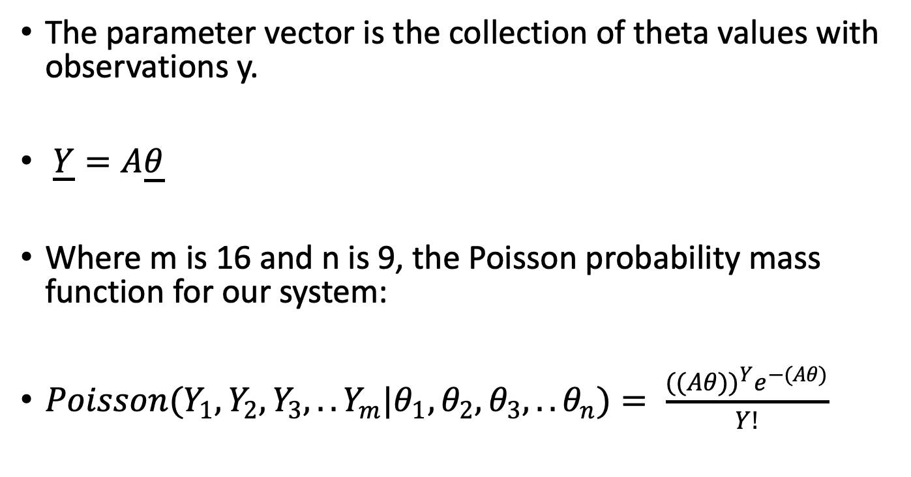
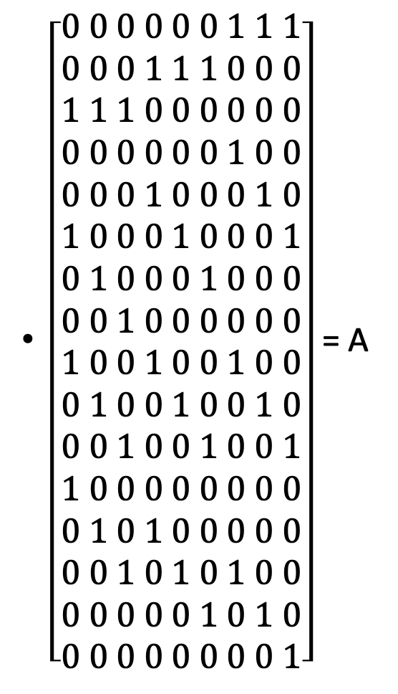
System Model (cont)
$\left[\begin{aligned}0 0 0 0 0 0 1 1 1 \\ 0 0 0 1 1 1 0 0 0 \\ 1 1 1 0 0 0 0 0 0 \\ 0 0 0 0 0 0 1 0 0 \\ 0 0 0 1 0 0 0 1 0 \\ 1 0 0 0 1 0 0 0 1 \\ 0 1 0 0 0 1 0 0 0 \\ 0 0 1 0 0 0 0 0 0 \\ 1 0 0 1 0 0 1 0 0 \\ 0 1 0 0 1 0 0 1 0 \\ 0 0 1 0 0 1 0 0 1 \\ 1 0 0 0 0 0 0 0 0 \\ 0 1 0 1 0 0 0 0 0 \\ 0 0 1 0 1 0 1 0 0 \\ 0 0 0 0 0 1 0 1 0 \\ 0 0 0 0 0 0 0 0 1\end{aligned}\right]$ = A
The parameter vector is the collection of theta values with observations y.
$\underline{Y}=A\underline{θ}$
Where m is 16 and n is 9, the Poisson probability mass function for our system:
$Poisson(Y_{1}, Y_{2},Y_{3},..Y_{m}|θ_{1},θ_{2},θ_{3},..θ_{n})= \frac{{((Aθ))}^{Y}e^{−(Aθ)}}{Y!}$

Slide 7
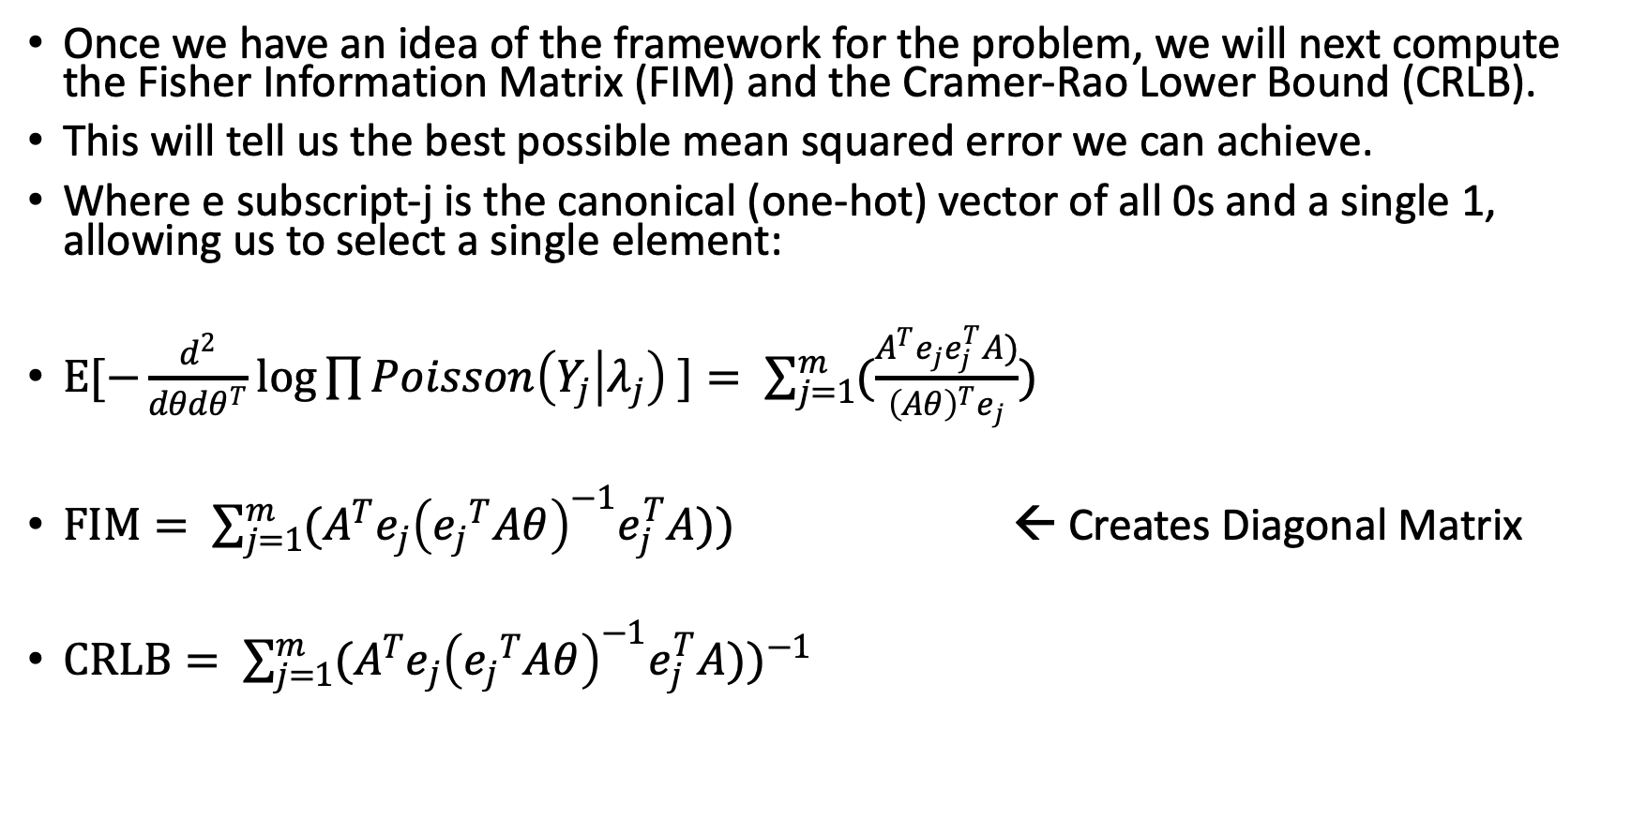
Model Performance Specs
Once we have an idea of the framework for the problem, we will next compute the Fisher Information Matrix (FIM) and the Cramer-Rao Lower Bound (CRLB).
This will tell us the best possible mean squared error we can achieve.
Where e subscript-j is the canonical (one-hot) vector of all 0s and a single 1, allowing us to select a single element:
$Ε[−\frac{d^{2}}{dθdθ^{T}}\log{\prod{Poisson\left(Y_{j} | λ_{j}\right) }}]= \sum_{j=1}^{m}{(\frac{A^{T}e_{j}e_{j}^{T}A)}{{\left(Aθ\right)}^{T}e_{j}}})$
$FIM= \sum_{j=1}^{m}{(A^{T}e_{j}{\left({e_{j}}^{T}Aθ\right)}^{−1}e_{j}^{T}A)})$ ← Creates Diagonal Matrix
$CRLB= {\sum_{j=1}^{m}{(A^{T}e_{j}{\left({e_{j}}^{T}Aθ\right)}^{−1}e_{j}^{T}A)})}^{−1}$

Slide 8
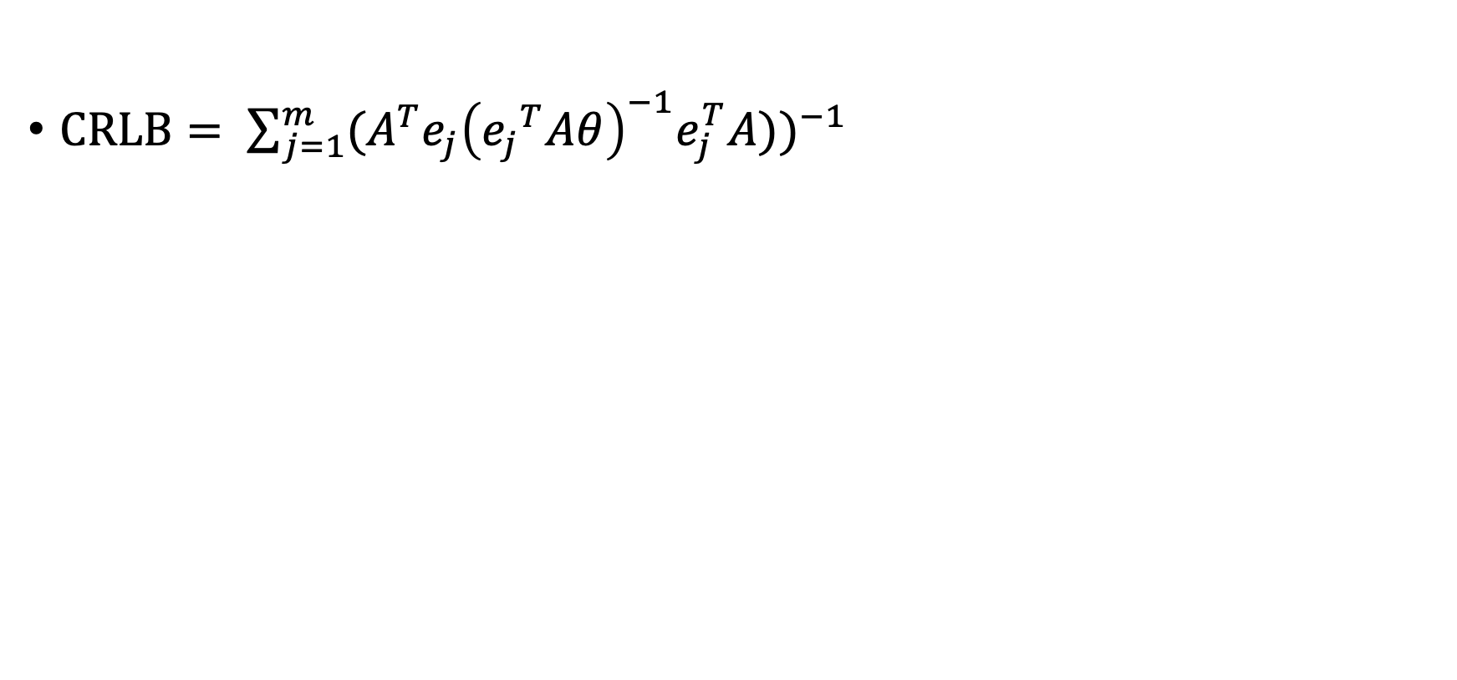
Model Performance Specs
$CRLB= {\sum_{j=1}^{m}{(A^{T}e_{j}{\left({e_{j}}^{T}Aθ\right)}^{−1}e_{j}^{T}A)})}^{−1}$

Slide 9
Kullback-Leibler Divergence

Slide 11
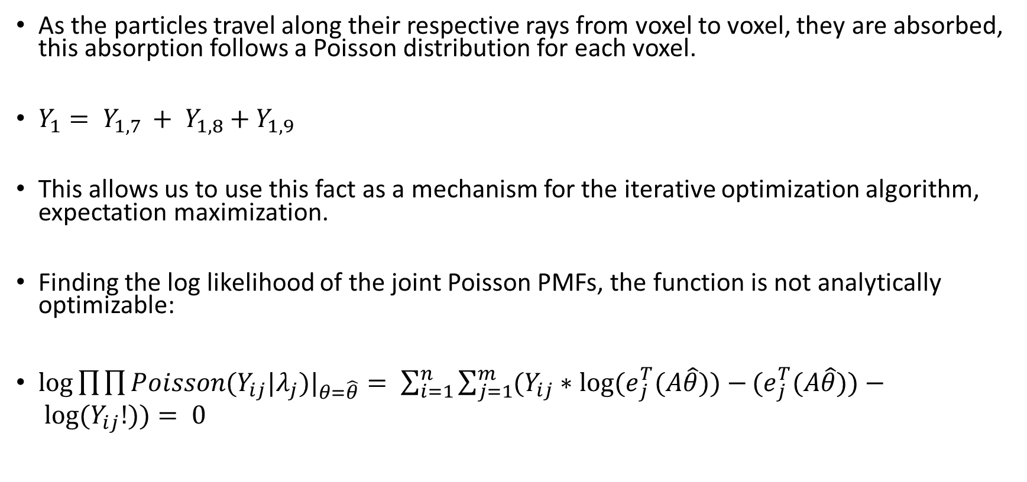
Expectation Maximization
As the particles travel along their respective rays from voxel to voxel, they are absorbed, this absorption follows a Poisson distribution for each voxel.
$Y_{1}= Y_{1,7 }+ Y_{1,8}+Y_{1,9}$
This allows us to use this fact as a mechanism for the iterative optimization algorithm, expectation maximization.
Finding the log likelihood of the joint Poisson PMFs, the function is not analytically optimizable:
$\log{\prod{\prod{Poisson(Y_{ij}|λ_{j})|_{θ=\hat{θ}}}}}= \sum_{i=1}^{n}{\sum_{j=1}^{m}{(Y_{ij}∗\log{{(e}_{j}^{T}(A\hat{θ}))−}}}{(e}_{j}^{T}(A\hat{θ}))− \log{(Y_{ij}!))}= 0$

Slide 12
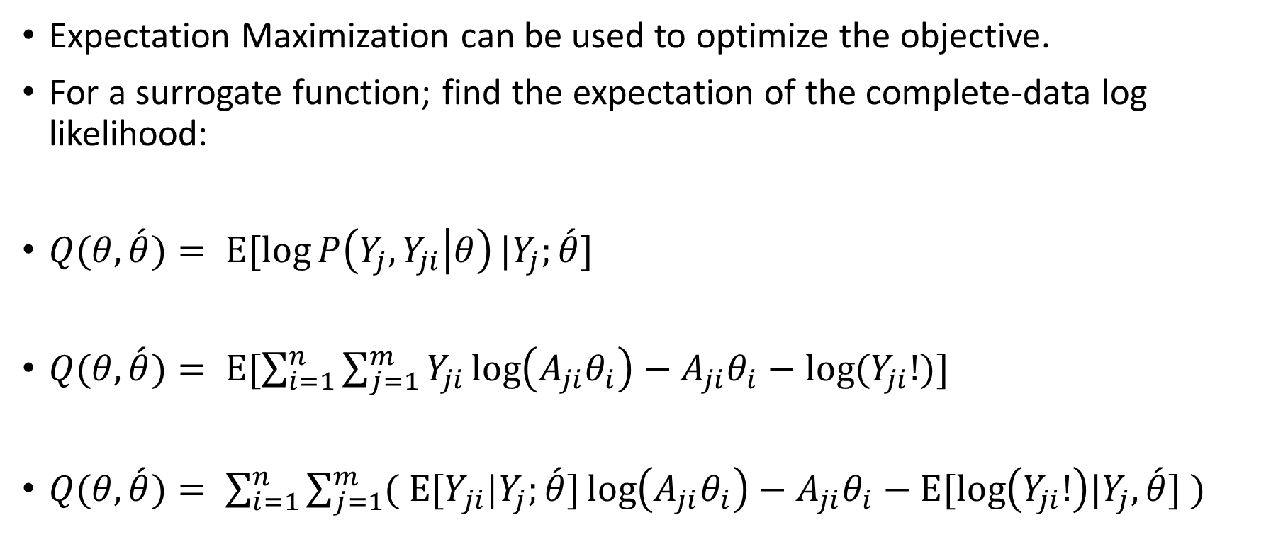
Expectation Maximization -- E-Step
Expectation Maximization can be used to optimize the objective.
For a surrogate function; find the expectation of the complete-data log likelihood:
$Q(θ,\acute{θ})= Ε[\log{P\left(Y_{j},Y_{ji} | θ\right)}|Y_{j};\acute{θ}]$
$Q(θ,\acute{θ})= Ε[\sum_{i=1}^{n}{\sum_{j=1}^{m}{Y_{ji}\log\left(A_{ji}θ_{i}\right)−A_{ji}θ_{i}−\log{(Y_{ji}!)}}}]$
$Q(θ,\acute{θ})= \sum_{i=1}^{n}{\sum_{j=1}^{m}{{( Ε[Y}_{ji}|Y_{j};\acute{θ}]\log\left(A_{ji}θ_{i}\right)−A_{ji}θ_{i}−Ε[log\left(Y_{ji}!\right)|Y_{j},\acute{θ}] )}}$

Slide 13
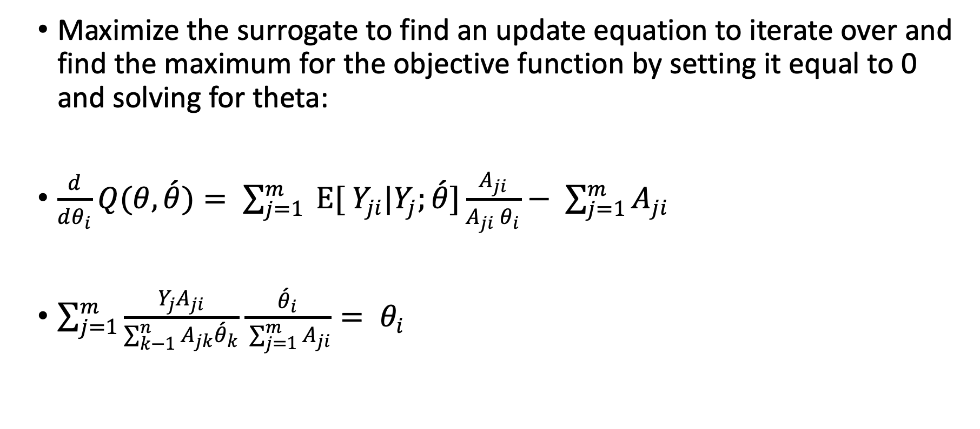
Expectation Maximization -- M-Step
Maximize the surrogate to find an update equation to iterate over and find the maximum for the objective function by setting it equal to 0 and solving for theta:
$\frac{d}{dθ_{i}}Q(θ,\acute{θ})= \sum_{j=1}^{m}{{ Ε[ Y}_{ji}|Y_{j};\acute{θ}]\frac{A_{ji}}{A_{ji} θ_{i}}− \sum_{j=1}^{m}{A_{ji}}}$
$\sum_{j=1}^{m}{\frac{{Y_{j}A}_{ji}}{\sum_{k−1}^{n}{A_{jk}{\acute{θ}}_{k}}}\frac{{\acute{θ}}_{i}}{ \sum_{j=1}^{m}{A_{ji}}}= θ_{i}}$

Slide 14
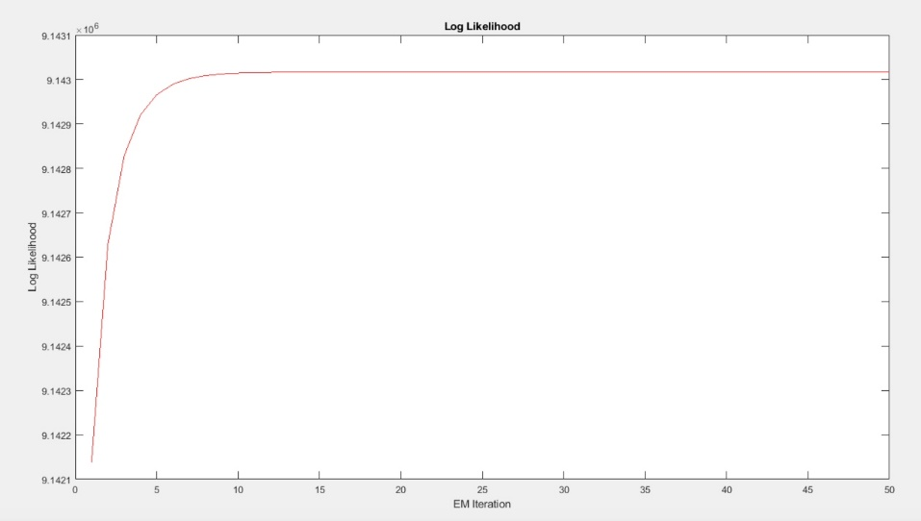
MATLAB Simulation
We implemented the expectation maximization algorithm in MATLAB to reduce the noise and estimate the 9 parameters from our 3x3 pixel matrix.
200 Monte Carlo simulations
50 EM Iterations
Plot of Log Likelihood

Slide 15
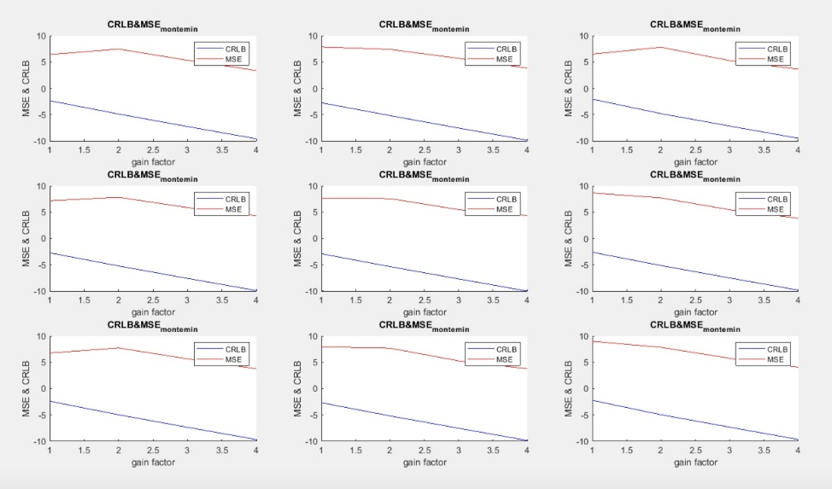
MATLAB Simulation
After sweeping the signal gain from 0.1 to 100 we found both the Cramer-Rao Lower Bound and the MSE for each parameter.

Slide 16
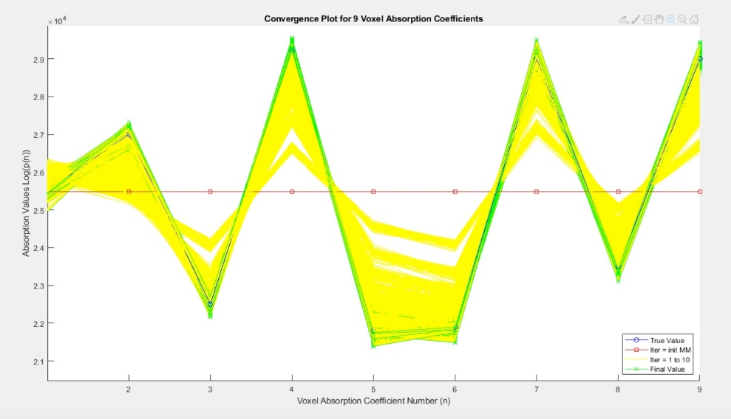
MATLAB Simulation
EM algorithm converging on the true value of the parameters.

Slide 17
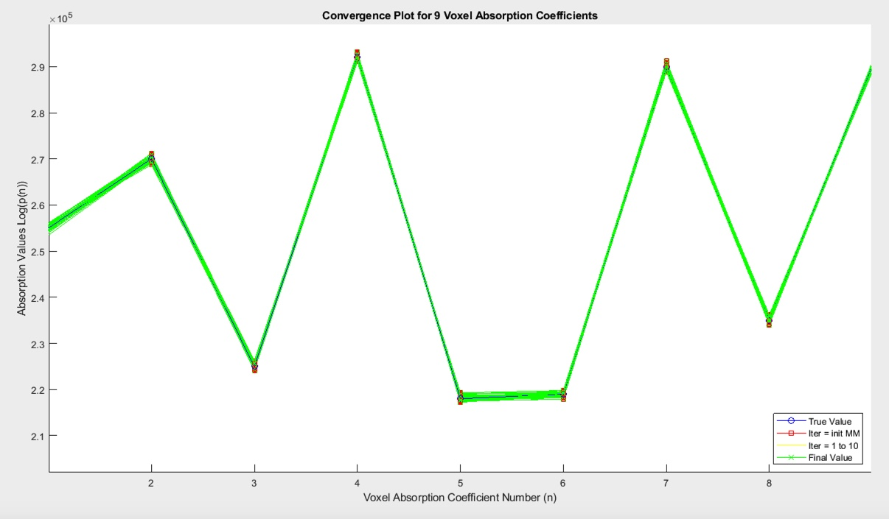
MATLAB Simulation
We chose a method of moments estimator via a least-squares approximation as a starting point.
EM algorithm converges on a solution faster.

Slide 18
References
[1] Buzwig, Thorsten. Computed Tomography from Photon Statistics to Modern Cone-Beam CT. Springer-Verlag Berlin Heildelberg, 2010.
[2] Hata, Akanori et al. Effect of Matrix Size on the Image Quality of Ultra-high-resolution CT of the Lung. Academic Radiology, vol 25 issue 7, 28 July. 2018, https://www.sciencedirect.com/science/article/pii/S1076633217305044 Accessed 24 Dec 2019.

